Slide 1



Sure-Park System Initial Presentation
Team 3(Infinite Challenge)
Namjin Lee(Team Leader) Jack Oh, Charles Park, Joan Kim, Jaeheon Kim

Slide 2
0. Contents
Introduction
Product Context
Functional Requirement
Use Cases
Use Case Scenario
Quality Attribute
Quality Attribute Scenario
Quality Attribute Utility
Business Constraint
Technical Constraint
Overall Project Schedule
Project Risk and Mitigation Plan
Role & Responsibility
Q&A

Slide 3
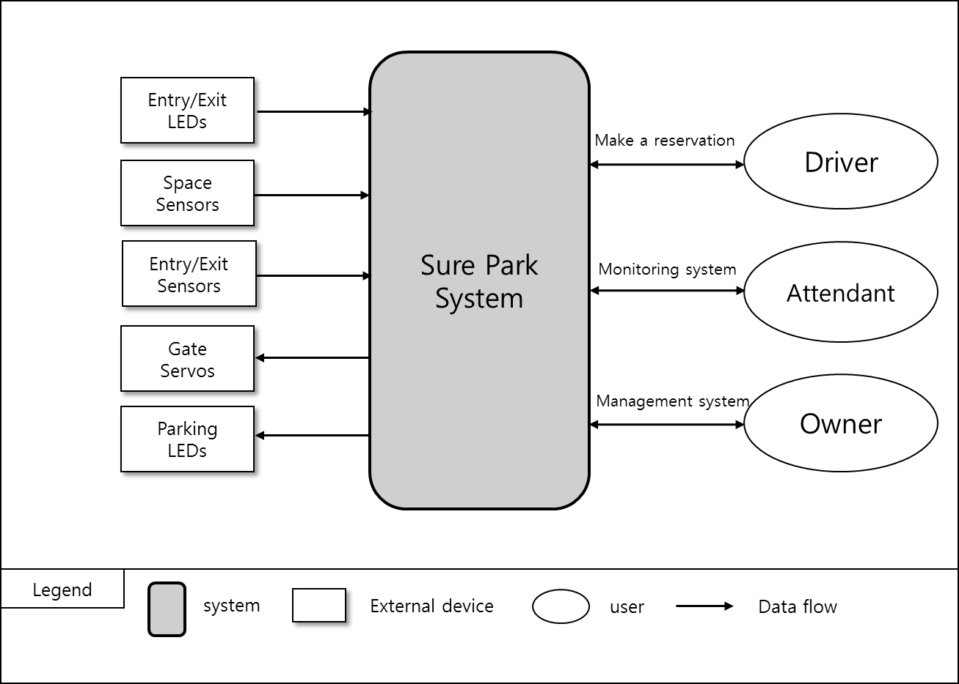
1. Introduction
The key requisites of the project are functions that:
drivers can reserve a parking space by using a laptop or a phone.
parking attendants can monitor parking facilities
the system is initially built for a small parking facility and should be able to be applied to various sized parking facilities
the system can provide basic statistics including average occupancy, peak usage hours, parking slot statistics, and revenue, which should be extensible in order to help developers to add more analysis algorithms
< Figure1. System context diagram >

Slide 4
2. Product Context
2.1) Market Context
Who the customer/stakeholders are | Garage owner, GTPS, Attendant, drivers, team members, team mentor, Smart phone company, App market, Credit card company, System installer, Project Manager
Notions of quality | Reduce driver frustration, more efficiently utilize the space, reducing liabilities, reducing operating costs for owner
Functional expectations | H/W control and reservation parking space, monitoring and managing parking facility
Product packaging | H/W devices, Server, Network device, DB, user manual and S/W.
How quickly you must design and deliver new products | We have various competitors, so we need to develop parking system in five weeks for preoccupying market.

Slide 5
2. Product Context
2.2) Organizational Context
Structure | The development team has 5 members. Namjin Lee, he is a team leader. Joan Kim, she is a documentation manager. Jaeheon Kim, he is an architect. Jack Oh, he is a software integration engineer. Charles Park, he is a test engineer. All members are involved software development.
Culture | Our team name is “Infinite Challenge”. It means that we have an “Infinite” passion and we love “Challenges”.

Slide 6
2. Product Context
2.3) Business Context
Strategies | We will focus on a successful deployment of the initial system and then we will extend markets into the global.
Internal and external providers | H/W parts company, Server provider
Cost obligations and assets | PC, Server, Development expense
Profit model | Maintenance fee/every month, Installation fee.
Competition | Other development team.
Future direction | GTPS would like to scale out the system to include larger parking lots and garages, and sell the system to other garage owners around the world if the solution is successful for them.

Slide 7
2. Product Context
2.4) Technical Context
Languages | JAVA, C, C++
Tools | Eclipse, Arduino IDE, JDK
Operating system and hardware platform | Arduino, Windows, Mac OSX
Implementation frameworks | Arduino

Slide 8
3. Functional Requirement
ID | Functional Requirement | Description
FR01 | The system must detect cars in parking space. | Arduino H/W control
FR02 | The system must open and close the entry/exit gates.
FR03 | The system must change the entry/exit LED color and turn on/off stall LEDs.
FR04 | The system must detect presence of a car when cars arrive at the entry/exit gates.
FR05 | The system shall allow drivers to reserve parking spaces. Reservations will be made via a mobile app, a laptop, or a desktop app for drivers. | Reservation system for drivers
FR06 | For reservation, drivers must sign up the system so that the system can prevent from unauthorized users.
FR07 | The system must provide available number of parking slots to drivers.
FR08 | Drivers must provide the day and time they would like to park, and credit card information (payment information) after logging in system.
FR09 | The system must return a confirmation information to the driver if reservation is succeed.
FR10 | The system must check the confirmation information to verify the deriver's information and reservation. | When drivers come up an entry gate

Slide 9
3. Functional Requirement
ID | Functional Requirement | Description
FR11 | “Grace period” must be configurable. | No-show process
FR12 | If the driver does not show up at the start of their reservation time, the system must operate the "grace period".
FR13 | If the driver doesn't show up within the grace period, the system must cancel the reservation.
FR14 | The system must calculate the total parking fee by hour and it shall charge on their credit card. | Charge system
FR15 | The system must show which parking spots are occupied and which are opened. | Monitoring system for attendants
FR16 | The system must show how long the car has occupied the particular parking space.
FR17 | The system must show the status when a driver parks in the wrong parking space and must automatically reassign parking spaces and correlate associated reservations.
FR18 | The system must show the facility usage and revenue. The facility usage must include average occupancy, peak usage hours, parking slot statistics. | Management system for owner
FR19 | The system shall extend analysis algorithms or applications without disrupting operations. | Management system for owner Extend system
FR20 | The system must provide login system for preventing unauthorized users. | System security
FR21 | The system must not allow anyone to view facility data (reservations, credit cards, etc.) except owner.

Slide 10
4. Use Case
ID | Title
UC01 | (FR05 ~ FR09) Reserve parking spaces
UC02 | (FR02 ~ FR04, FR10) Show up scenario
UC03 | (FR11 ~ FR13) No show scenario and grace period
UC04 | (FR01 ~ FR04, FR14) Get out the garage and charge scenario
UC05 | (FR01, FR03, FR17) Parking scenario
UC06 | (FR15, FR16) Monitoring scenario for attendants.
UC07 | (FR18) Management scenario for owner

Slide 11
5. Use Case Scenario : UC01’ Reserve parking spaces
ID: UC01 | Description
Title | (FR05 ~ FR09) Reserve parking spaces
Stakeholders | A driver who would like to reserve a parking space.
Preconditions | The driver must satisfy with FR06
Main success scenario | 1) The Sure-Park system allows an authorized driver to reserve a parking slot (FR05). 2) The system shows available number of parking slots to the driver (FR07). 3) If a parking slot is available, the driver needs to input the day and time they would like to park, and credit card information (FR08). 4) If all information is ok, the system provides confirmation information to drivers (FR09).
Post conditions | The reservation was confirmed.
Alternate scenario | 3a) No available parking spaces 1) The system closes the reservation. 4a) Some information is invalid 1) The system displays which information is failed. 2) Repeat steps 3-4 until all information is valid.

Slide 12
5. Use Case Scenario : UC02’ Show up scenario
ID: UC02 | Description
Title | (FR02 ~ FR04, FR10) Show up scenario
Stakeholders | A driver who has made a reservation, An attendant who confirms the reservation
Preconditions | UC01, The entry gate LED is red.
Main success scenario | A driver comes to the gate. The system detects the presence of a car at the gate (FR04). A driver provides confirmation information to attendant. The attendant inputs confirmation information to the system. The system verifies the driver’s information and confirms the reservation (FR10). The system lifts the entry gate and allows the driver to enter the facility (FR02). The system changes the entry gate LED from red to green (FR03). After the driver passed the gate, the system close the entry gate (FR02) and the entry LED turns red (FR03).
Post conditions | The car entered into the garage.
Alternate scenario | 5a) Invalid confirmation information, The system does not allow the driver to enter the garage.

Slide 13
5. Use Case Scenario : UC05‘ Parking scenario
ID: UC05 | Description
Title | (FR01, FR03, FR17) Parking scenario
Stakeholders | Attendant, A driver who is parking his/her car.
Preconditions | UC02
Main success scenario | 1) The system is illuminating the stall LED at assigned parking space (FR03). 2) A car parked at the designated parking spot (FR01). 3) The stall LED at the parking space will be turned off (FR03).
Post conditions | The car is parked correctly.
Alternate scenario | 2a) If a car parked at other spot, The system will automatically reassign parking spaces and correlate associated reservations (FR17).

Slide 14
6. Quality Attribute
ID | Quality Attribute | Priority | Description
QA01 | Scalability | HIGH | Installers should complete setup and tests for a new facility controller in an hour.
QA02 | Availability | HIGH | Facility controller experiences a catastrophic hardware failure. In this case, Sure Park system’s software detects the fault and notify attendants in 30 seconds.
QA03 | Security | MID | Users log in the system and get the permission to access the authorized data and information. The unauthorized user tries to access the data and information which are permitted only attendants and owner. The system prevents all unauthorized access.
QA04 | Extensibility | MID | Developer wants to add new algorithm application to Sure Park software. The system needs to be updated without disrupting operations. New algorithm can be implemented and tested within 1 week.
QA05 | Performance | MID | When driver wants to get an empty parking slot, system must provide it in 5 sec.
QA06 | Usability | LOW | The owner wants to check basic statistics on facility usages. The owner can show statistic report in 3 step after login.
QA07 | Interoperability | MID | When a driver enters and goes out the parking garage, facility controller and Sure park system must communicate without communication loss.
QA08 | Modifiability | MID | The developers want to design scale up/out the system. The new system is implemented and tested in a week.
QA09 | Availability | MID | Sure park system’s software detects software failure. In this case, Sure Park system’s software notify attendants in 30 seconds and restart in 1mins.

Slide 15
7. Quality Attribute Scenario : QA01 Scalability
Title | Scale out to other parking facilities
ID | QA01
Quality Attribute | Scalability
Scenario | Installers should complete setup for a new facility controller in an hour.
Source of stimulus | Installer
Stimulus | Installer wants a new facility controller in the parking garage.
Artifact | The System
Environment | New owner wants to install a new system or existing owner wants to extend the current system.
Response | New facility controller will be installed completely
Response measure | 1 hour for installing

Slide 16
7. Quality Attribute Scenario : QA02 Availability
Title | Detect malfunction of the facility controller
ID | QA02
Quality Attribute | Availability
Scenario | Facility controller experiences a catastrophic hardware failure. In this case, Sure Park system’s software detects the fault and notify attendants in 30 seconds.
Source of stimulus | Facility controller (Arduino)
Stimulus | Malfunction of facility controller
Artifact | Facility controller software and Sure Park system’s software
Environment | During normal operation
Response | The hardware fault is detected, the system logs the fault and notifies attendants.
Response measure | The system should notify attendants of the fault in 30 seconds.

Slide 17
7. Quality Attribute Scenario : QA07 Interoperability
Title | Detect malfunction of the Sure park system’s software
ID | QA09
Quality Attribute | Availability
Scenario | Sure park system’s software detects software failure. In this case, Sure Park system’s software notify attendants in 30 seconds and restart in 1mins.
Source of stimulus | Sure park system’s software
Stimulus | Malfunction of Sure park system
Artifact | Sure Park system’s software
Environment | During normal operation
Response | The system software fault is detected, the system logs the fault and notifies attendants.
Response measure | The system should notify attendants of the fault in 30 seconds and restart in 1 mins.

Slide 18
8. Quality Attribute Utility
ID | Quality Attribute | Description | Difficulty(D) | Priority (P) | Total Score (D x P)
QA01 | Scalability | Scale out to other parking facilities | 9 | 9 | 81
QA02 | Availability | Detect malfunction of the facility controller | 3 | 9 | 27
QA03 | Security | Protect data and information from unauthorized access | 3 | 3 | 9
QA04 | Extensibility | Add more analysis algorithms or analysis applications | 3 | 3 | 9
QA05 | Performance | Retrieve an available parking slot ASAP. | 1 | 3 | 3
QA06 | Usability | Obtain basic statistics on facility usage. | 1 | 1 | 1
QA07 | Interoperability | Communicate between facility controller and Sure Park system. | 3 | 3 | 9
QA08 | Modifiability | Scale up/out to parking facilities | 9 | 3 | 27
QA09 | Availability | Detect malfunction of the Sure park system’s software | 9 | 3 | 27

Slide 19
9. Business Constraint
ID | Business Constraint | Description
BC01 | Reducing complain | GTPS wants to reduce driver frustration when customers find available parking slots and reserve them.
BC02 | Increasing profits | More efficient space utilization is needed.
BC03 | Reducing liabilities | It is needed to reduce traffic congestion and the chance for accidents inside the parking facilities.
BC04 | Reducing operating costs | It is required to utilize personnel efficiently and reduce the number of employee.
BC05 | Applying other garage | GTPS would like to market the system to other garage owners around the world.
BC06 | Delivery | The system should be delivered in 5 weeks.
BC07 | Availability of workforce | The team is consists of 5 members. Java expert is only 1 person.

Slide 20
10. Technical Constraint
ID | Technical Constraint | Description
TC01 | H/W System | Wi-Fi enabled Arduino(mega 2560) - Flash Memory: 256KB of which 8KB used by bootloader - SRAM: 8KB - EEPROM: 4KB - Clock Speed: 16MHz
TC02 | Programming language | For development Arduino: C/C++ For server and application: Java
TC03 | Network | Wi-Fi Wi-Fi configuration

Slide 21
11. Overall Project Schedule
Activity | -2W | -1W | 1W | 2W | 3W | 4W | 5W | Output
 | Phase 0 |  |  | Phase 1 |  | Phase 2
Planning |  |  |  |  |  |  |  | Project Planning Document
Requirement |  |  |  |  |  |  |  | Architecture Driver Document
Design |  |  |  |  |  |  |  | Architecture Specification Document
Implementation |  |  |  |  |  |  |  | Product
Testing |  |  |  |  |  |  |  | Test Result
Notes:
Insert “we are here”

Slide 22
11. Overall Project Schedule
Output
Phase 0 | Phase 1 | Phase 2
Project planning document Architecture driver document | Architecture design document(draft) Arduino design & prototype implementation Controller design & prototype implementation UI design & prototype implementation Protocol design DB design Unit test result Time log | Architecture design document(final) Sure park system (final product) Integration Test result Time log
Notes:
Insert “we are here”

Slide 23
12. Project Risk and Mitigation Plan
RISK | Priority | Mitigation Plan
Low experience of JAVA development | Low | We will be familiar with JAVA before arrived at CMU.
No experience of Arduino development | Low | We will be familiar with Arduino before arrived at CMU.
Not familiar with architectural patterns | High | We discuss various architectural patterns with mentor.
Short term for development | High | We will make a plan well and manage it perfectly.
Difficult to test big scaled system | Mid | We will design architecture considering testability.

Slide 24
13. Role & Responsibility
Role | Assign | Responsibility
Team leader | Namjin Lee | Check time log and risk management
Architect | Jaeheon Kim | Design system architecture
Integration | Jack Oh | Integrate all artifacts(source code, documents …etc).
Test | Charles Park | Test and delivery.
Documentation | Joan Kim | Create document artifacts.
Development | All | We all develop the parking system.

Slide 25

14. Q & A

