Slide 1



Sure-Park System Final Presentation
Team 3(Infinite Challenge)
Namjin Lee(Team Leader) Jack Oh, Charles Park, Joan Kim, Jaeheon Kim

Slide 2
0. Contents
Introduction
Product Context
Functional Requirement
Use Cases
Use Case Scenario
Quality Attribute
Quality Attribute Scenario
Quality Attribute Utility
Business Constraint
Technical Constraint
Overall Project Schedule
Project Risk and Mitigation Plan
Role & Responsibility
Q&A

Slide 3
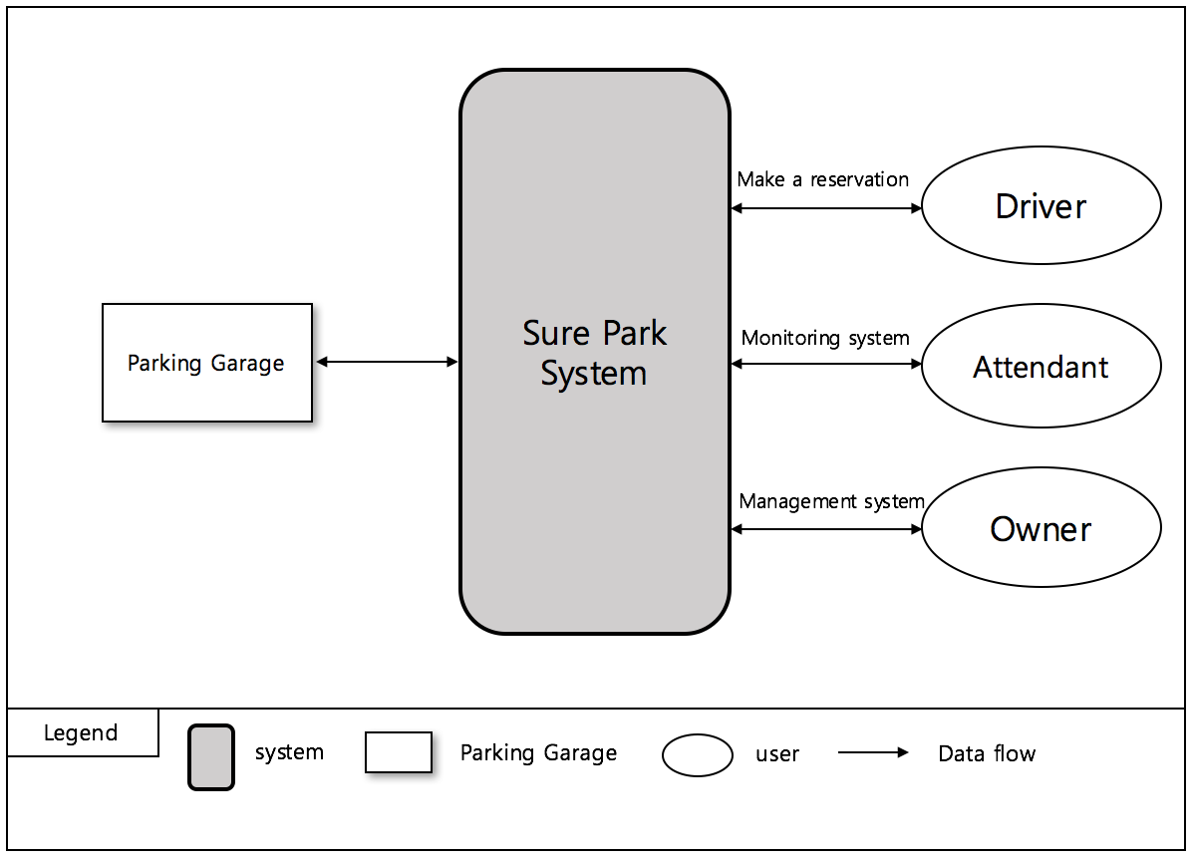
1. System Context
The key requisites of the project are functions that:
drivers can reserve a parking space by using a laptop or a phone.
parking attendants can monitor parking facilities
the system is initially built for a small parking facility and should be able to be applied to various sized parking facilities
the system can provide basic statistics including average occupancy, peak usage hours, parking slot statistics, and revenue, which should be extensible in order to help developers to add more analysis algorithms
< Figure1. System context diagram >

Slide 4
2. 1st Decomposition
2.1) Market Context
Modifiability(QA08) | Perspective: Static
Architectural Tactic | Increase Cohesion, Reduce Coupling
Rationale | In SurePark Manager, we’ve divided three parts, Common, Control Service and Management Service. Control Service have a responsibility of communication with the Facility Controller. And it also have managed Facilities. The Management Service have a responsibility of communication with the Web Service and also manage DB. Common is common source between Control Service and Management Service. Control service and Management service call each interface class for reducing coupling.

Slide 5
12. Project Risk and Mitigation Plan
RISK | Priority | Mitigation Plan
Low experience of JAVA development | Low | We will be familiar with JAVA before arrived at CMU.
No experience of Arduino development | Low | We will be familiar with Arduino before arrived at CMU.
Not familiar with architectural patterns | High | We discuss various architectural patterns with mentor.
Short term for development | High | We will make a plan well and manage it perfectly.
Difficult to test big scaled system | Mid | We will design architecture considering testability.

Slide 6
13. Role & Responsibility
Role | Assign | Responsibility
Team leader | Namjin Lee | Check time log and risk management
Architect | Jaeheon Kim | Design system architecture
Integration | Jack Oh | Integrate all artifacts(source code, documents …etc).
Test | Charles Park | Test and delivery.
Documentation | Joan Kim | Create document artifacts.
Development | All | We all develop the parking system.

Slide 7

14. Q & A

