Slide 1


Sure-Park System Initial Presentation
Team 3
Namjin Lee(Team Leader) Jack Oh, Charles Park, Joan Kim, Jaeheon Kim

Slide 2
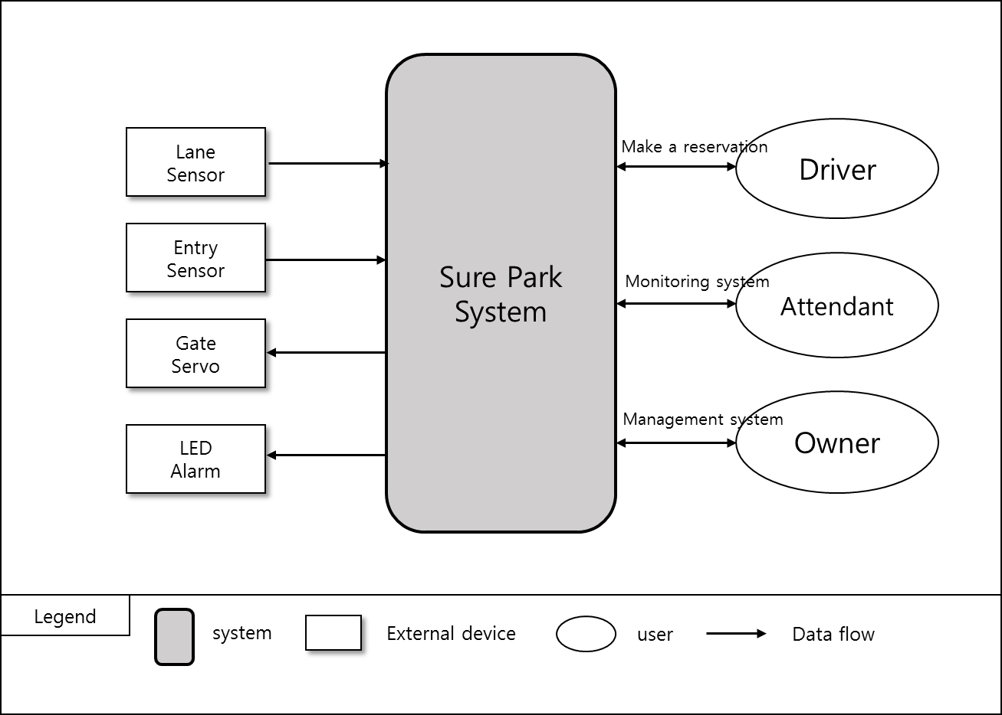
1. Introduction
The key requisites of the project are functions that:
drivers can reserve a parking space by using a laptop or a phone.
parking attendants can monitor parking facilities
the system is initially built for a small parking facility and should be able to be applied to various sized parking facilities
the system can provide basic statistics including average occupancy, peak usage hours, parking slot statistics, and revenue, which should be extensible in order to help developers to add more analysis algorithms
< Figure1. System context diagram >

Slide 3
2. Product Context
2.1) Market Context
Who the customer/stakeholders are | Garage owner, GTPS, Attendant, drivers, team members, team mentor, Smart phone company, App market, Credit card company, System installer, Project Manager
Notions of quality | Reduce driver frustration, more efficiently utilize the space, reducing liabilities, reducing operating costs for owner
Functional expectations | H/W control and reservation parking space, monitoring and managing parking facility
Product packaging | H/W devices, Server, Network device, DB, user manual and S/W.
How quickly you must design and deliver new products | We have various competitors, so we need to develop parking system in five weeks for preoccupying market.

Slide 4
2. Product Context
2.2) Organizational Context
Structure | The development team has 5 members. Namjin Lee, he is a team leader. Jack Oh, he is a software integration engineer. Charles Park, he is a test engineer. Joan Kim, she is a documentation manager. Jaeheon Kim, he is an architect. All members are involved software development.
Culture | Our team name is “Infinite Challenge”. It means that we have an “Infinite” passion and we love “Challenges”.

Slide 5
2. Product Context
2.3) Business Context
Strategies | We will focus on a successful deployment of the initial system and then we will extend markets into the global.
Internal and external providers | H/W parts company, Server provider
Cost obligations and assets | PC, Server, Development expense
Profit model | Maintenance fee/every month, Installation fee.
Competition | Other development team.
Future direction | GTPS would like to scale out the system to include larger parking lots and garages, and sell the system to other garage owners around the world if the solution is successful for them.

Slide 6
2. Product Context
2.4) Technical Context
Languages | JAVA, C, C++, Scratch
Tools | Eclipse, Arduino IDE, JDK
Operating system and hardware platform | Arduino, Windows, Mac OSX
Implementation frameworks | Arduino

Slide 7
3. Architecture Driver : Functional Requirement
ID | Functional Requirement | Description
FR01 | The system must detect cars in parking space. | Arduino H/W control
FR02 | The system must detect when cars are parked incorrectly. If a car straddle on parking slot lanes, the system shall blink LED and the system shall inform it to attendants in 2 minutes.
FR03 | The system must open and close an entry gate.
FR04 | The system must detect when cars arrive at the gate.
FR05 | The system shall allow drivers to reserve parking spaces. Reservations will be made via a mobile app, a laptop, or a desktop app for drivers. | Reservation system for drivers
FR06 | For reservation, drivers must sign up the system so that the system can prevent from unauthorized users.
FR07 | The system must provide available parking slot information to drivers.
FR08 | Drivers must provide a license plate (identifying information), the day and time they would like to park, and credit card information (payment information).
FR09 | The system must return a confirmation information to the driver if reservation is succeed.
FR10 | The system must check the confirmation information to verify the deriver's information and reservation. | When drivers come up an entry gate
FR11 | “Grace period” must be configurable. | Operating a "grace period"
FR12 | If the driver does not show up at the start of their reservation time, the system must operate the "grace period".

Slide 8
3. Architecture Driver : Functional Requirement
ID | Functional Requirement | Description
FR13 | If the driver doesn't show up within the grace period, the system must cancel the reservation. | No-show process
FR14 | The system must calculate the total parking fee by hour and it shall charge on their credit card. | Charge system
FR15 | The system must show available parking lots. | Monitoring system for attendants
FR16 | The system must show how long the car has occupied the particular parking lot.
FR17 | The system must notify the attendant if a driver parks other spot, and it will reallocate the parking lot.
FR18 | The system must notify the attendant after 2 minutes if a car crosses the lanes and LED is blinking.
FR19 | The system must show the facility usage and revenue. The facility usage must include average occupancy, peak usage hours, parking slot statistics. | Management system for owner
FR20 | The system shall extend analysis algorithms or applications without disrupting operations. | Management system for owner Extend system
FR21 | The system must provide login system for preventing unauthorized users. | System security
FR22 | The system must not allow anyone to view facility data (reservations, credit cards, etc.) except owner.

Slide 9
3. Use Case
ID | Title
UC01 | (FR05 ~ FR09) Reserve parking spaces
UC02 | (FR03, FR04) Show up scenario
UC03 | (FR11 ~ FR13) No show scenario and grace period
UC04 | (FR14) Get out the garage and charge scenario
UC05 | (FR01, FR02, FR10, FR17, FR18) Parking scenario
UC06 | (FR15, FR16) Monitoring scenario for attendants.
UC07 | (FR19) Management scenario for owner

Slide 10
4. Use Case Scenario : UC01’ Reserve parking spaces
ID: UC01 | Description
Title | (FR05 ~ FR09) Reserve parking spaces
Stakeholders | A driver who would like to reserve a parking lot.
Preconditions | The driver must satisfy with FR06
Main success scenario | 1) The Sure-Park system allows an authorized driver to reserve a parking lot. 2) The system shows available parking spaces to the driver. 3) If a parking space is available, the driver needs to input his/her license plate, the day and time they would like to park, and credit card information. 4) If all information is ok, the system provides confirmation information to drivers.
Post conditions | The reservation was confirmed.
Alternate scenario | 3a) No available parking spaces 1) The system closes the reservation. 4a) Some information is invalid 1) The system displays which information is failed. 2) Repeat steps 3-4 until all information is valid.

Slide 11
4. Use Case Scenario : UC02’ Show up scenario
ID: UC02 | Description
Title | (FR03, FR04) Show up scenario
Stakeholders | A driver who has made a reservation, An attendant who confirms the reservation
Preconditions | UC01
Main success scenario | A driver comes to the gate. The system detects the presence of a car at the gate. A driver provides confirmation information to system. The system verifies the driver’s information and confirms the reservation. The system gives a driver a unique alpha-numeric identifier. The system lifts the entry gate and allows the driver to enter the facility.
Post conditions | The car entered into the garage.
Alternate scenario | 4a) Invalid confirmation information, The system does not allow the driver to enter the garage.

Slide 12
4. Use Case Scenario : UC05‘ Parking scenario
ID: UC05 | Description
Title | (FR01, FR02, FR10, FR17,FR18) Parking scenario
Stakeholders | Attendant, A driver who is parking his/her car.
Preconditions | UC02
Main success scenario | 1) A car parked at the designated parking spot. 2) A car breaks the lane keeping systems in the garage for 2 minutes. 3) The system notifies the parking attendant.
Post conditions | The car is parked correctly.
Alternate scenario | 1a) If a car parked at other spot, The system will notify the attendant and it will reallocate the parking spaces. 2b) If a car crosses the line or occupied 2 parking spaces, The system blinks a visual indicator(LED) at the parking spot. The system notifies the parking attendant. The attendant notify to the driver that car breaks the lane keeping systems.

Slide 13
5. Quality Attribute
ID | Quality Attribute | Priority | Description
QA01 | Modifiability | 9 | Installers should complete setup and tests for a new facility controller in an hour.
QA02 | Availability | 1 | Facility controller experiences a catastrophic hardware failure. In this case, Sure Park system’s software detects the fault and notify attendants in 30 seconds.
QA03 | Security | 9 | Users log in the system and get the permission to access the authorized data and information. The unauthorized user tries to access the data and information which are permitted only attendants and owner. The system prevents all unauthorized access.
QA04 | Extensibility | 3 | Developer wants to add new algorithm application to Sure Park software. The system needs to be updated without disrupting operations. New algorithm can be implemented and tested within 1 week.
QA05 | Performance | 3 | When driver wants to get an empty parking slot, system must provide it in 5 sec.
QA06 | Usability | 1 | The owner wants to check basic statistics on facility usages. The owner can show statistic report in 3 step after login.
QA07 | Interoperability | 9 | When a driver enters and goes out the parking garage, facility controller and Sure park system must communicate without communication loss.

Slide 14
6. Quality Attribute Scenario : QA01 Scalability
Title | Scale out to other parking facilities
ID | QA01
Quality Attribute | Scalability
Scenario | Installers should complete setup for a new facility controller in an hour.
Source of stimulus | Installer
Stimulus | Installer wants a new facility controller in the parking garage.
Artifact | The System
Environment | New owner wants to install a new system or existing owner wants to extend the current system.
Response | New facility controller will be installed completely
Response measure | 1 hour for installing

Slide 15
6. Quality Attribute Scenario : QA03 Security
Title | Protect data and information from unauthorized access
ID | QA03
Quality Attribute | Security
Scenario | Users log in the system and get the permission to access the authorized data and information. The unauthorized user tries to access the data and information which are permitted only attendants and owner. The system prevents all unauthorized access.
Source of stimulus | Unauthorized user, unauthorized system
Stimulus | Unauthorized attempts to display data and access system service.
Artifact | The system
Environment | Normal operation (run time)
Response | The data and information are protected from unauthorized access.
Response measure | How many unauthorized accesses are protected? 100%

Slide 16
6. Quality Attribute Scenario : QA07 Interoperability
Title | Communicate between facility controller and Sure Park system.
ID | QA07
Quality Attribute | Interoperability
Scenario | When a driver enters and goes out the parking garage, facility controller and Sure park system must communicate without communication loss.
Source of stimulus | Facility controller and Sure park system
Stimulus | Exchange updated status or commands.
Artifact | Facility controller and Sure park system
Environment | Normal operation (run time)
Response | Communication success.
Response measure | Communication success rate : 100%(100 times communication try and 100 times success.)

Slide 17
7. Quality Attribute Utility
ID | Quality Attribute | Description | Difficulty | Priority
QA01 | Scalability | Scale out to other parking facilities | 9 | 9
QA02 | Availability | Detect malfunction of the facility controller | 3 | 1
QA03 | Security | Protect data and information from unauthorized access | 3 | 9
QA04 | Extensibility | Add more analysis algorithms or analysis applications | 3 | 3
QA05 | Performance | Retrieve an available parking slot ASAP. | 1 | 3
QA06 | Usability | Obtain basic statistics on facility usage. | 1 | 1
QA07 | Interoperability | Communicate between facility controller and Sure Park system. | 9 | 9

Slide 18
8. Business Constraint
ID | Business Constraint | Description
BC01 | Reducing complain | GTPS wants to reduce driver frustration when customers find available parking slots and reserve them.
BC02 | Increasing profits | More efficient space utilization is needed.
BC03 | Reducing liabilities | It is needed to reduce traffic congestion and the chance for accidents inside the parking facilities.
BC04 | Reducing operating costs | It is required to utilize personnel efficiently and reduce the number of employee.
BC05 | Applying other garage | GTPS would like to market the system to other garage owners around the world.
BC06 | Delivery | The system should be delivered in 5 weeks.
BC07 | Availability of workforce | The team is consists of 5 members. Java expert is only 1 person.

Slide 19
9. Technical Constraint
ID | Technical Constraint | Description
TC01 | H/W System | Wi-Fi enabled Arduino(mega 2560) - Flash Memory: 256KB of which 8KB used by bootloader - SRAM: 8KB - EEPROM: 4KB - Clock Speed: 16MHz
TC02 | Programming language | For development Arduino: C/C++ For server and application: Java
TC03 | Network | Wi-Fi Wi-Fi configuration

Slide 20
10. Overall Project Schedule
Activity | -2W | -1W | 1W | 2W | 3W | 4W | 5W | Output
 | Phase 0 |  |  | Phase 1 |  | Phase 2 | Phase 3
Planning |  |  |  |  |  |  |  | Project Planning Document
Requirement |  |  |  |  |  |  |  | Architecture Driver Document
Design |  |  |  |  |  |  |  | Architecture Specification Document
Implementation |  |  |  |  |  |  |  | Product
Testing |  |  |  |  |  |  |  | Test Result
Notes:
Insert “we are here”

Slide 21
11. Project Risk and Mitigation Plan
RISK | Priority | Mitigation Plan
Low experience of JAVA development | Low | We will be familiar with JAVA before arrived at CMU.
No experience of Arduino development | Low | We will be familiar with Arduino before arrived at CMU.
Not familiar with architectural patterns | High | We discuss various architectural patterns with mentor.
Short term for development | High | We will make a plan well and manage it perfectly.
Difficult to test big scaled system | Mid | We will design architecture considering testability.

Slide 22
12. Role & Responsibility
Role | Assign | Responsibility
Team leader | Namjin Lee | Check time log and risk management
Architect | Jaeheon Kim | Design system architecture
Integration | Jack Oh | Integrate all artifacts(source code, documents …etc).
Test | Charles Park | Test and delivery.
Documentation | Joan Kim | Create document artifacts.
Development | All | We all develop the parking system.

