Slide 1
SurePark System
1st Decomposition

Slide 2
Physical View
Web Browser
…
Web Browser
Facility Controller
…
Facility Controller
Legend
Arduino Hardware
Client Machine
Server Machine
Process
Database
Wireless Connection
Wired Connection
Web Service
SurePark Manager
SurePark DB

Slide 3
Dynamic View
Web Browser
Facility Controller
Legend
Process
Processes
Database
HTTP
TCP/IP
BSON
Web Service
SurePark Manager
SurePark DB

Slide 4
Static View
Facility Controller Application
Needs to shares common protocol
Needs to shares common DB schema
Legend
SurePark Manager Application
Web Service Application
Package
Note

Slide 5
Entity Catalog
Entity | Desctiption
Web Browser | Users, attendants and owner can access their own UI through the web browser provided by the web server.
Web Service | Provides users with the functions of sign-up, log in, reservation, monitoring facilities and/or showing parking statistics based on data retrieved from SurePark DB. Sends information to SurePark Manager for DB updates.
Facility Controller | Controls parking facilities; get the status of parking slots, turn on/off LEDs, detect a car at the gates and open/close the gates. Receives data from SurePark Manager to control LEDs and/or gates. Sends data to SurePark Manager to update the status of parking slots.
SurePark Manager | Handles show-up and no-show scenarios based on DB information. Updates SurePark DB when a user has signed up, a reservation has been made or facility status has been changed.
SurePark DB | Keeps all of the data about users, garages and reservations. Only can be updated by SurePark Manager.

Slide 6
Rationale
Web Browser
Web Browser
Facility Controller
Facility Controller
Client-Server Pattern
Client-Server pattern promotes modifiability and reuse, by factoring out common services and modifying them in a single location. Also, it improves scalability and availability by centralizing the control of resources and services.
…
…
Web Service
SurePark Manager
SurePark DB
Repository Pattern
This pattern supports modifiability by decoupling producers and consumers of data.

Slide 7
Rationale (Cont’d)
Modifiability is one of the most important QAs of the SurePark system. An engineer needs to scale up the system within a week. We have divided the whole system into 5 parts according to their responsibilities, and applied client-server and repository pattern to connect each parts.

Slide 8
Rationale (Cont’d)
Client-Server Pattern
Pros: scale, in that it is easy to add more clients and easy to add more data
Cons: reliability, performance, security, complexity, modifiability (can be hard to change data structure, protocols, or identify of servers)
Repository Pattern
provides a structure to store and provide access to all of the data about users, garages and reservations

Slide 9
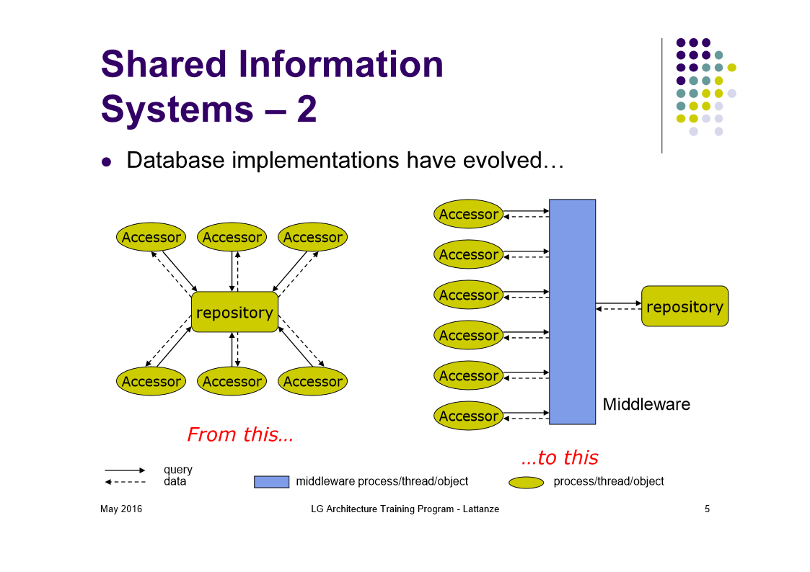

Slide 10
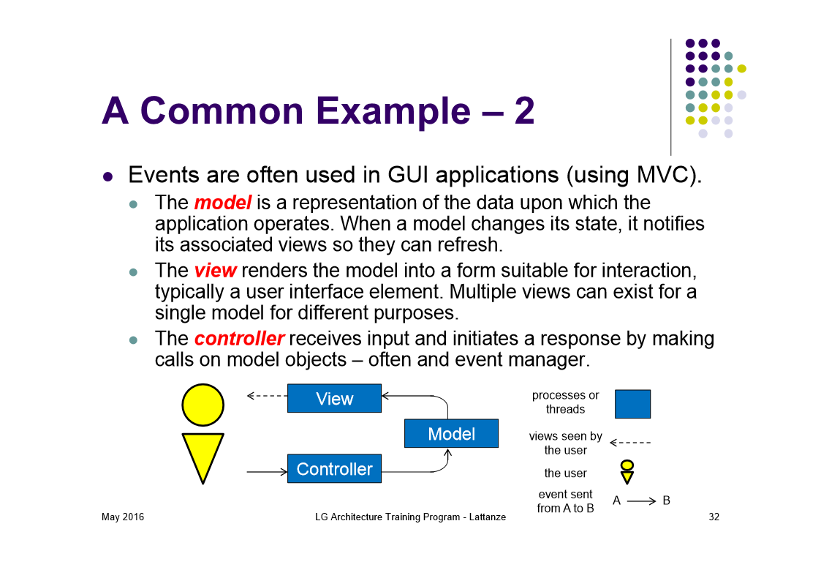
Rationale

Slide 11
Common
Legend
Package
Note Uses
Management Service
Control Service
Needs to shares common DB schema
Needs to shares common protocol

