Slide 1

SW Architect COURSE 5/23 ~ 6/26 2015 (Team Four)

Slide 2
CONTENTS
Final Presentation of Team Four : Laon IoT System
Introducing Team Four
Project Overview
Architecture Drivers
System Context
Key Design
Project Management
Artifacts
Lessons Learned
2 / 23

Slide 3

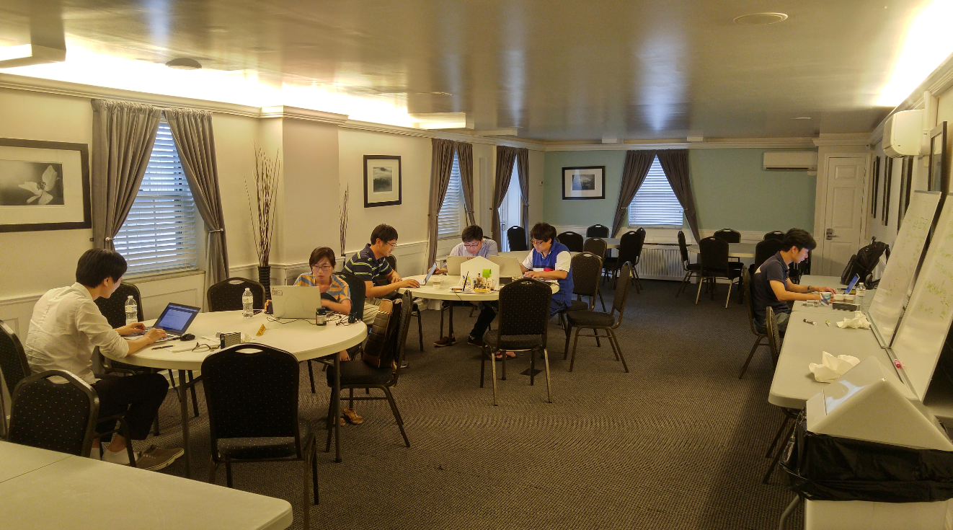


Introducing TEAM four
<Mentor>
Jeffrey Gennari
Team Members & Role Assignment
Yongbong, Choe
SW Architect
Communication SW Developer
Yongjae, Jang
SW Architect
Database SW Developer
Seungchan, Kwon
SW Architect
Middleware SW Developer
Juhyung, Woo
SW Architect
Firmware SW Developer
Yumi, Kim
Project Manager
SW Architect
UI/UX SW Developer
Sangwon, Lim
Chief Architect
Requirements Engineer
3 / 23

Slide 4
Project Overview
Key Business Goal
Development a system / infrastructure for enter the IoT market successfully
Easy control and monitoring
Support an open eco-system
Make a data centric infrastructure
Stakeholders
Customers
3rd party company
Anthony Lattanze, Jeffery Gennari
Developer (Team four members)
4 / 23

Slide 5
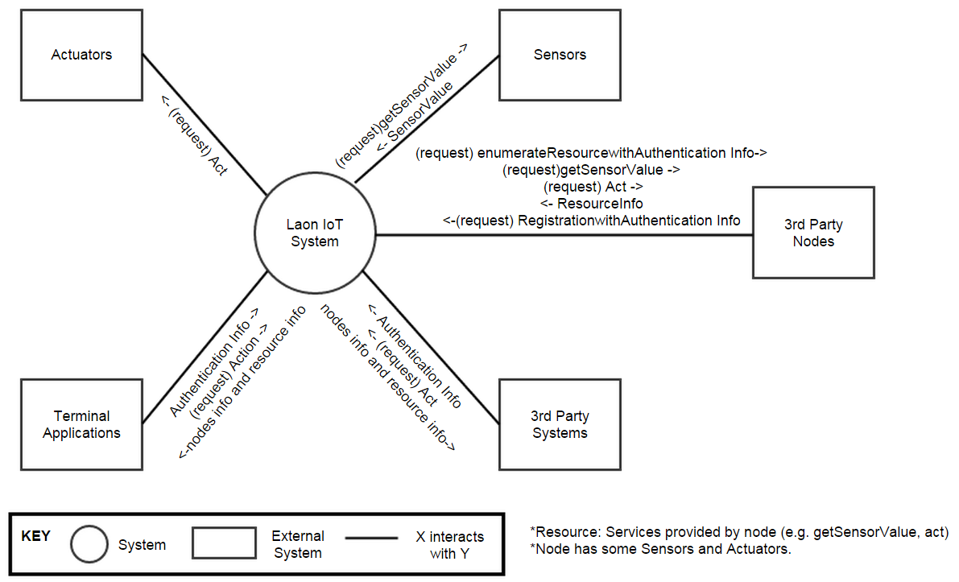
SYSTEM CONTEXT
Development a system/infrastructure
Resource : Service provided by node
(e.g. getSensorValue, act)
Node has some Sensors and Actuators
5 / 23

Slide 6
Architecture Drivers
High-level functional requirements (1/3)
Category | ID | Description
Install | FR-01 | Shall allow users to query the home to find out both 1) how many nodes are installed 2) what sensors/actuators are installed on each node
 | FR-12 | Shall add and remove nodes to and from the system without having to restart the system or other nodes. This includes registration and recognition of the type of sensors and actuators provided by the node.
Control | FR-02 | Shall allow users to control 1) turn on and off lights 2) open and close the door 3) turn on and off the alarm
 | FR-09 | Shall not allow automatic door opening while the house is alarmed.
 | FR-11 | Shall turn off the lights when no one is home and 10 minutes elapses.
Monitoring | FR-03 | Shall allow users to determine 1) temperature 2) humidity 3) presence 4) door status 5) alarm status 6) light status
6 / 23

Slide 7
Architecture Drivers
High-level functional requirements (2/3)
Category | ID | Description
Monitoring | FR-16 | When mailbox receives something, the system sends SMS message to registered number.
Log | FR-04 | Shall log sensor values for (configurable) one year.
 | FR-05 | Shall allow user applications to review their sensor and command history.
 | FR-14 | Shall log all user commands for (configurable) one year.
 | FR-18 | The system restores the last configuration when it's turned on. But door will be close every time
Exception | FR-06 | Shall not allow unauthorized persons to access 1) the home sensors / actuators 2) any data generated by sensors / actuators 3) any data stored
 | FR-07 | Shall not allow unauthorized persons to register a sensor that they do not own
7 / 23

Slide 8
Architecture Drivers
High-level functional requirements (3/3)
Category | ID | Description
 | FR-08 | Shall send an emergency message (SMS) to registered users (i.e, house owner and/or police officer) when the door is manually opened while alarmed
Exception | FR-10 | Shall send a message(SMS) to the user to inform them when the house is vacant and not alarmed. It should ask them if they want to alarm the home. Shall lock(door closed and alarmed) the house, if they do not respond within 5 minutes. If a door is open, Will close the door before alarming the house.
 | FR-15 | Shall send an emergency message(SMS) to registered users (i.e, house owner and/or police officer) when the house is suddenly occupied while alarmed
 | FR-17 | Shall not allow to set alarm while door is opening.
 | FR-19 | Shall send an emergency message to registered users (i.e, house owner and/or police officer) when the node is disconnected(i.e, physical removal) or network shut-down
8 / 23

Slide 9
Architecture Drivers
Business Constraints
You may use 3rd party open source software but please check with the project manager and business developer
The system should be delivered in 5 weeks
The team is consist of 6 members
Technical Constraints
Permissible languages for this system (excluding the nodes) include Java and Python
The node should be implemented on Arduino Uno and WIFI Shield
9 / 23

Slide 10
Architecture Drivers
Quality Attribute requirements
(V : Business value, D : Difficulty)
(M, H)
Security
Data
Confidentiality
User application to review in a secure and private way
(H, H)
User
Authorization
Shall not allow unauthorized person to register or access the SA node or database
(M, M)
User
Authentication
Shall provide some authentication method for user
(M, M)
Usability
Number of tasks accomplished
Shall provide easy ways to add and remove nodes within 5 step tasks
(M, L)
Availability
No downtime
Shall provide to add and remove nodes without having to restart the system or nodes
(H, H)
Scalability
Number of nodes
Can have one or more nodes up to 100
(L, M)
Modifiability
Coupling
should make it easy to add emerging protocols with modifying only 1 element
10 / 23

Slide 11
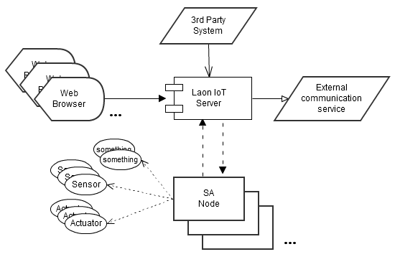
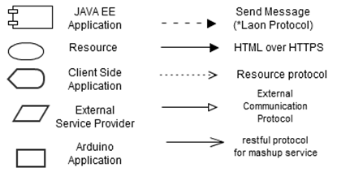
Key Design
Architecture Decision (C&C View)
Laon IoT Middleware : Satisfy security and scalability QA
SA Node : Publish status of sensor and subscribe control command
Level 1
Laon IoT
Middleware
Resource is a object managed by SA Node.
It can be logical object. (e.g. WIFI profile)
Laon Protocol is specified on other document.
Restful protocol is specified on other document.
SA Node can be made by 3rd party.
Key
11 / 23

Slide 12
Key Design
Candidate Notional Architecture
Quality Attribute | Description
Security | Unauthorized person can not access the nodes or database
Availability | Provide to add and remove without restart the system or nodes
Scalability | Can have one or more nodes up to 100
√
#1. Client/Server Pattern with middleware
#2. Client/Server Pattern without middleware
SA Node
Laon
IoT
Middleware
Web
Browser
SA Node
Web
Browser
Pros
Provide user authorization / authentication
by web application service
Middleware can monitoring status of SA nodes
Middleware provide proxy service it reduce SA node burden (It allow multi-user)
Cons
Every user can not use the service when middleware is down
Pros
SA node does not affected by another SA node.
Easy to develop with server of SA node.
Cons
SA Node have to support user authorization / authentication (Not good for security)
Web browser have to know SA node’s location.
12 / 23

Slide 13
Key Design
Dynamic Perspective (C&C View)
Level 2
Tomcat
mySQL
Web
Web
Browser
Web
server
Web
Application
Server
DB
Event
Bus
Log
Service
SA Node
Laon IoT Server
Rule Engine
Notify
Service
Key
Client Side
Application
External
SAAS
Laon IoT Sever
HTTPS
Event send/receive (Tomcat)
Arduino
Application
JAVA EE Application
Note
JDBC
TCP / Laon Protocol
13 / 23

Slide 14
Key Design
Satisfy Quality Attribute : Security
QA Refinement | Description
Authentication | Shall provide some authentication method for user
Authorization | Shall not allow unauthorized person to register or access the SA node or database
Detect Service
Denial & Revoke Access
Web
Web
Browser
Web
server
Web
Application
Server
DB
Authentication
/Authorization
Event
Bus
Log
Service
SA Node
Laon IoT Server
Rule Engine
Limit Exposure tactic is applied.
SA Node don’t expose any service.
SMS
Service
14 / 23

Slide 15
Key Design
Satisfy Quality Attribute : Security
QA Refinement | Description
Data Confidentiality | User application to review in a secure and private way
HTTPS
Web
Web
Browser
Web
server
Web
Application
Server
DB
AES, CRC,
Event
Bus
Log
Service
SA Node
Laon IoT Server
Rule Engine
Notify
Service
Limit Exposure tactic is applied
(write only)
15 / 23

Slide 16
Key Design
Satisfy Quality Attribute : Availability, Scalability
QA Refinement | Description
Number of nodes | Can have one or more nodes up to 100
No downtime | Shall provide to add and remove nodes without having to restart the system or nodes
√
#1. Put services out of the server using Publish/Scribe Pattern
#2. Put services in the server using Simple Server/Client Pattern
Node A
Event
Bus
Service A
Node A
Server
Service A
Node B
Service B
Node B
Service B
Node C
Service C
Node C
Service C
Service / Node Component
Server
Call / Return
Socket connection
Pros
A new node can join the server easily without any request to any other services and nodes.
A new service can join the server easily without any request to any other services and nodes.
Cons
Performance can be worse than direct connection.
Pros
The server can control all node connections.
It can raise the security.
Performance can be better. The server can use some tactic for the performance.
Cons
No way to add new service without server-side change.
16 / 23

Slide 17

Key Design
Static Perspective (Module View)
Level 2
Rational
- Stable module is used by unstable module.
- Resource type modules are separated for reusability.
- Change effect is mitigated by adapter or broker.
Key
17 / 23

Slide 18
Key Design
Physical Perspective (Allocation View)
Level 2
Key
18 / 23

Slide 19
Key Design
Laon Protocol (Interface)
<Header>
<Message>
<Message Type>
19 / 23

Slide 20
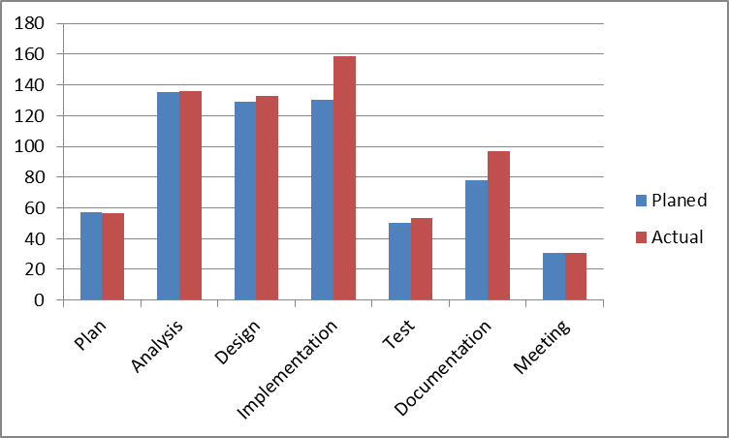
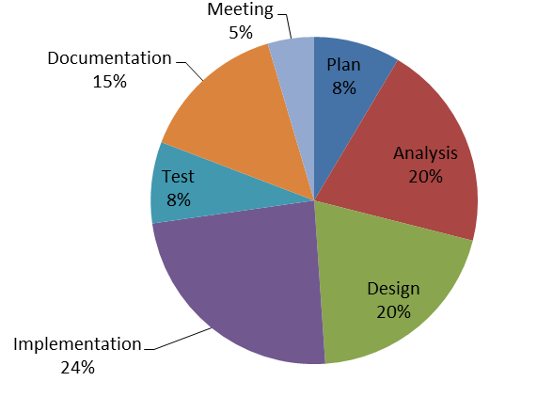
PROJECT MANAGEMENT
Planned vs. Spent cost (Hours)
Hour
Time Spent(%)
20 / 23

Slide 21
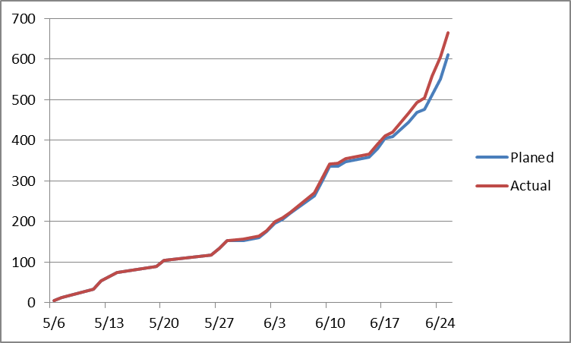
PROJECT MANAGEMENT
Time Log
Hour
Time Log Format
21 / 23

Slide 22
ARTIFACTS
Architecture Document
No | Name | Description | Pages
1 | Initial Presentation | This is explained project plan and architecutre drive with business goals | 17
2 | Final Presentation | This is explained project result with architecutre of Laon IoT system. | 26
3 | Laon IoT System Architecture Document | This is explained about architecture of Laon IoT system | 45
4 | Laon Protocol | This is explained about communication protocol for Laon IoT system | 13
Source code
No | Program Type | Used Technology | LOC
1 | Client Base | Java | 459
2 | Event Bus | Java | 398
3 | Rule Engine | Java | 116
4 | Log Service | Java | 67
5 | Notify Service | Android Java | 256
5 | Database Manager | Java | 423
6 | Web Application | Java servlet | 616
7 | Web Application | JSP | 978
8 | SA Node | Arduino C | 980
22 / 23

Slide 23
LESSONS LEARNED
Architecture
Great Architecture begins from listening others courteously
At first, each of us thought that “I’m always right.”
After admitting that “I can be wrong”, we could go forward.
Do more experimentation than arguing with unclear knowledge
Every team member insisted his architecture right based on his experience
It became never ending argument.
Documentation
Need concrete perspectives
Hard to write architecture documentation without concrete perspectives
To make understandable architectural documents for other developers,
very hard effort is needed.
23 / 23

Slide 24
Q&A
Do you have any question ?

Slide 25
Appendix. Key Design
Satisfy Quality Attribute : Usability
QA Refinement | Description
Number of tasks accomplished | Shall provide easy ways to add and remove nodes within 5 step tasks
#1. Installation application
√
#2. Using Web Browser
Pros
It can provide various functions
Cons
User don’t want to install on computer.
User can’t use the system other computer.
Pros
User can use various device having browser.
It don’t need to install step.
Cons
It’s not fancy
#1. User input node service schema
√
#2. SA Node send schema itself
Pros
Easy to develop
Cons
It’s not safe.
User hate it.
Pros
User don’t need to know about that.
It leads simple install step.
Cons
Difficult to develop

Slide 26
Appendix. Key Design
Level 2
Satisfy Quality Attribute : Modifiability
QA Refinement | Description
Coupling | SA nodes currently utilize 802.11 the system should make it easy to add emerging protocols with modifying only 1 element.
√
#1. Using the adapter.
#2. Not using a adapter
1
Protocol
Adapter
Laon
Protocol
1
Laon
Protocol
2
2
3
…
3
…
key
use
module
Affected module
Module 1,2,3 are SA Node’s main modules. When the Laon protocol is changed they can be affected if system don’t have protocol adapter module. Our system have Protocol adapter module so the change affect only protocol adapter module.

Slide 27
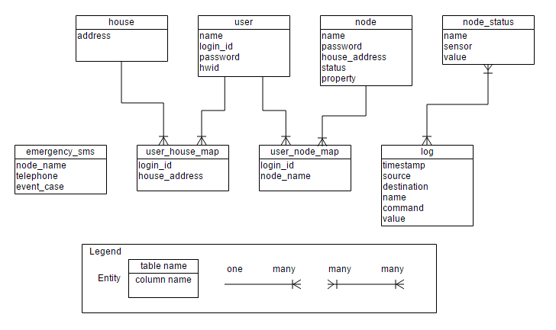
Appendix. Key Design
Data Model

