Slide 1



Sure-Park System Final Presentation
Team 3(Infinite Challenge)
Namjin Lee(Team Leader) Jack Oh, Charles Park, Joan Kim, Jaeheon Kim
Notes:
Hey, How are you? Yes… It’s me, again.
5 weeks ago, I was here to talk about architectural drivers of SurePark system and project plan.
Today, I am here to introduce our final architecture design and implementation.

Slide 2
Contents
1. Introduction
2. Architectural Drivers
3. System Context
4. Architectural Design
5. Protocol
6. Test
7. Time Log
8. Artifacts
9. Lesson Learned
Q&A
APPENDIX
Notes:
First, I’ll briefly mention about architectural drivers and introduce our design.
Protocol, test, time log, artifacts we made and lesson learned will be covered in order.

Slide 3
1. Introduction
We are team 3 and we were assigned this project 7 weeks ago. There are 5 team members and a mentor who have set out to build a new parking garage management system called “Sure Park”.
Role | Assign | Responsibility
Mentor | Mel Rosso-Llopart | Coaching team members
Team leader | Namjin Lee | Check time log and risk management
Architect | Jaeheon Kim | Design system architecture Developed “Sure Park Manager” part.
Integration | Jack Oh | Integrate all artifacts(source code, documents …etc). Developed “Web Service” part.
Test | Charles Park | Test and delivery. Developed “Facility Controller” part.
Documentation | Joan Kim | Create document artifacts. Developed “Sure Park Manager” part.
Notes:
We are team 3 and we were assigned this project 7 weeks ago.
There are 5 team members and a mentor to build a new parking garage management system called “Sure Park”.

Slide 4
2.1 Functional Requirement (1)
ID | Functional Requirement | Description
FR01 | The system must detect cars in parking space. | Arduino H/W control
FR02 | The system must open and close the entry/exit gates.
FR03 | The system must change the entry/exit LED color and turn on/off stall LEDs.
FR04 | The system must detect presence of a car when cars arrive at the entry/exit gates.
FR05 | The system shall allow drivers to reserve parking spaces. Reservations will be made via a mobile app, a laptop, or a desktop app for drivers. | Reservation system for drivers
FR06 | For reservation, drivers must sign up the system so that the system can prevent from unauthorized users.
FR07 | The system must provide available number of parking slots to drivers.
FR08 | Drivers must provide the day and time they would like to park, and credit card information (payment information) after logging in system.
FR09 | The system must return a confirmation information to the driver if reservation is succeed.
FR10 | The system must check the confirmation information to verify the deriver's information and reservation. | When drivers come up an entry gate
Notes:
I already mentioned about functional requirements in initial presentation, so I’ll just mention them briefly today.
As you can see in the table, some FRs are talking about Arduino H/W.
Some requirements are related with reservation
Some of them covers parking scenario.

Slide 5
2.1 Functional Requirement (2)
ID | Functional Requirement | Description
FR11 | “Grace period” must be configurable. | No-show process
FR12 | If the driver does not show up at the start of their reservation time, the system must operate the "grace period".
FR13 | If the driver doesn't show up within the grace period, the system must cancel the reservation.
FR14 | The system must calculate the total parking fee by hour and it shall charge on their credit card. | Charge system
FR15 | The system must show which parking spots are occupied and which are opened. | Monitoring system for attendants
FR16 | The system must show how long the car has occupied the particular parking space.
FR17 | The system must show the status when a driver parks in the wrong parking space and must automatically reassign parking spaces and correlate associated reservations.
FR18 | The system must show the facility usage and revenue. The facility usage must include average occupancy, peak usage hours, parking slot statistics. | Management system for owner
FR19 | The system shall extend analysis algorithms or applications without disrupting operations. | Management system for owner Extend system
FR20 | The system must provide login system for preventing unauthorized users. | System security
FR21 | The system must not allow anyone to view facility data (reservations, credit cards, etc.) except owner.
Notes:
Some of them is about charging parking fees.
Some of them is about monitoring facilities.
And some requirements is about providing owner with facility usage statistics.

Slide 6
2.2 Quality Attribute Utility
※ Greater number equals to higher priority
ID | Quality Attribute | Description | Difficulty(D) | Priority (P) | Total Score (D x P)
QA01 | Scalability | Scale out to other parking facilities | 3 | 3 | 9
QA02 | Availability | Detect malfunction of the Sure park system’s software | 9 | 9 | 81
QA03 | Security | Protect data and information from unauthorized access | 3 | 9 | 27
QA04 | Extensibility | Add more analysis algorithms or analysis applications | 3 | 3 | 9
QA05 | Performance | Retrieve an available parking slot ASAP. | 1 | 3 | 3
QA06 | Usability | Obtain basic statistics on facility usage. | 1 | 9 | 9
QA07 | Interoperability | Communicate between facility controller and Sure Park system. | 3 | 3 | 9
QA08 | Modifiability | Scale up/out to parking facilities | 9 | 9 | 81
Notes:
Quality attributes! We defined 8 quality attributes for SurePark system.
Among them, the most important QAs are availability, security and modifiability.
In the table, you can see the reason why we picked them.
The score of the most important items are highlighted in red.

Slide 7
2.3 Business Constraint
※ More constraints added after meeting with Tony (BC07~BC11)
ID | Business Constraint | Description
BC01 | Reducing complain | GTPS wants to reduce driver frustration when customers find available parking slots and reserve them.
BC02 | Increasing profits | More efficient space utilization is needed.
BC03 | Reducing liabilities | It is needed to reduce traffic congestion and the chance for accidents inside the parking facilities.
BC04 | Reducing operating costs | It is required to utilize personnel efficiently and reduce the number of employee.
BC05 | Applying other garage | GTPS would like to market the system to other garage owners around the world.
BC06 | Delivery | The system should be delivered in 5 weeks.
BC07 | Availability of workforce | The team is consists of 5 members. Java expert is only 1 person.
BC08 | Access the garage | Only a car can get in/out the garage.
BC09 | Parking | A driver who made a reservation can park a car.
BC10 | Charge | The system will charge a check by 30 minutes.
BC11 | Reservation | A driver can make a reservation within 3 hours.
Notes:
Constraint is also important architectural driver.
We added 5 more business constraints after discussing with our customer, Tony.
How to charge parking fees, what is a valid reservation and how many cars permitted at a time.
These things are defined more clearly after customer meeting.

Slide 8
2.4 Technical Constraint
※ More constraints added after meeting with Tony (TC04)
ID | Technical Constraint | Description
TC01 | H/W System | Wi-Fi enabled Arduino(mega 2560) - Flash Memory: 256KB of which 8KB used by bootloader - SRAM: 8KB - EEPROM: 4KB - Clock Speed: 16MHz
TC02 | Programming language | For development Arduino: C/C++ For server and application: Java
TC03 | Network | Wi-Fi Wi-Fi configuration
TC04 | Facility parts | Add more sensors, alarm LEDs, and gate servos of the same type to the existing controller. A controller can have maximum 10 slots.
Notes:
One more technical constraint is added also.
It’s about Arduino H/W limitation.

Slide 9
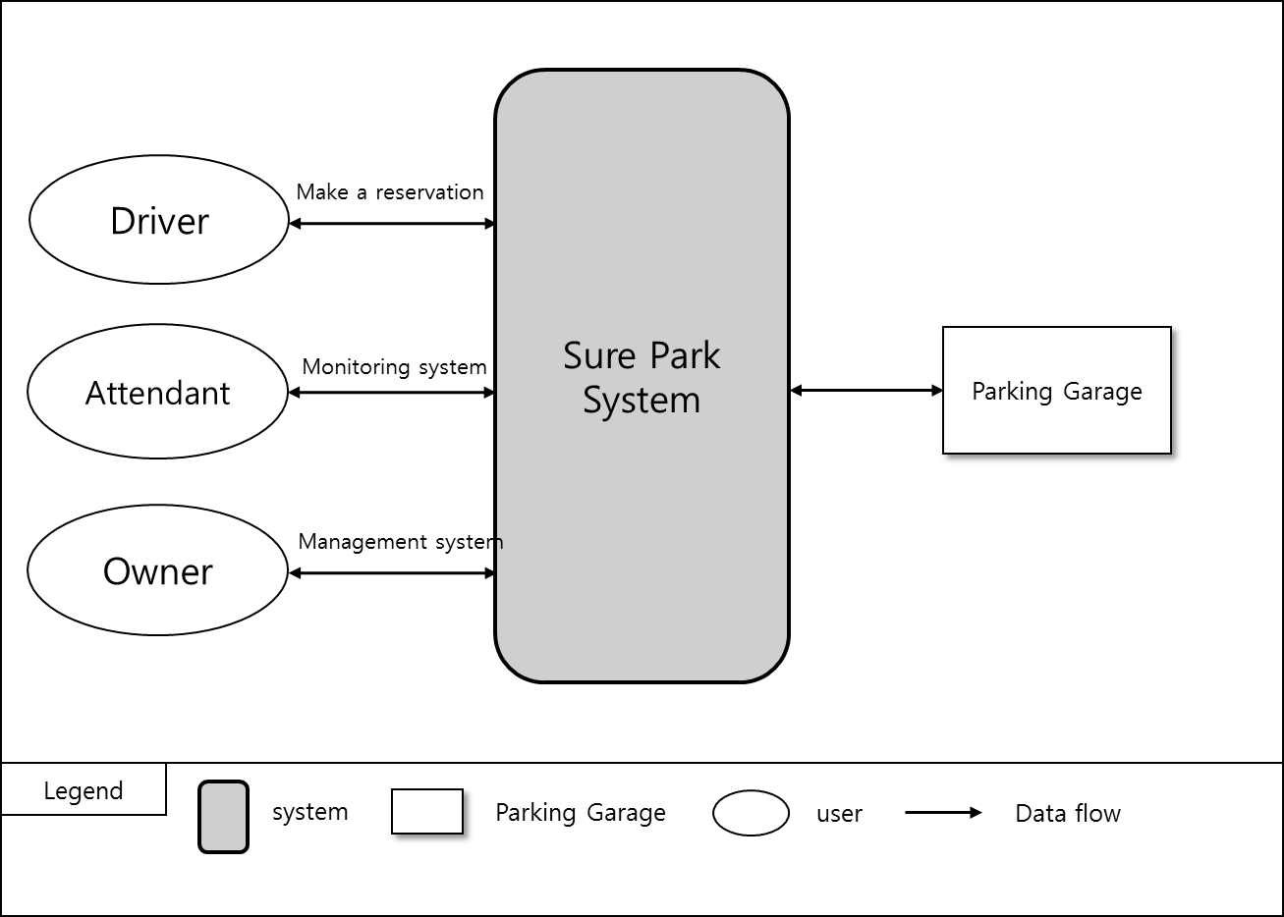
3. System Context
The scope of SurePark system is shown below.
Drivers can reserve a parking space by using a laptop or a phone.
Parking attendants can monitor parking facilities.
For the owner, the system provides facility usage statistics including average occupancy, peak usage hours, parking slot statistics, and revenue.
The system controls entry/exit gates and LED indicators based on the status of sensors.
Notes:
This picture shows system context of SurePark system.
By using SurePark system…
Drivers can reserve a parking space.
Attendants can monitor facilities.
Owners get information about average occupancy, peak usage hours and parking slot statistics.
The system controls the gates and LED indicators based on the data from sensors.

Slide 10
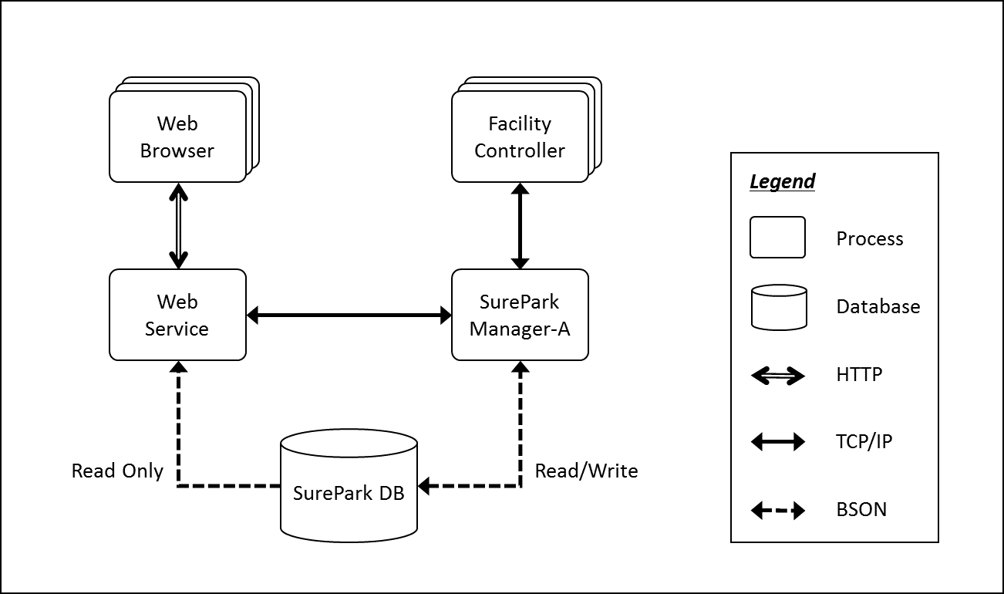
4.1 1st Decomposition (1)
Dynamic View
Notes:
OK, it’s time to introduce architecture design. You’re seeing dynamic view of SurePark system.
There are several processes in the picture. They communicate with each others.
To exchange data, the system uses protocols such like HTTP, TCP/IP and BSON.
Each processes has their own roles. They collaborate with each others to achieve FRs.
I’ll talk about the roles of each components more detailed in later slide.

Slide 11
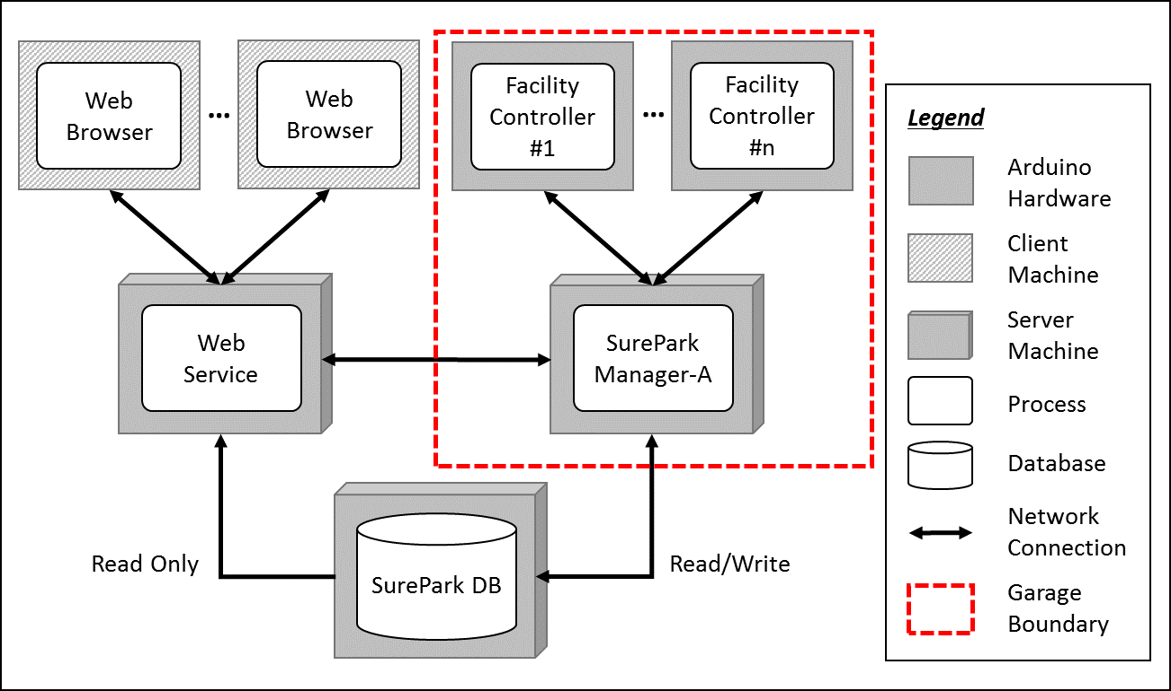
4.1 1st Decomposition (2)
Physical View
Notes:
This is physical view. Are you familiar with this picture? Yes, it’s almost same as the previous one.
The difference is the hardware. You can see three kind of hardware; Arduino H/W, client machine and server machine. Processes run in separate machines independently .
The red box is boundary of a parking garage. Every garages have one server machine and several Arduino hardware.

Slide 12
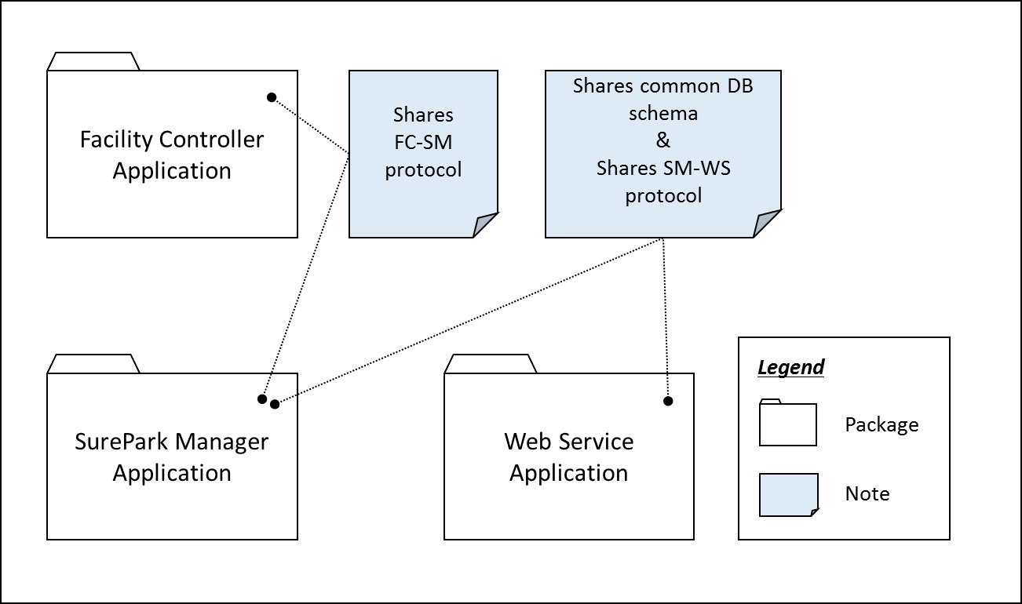
4.1 1st Decomposition (3)
Static View
Notes:
There is nothing special in static view. Three applications are build from their own code and have no relationship with each others.
But they have to know about protocols and DB schema to make meaningful packets.

Slide 13
4.1 1st Decomposition (4)
Entity Catalog
Entity | Description
Web Browser | Users, attendants and owner can access their own UI through the web browser provided by the web server.
Web Service | Provides users with the functions of sign-up, log in, reservation, monitoring facilities and/or showing parking statistics based on data retrieved from SurePark DB. Sends information to SurePark Manager for DB updates.
Facility Controller | Controls parking facilities; get the status of parking slots, turn on/off LEDs, detect a car at the gates and open/close the gates. Receives data from SurePark Manager to control LEDs and/or gates. Sends data to SurePark Manager to update the status of parking slots.
SurePark Manager | Handles show-up and no-show scenarios based on DB information. Updates SurePark DB when a user has signed up, a reservation has been made or facility status has been changed.
SurePark DB | Keeps all of the data about users, garages and reservations. Only can be updated by SurePark Manager.
Notes:
Here is the role of each component.
Web browser is the gate for users to access to SurePark system.
Web server provide users with functions to log in, make a reservation, monitoring facilities and so on.
Facility Controller gathers information from sensors and controls LEDs and servo.
SurePark Manager is a business logic, and SurePark DB keeps all of the data of the system.

Slide 14
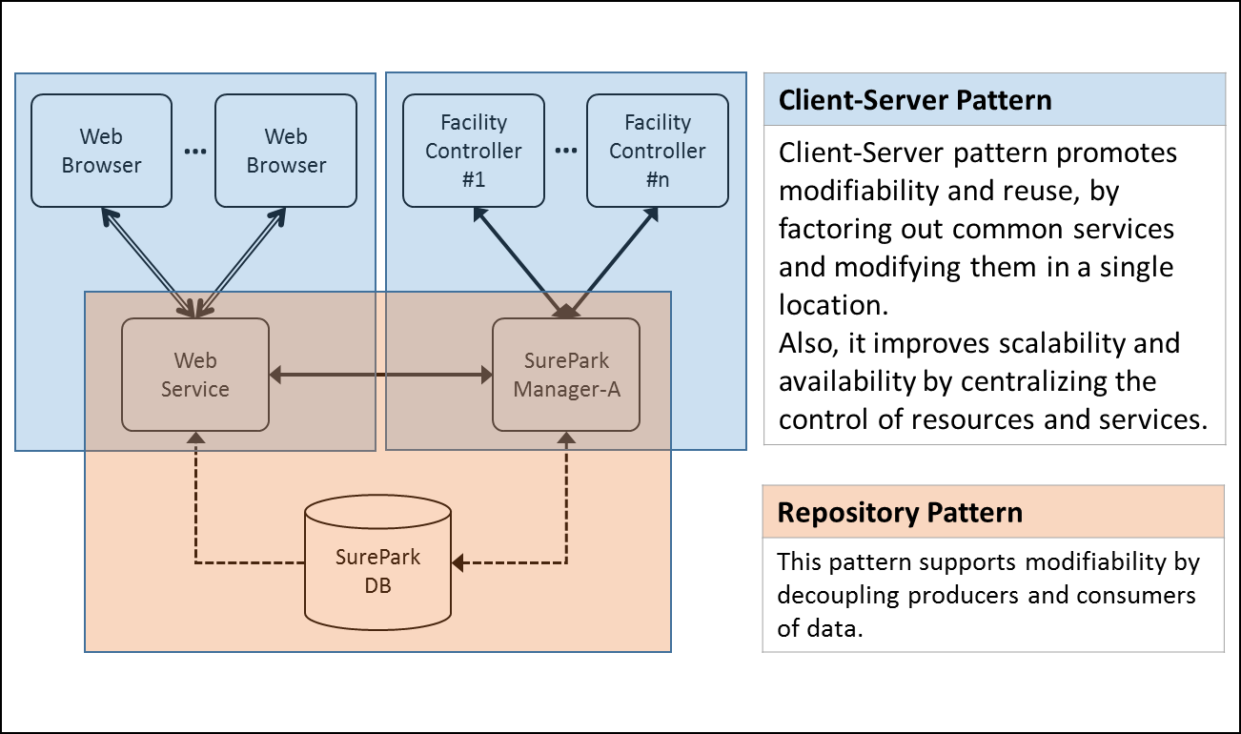
4.1 1st Decomposition (5)
QA Scenario of Modifiability (QA08)
The developers want to design scale up/out the system. The new system is implemented and tested in a week.
Rationale
To achieve modifiability, we have divided the whole system into 5 parts based on their responsibilities, and applied client-server and repository pattern to connect each parts.
Notes:
Here is the rationale for the 1st decomposition.
Modifiability is the most important QA. New SurePark system must be implemented in a week.
To achieve modifiability, we divided whole system into 5 parts based on responsibilities, and applied client-server and repository pattern.
Client-server pattern promotes modifiability and reuse, by factoring out common services and modifying them in a single location.
Repository pattern also supports modifiability by decoupling producers and consumers of data.

Slide 15
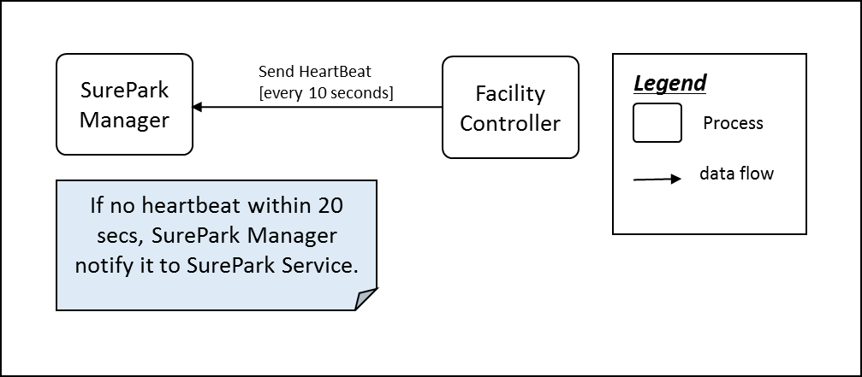
4.2 2nd Decomposition: SurePark Manager
QA Scenario of Availability (QA02)
Sure park system’s software detects software failure. In this case, Sure Park system’s software notify attendants in 30 seconds.
Rationale
Network communication can be failed by many reasons.
Tactics for detecting fault: Heartbeat or Ping/Echo
To reduce network traffic, we select Heartbeat.
Notes:
Availability is also the most important QA.
When the system detects a failure, it should notify attendants in 30 seconds.
SurePark system communicates through network, and network communication could be failed by many reasons.
As we learned in CMU course, there are several tactics to promote availability.
Among them, we choose heartbeat to minimize network traffic.

Slide 16
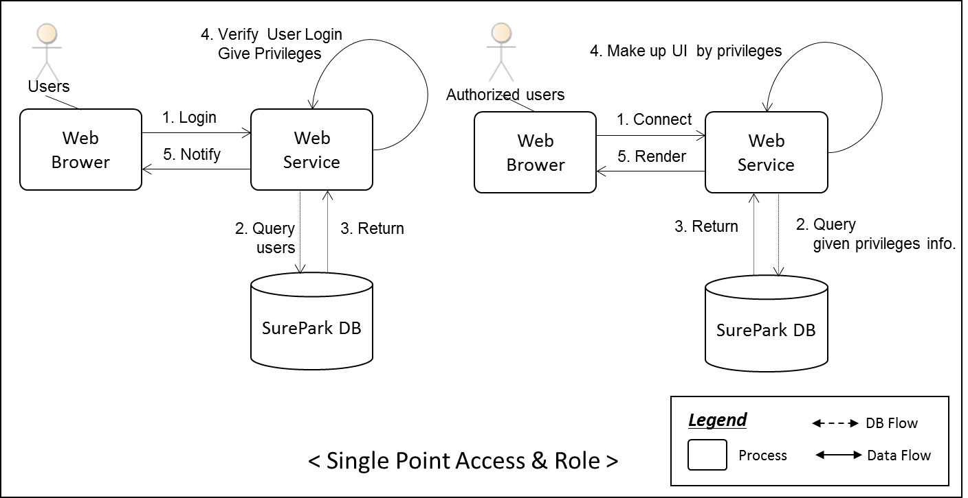
4.3 2nd Decomposition: Web Server (1)
QA Scenario of Security (QA03)
Users log in the system and get the permission to access the authorized data and information. The unauthorized user tries to access the data and information which are permitted only attendants and owner. The system prevents all unauthorized access.
Rationale
Secure applications should not allow users to get through a back door that allows them to view or edit sensitive data. Single Access Point helps solve this problem by limiting application entry to one single point.
Notes:
Security is also very important.
QA scenario says that all users must log in the system to access the authorized data.
To achieve that, we applied single access point pattern in the design.
Web browser is the single access point of SurePark system.

Slide 17
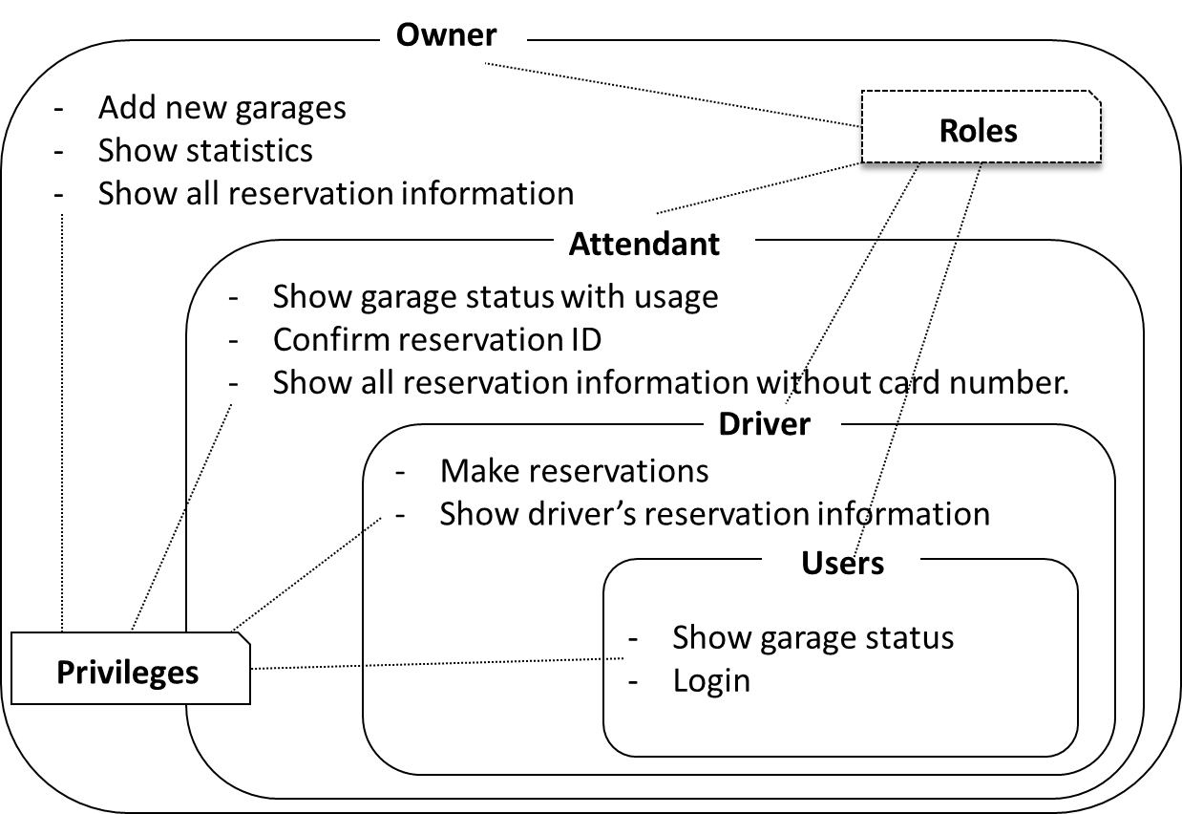
4.3 2nd Decomposition: Web Server (2)
Rationale
Groups of users will have different roles that define what they can and can not do.
Sure Park system provides different Roles to each user; creating, maintaining and viewing the data.
Notes:
This picture shows roles pattern.
Each groups have different roles that define what they can do and cannot do.
Sure Park system provides different roles to owner attendant and driver.
Driver has user’s role plus his own role.
Attendant has user’s role, driver’s role and his own role.
Finally, owner has all privileges of the system.

Slide 18
5. Protocol
SurePark Manager to Facility Controller
Start Symbol | Facility Id | Code | Value | End Symbol
1byte($) | 4byte | 1byte | Variable length | 1byte(\n)
Code List:
I = Information, S = Slot Status, E = Entry Gate, X = Exit Gate, L = LED.
Packet Example
Slot status packet: $1001S1001\n (Slot 0 and 3 are occupied.)
Heartbeat packet: $1001\n (Only have facility Id.)
SurePark Manager to Web Service
Client-server communication with JSON
Detailed protocol is described in SurePark_ADS_TEAM3.doc.
JSON reference: http://www.json.org/
Notes:
Protocols!
Arduino hardware is not so powerful. Lots of data could make it very busy.
Because of this reason, packets between SM and FC are very simple.
Heartbeat packet is only 6 byte long, for example.
On the other hand, packets between SM and WS are very complicate but very flexible.
This protocol is based on JSON.

Slide 19
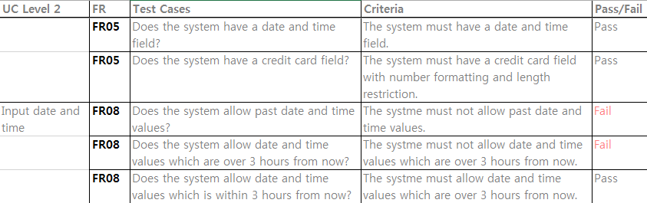
6. Test
ID | Functional Requirement
FR05 | The system shall allow drivers to reserve parking spaces. Reservations will be made via a mobile app, a laptop, or a desktop app for drivers.
FR06 | For reservation, drivers must sign up the system so that the system can prevent from unauthorized users.
FR07 | The system must provide available number of parking slots to drivers.
FR08 | Drivers must provide the day and time they would like to park, and credit card information (payment information) after logging in system.
FR09 | The system must return a confirmation information to the driver if reservation is succeed.
ID: UC01 | Description
Title | (FR05 ~ FR09) Reserve parking spaces
Stakeholders | A driver who would like to reserve a parking space.
Preconditions | The driver must satisfy with FR06,FR20
Main success scenario | 1) The Sure-Park system allows an authorized driver to reserve a parking slot (FR05). 2) The system shows available number of parking slots to the driver (FR07). 3) If a parking slot is available, the driver needs to input the day and time they would like to park, and credit card information (FR08). 4) If all information is ok, the system provides confirmation information to drivers (FR09).
Post conditions | The reservation was confirmed.
Alternate scenario | ….
Use Case
Test
Case
Notes:
Test is also very important. Our test cases are built based on the functional requirement. From FRs, we made UCs, and then we made test cases too.
As you can see in the picture, every requirements are described in UCs and test cases.
It’s very powerful because we can cover all FRs through test cases. It’s very easy to trace back which FRs are failed or not tested yet.

Slide 20
7. Time Log
Why gap happened?
Left chart looks like a pregnant lady chart but the gap only happened on the first week.
We had a trouble adjusting to the time difference on the first week.
Reading assignment was a big burden more than we thought.
Time (hour)
GAP
Date
Accumulated Worktime
Development Phase Distribution
Notes:
This slide shows our time log.
The upper line is planned curve and the lower line is actual curve.
At the early stage of the development, we didn’t do so much than planned.
It’s because we had a trouble adjusting to the time difference on the first week.
From the second week, actual curve almost follows planned curve.
The chart on the right shows how much time we spent for each development phases.

Slide 21
8. Artifacts
Document
No. | File Name | Description
1 | SurePark_Initial_TEAM3.pptx | Initial presentation document
2 | SurePark_Final_Presentation_TEAM3.pptx | Final presentation document
3 | SurePark_ADS_TEAM3.docx | Architectural Driver Specification document
4 | SurePark_ADD_TEAM3.docx | Architectural Design Document
5 | SurePark_TestCase_TEAM3.xlsx | Test case document
6 | SurePark_TimeLog_TEAM3.pdf | Time log
7 | SurePark_GanttChart_TEAM3.xlsx | Gantt chart
Source Code
No. | Application | Language | LOC
1 | Facility Controller | C | 616
2 | SurePark Manager | JAVA | 1263
3 | Web Service | HTML5 CSS JAVASCRIPT | 1650
Notes:
This slide shows the list of documents and the source codes.

Slide 22
9. Lesson Learned
Perspective
Before CMU course: Use only static view or mixed perspective.
After CMU course: We can distinguish three perspectives.
Interface
Once the interface has been fixed, it becomes a constraint.
We’ve experienced this kind of situation and had to spend lots of resources because of changing protocols at the late stage.
Using COTS is not free
MongDB, Google Chart and Javascript libraries are used.
Google Chart are not available during demo because the router has no internet access.
Some of Java script libraries caused network problems and it takes time to fix them.
Development Tools
We’ve learned lots of tools can help us during development process. For example…
Toggl: Online tool to help time tracking and record logs.
Smartsheet: Online tool to help with drawing Gantt chart.
GitHub: Configuration management tool.
Notes:
This is the last slide!
What did we learn through CMU course?

Slide 23

Q & A

Slide 24
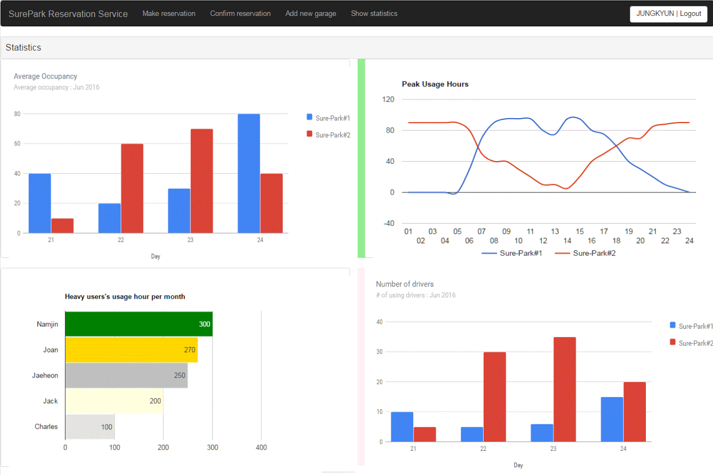
APPENDIX
QA Scenario of Usability (QA06)
The owner wants to check basic statistics on facility usages. The owner can show statistic report in 3 step after login.
Rationale
All UIs are designed to show their contents within 1 step.
Notes:
Though we did not focus on usability in this presentation, usability is very important for the customer.
To make it easy to access UI, we limited menu depth. All menus can be accessed by only 1 depth.
You can see that in the successive demo session.

