Slide 1


Sure-Park System Architecture Deriver Specification
3 Team
Namjin Lee(Team Leader) Jack Oh, Charles Park, Joan Kim, Jeaheon Kim

Slide 2
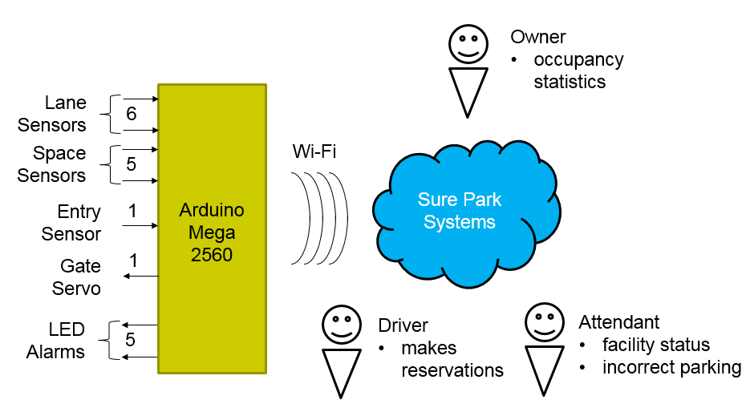
1. Introduction
Key business goals for the system are to create:
A system/infrastructure that enables users to reserve parking spaces using a laptop or phone.
Enables a parking attendant to monitor the parking facility
A system that can be reused and scaled for another parking facility (garage or lot)
Provide owner with facility usage data to initially include average usage, peak usage hours, revenue and must be extensible for adding more analysis algorithms

Slide 3
2. Product Context

