Slide 1
Folder structure
Main folder
<top>
< Module Folder >
Script 1 (.py) : Execute a command, check the read-back value, and
operate an option
< External Module >
Config File (.csv)
Description about the sequences of check to be done. The set of operations must be provided step by step.
AutoBuild File (.py)
Executable file used to create automaticaly the test-bench application based on Config file
ValidationTest(.py)
Executable script created to provide final function tests
Notes:
4

Slide 2
Script 1 (.py)
Where:
- « PV » is Cmd PV (from Config File)
- « XXX » is Cmd value (From Config File)
Caput « PV » « XXX »
Yes
« Delay » ?
No
Where:
- « Delay » is Time delay value (from Config File)
Wait « Delay »
Where:
- « PV » is Rdbk PV (from Config File)
- « XXX » is Rdbk value (From Config File)
Caget « PV »
Check « Threshold » ?
Where:
- « Threshold » is Rdbk/Threshold value (from Config File)
Where:
« Result » is result value (from Config File) :
Not Critical : OK continue test
Warning : Write in file « Failure Message », and continue test
Critical : Write in file « Failure Message », and stop test
Continue test depending on « Result »

Slide 3
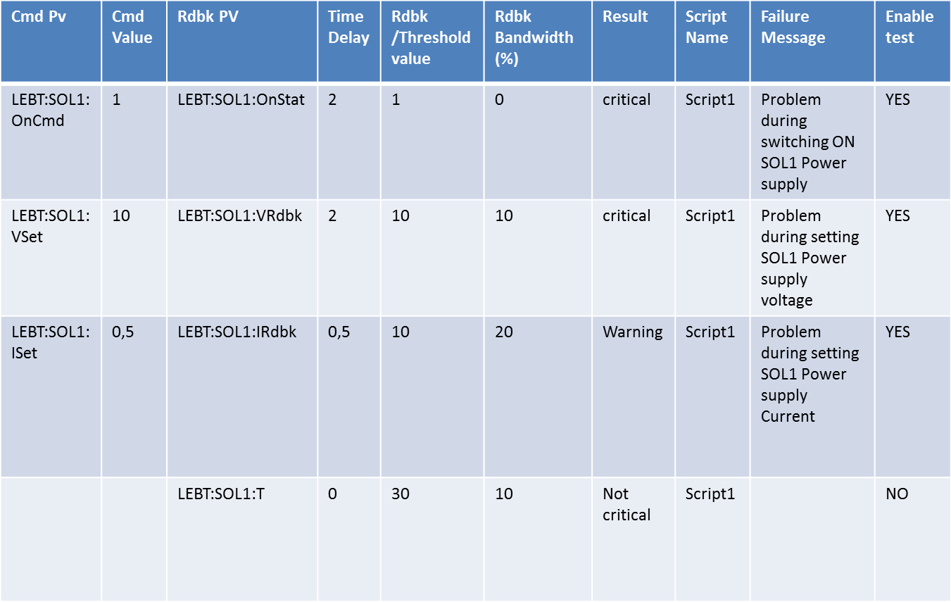
Config File (.csv)

Slide 4
Observations / News ideas
Add a « sucess message » colonn for the reading pdf file
Result => Severity : This tool is develloped in first for a EPICS user, why don’t use the same vocabulary?
  ( 0 -> Rien ; 1 -> Warning ; 2 -> Error )
Future possible extension (next step ;-) )
  Create a phyton PLC test with sending only a Excel file, because many records and perhaps borring to fill up configFile.csv, if the test are always the same?
  Give the possibility to repeate an action ?? With an other script?
( example : Increment a voltage of a power supply every 5s)

