Slide 1

Dragon Tiger Billboard of Compulsory Testing Notice
this billboard celebrates the top 10 places by area being tested the most
🕺 nose picking is exciting and addictive, let’s party our noses! 💃
Hong Kong
TOP N
DISTRICT
Kowloon
TOP N
DISTRICT
New Territories
TOP N
DISTRICT
MAP
Source: (Hong Kong) Centre for Health Protection
* Only listing specified places with correct address on Compulsory Testing Notice

Slide 2





cache
process
output
visualise

Slide 3
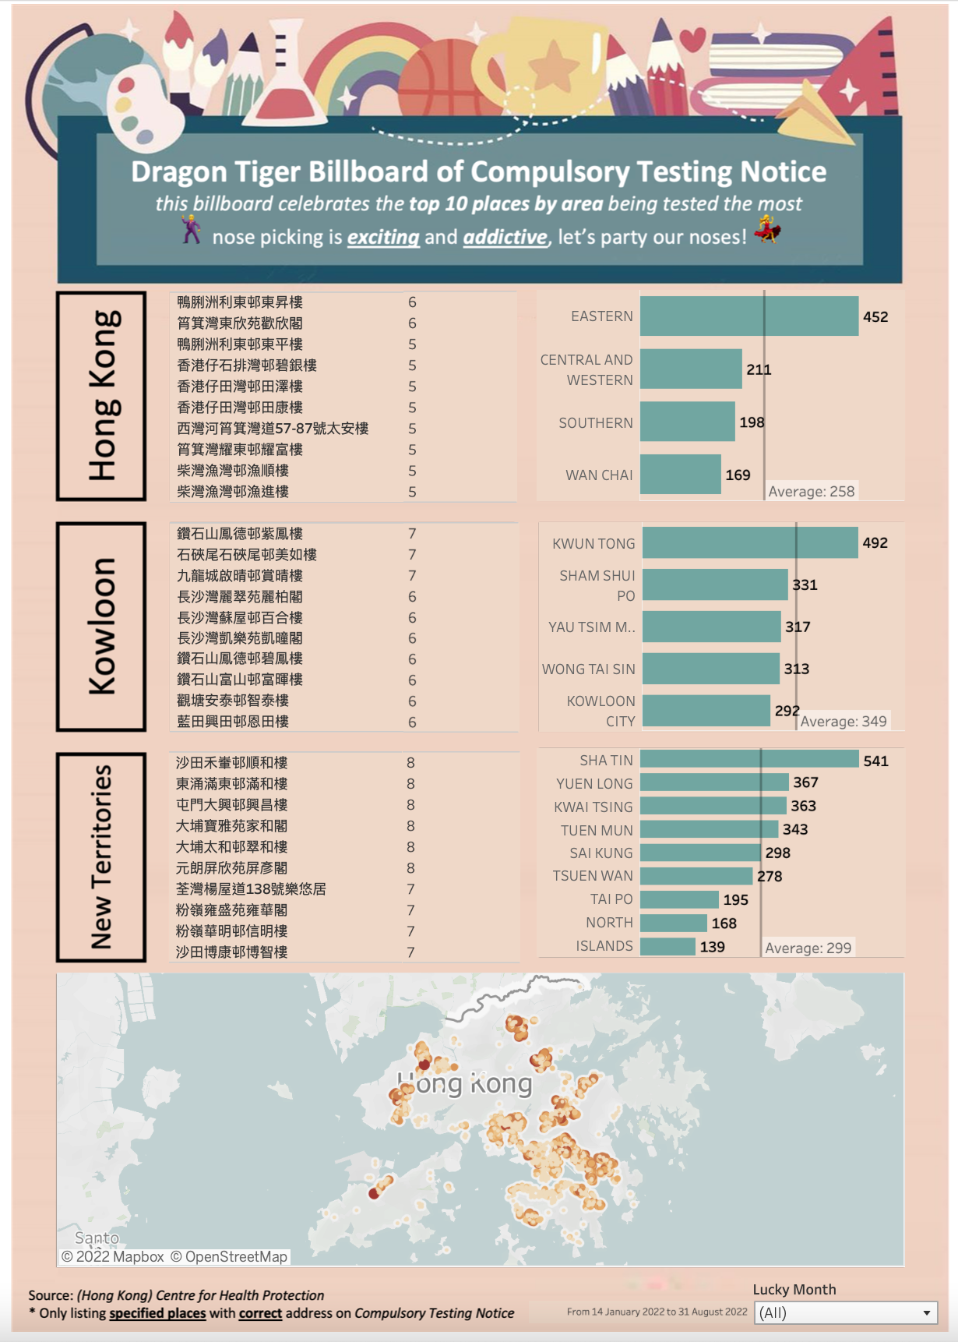
Dragon Tiger Billboard description
Top 10 specified premises listed on CTN according to its area
A Map showing the location of each specified premises

