Slide 1
Athena MATLAB Ballast Optimizer
Turning broken code to slightly less broken code
Jack Hammer

Slide 2
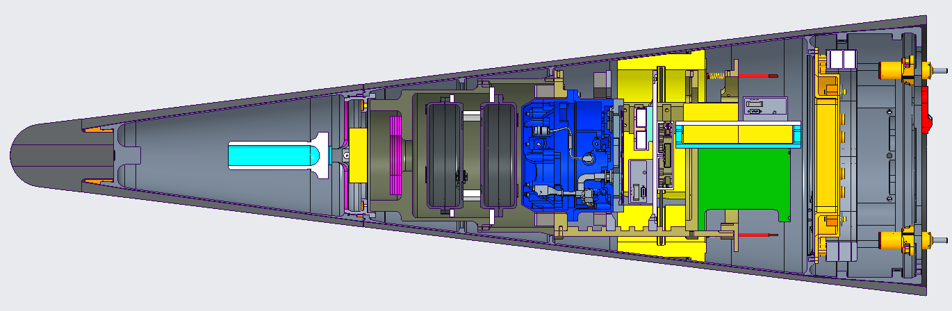
Athena Objective
CUI
We want to reduce the complexity for building a telemetry capsule, integrating into aeroshell, and reworking after initial build
  Repackaging
  Re-ballasting
Ballast Ring
Ballast Rings
Ballast Bowl
Ballast Post
Capsule Internals
Athena - Capsule
CUI

Slide 3
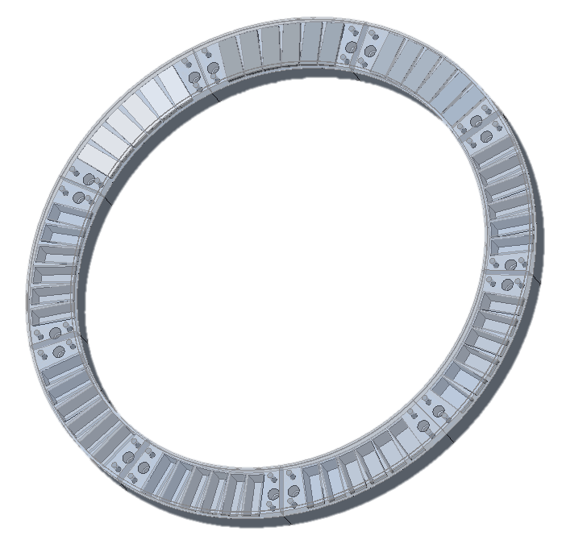
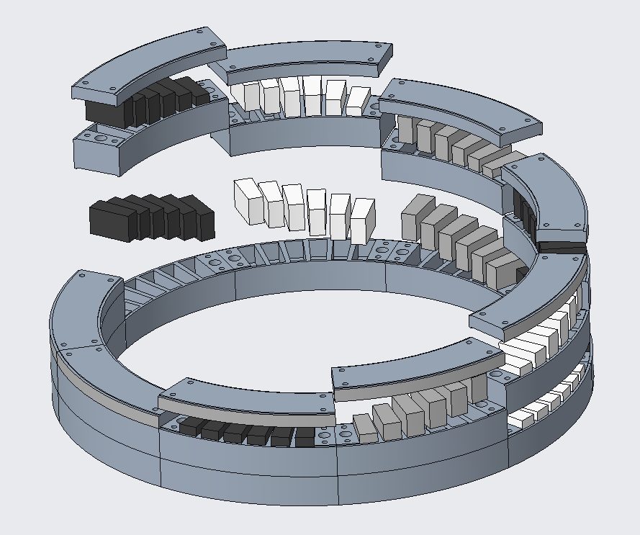
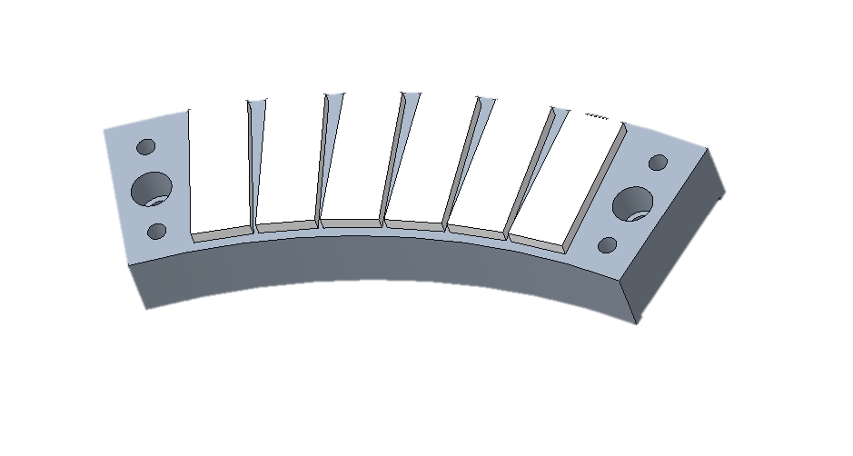
Ballast Ring Design
CUI
Cartridge Covers
Cartridges
Stackable cartridge holders
CUI

Slide 4
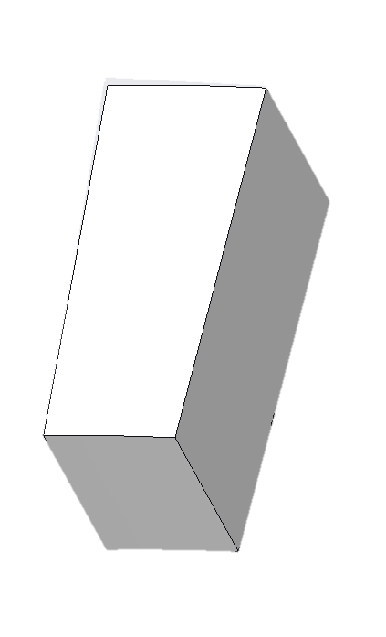
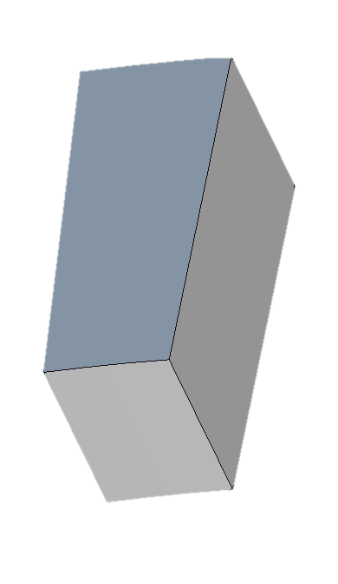
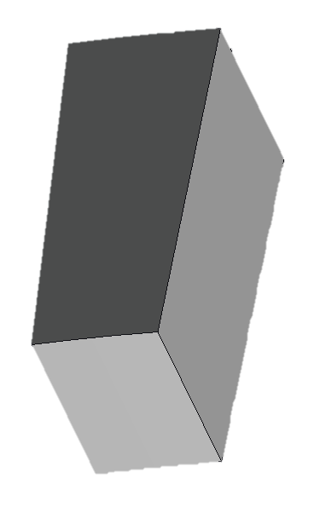
Individual Cartridge Design
CUI
X-04: Al6061 Cartridge
Weight: 0.02164 lbs.
X-05: Tungsten Cartridge
Weight: 0.1348 lbs.
X-06: Stainless Steel Cartridge
Weight: 0.06184 lbs.
CUI
Notes:
Different weights, note min and max

Slide 5
Athena
CUI
?????
29.134 lbs?
.000034 lbs?
3.4 lbs?
2 lbs?
Athena - Capsule
CUI

Slide 6
MATLAB Ballast Optimizer Flow
CUI
Unballasted CG
MATLAB Optimizer
Location and weight of ballast to achieve desired CG
Desired CG
Locations and limits for ballast
CUI
Notes:
Desired cg outlined in ICD

Slide 7
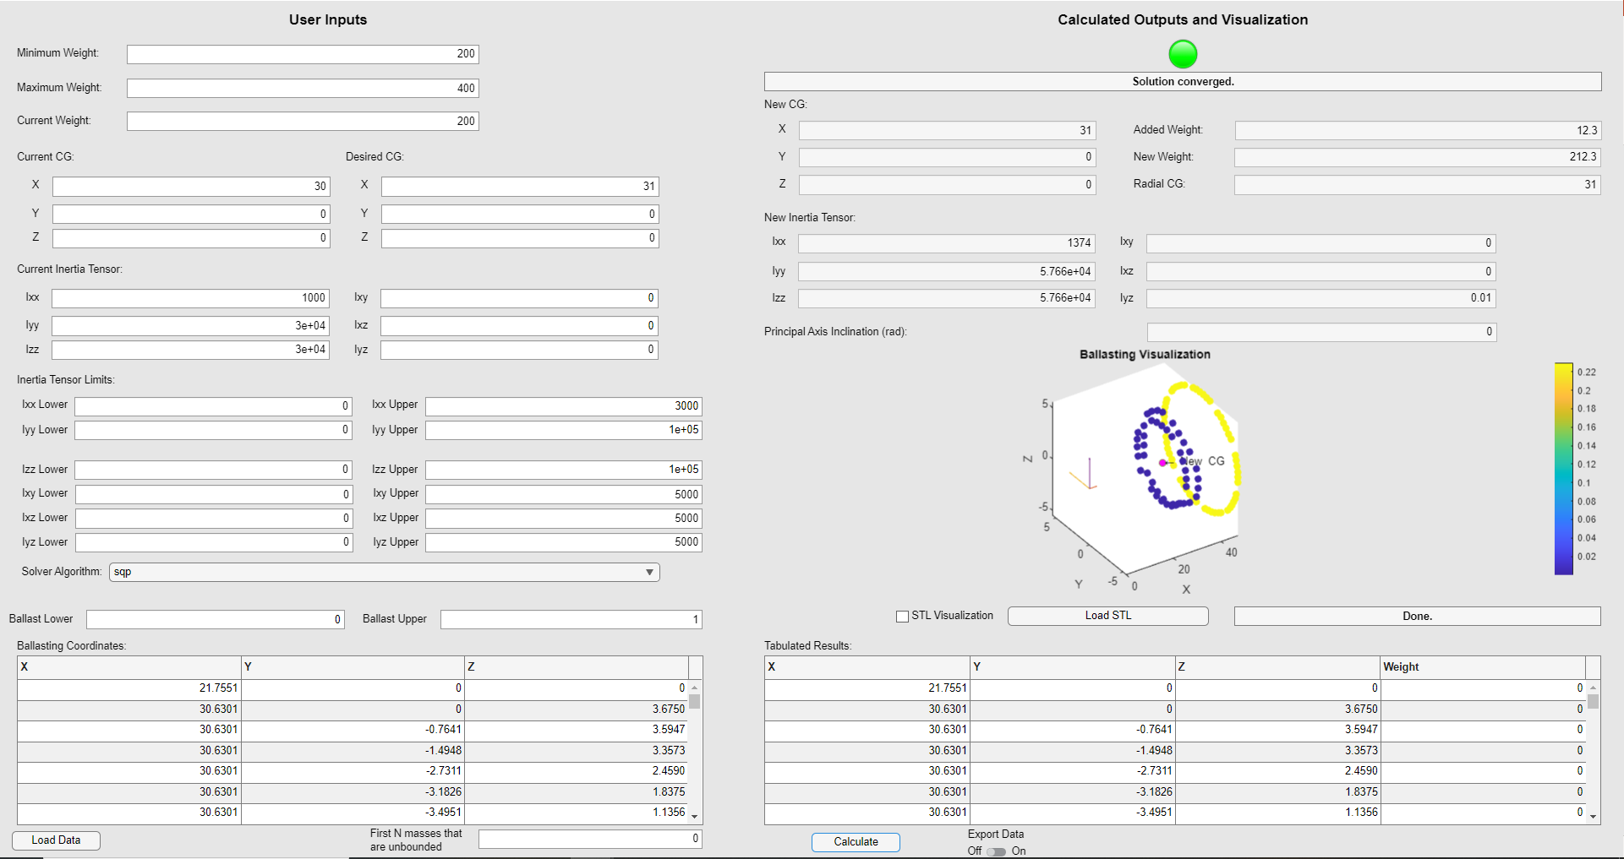
CUI
CUI

Slide 8
CUI
Input weight constraints, current and desired CG
CUI

Slide 9
CUI
Input current inertia tensor and the limits for the output tensor
CUI

Slide 10
CUI
Load point data via csv file
CUI

Slide 11
CUI
Output panel
CUI

Slide 12
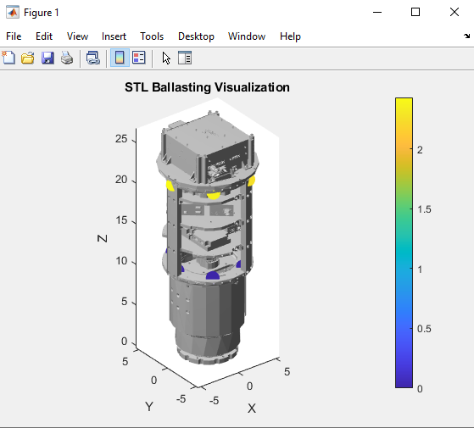
Ballas Optimizer Outputs
CUI
CUI

Slide 13
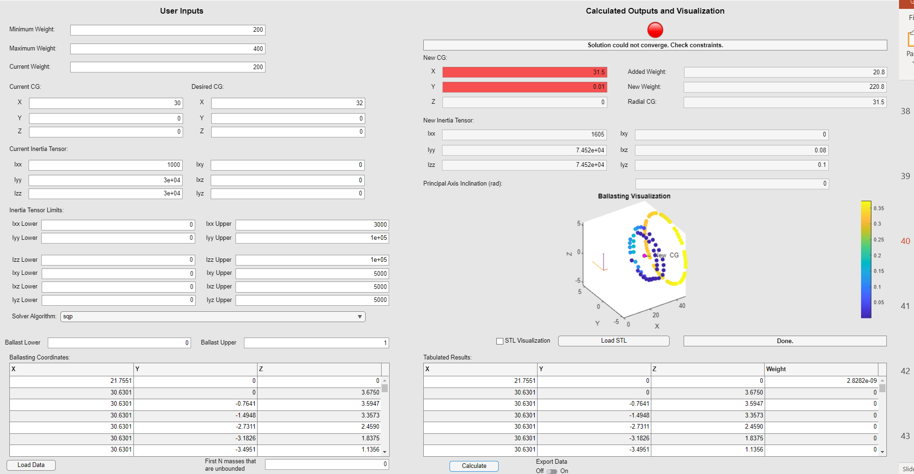
CUI
Output rarely converges
Ballast output ranged from 1e-20lbs to 30lbs
CUI

Slide 14
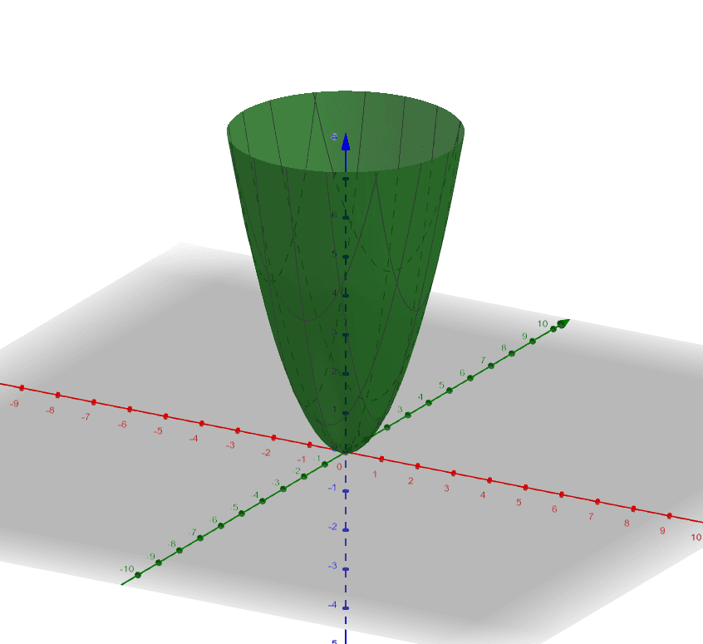
Review: Optimizers
CUI
Gradient Descent:
Setup equation to be minimized
Take gradient at initial guess
  Components tell us direction of maximum positive change
Take small step in the opposite direction
Function value after this small step is now the initial guess and steps 2-3 are repeated until step delta is sufficiently small.
CUI

Slide 15
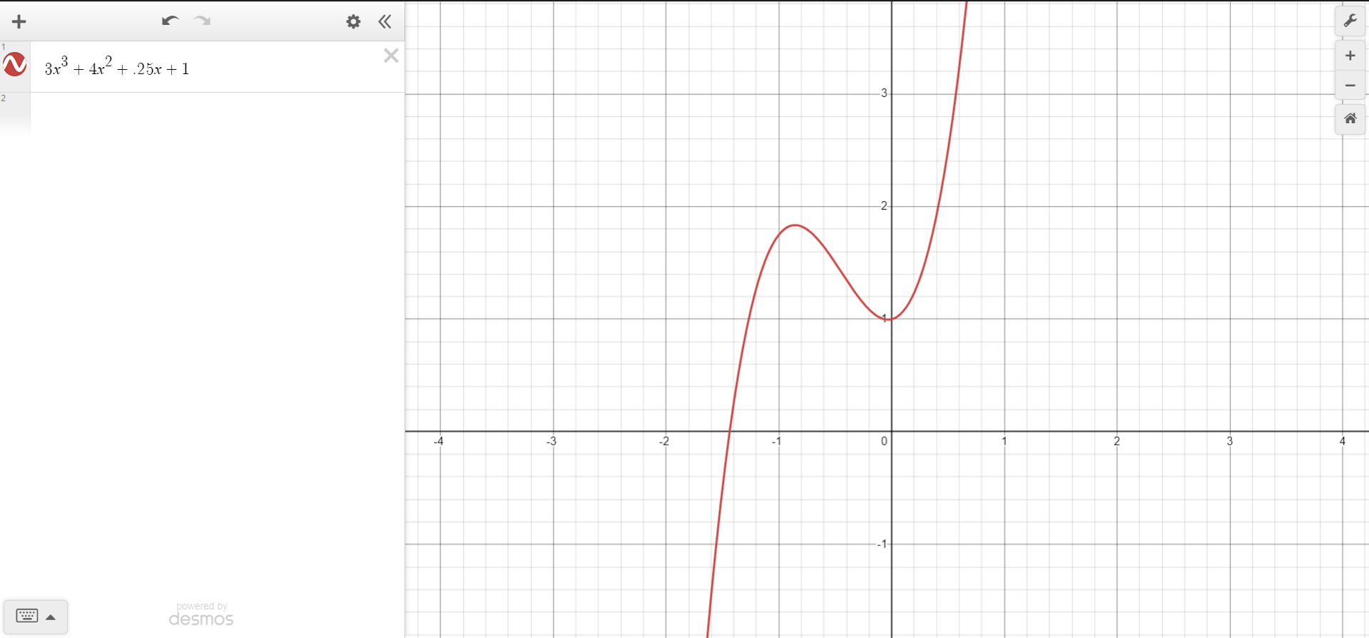
Review: Optimizer Sensitivity
CUI
Initial guess 2
Initial guess 1
CUI

Slide 16
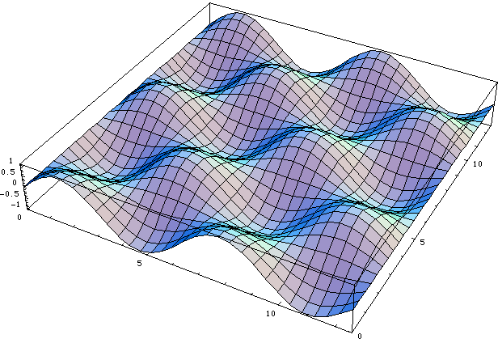
Review: Optimizer Sensitivity
CUI
CUI

Slide 17
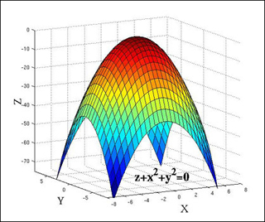
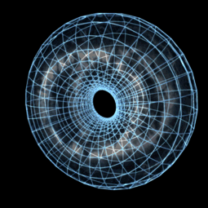
A side note’s side note
CUI
CUI

Slide 18
MATLAB Ballast Optimizer Flow
CUI
Unballasted CG
MATLAB Optimizer
Location and weight of ballast to achieve desired CG
Desired CG
Locations and limits for ballast
CUI
Notes:
Desired cg outlined in ICD

Slide 19
MATLAB Optimizer
CUI
Goal (Objective Function):
Minimize the amount of weight added
Gradient Descent-Like Algorithm
Non-Linear Constraints:
Work towards the desired CG and stay within inertia tensor limits
Linear Constraints:
Upper and lower ballast boundaries
CUI
Notes:
Desired cg outlined in ICD

Slide 20
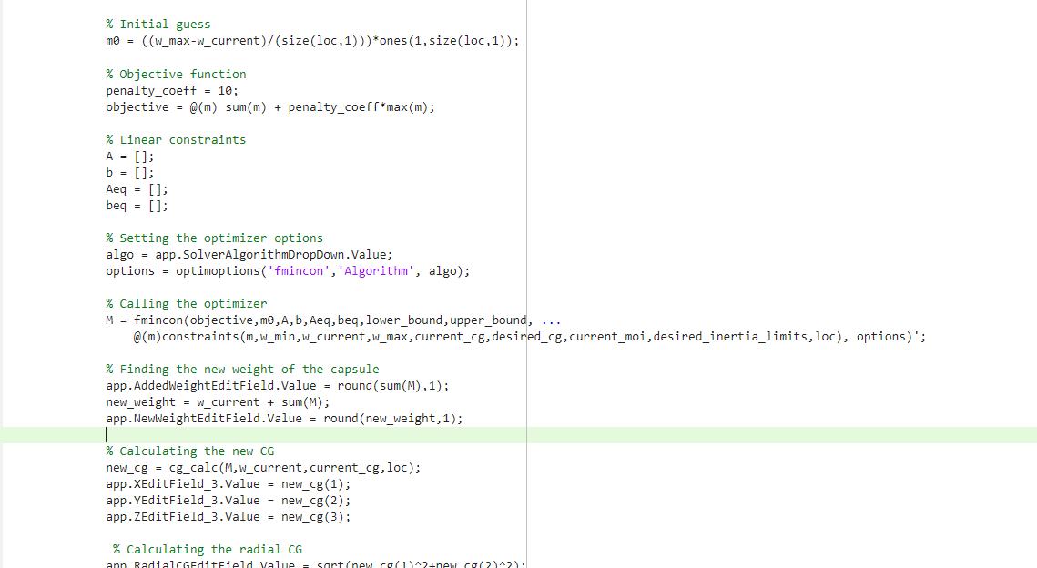
MATLAB Optimizer Code
CUI
CUI

Slide 21
CUI
Output rarely converges
Ballast output ranged from 1e-20lbs to 30lbs
CUI

Slide 22
Ballast Optimizer Problem Summary
CUI
MATLAB Optimizer app used to get ballast placements and weights doesn’t seem to work for Athena specific values
  Outputs one far too massive weight
  Places many small weights, so small they are insignificant
  Can’t take into account different types of ballast
    Some areas can take up to 20lbs where as others can only be .135lbs
  Doesn’t converge
  Doesn’t display convergence correctly
    States non-convergent due to floating point error
CUI

Slide 23
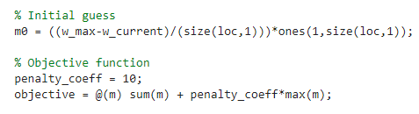
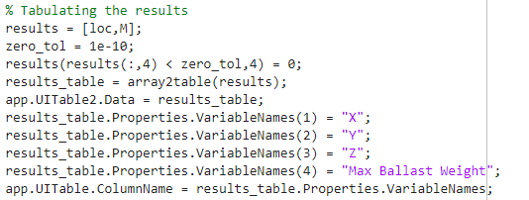
Large and Small Ballast Fix
CUI
Alter objective function to also minimize the value of largest weight
Created tolerance to round towards zero for better displayed results
CUI

Slide 24
Different Ballast Types
CUI
Ballast Ring
Ballast Rings
Ballast Bowl
Ballast Post
Athena - Capsule
CUI

Slide 25
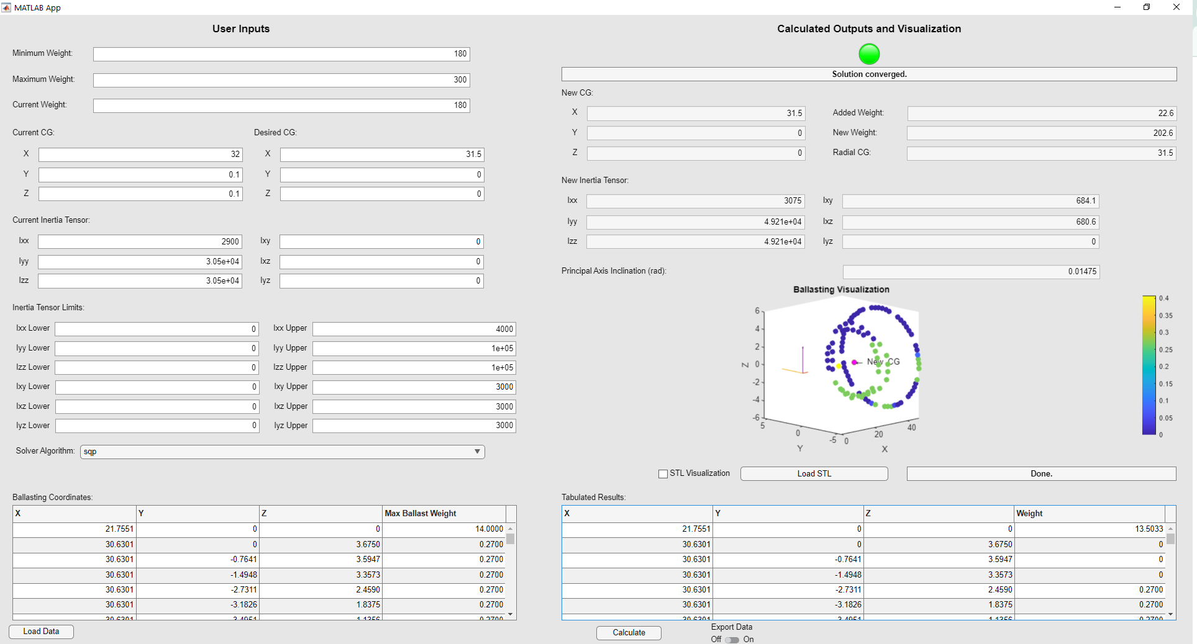
CUI
Input point data now includes a max weight available for each point
CUI

Slide 26
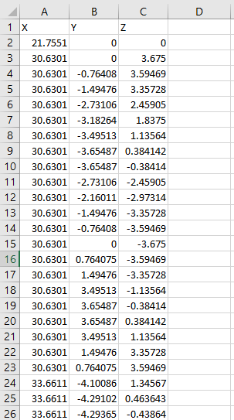
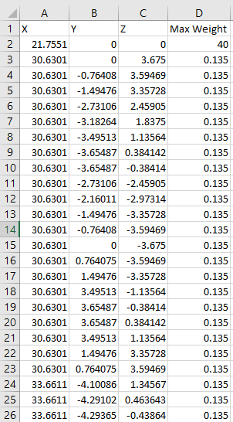
Different Ballast Types
CUI
CUI

Slide 27
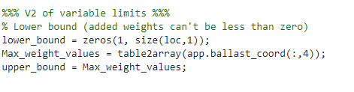
Different Ballast Types
Max weight values pushed into upper_bound variable

Slide 28
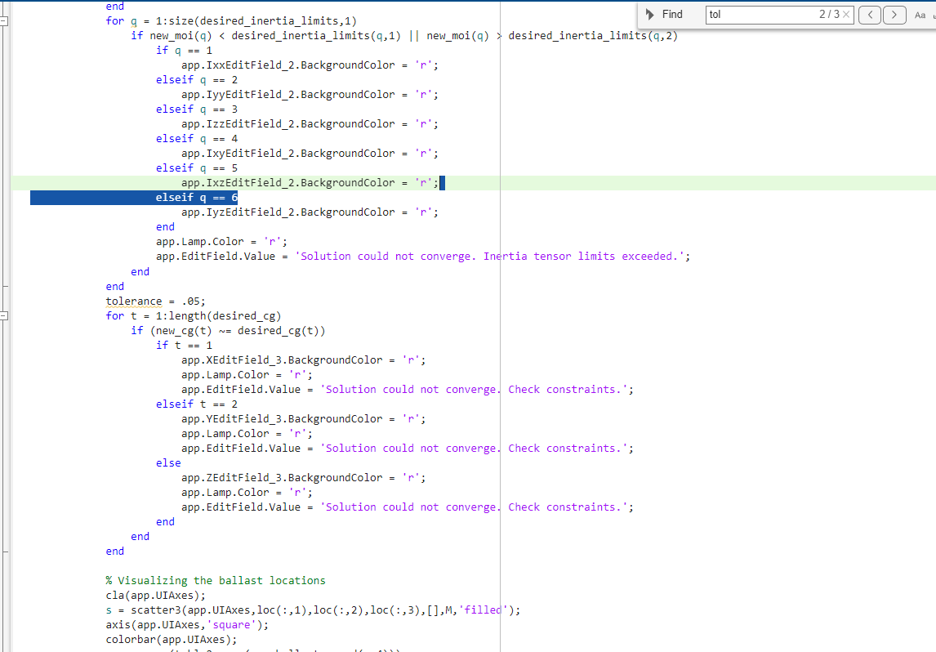
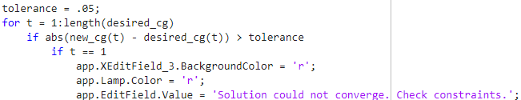
Athena
CUI
  Previously, convergence was determined by checking if goal values and new values were the same.
  Due to floating point error, I was able to create a scenario where the new and old CG’s were .0000000051 off and the program didn’t show convergence.
Previous:
Used a tolerance to avoid this problem
Updated:
CUI

Slide 29
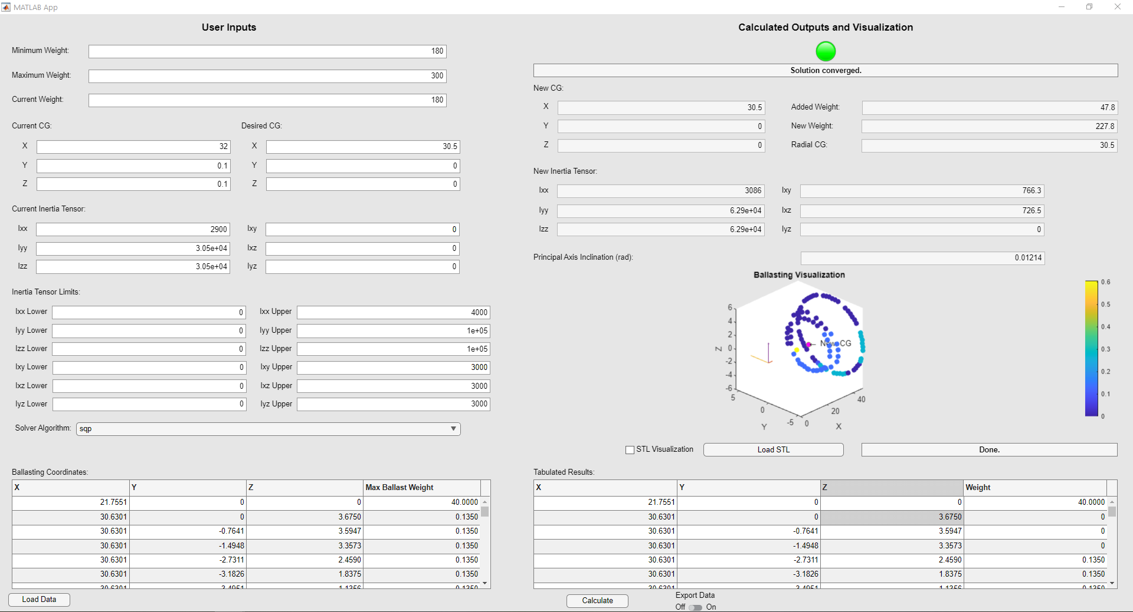
CUI
CUI

Slide 31
