Slide 1
Mass Optimization Tool Updated
How To Use, What's been changed, What should change
Jack Hammer
FPS/KFP

Slide 2
Using the App: A Walkthrough

Slide 3
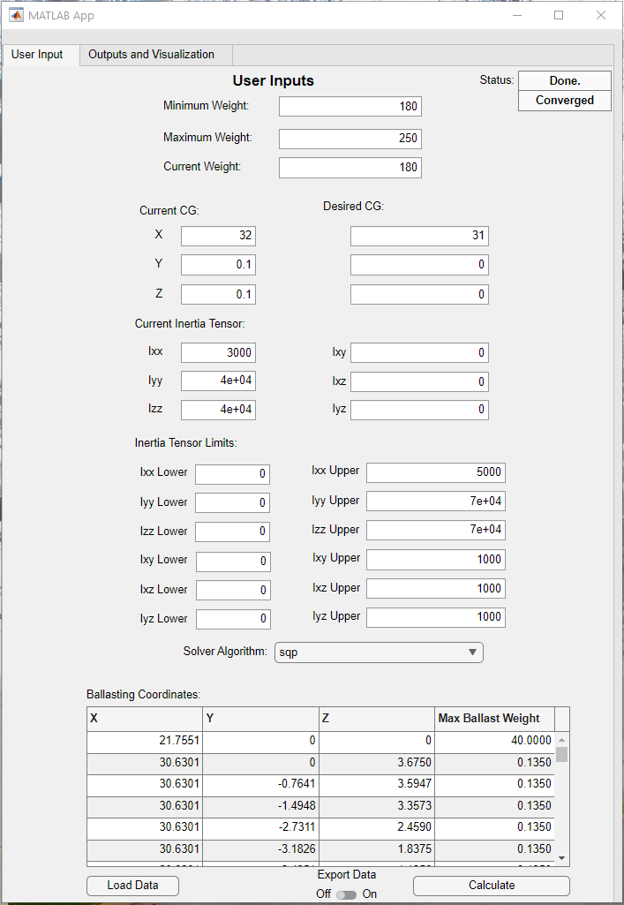
App GUI
Status and Convergence Display
Min weight constraint
Max weight constraint
Current weight
X,Y,Z coordinates for current and desired CG
Current inertia tensor and inertia tensor limits
Solver algorithm
Interior-point
Sqp (sequential quadratic programming)
Displays ballasting locations and maximum weight
Data export toggle
Begin Calculation button

Slide 4
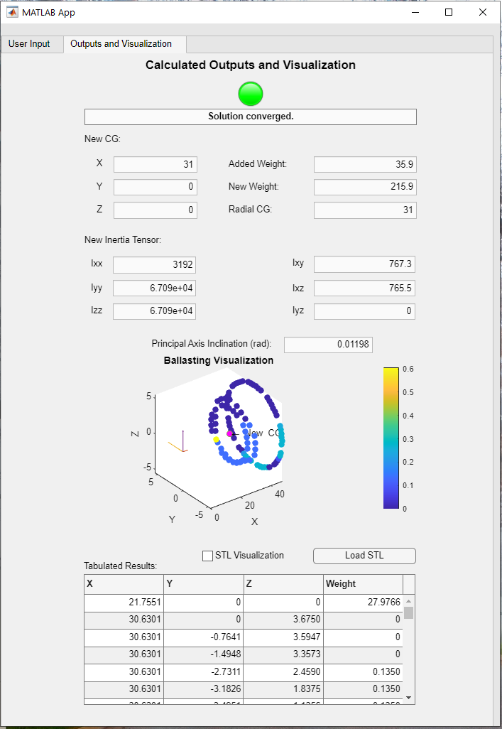
App GUI
Convergence/divergence indicator
Outputs added weight, new (total) weight, new CG coordinates, and new inertia tensor
3D plots the ballasting locations with the computed weights
Controls STL visualization and informs user of state
Tabulates the computed weights with their respective ballasting locations

Slide 5
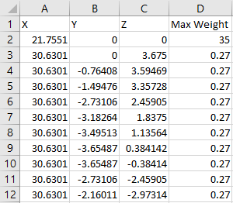
App Demo: Using the App
CUI
Tab 1: User Input
Step 1: Input current and desired mass properties
Step 2: Choose the solver algorithm
Step 3: Load in ballasting coordinates and their max weight from Excel sheet
  Example spreadsheet:
    Note the max weight column is the maximum weight that could be placed at that point
Step 4: Hit calculate
Optional Steps: STL Visualization and Export Data
CUI

Slide 6
App Demo: Results
CUI
Tab 2: Outputs and Visualization
Informs the user that the solution converges
Outputs new CG, new weight, and new inertia tensor
3D plots the ballast weights at their respective coordinates
Tabulates the ballast weights at their respective coordinates
CUI

Slide 7
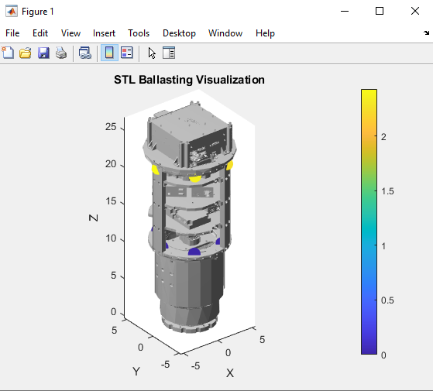
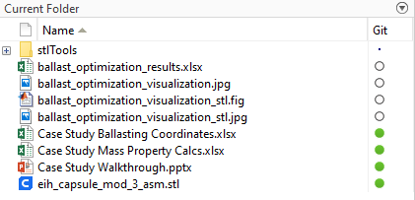
App Demo: Optional Results
CUI
If the STL visualization checkbox is marked, the user can upload an STL file and the weights at their respective coordinates will be plotted on the STL file in a separate MATLAB figure
If the Export Data switch is turned on, all of the numerical outputs will be exported into an Excel sheet in the user’s current working directory and the ballasting visualizations will be saved as a jpeg
  The STL visualization figure will be saved as a MATLAB figure
CUI

Slide 8
App Demo: Optional Results
CUI
If the STL visualization checkbox is marked, the user can upload an STL file and the weights at their respective coordinates will be plotted on the STL file in a separate MATLAB figure
If the Export Data switch is turned on, all of the numerical outputs will be exported into an Excel sheet in the user’s current working directory and the ballasting visualizations will be saved as a jpeg
  The STL visualization figure will be saved as a MATLAB figure
CUI

Slide 9
Changes From the Base Code

Slide 10
Changes from Base Code
CUI
MATLAB Optimizer app used to get ballast placements and weights doesn’t seem to work for Athena specific values
  Outputs one far too massive weight
  Places many small weights, so small they are insignificant
  Can’t take into account different types of ballast
    Some areas can take up to 20lbs where as others can only be .135lbs
  Doesn’t converge
  Doesn’t display convergence correctly
    States non-convergent due to floating point error
CUI

Slide 11
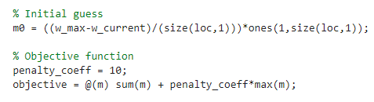
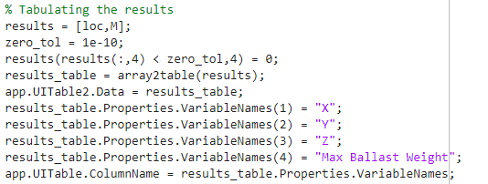
Large and Small Ballast Fix
CUI
Alter objective function to also minimize the value of largest weight
Created tolerance to round towards zero for better displayed results
CUI

Slide 12
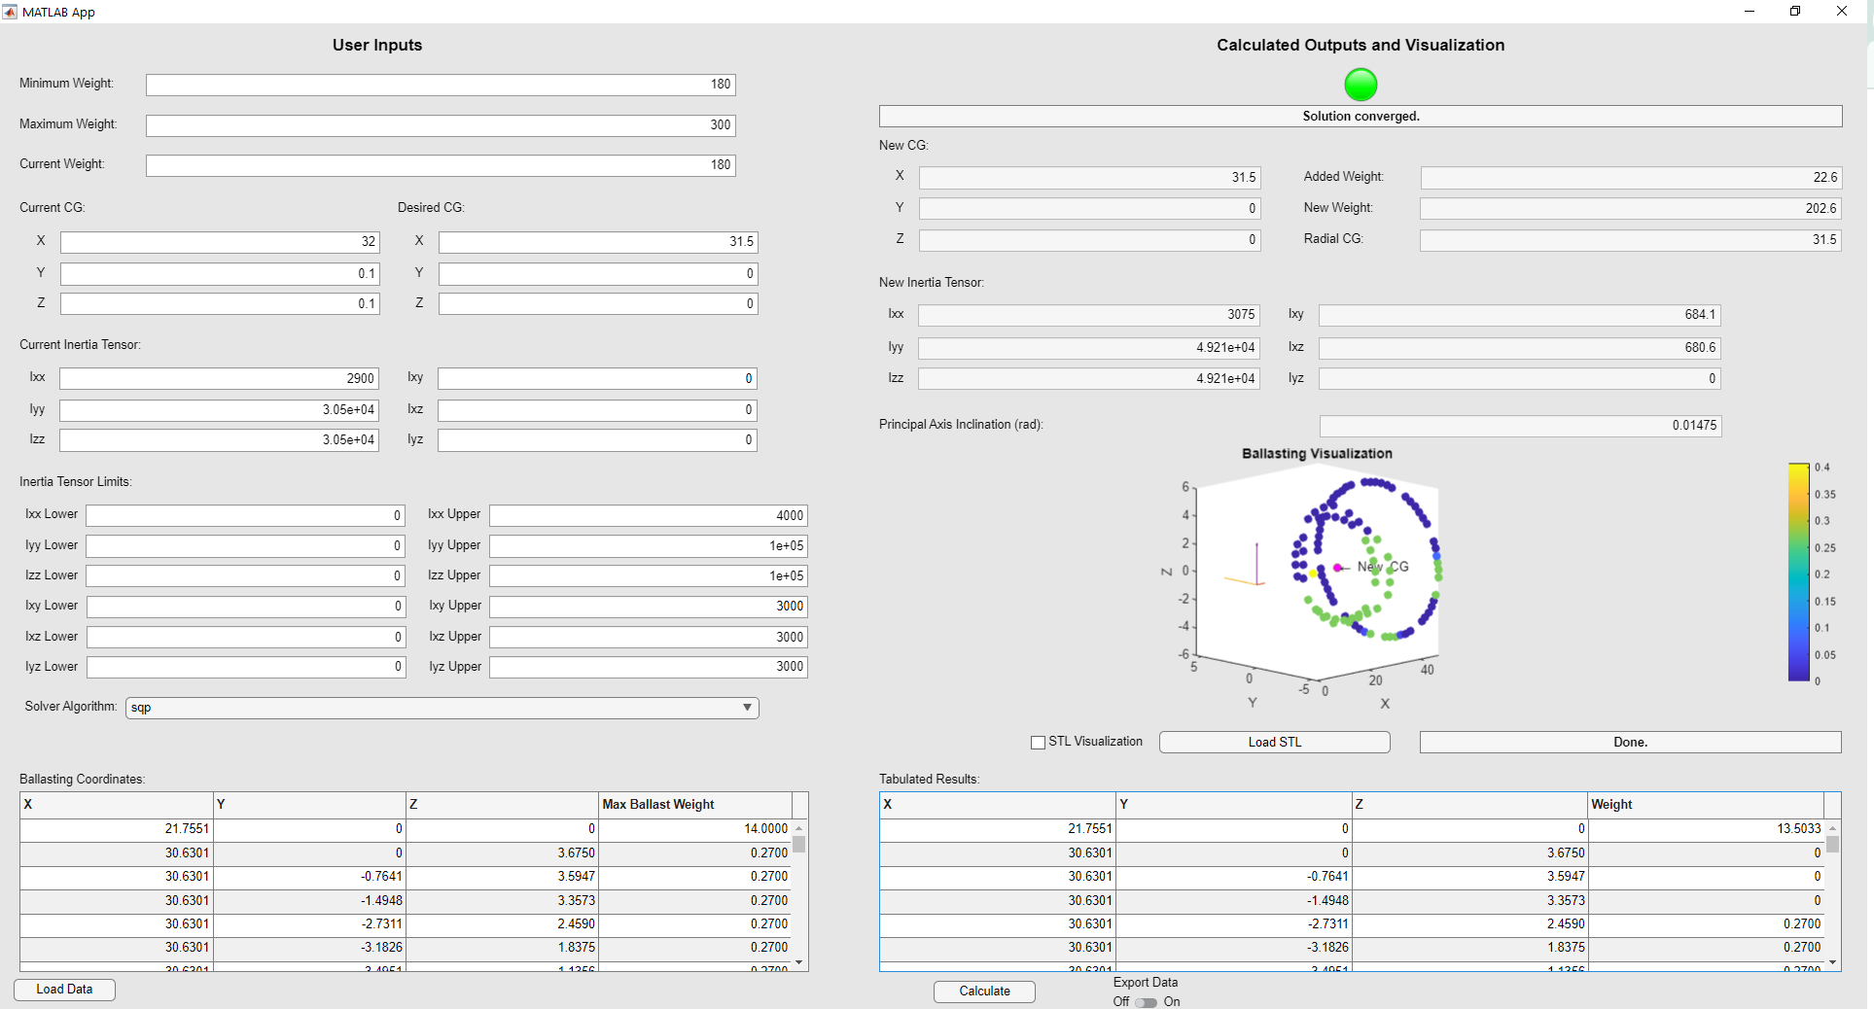
CUI
Input point data now includes a max weight available for each point
CUI

Slide 13
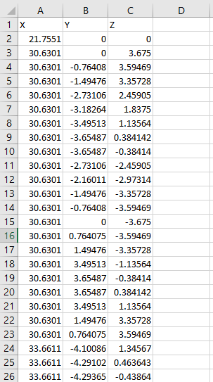
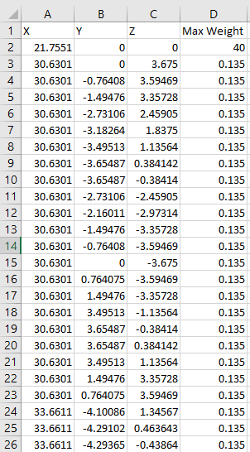
Different Ballast Types
CUI
CUI

Slide 14
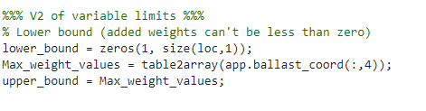
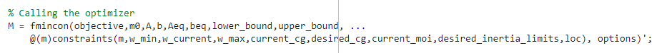
Different Ballast Types
Max weight values pushed into upper_bound variable

Slide 15
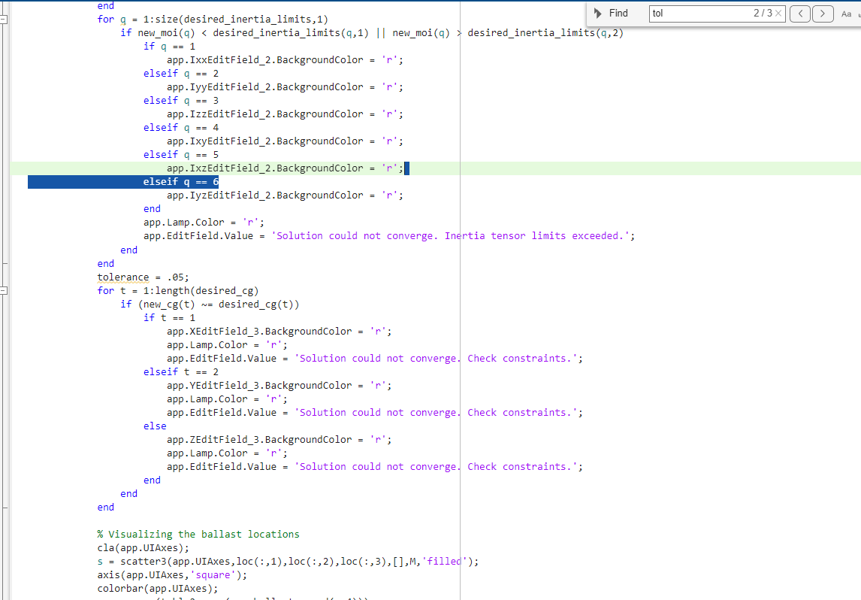
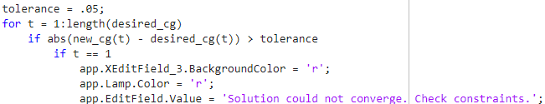
Athena
CUI
  Previously, convergence was determined by checking if goal values and new values were the same.
  Due to floating point error, I was able to create a scenario where the new and old CG’s were .0000000051 off and the program didn’t show convergence.
Previous:
Used a tolerance to avoid this problem
Updated:
CUI

Slide 16
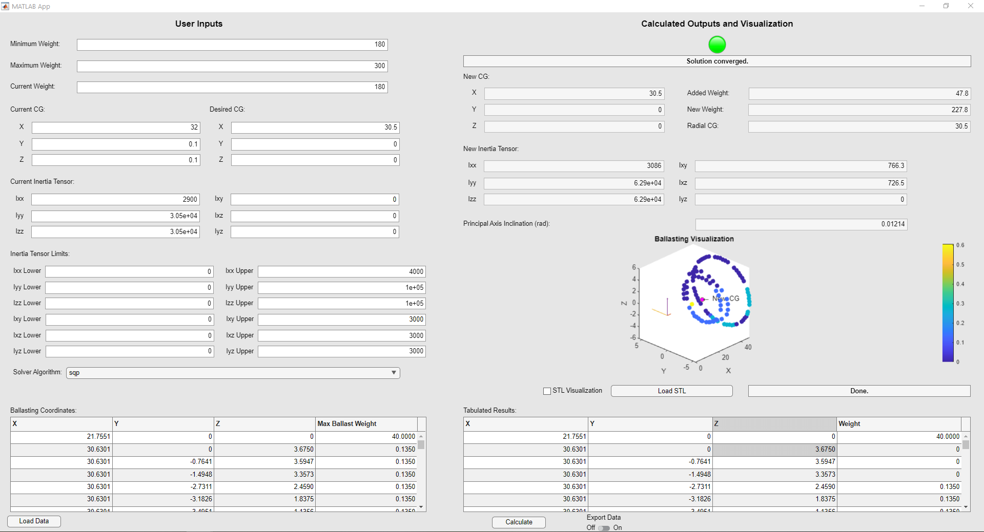
CUI
CUI

Slide 17
Future Updates

Slide 18
Future Work
CUI
On the current code base:
Implement MOI’s for ballast cartridges
Add user inputs for tolerancing and accuracy
  Make the UI more conducive to working with an ICD
On the project as a whole:
Implement genetic algorithm for underlying optimization
CUI

Slide 19
Future Work
CUI
Genetic Algorithm (GA)
This problem is extremely well suited for the use of a GA
  The discrete nature of the problem as well as the ability to “breed” individual solutions
Steps to Implement:
Generate N random solutions as a part of one generation
Rank those individuals based on some loss function
Take the top 50% and “breed” them by exchanging different aspects of the solution, creating a new generation
  Add some random variance to each solution as well
Take this generation and do steps 2-3 over again until the loss function evaluates below a certain value
Note: speak with David Wolmark, he may offer more guidance than I have outlined here and expressed interest in this solution.
CUI

Slide 20
Future Work
Information on genetic algorithms
https://www.geeksforgeeks.org/genetic-algorithms/
https://www.youtube.com/watch?v=XP2sFzp2Rig
https://www.youtube.com/watch?v=uQj5UNhCPuo

