Slide 1
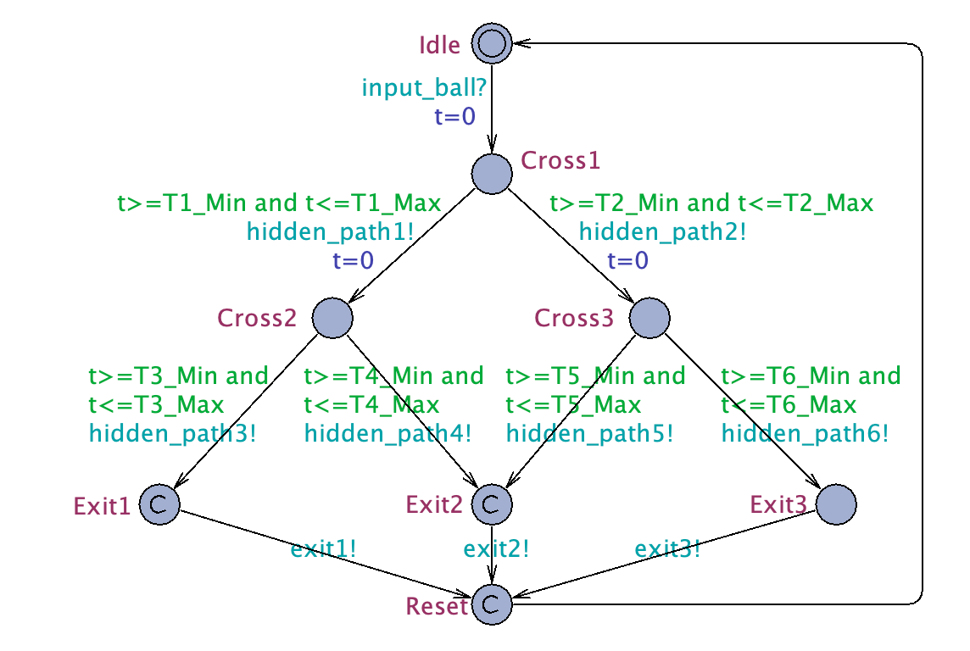
input_ball
exit1
exit2
exit3

Slide 2
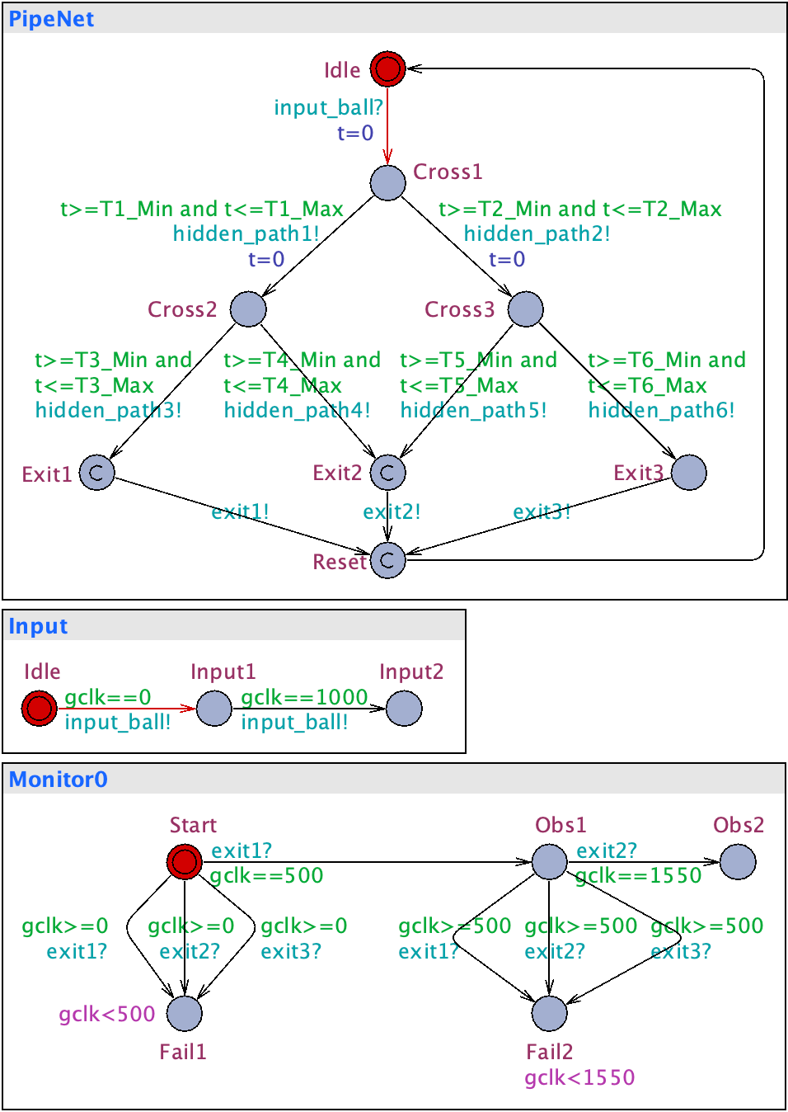
Communication Graph
对问题对描绘基于 Process
(NTA)
Communication Graph：抽象
PipeNet
exit1, exit2, exit3
Monitor0
Input_ball
Input

Slide 3
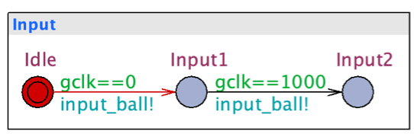
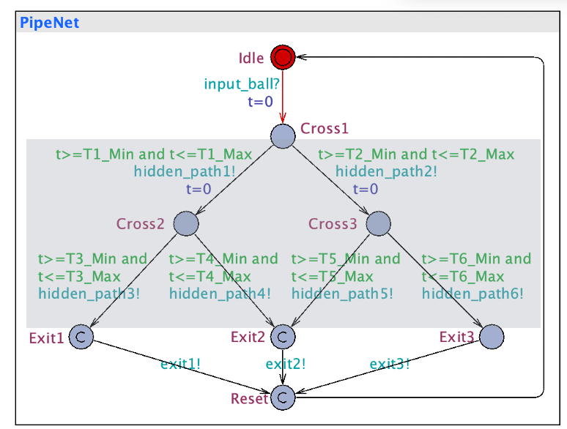

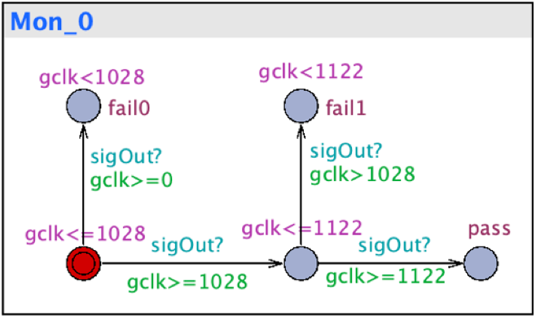

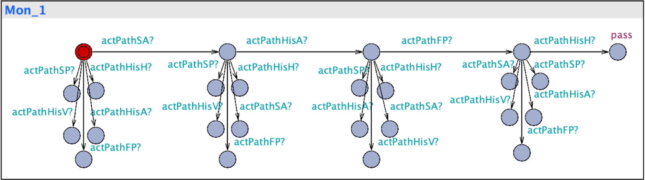
All patterns
control
Input
Environment
observe
Monitor
E<> Mon0.pass and not Mon1.pass
Unobservable
Hidden Actions H, or internals)
Focused Actions
All patterns, 基于Focused Actions，

Slide 4
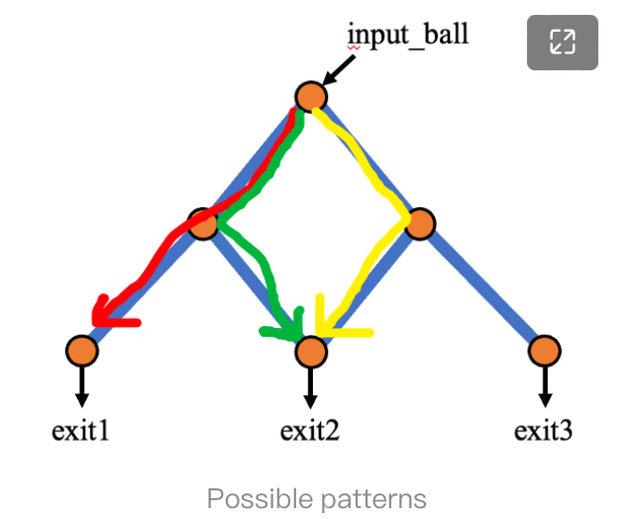
All patterns
exit1
exit2

Slide 5
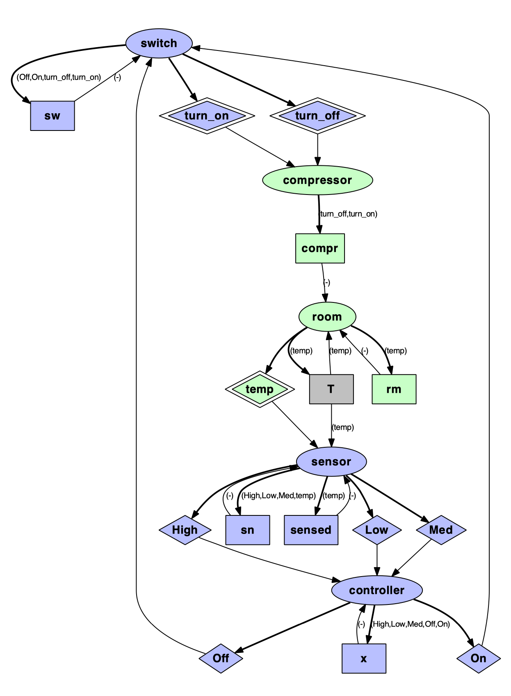
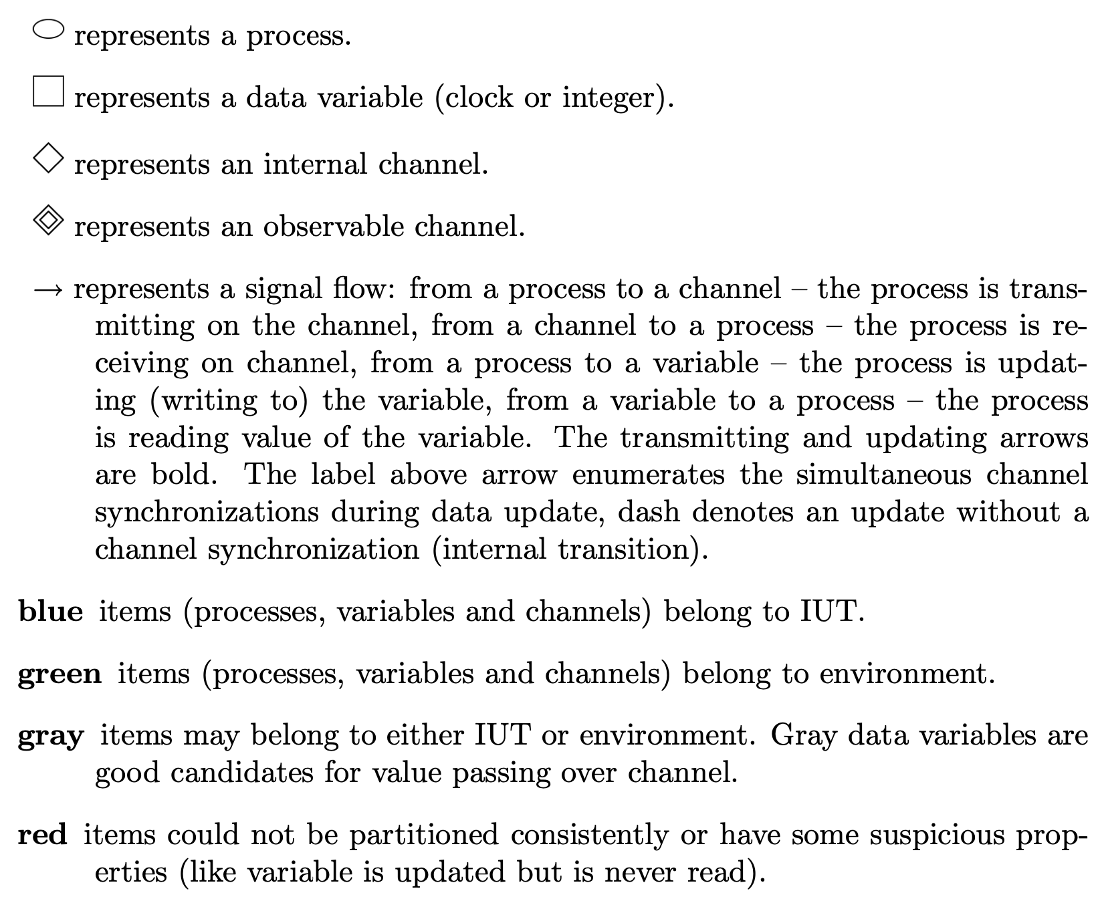

Slide 6
基于state-signal
基于process-signal
1-Input_ball,
2-hidden_path1,
3-hidden_path3,
4-exit1
PipeNet
2
3
Monitor1
4
1
4
Input
Monitor0

Slide 7
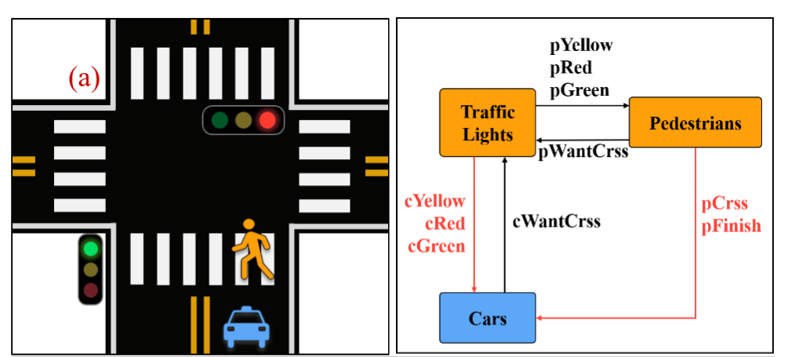
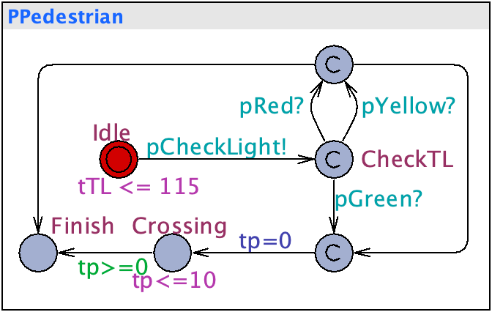
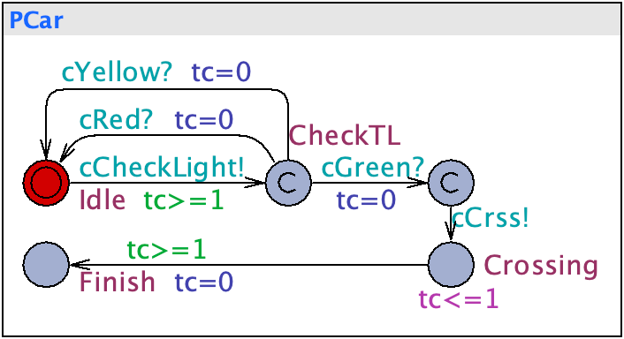
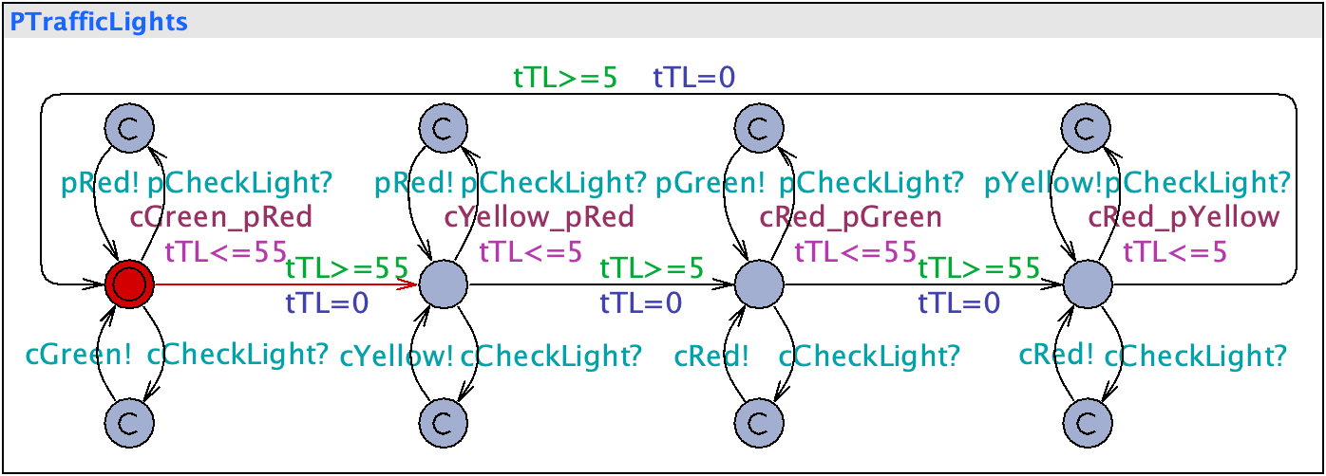

Slide 8
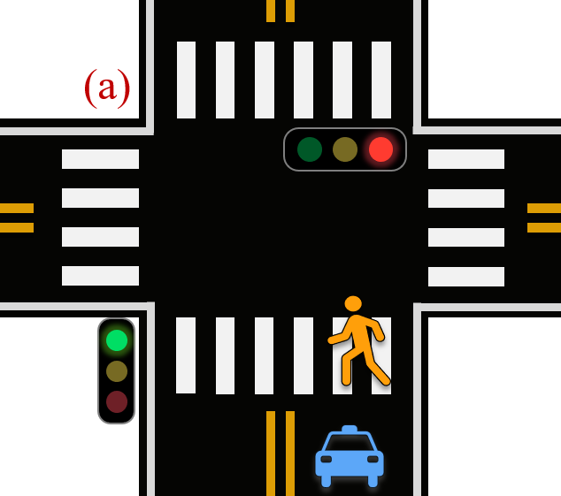

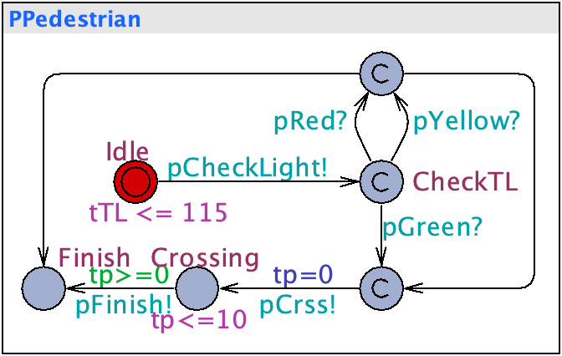
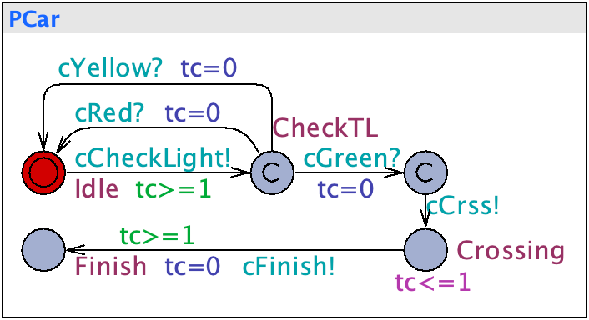
(a)
pYellow
pRed
pGreen
Traffic Lights
Pedestrians
pCheckLight
cYellow
cRed
cGreen
pCrss
pFinish
cCheckLight
Cars
(b)
(C)

Slide 9
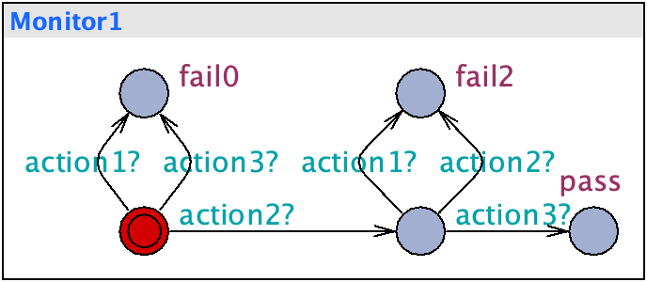
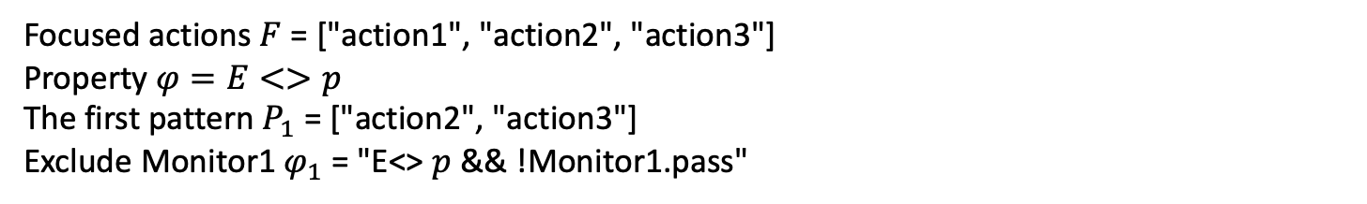


(a)
$$F\backslash P_{1}[0]$$
$$F\backslash P_{1}[1]$$
Focused actions $F$ = ["action1", "action2", "action3"]
Property $φ=E<>p$
The first pattern $P_{1}$ = ["action2", "action3"]
Exclude Monitor1 $φ_{1}$ = "E<> $p$ && !Monitor1.pass"

Slide 10
