Slide 1
Kiddi ML in the Future
Kiddi ML team

Slide 2
Past lead-patients prediction
idd | value 1 sd | value 1 last | value 2 sd | value 2 last
801 | 0.02963291 | 0.72411471 | 0.90508374 | 0.39355469
802 | 0.6949869 | 0.78817615 | 0.0829684 | 0.15047007
803 | 0.30516413 | 0.14882734 | 0.89561599 | 0.88168794
1 record means one idd
Features are not related to patient’s current situation
Only predict the next two months of patients’ last record
Lack of diversity of features
Dataset is too small

Slide 3
New version of data
idd | ft_data_dt | value 1 sd_3_mth | value 1 last_3_mth | value 1 sd_6_mth | value 1 last_6_mth | value 2 sd_3_mth | value 2 last_3_mth | value 2 sd_6_mth | value 2 last_6_mth
801 | 2017-08-31 | 0.90170261 | 0.20935418 | 0.58465696 | 0.68570285 | 0.58118469 | 0.50079041 | 0.05173282 | 0.17759721
802 | 2017-08-31 | 0.94532727 | 0.4354054 | 0.44139455 | 0.18976521 | 0.42406274 | 0.90734699 | 0.50707475 | 0.8638016
803 | 2017-08-31 | 0.54247213 | 0.41867912 | 0.44249404 | 0.94295472 | 0.94256728 | 0.49585307 | 0.21460734 | 0.02259867
801 | 2017-09-31 | 0.16346355 | 0.13343554 | 0.09052669 | 0.01361766 | 0.73768988 | 0.63190917 | 0.33618829 | 0.97740608
802 | 2017-09-31 | 0.28527757 | 0.31017681 | 0.14244 | 0.03126989 | 0.44469921 | 0.31012495 | 0.86561231 | 0.1576043
803 | 2017-09-31 | 0.43247604 | 0.62690299 | 0.74459183 | 0.16433329 | 0.49630157 | 0.3173756 | 0.30914268 | 0.97027751
1 record means one idd and one ft_data_dt
Partitioned data by ft_data_dt
Features are related to patient’s current situation
Only predict the next two months of patients’ infected likelihood in every month with the latest data
Dataset is will be enlarged
Train, Validation, Test period can be selected by duration of ft_data_dt

Slide 4
New model
Lag months : 2
Target Creating
Train period : 2016-02-29 to 2017-04-30
idd | Infected_date
801 | 2017-05-01
idd | ft_data_dt
801 | 2017-05-31
801 | 2017-06-30
801 | …
801 | 2021-08-31
Target (infected) | count
0 | 5565
1 | 1602
Validation period : 2016-02-29 to 2017-04-30 with sample of 0.4
Target (infected) | count
0 | 2209
1 | 658
Test period : 2017-05-31 to 2017-06-30
Target (infected) | count
0 | 989
1 | 407

Slide 5
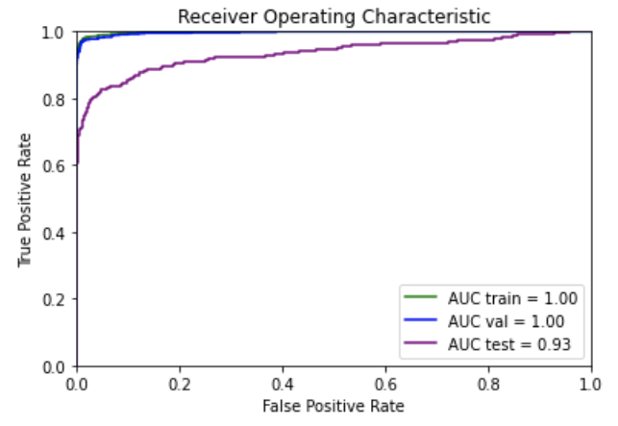
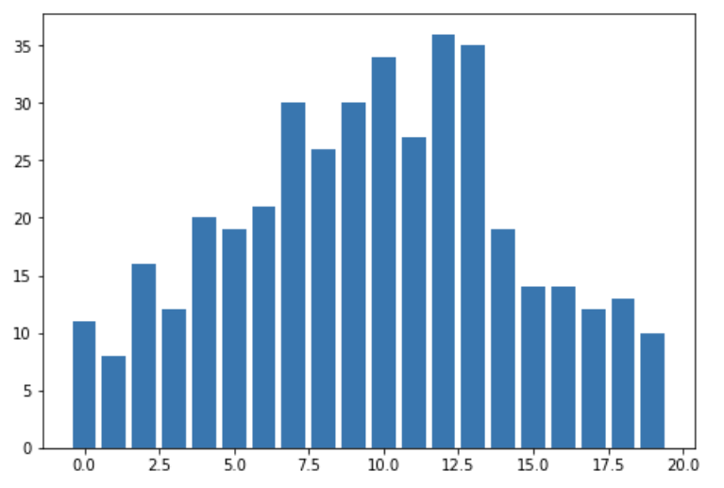
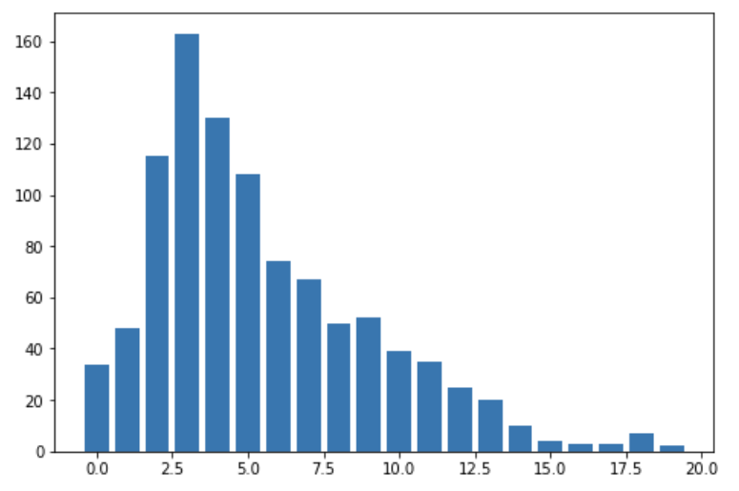
Result
feature | value | cum_value
qLymphVal_min_12mth | 0.02551188 | 0.02551188
qLymphVal_min_9mth | 0.02047812 | 0.04599
qNeutrophilsVal_max_12mth | 0.01937652 | 0.06536651
PDVintage | 0.01850582 | 0.08387233
zscore_age_qCreatCon4HrCorUnit_sum_12mth | 0.01816452 | 0.10203685
qNeutrophilsVal_max_9mth | 0.01765104 | 0.11968789
PatientAge | 0.01489728 | 0.13458516
zscore_age_qExch4CAPDOtherSolType_sum_12mth | 0.01479989 | 0.14938506
zscore_age_BactInfec_sum_12mth | 0.01454817 | 0.16393323
zscore_age_qWeightVolVitalVal_sum_9mth | 0.01383211 | 0.17776534
AUC Train | AUC Validation | AUC Test
1.00 | 1.00 | 0.93
Bins of tests of infected patients
Bins of tests of non infected patients

Slide 6
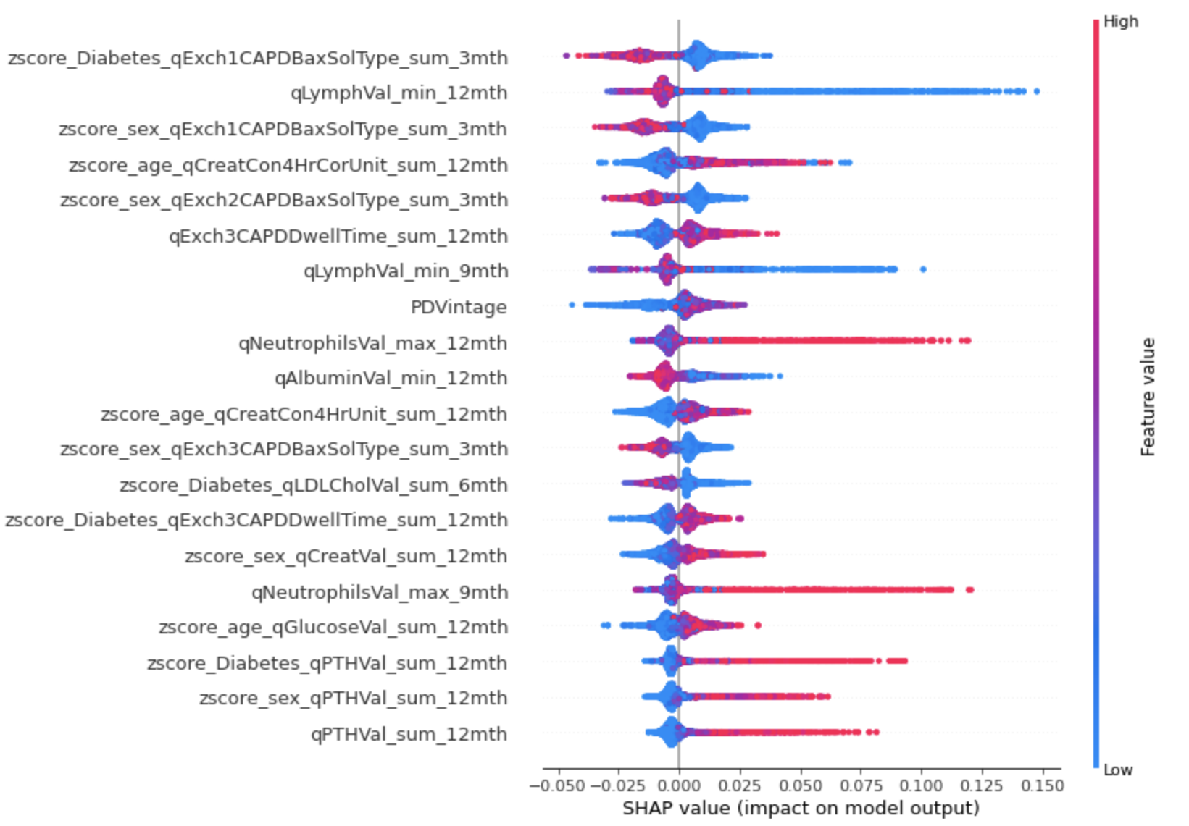
Shap plot

Slide 7


How to keep data?
Model 1
Model2
Cleane data
Feature
Engineer
Excel file
Cleaned Data
FeatureStore
Model 3
Everyone can create his/her
feature, then upload to feature store.
Prediction score can also be uploaded to feature store as well.
There will be script to pull the data from cleaned data to
engineer feature every month.
Model can get feature by joining by [‘idd’, ‘ft_data_dt’]

Slide 8
Combine tables
FeatureStore
idd | ft_data_dt | feature 1 | feature 2
801 | 2017-09-31 | 0.6962524 | 0.25721654
802 | 2017-09-31 | 0.22980312 | 0.79995755
803 | 2017-09-31 | 0.97886255 | 0.89726567
idd | ft_data_dt | target
801 | 2017-11-30 | 1
802 | 2017-11-30 | 0
803 | 2017-11-30 | 1
idd | ft_data_dt | feature 1 | feature 2 | target
801 | 2017-09-31 | 0.34734258 | 0.34455954 | 1
802 | 2017-09-31 | 0.02662759 | 0.46452912 | 0
803 | 2017-09-31 | 0.35361085 | 0.8766037 | 1
Can be incorporate with lag_target.

Slide 9
Combine tables
Table 1
idd | ft_data_dt | feature 1 | feature 2
801 | 2017-09-31 | 0.6962524 | 0.25721654
802 | 2017-09-31 | 0.22980312 | 0.79995755
803 | 2017-09-31 | 0.97886255 | 0.89726567
Table 2
idd | ft_data_dt | target
801 | 2017-11-30 | 0
802 | 2017-11-30 | 0
803 | 2017-11-30 | 1
idd | ft_data_dt | feature 1 | feature 2
801 | 2017-09-31 | 0.6962524 | 0.25721654
802 | 2017-09-31 | 0.22980312 | 0.79995755
803 | 2017-09-31 | 0.97886255 | 0.89726567
It is crucial that the doctor record both infected and non-infected result.
Table 3
idd | ft_data_dt | feature 1 | feature 2
801 | 2017-09-31 | 0.6962524 | 0.25721654
802 | 2017-09-31 | 0.22980312 | 0.79995755
803 | 2017-09-31 | 0.97886255 | 0.89726567
Target.join(table, on=[‘idd’, ‘ft_data_dt’], how=‘left’)

Slide 10
Prediction model choices
Supervised learning
Tree based model
Unsupervised learning
Embedding patients’ information
May use LSH, etc.
Using infected patients as seeds
May consider utilizing dynamic time warping

