Slide 1
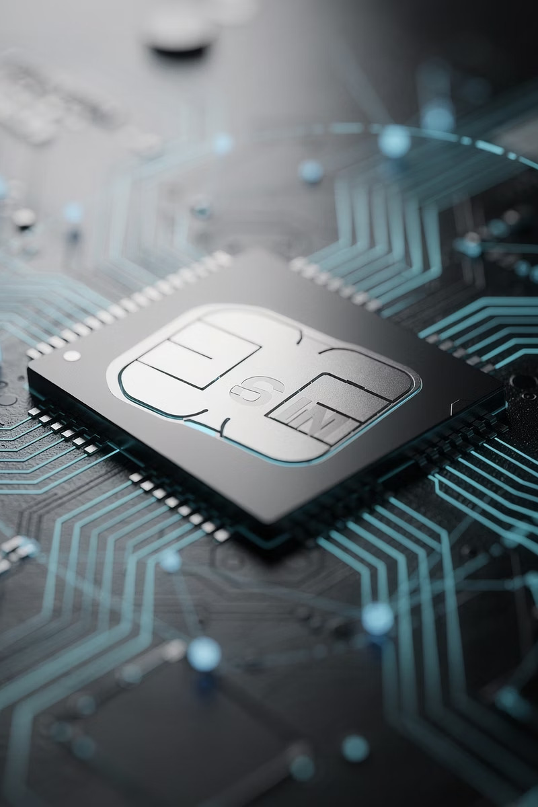
Streamax eSIM Solutions
Streamax Technology · June 2026
LOWER TCO
HIGHER UPTIME
01
02
Current Painpoints
The Streamax eSIM
03
04
Form Factors & Data Plans
FT Cloud Platform

Slide 2
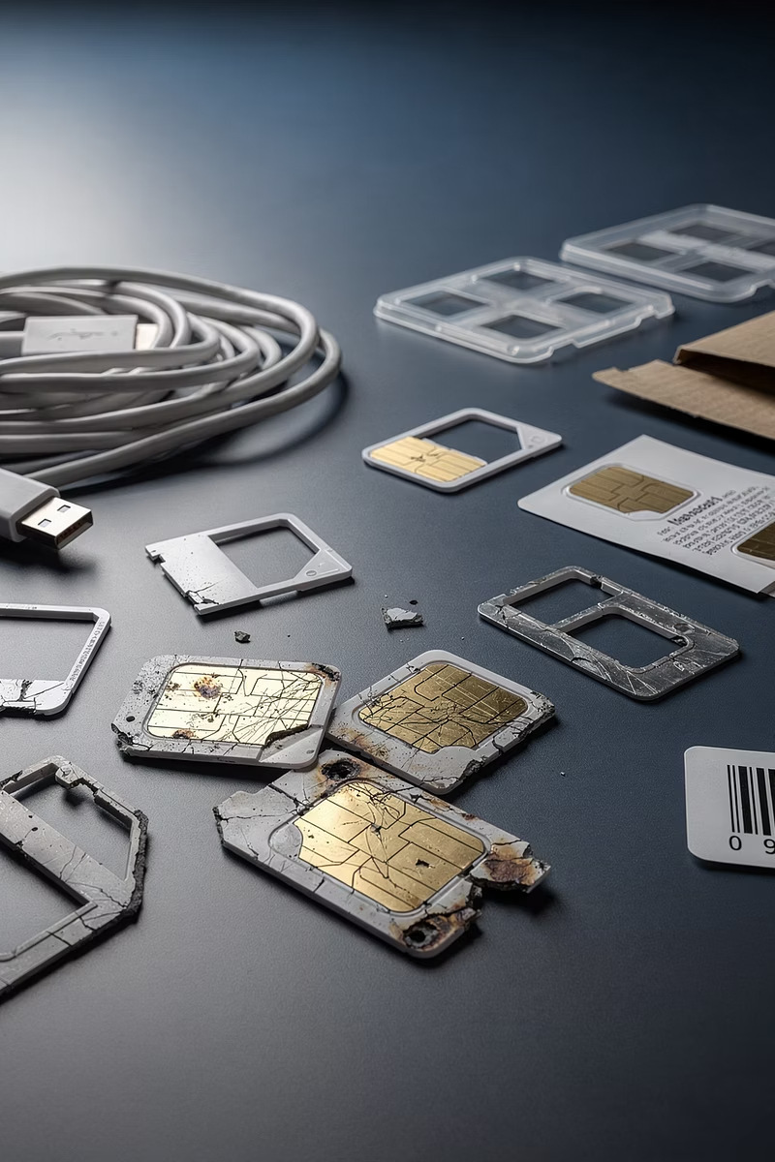
01
Current Painpoints & Challenges
1
2
Self-Sourced SIMs
SIM Malfunction
Clients buy and install SIMs themselves; re-pack costs ~$10–15 per unit. Factories cannot reliably test overseas SIMs before shipment.
Plastic SIMs degrade under heat; 2–3 years later data silently fails, causing false RMAs and serious reputation risk.
3
Hidden Costs
Truck rolls and unplanned downtime add significant operational expense that rarely appears in initial procurement budgets.

Slide 3
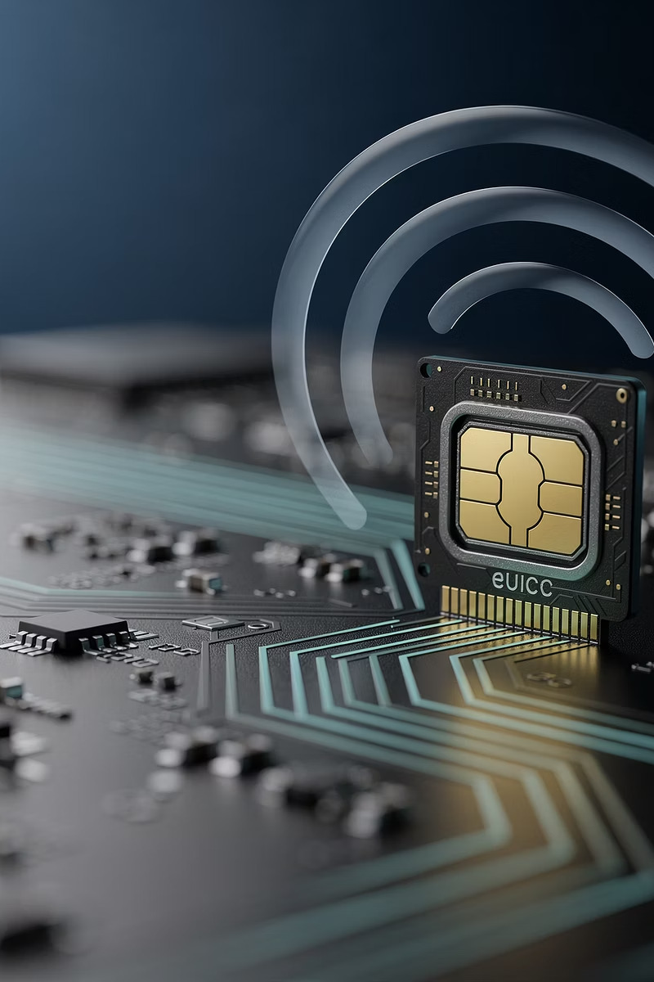
02
eSIM Explained
What is an eSIM?
What is an eUICC?
A tiny built-in SIM chip inside a device (dashcam, tracker, MDVR). Instead of inserting a plastic SIM, you download a carrier profile — like installing an app. Activate, switch carriers, or change plans remotely — no opening devices, no swapping cards.
Embedded Universal Integrated Circuit Card — the underlying architecture and standard for eSIMs. It lets a device remotely download, store, and switch between multiple network operator profiles OTA (over the air) — the foundation that makes remote carrier changes possible.

Slide 4
BOTH AVAILABLE
Two SIM Form Factors
Choose the right physical SIM for each deployment — we support both.
Triple-Cut SIM Card
MFF2 (Soldered)
Removable · Mini / Micro / Nano
M2M Form Factor · Chip on board
A standard removable SIM in a triple-cut frame — exactly like the SIM you slot into your phone. Pop it out in three sizes to fit any device. Easy to swap in the field or pre-provision per region.
An industrial SIM soldered directly onto the device board. No moving parts and no slot to corrode — immune to vibration, moisture, and thermal stress. Built for sealed, automotive-grade deployments.
✓ Field-swappable
✓ Vibration-proof
✓ Familiar format
✓ Sealed & tamper-resistant
✓ Pre-provision per region
✓ Automotive-grade

Slide 5

Why Streamax eSIM?
✓
Proven Reliability
Automotive-grade hardware engineered for the harshest fleet environments — heat, vibration, and continuous operation.
↑
OTA Management
Activate, switch carriers, and update policies remotely. No truck rolls, no device disassembly, no downtime.
$
Lower Total Cost
Eliminate re-packaging fees, reduce field visits, and gain full cost visibility with per-device telemetry and automatic caps.
◆
Single Partner SLA
One point of contact for hardware, connectivity, and diagnostics. Faster resolution, clearer accountability.

Slide 6
VALUE PROPOSITIONS
Uptime & Provisioning
▲
Higher Uptime, Fewer Mystery Outages
→
Zero-Touch Provisioning & Faster Rollouts
⇄
Carrier Agility Without Hardware Swaps
Automotive-grade eSIMs tolerate heat and vibration far better than plastic SIMs, preventing the 2–3 year degradation that causes silent data loss. Fewer false camera failures, fewer RMAs, more reliable video uploads.
Ship sealed devices; activate, assign APNs, and set policies over the air. Bulk provisioning (IMEI ↔ ICCID mapping), policy templates, and automated QA cut weeks from deployment timelines.
Multi-profile eUICC lets you switch carriers / IMSI OTA — ideal for coverage gaps, roaming costs, or 2G/3G sunsets. Choose LTE Cat-1 / Cat-M / NB-IoT profiles per region without touching the truck.

Slide 7
VALUE PROPOSITIONS
Performance & Maintenance
▶
Better Video Telematics Performance
●
Stronger Security & Compliance
Private APN/QoS options, pooled data, and burst allowances keep alert clips and evidence uploads flowing during spikes — collisions, storm events, and audits.
Private APN/VPN, IMEI lock, SIM theft prevention, and audit trails at the line level. Centralized policy means fewer misconfigurations in the field.
◆
One Partner, One SLA
▣
Deep Diagnostics & Cost Control
Hardware + connectivity + diagnostics under a single support model. Our NOC monitors device/SIM health so issues are resolved faster with clearer ownership.
Per-device telemetry on signal, registration state, fallback behavior, and data usage. Automatic alerts, caps, and remote suspend/resume — no more bill shocks.

Slide 8
VALUE PROPOSITIONS
TCO: Total Cost of Ownership
TCO is the complete cost of owning and operating an asset over its entire lifecycle — purchase price, operational costs, maintenance, and eventual disposal.
→
→
Lower Total Cost
Future-Proofing
No re-packaging fees, no client labor to open / install / repack, and far fewer site visits from SIM faults. A single truck roll avoided often offsets months of connectivity fees.
eUICC keeps you ready for new radio profiles (e.g., LTE-M / NB-IoT or 5G RedCap) as networks evolve — without hardware changes or field visits.

Slide 9
FLEXIBLE BY DEFAULT
Data Plans & Dynamic Pooling
WORKED EXAMPLE — 3 GB / DEVICE / MONTH
Every Streamax data plan defaults to a dynamic pool. Pick a per-device allowance and your shared monthly pool scales automatically as devices join the fleet — no per-SIM overage juggling, usage is shared across every device.
3 GB
1 device
3 GB / mo pool
30 GB
3 GB
×
N
=
Shared monthly pool
10 devices
PER DEVICE / MO
DEVICES
(3 × N) GB / MONTH
10 × 3 GB
✓ Data is shared fleet-wide — no stranded per-SIM allowances and no manual top-ups.
33 GB
11 devices
+1 device = +3 GB

Slide 10
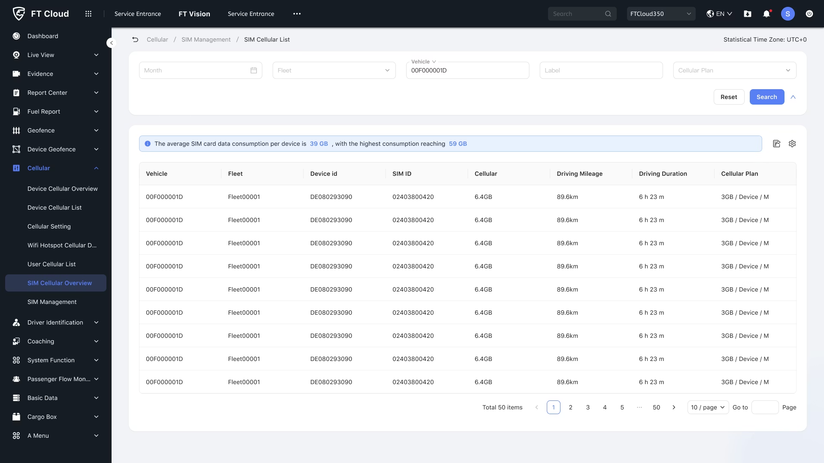

Slide 11
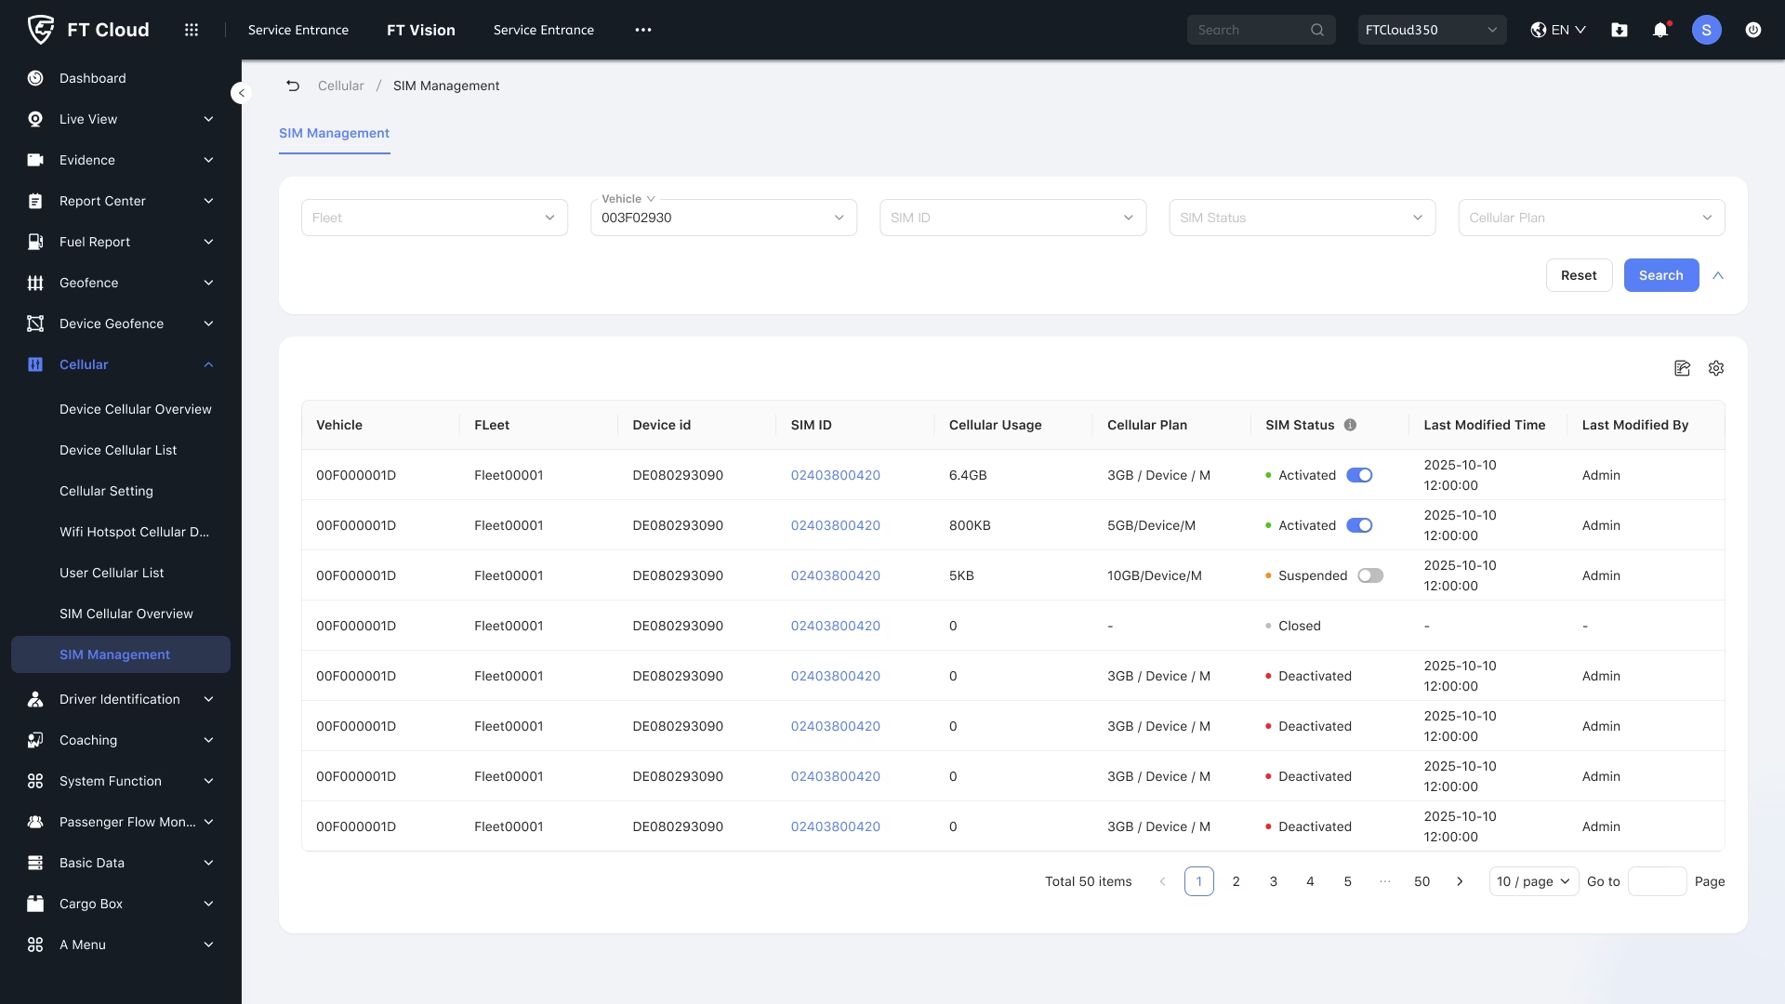

Slide 12
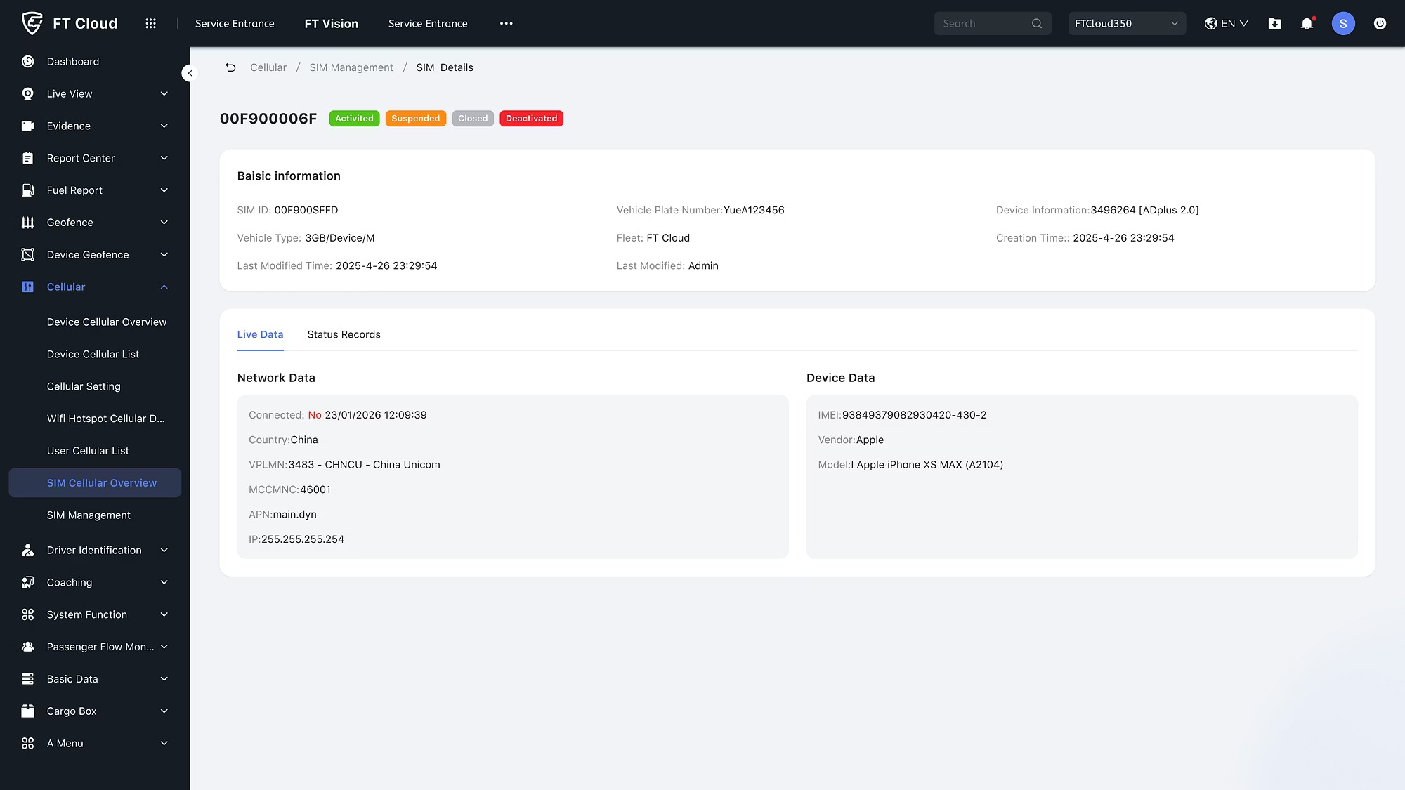

Slide 13
