Slide 1
CSC14008 – Pattern Recognition
Lastterm Project Seminar
Face Detection
––– Group 7 –––

Slide 2
About Face detection
The first step in automatic face recognition pipeline.
Given an image or a video frame as input, the output consists of bounding boxes containing the coordinates and dimensions of the detected faces.
Be formulated as a binary classification problem.

Slide 3
I. Related works

Slide 4
Adaboost-based method
Strong classifier from weak ones: AdaBoost combines multiple weak classifiers into a strong one by assigning optimal weights based on performance.
Cascade structure for efficiency: Viola–Jones uses a cascade of classifiers – simple stages reject non-face regions early, reducing computation time.
Limitation: Relies on handcrafted low-level features, which perform poorly under uncontrolled conditions (e.g., lighting, pose, occlusion) and lack context awareness.

Slide 5
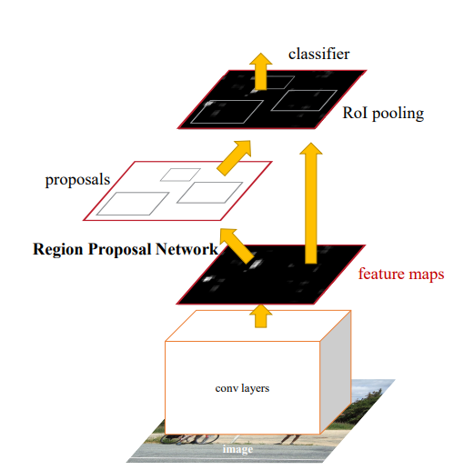
Faster R-CNN
Faster R-CNN is a single, unified network for object detection. The RPN module serves as the “attention” of this unified network
The picture from paper Faster R-CNN: Towards Real-Time Object Detection with Region Proposal Networks

Slide 6
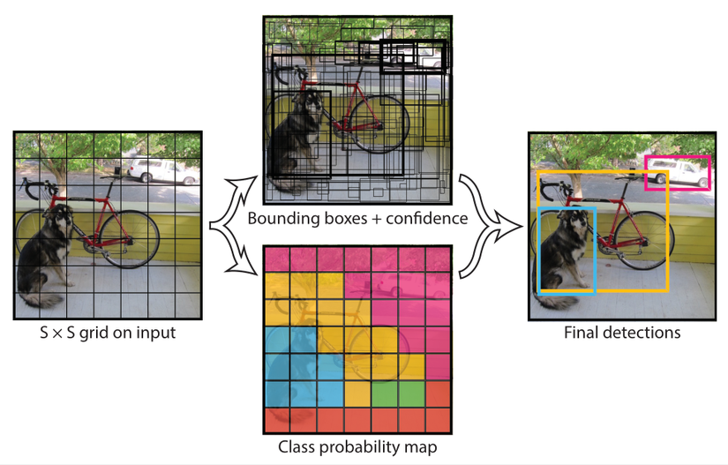
The idea of YOLOv5

Slide 7
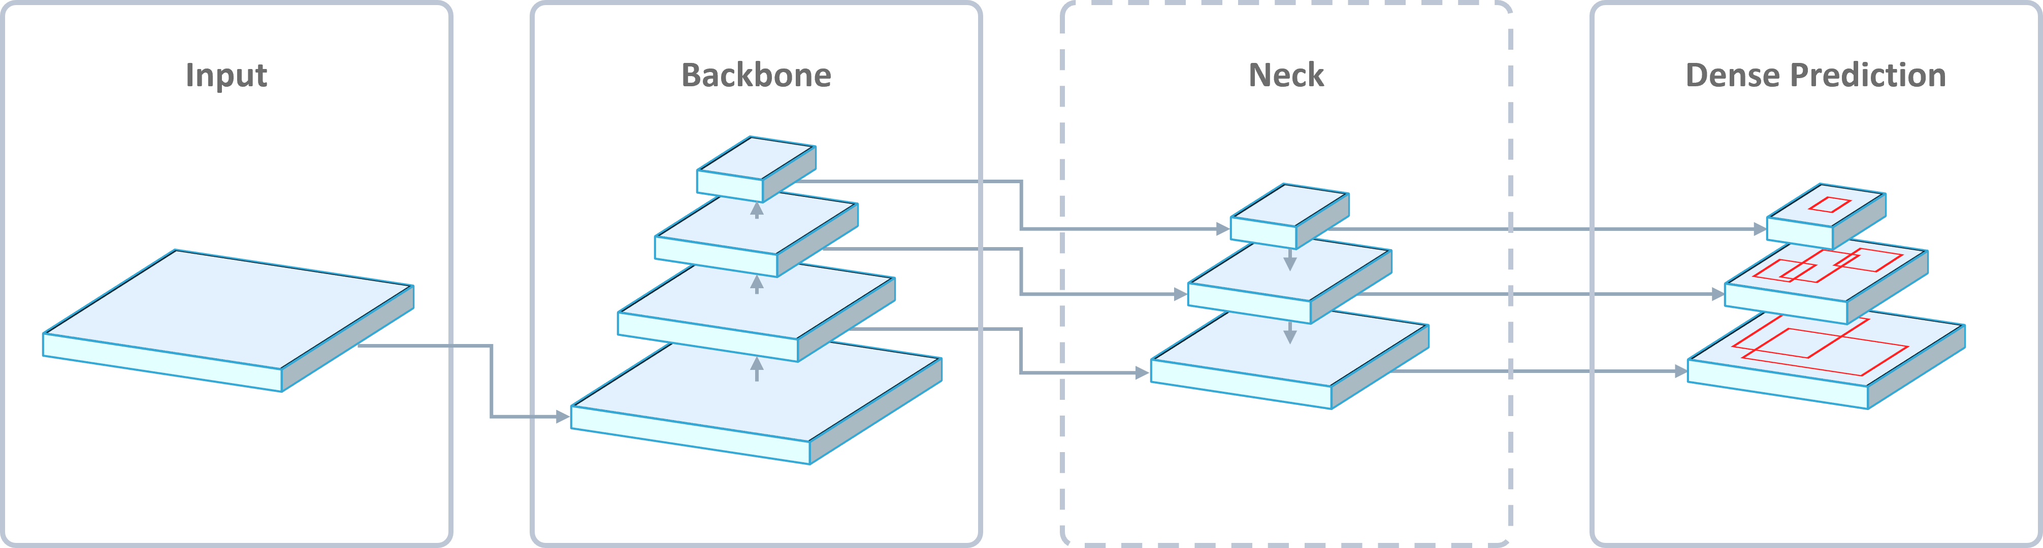
The architecture of YOLOv5

Slide 8
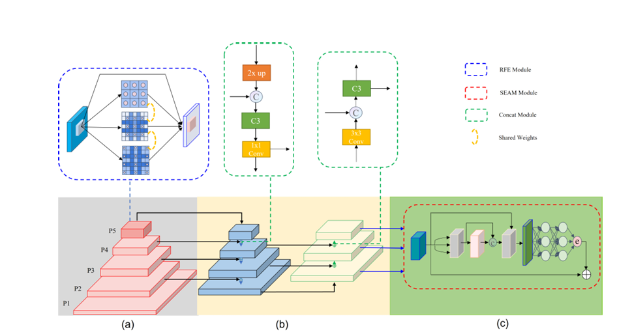
YOLO FaceV2
Network architecture of YOLO-FaceV2.
Backbone
Neck
a Separated and Enhancement Attention Module (SEAM) uses the relationship between feature maps to recall occluded features which is shown in the red dotted box.

Slide 9
II. Proposed method

Slide 10
Architecture of backbone
RFE instead of Bottleneck
P5
P4
P3
P2
P1

Slide 11
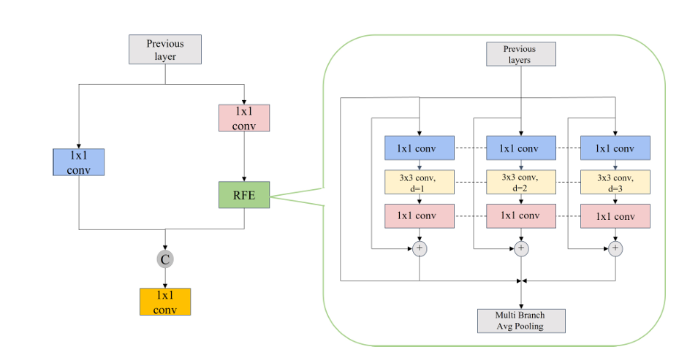
RFE Module
The picture from paper YOLO-FaceV2: A Scale and Occlusion Aware Face Detector

Slide 12
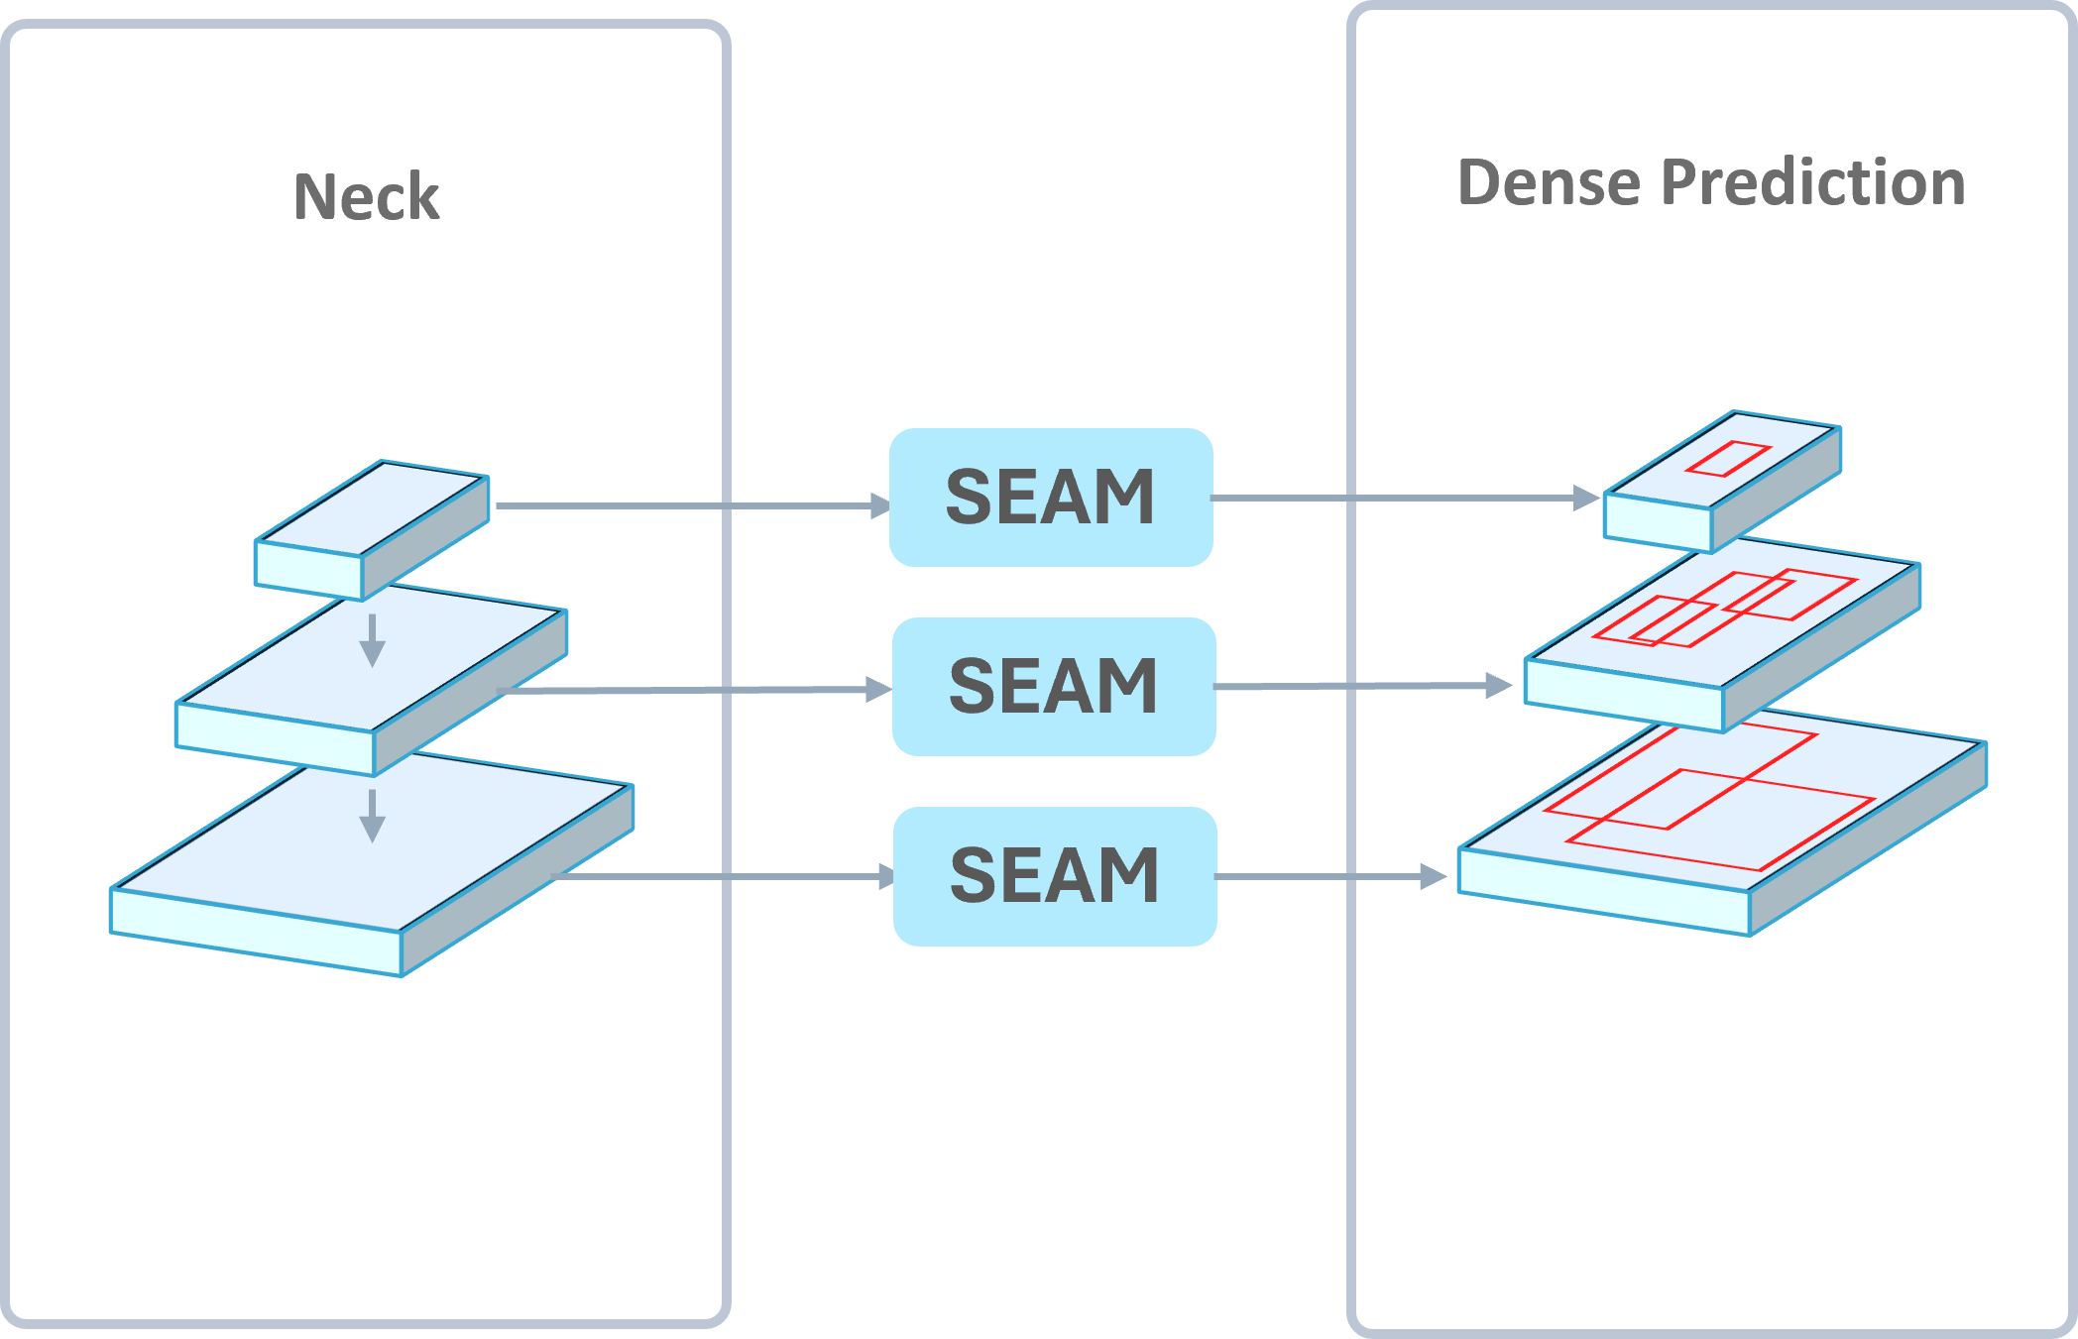
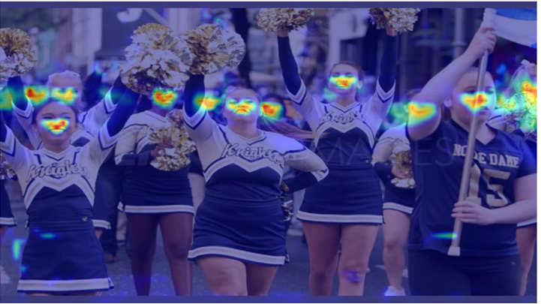
_____________ SEAM

Slide 13
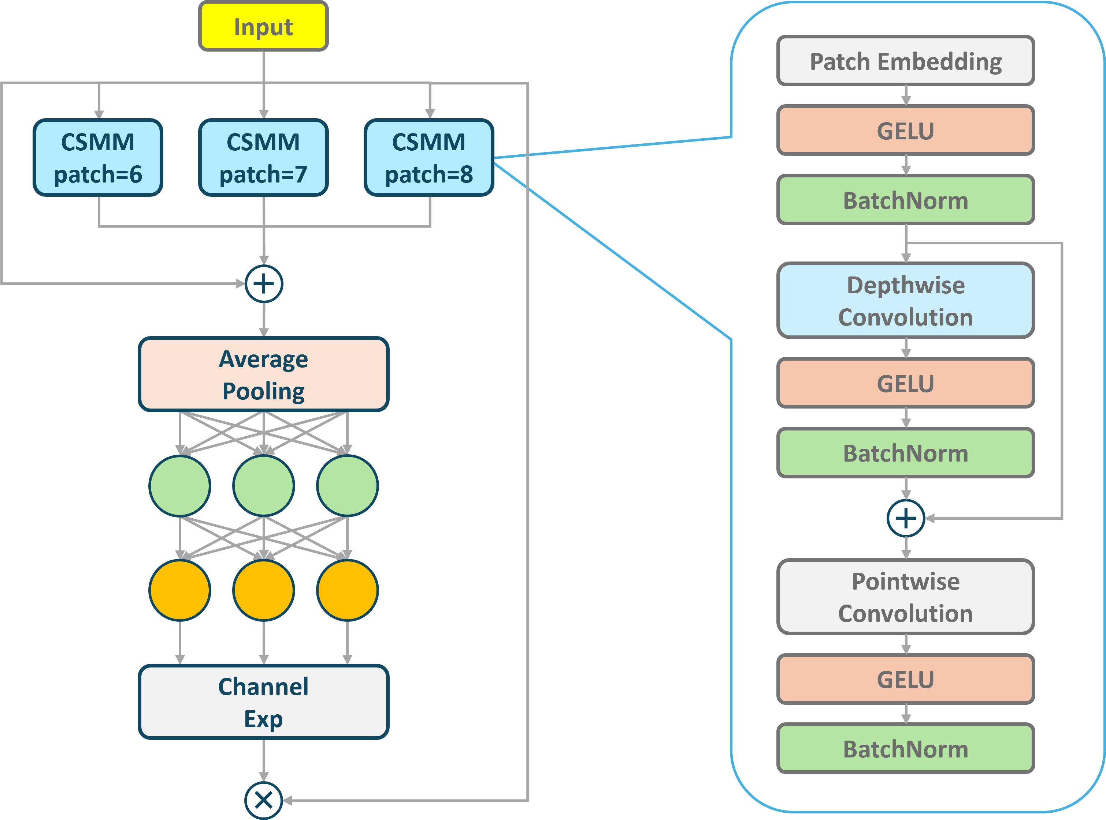
The architecture
of SEAM

Slide 14


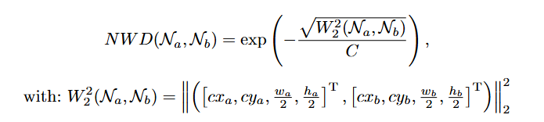



Loss functions
IoU loss:
Normalized Wasserstein Distance (NWD) loss:
Repulsion loss:

Slide 15
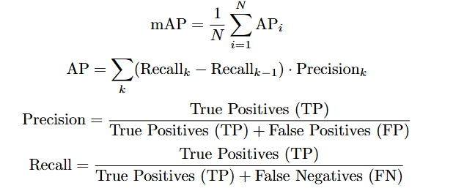
Accuracy metric: mean Average Precision (mAP)
Measures the overall effectiveness of a model by averaging its precision across all levels of recall, based on the Precision-Recall (PR) curve.
mAP:
AP:
Precision:
Recall:

Slide 16
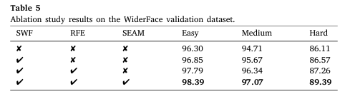
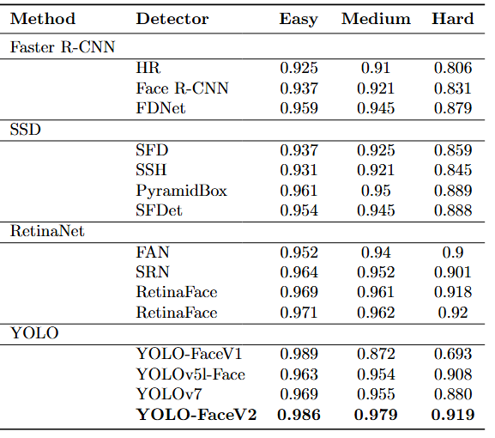
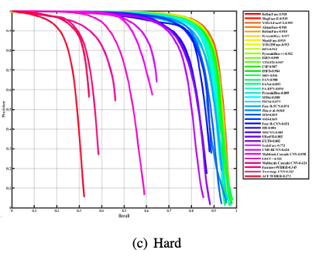
Experiments in the paper

Slide 17
III. Our Experiments

Slide 18
Hardware used
The experiments were carried out using the following hardware configuration:
OS: Debian GNU/Linux 12 (bookworm) x86_64
CPU: AMD Ryzen 5 6600H with Radeon Graphics (12) @ 3.300GHz
GPU: NVIDIA GeForce RTX 3050 Mobile
RAM: 16 G

Slide 19
Dataset Selection
In our experiments, we used two datasets: WIDER FACE and DARK FACE, each serving a different purpose.
WIDER FACE was used solely for comparison with the original research. Since the model was pre-trained onthis dataset, our evaluation on WIDER FACE serves as a sanity check to confirm consistency with publishedresults. Covers a wide range of conditions including variations in scale, pose, and occlusion.
DARK FACE is the main dataset we selected for evaluation. It is specifically designed to test face detection per-formance under extremely low light conditions, one of the most challenging environments for current detectors.

Slide 20
Experimental results
 | WIDER FACE | DARK FACE
Confidence threshold | 0.02 | 0.02
IoU threshold | 0.5 | 0.5
Calculation method | Pascal VOC | Pascal VOC
Total ground truth boxes | 39112 | 50396
Total predicted boxes | 64885 | 55850
mAP | 0.9290 | 0.2463

Slide 21
Discussion
While conducting experiments, we observed several limitations of YOLO-FaceV2:
False detection in nonface regions such as hands, backs, masks, etc., which is also a common issue even in modern face detectors such as RetinaFace. This problem often requires additional techniques, such as segmentation masks or identity verification, to mitigate false positives.
It struggles to detect faces that are upside down or heavily rotated (i.e., it can still detect them but with a very low confidence score).

Slide 22
IV. Demonstration

Slide 23
Implementation demo
Frontend: Built with TypeScript, ReactJS, and Tailwind CSS for styling.
Backend: A FastAPI server handles file uploads (image/video), processes them using YOLO-FaceV2, and returns the detected output.
Model: The YOLO-FaceV2 model is cloned from the official GitHub repository: here.

Slide 24
Video Demo
https://youtu.be/mx134hOXO14

Slide 25
Lastterm Project Seminar
Thanks for watching!
––– Group 7 –––

