Slide 1

T-JAV-501
Kick-off

Slide 2

Why Object-Oriented Programming?
Modularity
OOP promotes breaking down a program into smaller pieces.
Reusability
With OOP, code can be reused, reducing redundancy.
Maintainability
OOP clear structure and modularity make it easier to debug, update and test.
Scalability
OOP supports the creation of large and complex applications, easy to extend.

Slide 3
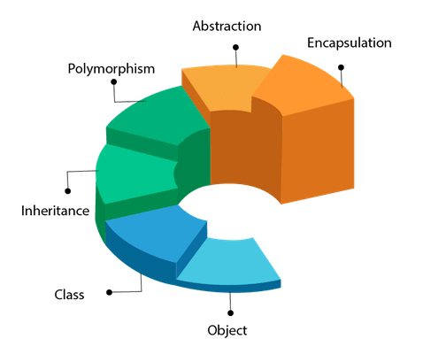
OOP main components and principles

Slide 4

Examples of OOP benefits in game development
OOP reflects real-world
Game elements (characters, items, …) are easier to model and implement
Inheritance fasten development and reduces dev costs
A single class can be used to generate tons of objects
Player and Enemy classes can derive from a Character class
Polymorphism provides flexibility and consistency
An attack method or an item object can be used, sometimes differently, by many characters
Encapsulation ensures robustness
Attributes, such as age and health, are protected from “accidental” modifications
Abstraction decreases complexity
The underlying complexity of high-level methods, such as move() or attack(), is hidden

Slide 5
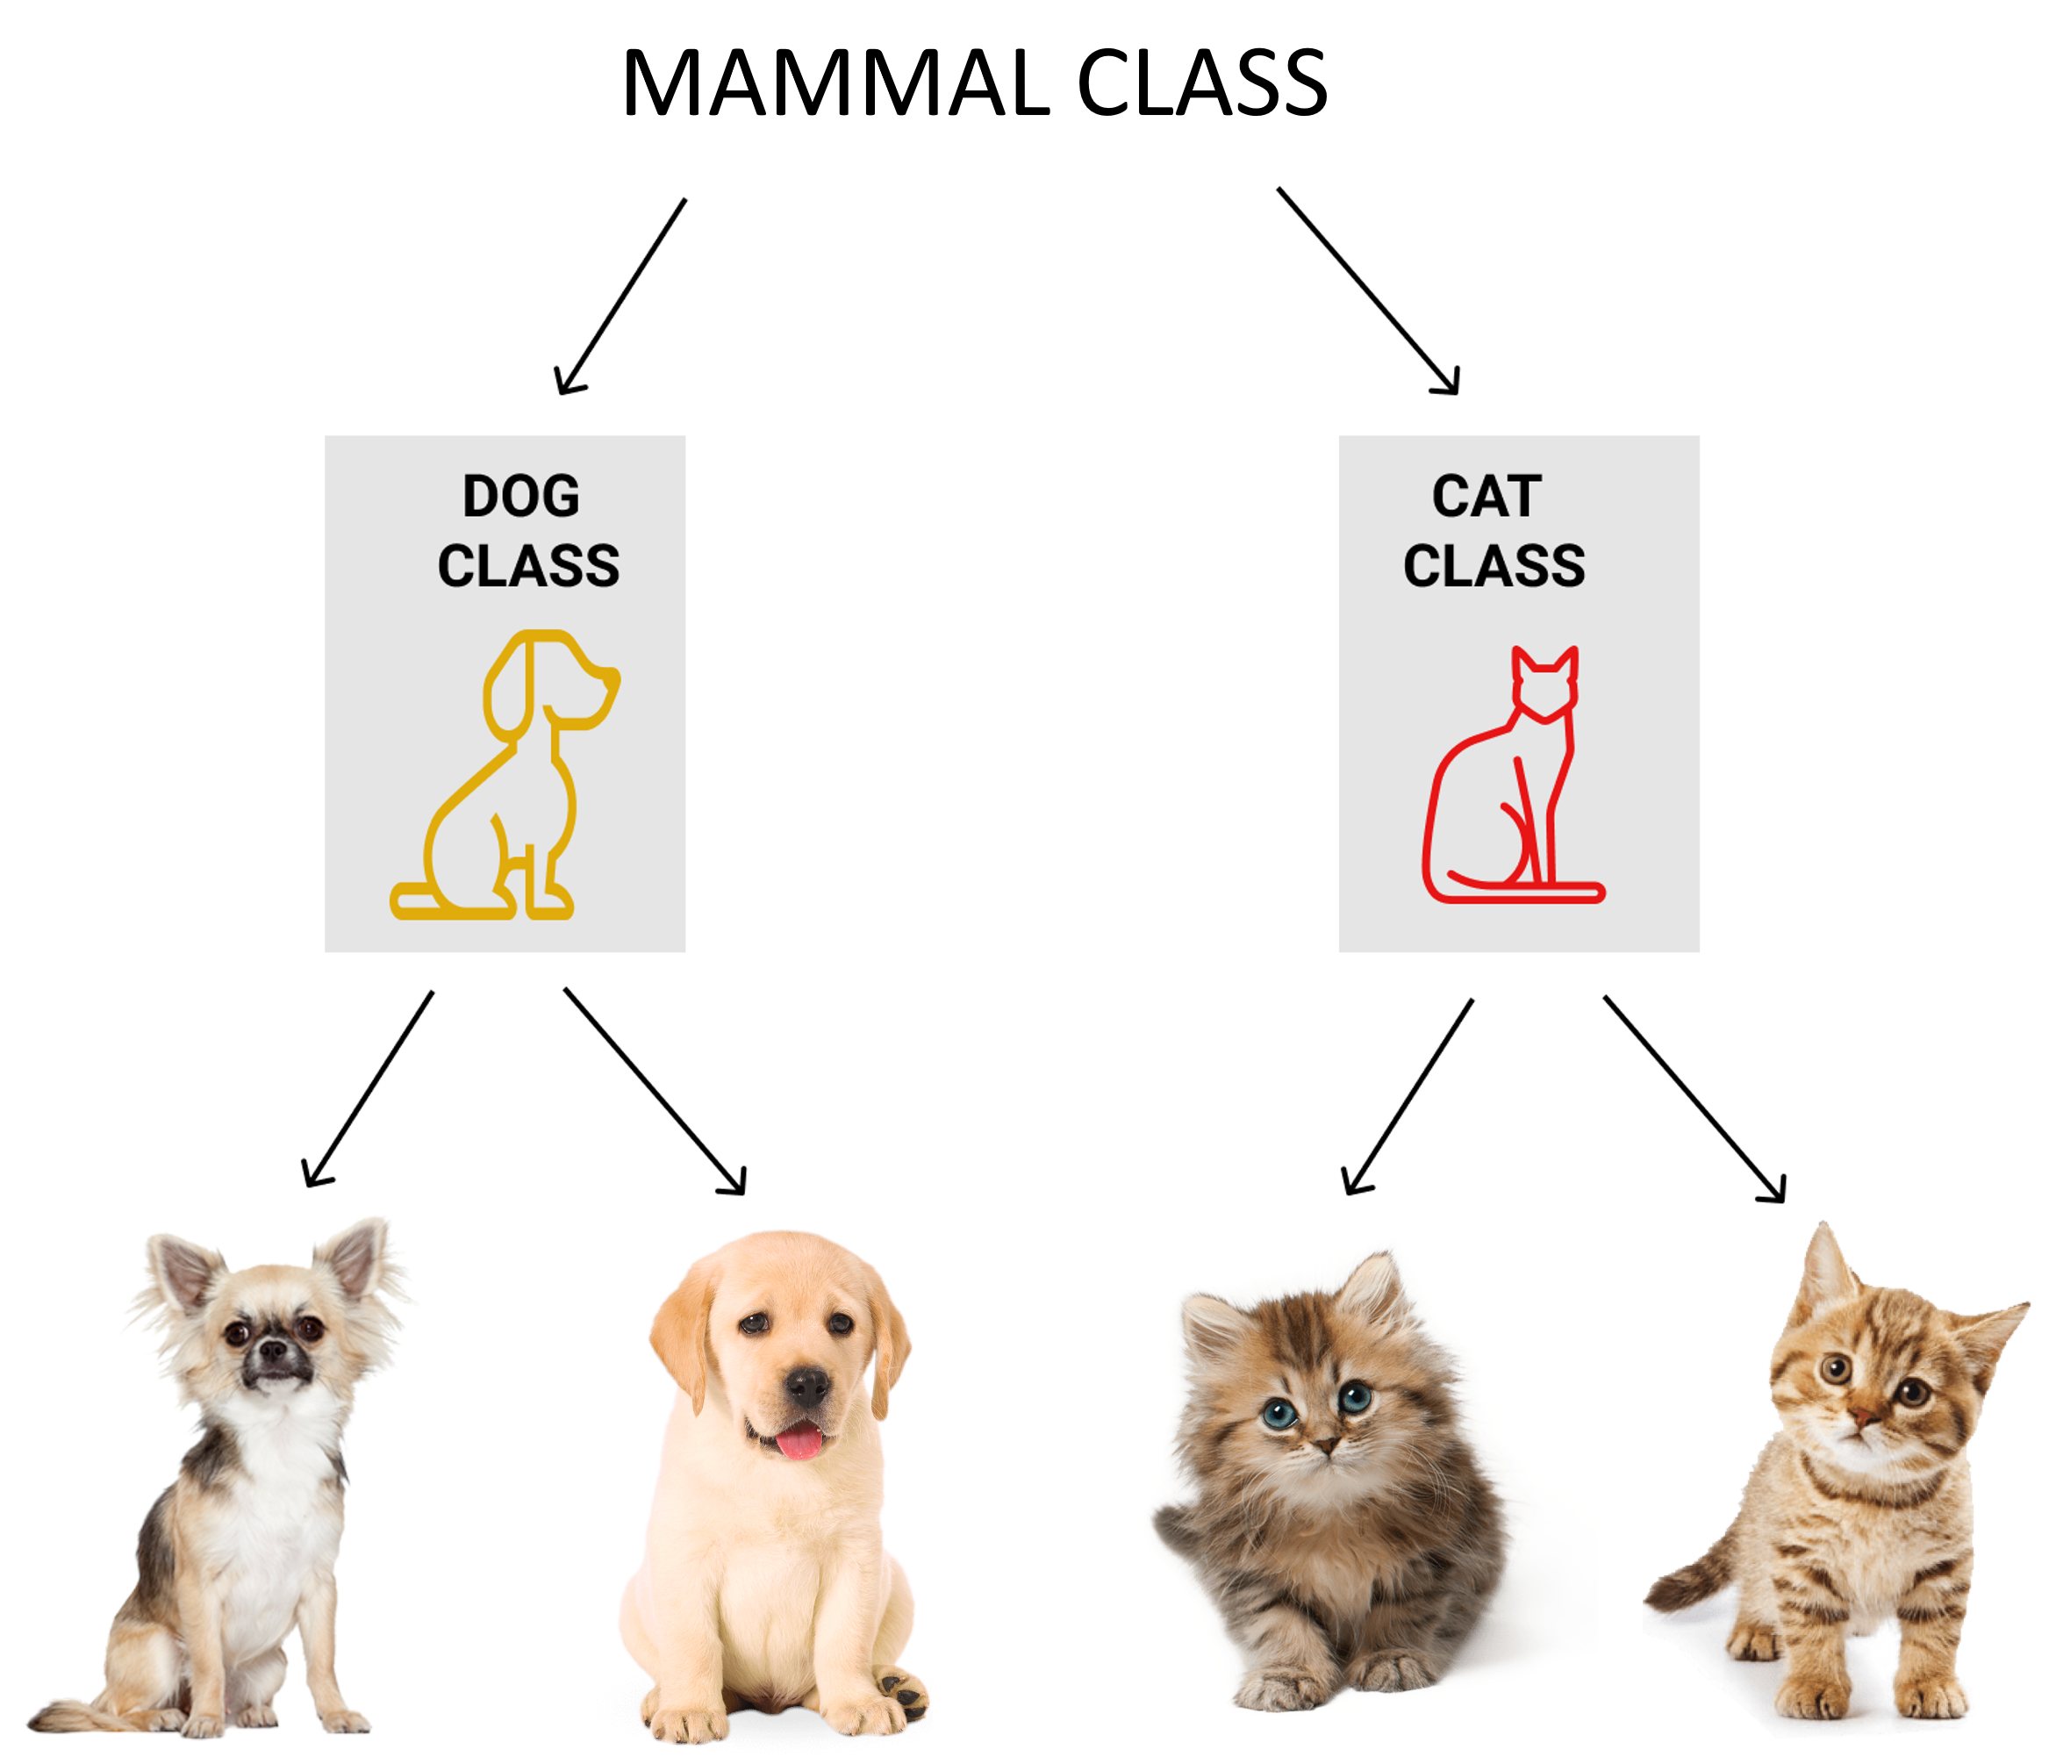
Inheritance & Polymorphism
Don’t Repeat Yourself!
Code it once, reuse anywhere.
speak() -> Woof
speak() -> Meoow

Slide 6
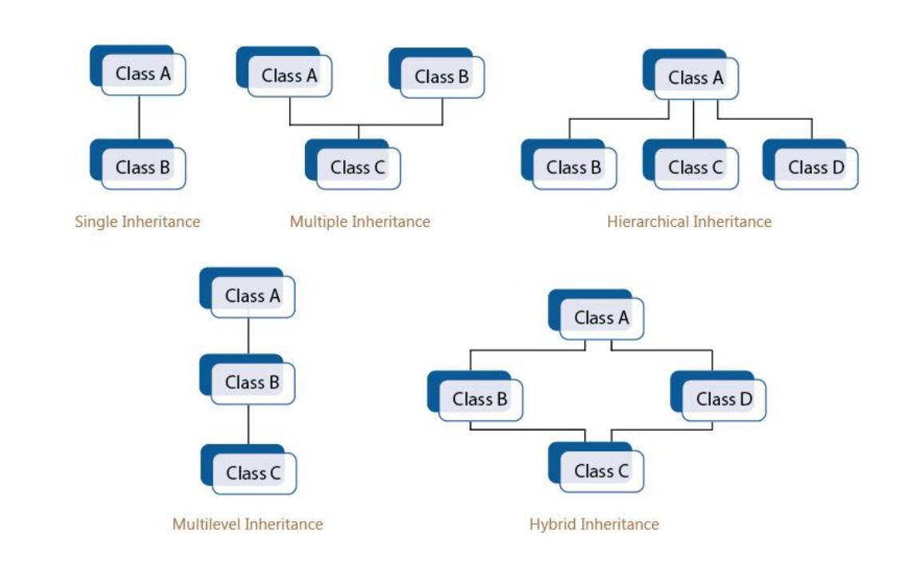
Inheritance types
Many types exists, use the one(s) that fit your needs

Slide 7
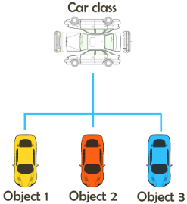
Class = blueprint for objects

Slide 8
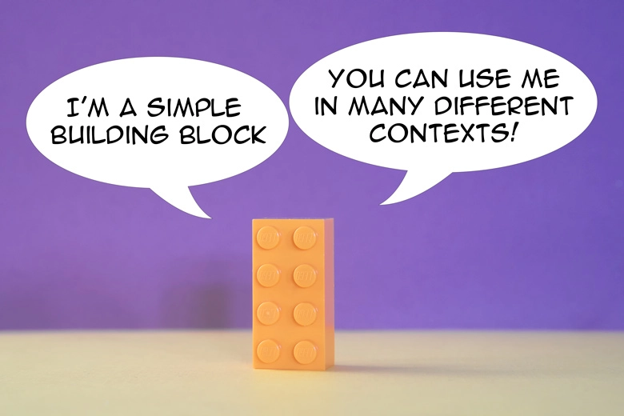
Class abstraction
handle complexity by hiding unnecessary details
contain at least one abstract "empty" method
provide a kind of template to inherit from
allow the creation of interface with definitions
optimize inheritance by not duplicating functions

Slide 9
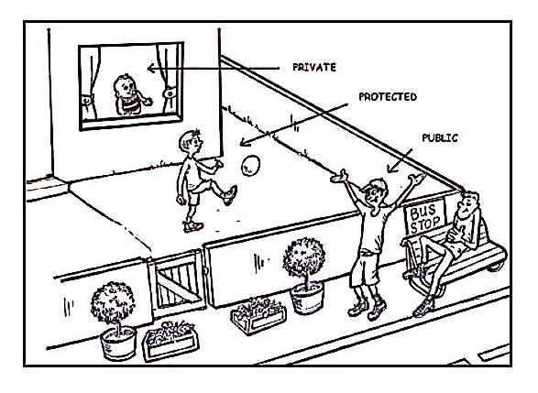
Visibility

Slide 10

Exceptions
Manage the unexpected events by catching errors and anomalies:
=> Reduce the probability of crashes.

Slide 11
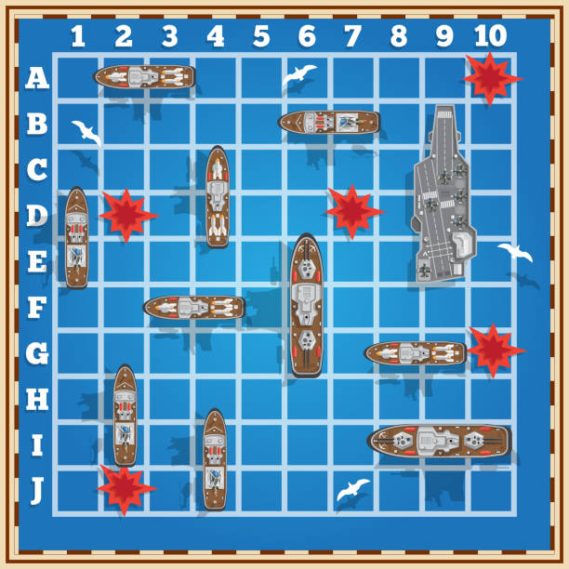
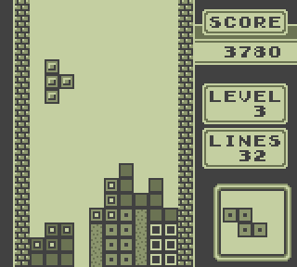
About the project
Use OOP to create a 2D game
Use as many OOP principles as possible
First, validate your idea with local staff
A graphical interface is mandatory
Use docker and automate your project
Provide documentation (UML diagrams)

Slide 12


Stuff to dig
Unveiling the power of OOP in gaming concepts
Basics of OOP from a game development point of view
OOUX Happy Hour – Object-Oriented video games
Java programming: Let’s build a game
Common java security issues and their remediations
10 Most Common Java Developer Mistakes

