Slide 1
CRUD Application
Jack Bailey

Slide 2
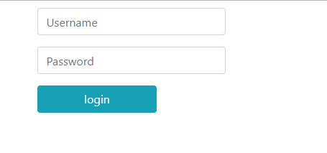
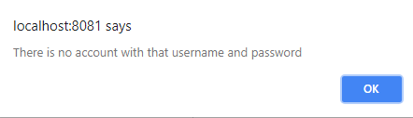

Slide 3
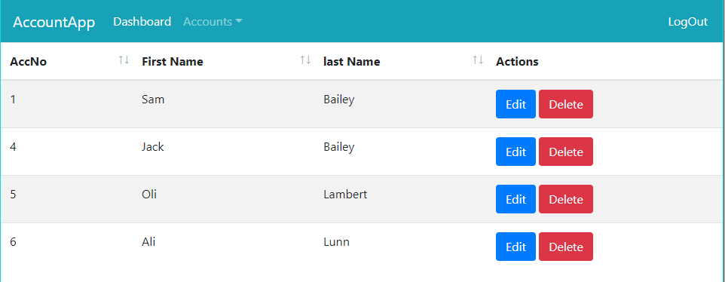
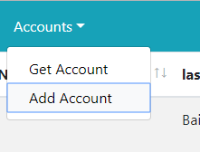


Slide 4
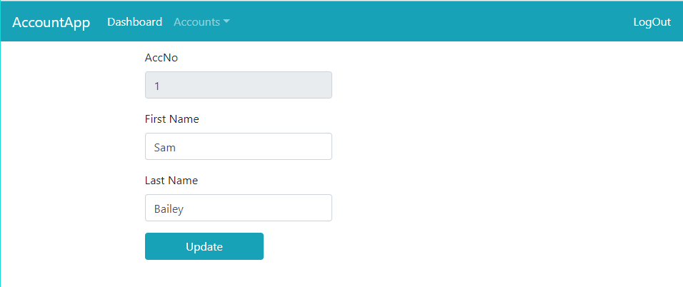


Slide 5


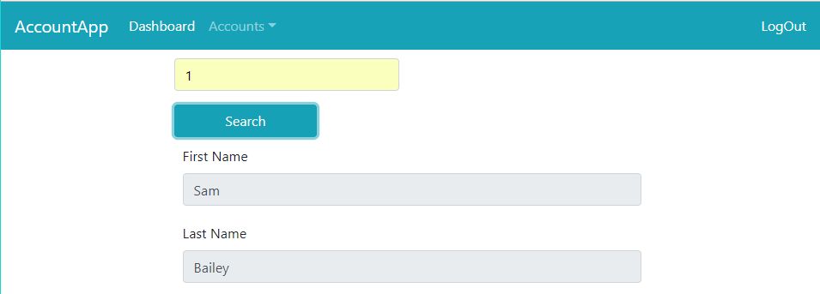

Slide 6

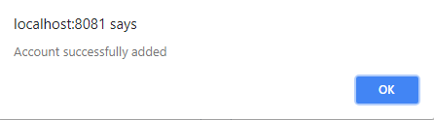

Slide 7




Technologies
MySQL
Docker
Vue.js
Spring Boot

Slide 8








Development Tools
IntelliJ
WebStorm
Chrome developer tools
Postman
Github
Maven
NPM
Webpack

Slide 9
Any Questions?

