Slide 1

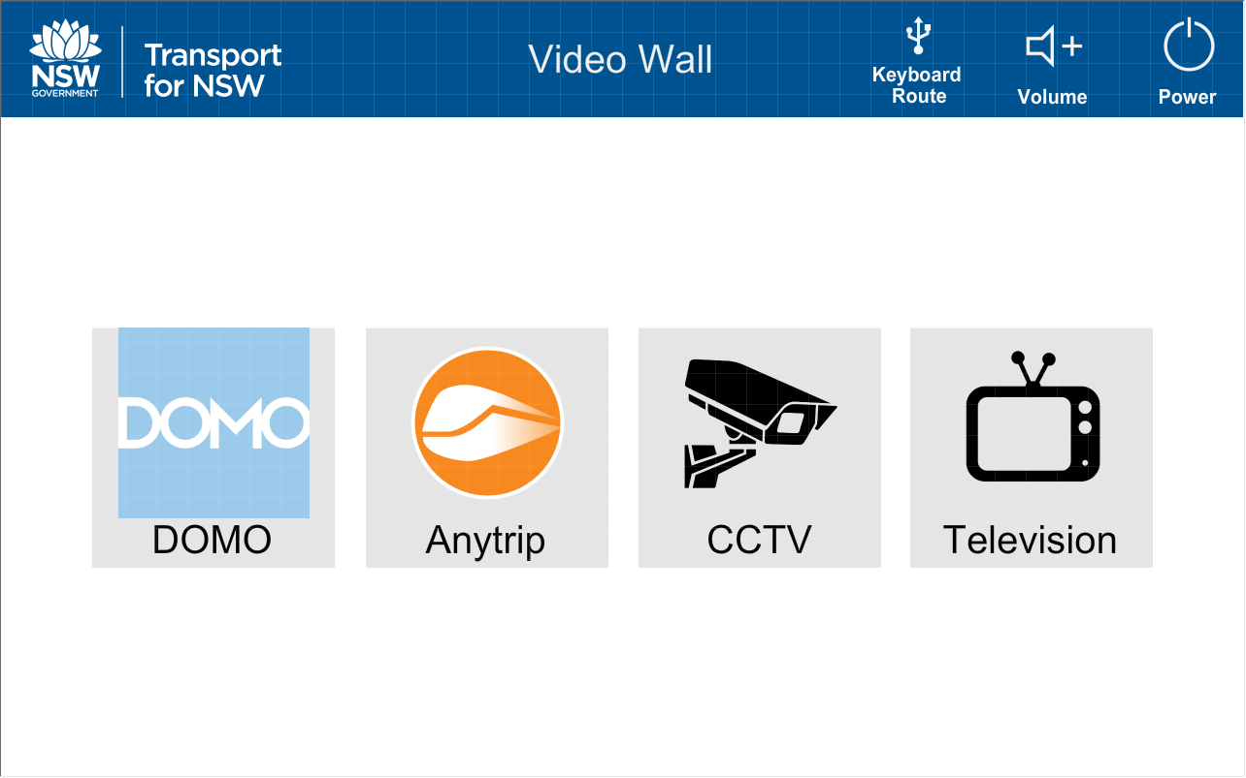
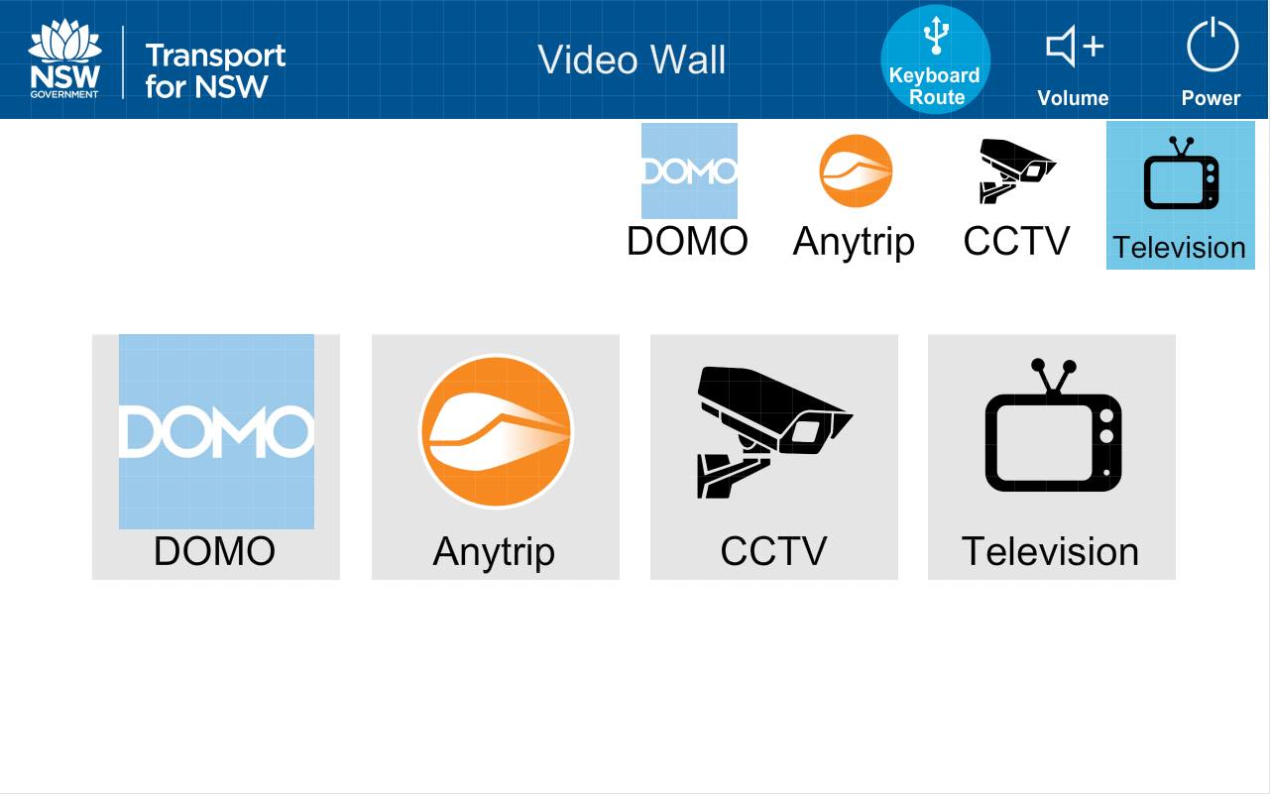
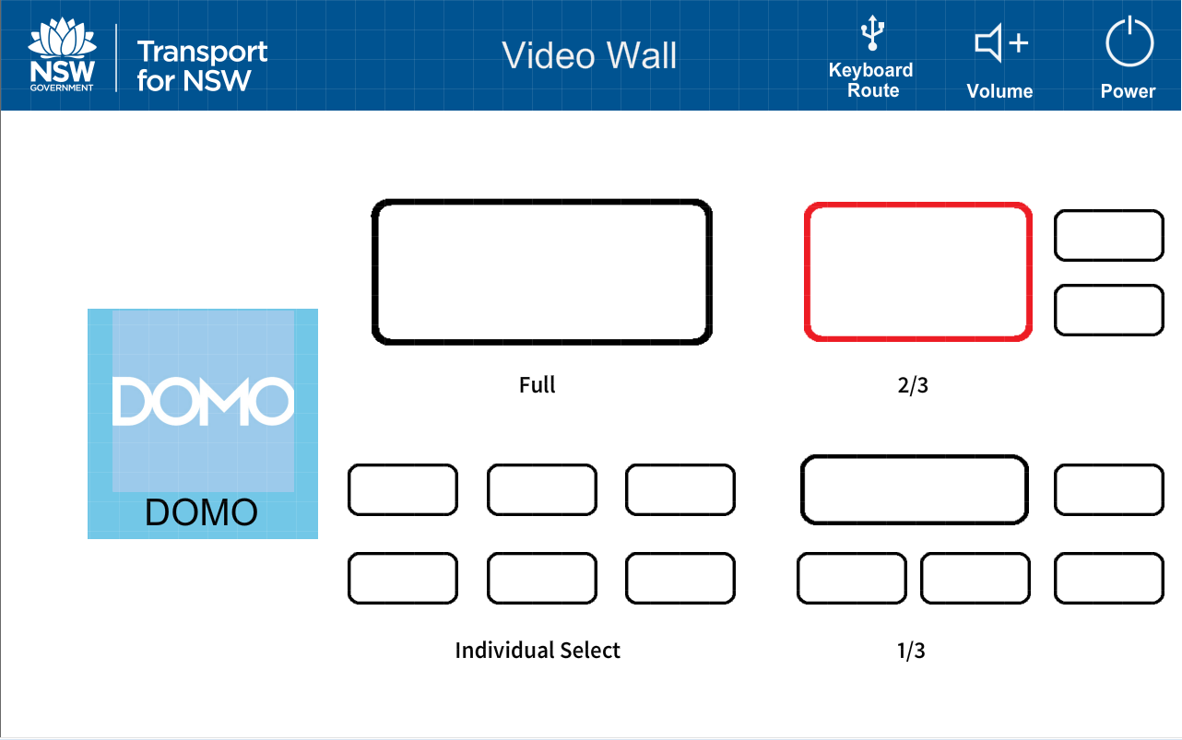
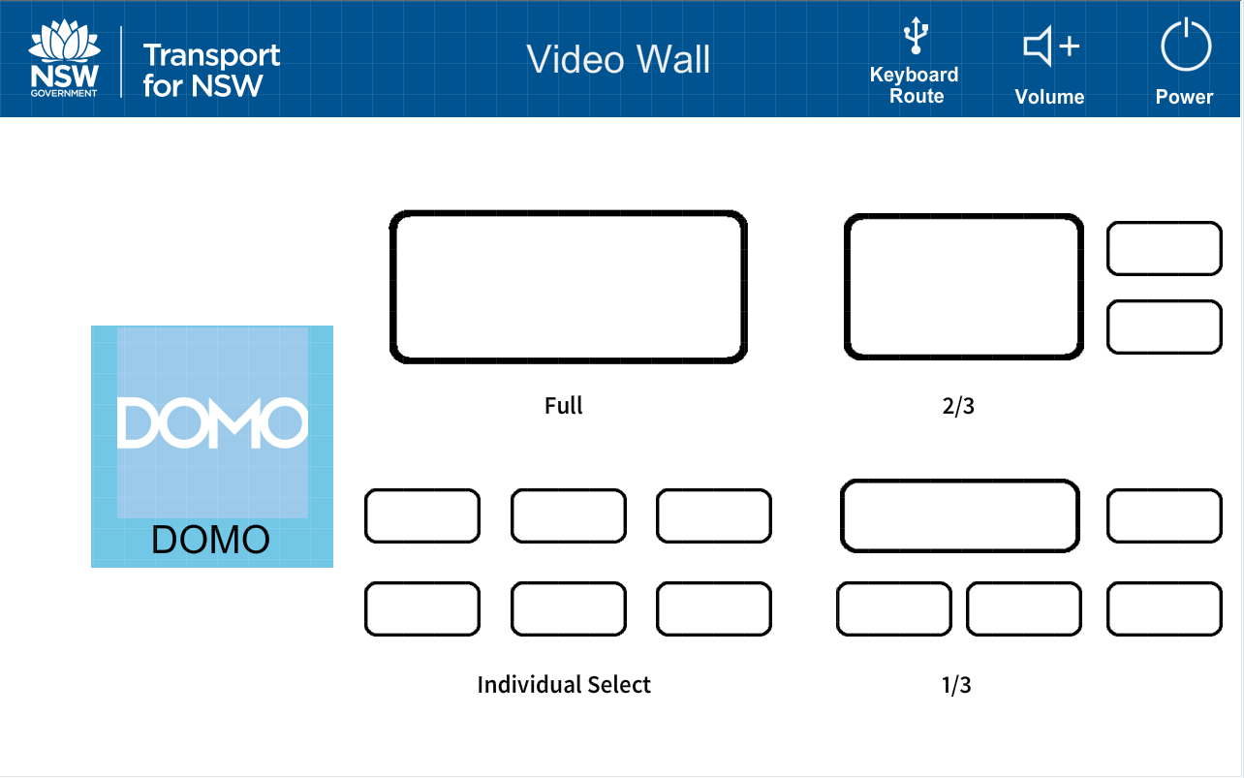
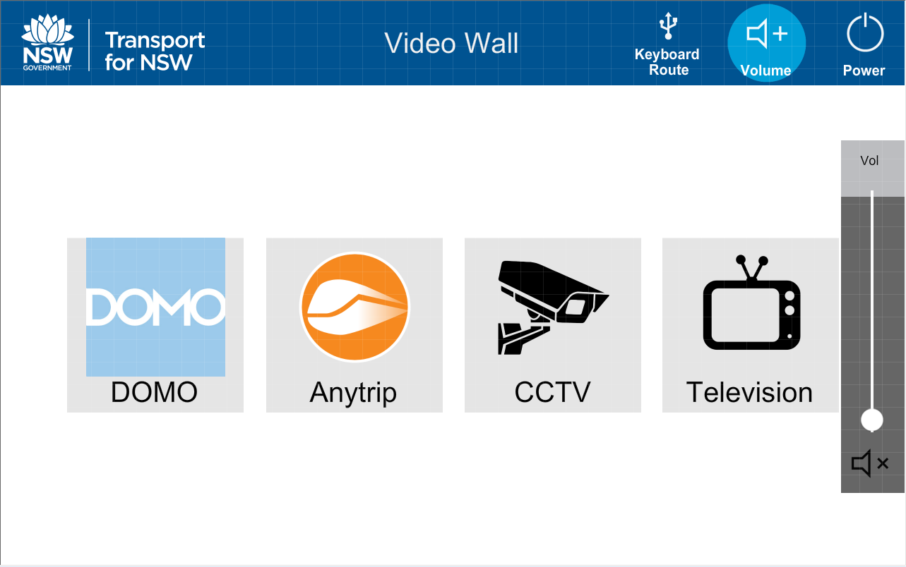
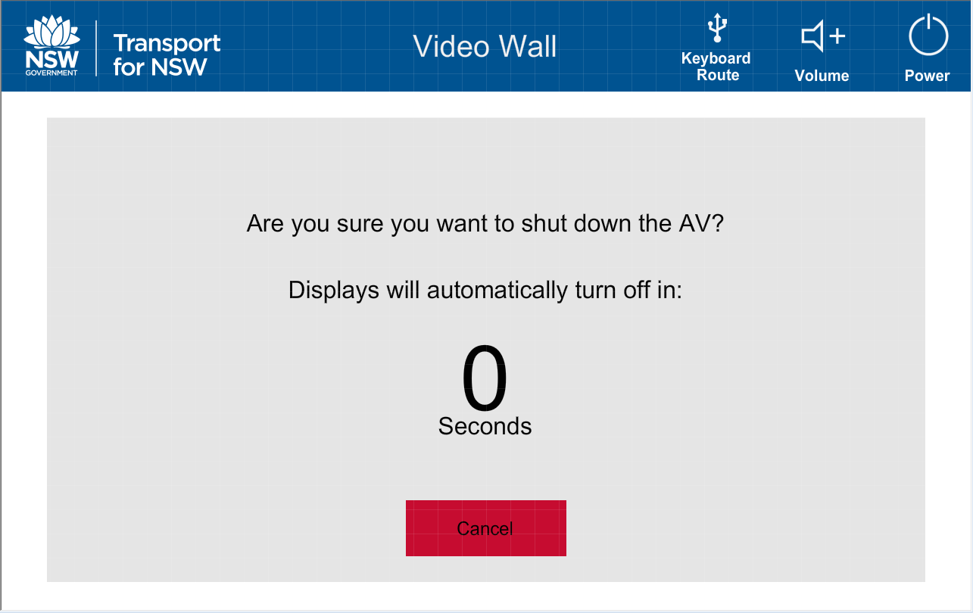

Slide 2
Start up page will show up after the shutdown page finishes it’s countdown.
Screens will be off, audio will be off, Keyboard/Mouse route will be left to last PC.

Slide 3
Main page shows up after touching screen from start up page.
All Icons are in a non-highlighted state until selected.

Slide 4
Selecting the keyboard route will display the four PC sources to route Keyboard & mouse to.
In this picture the Television PC is selected.

Slide 5
Selecting the Volume button displays the volume slider and mute button.

Slide 6
Selecting a Video Source button will display the flexible routing system as shown.
There are four ways you can select your routes.
“Full” routes the source to the entire wall
“2/3” routes the source to the left-hand side leaving the two individual screens on the right column.
“1/3” routes the source to the top left-hand side leaving four individual screens below and to the right.
“Individual select” lets you select which specific screen on the wall you would like to route your source to.

Slide 7
Here is an example of your highlighted flexible routing selection.
The route selection turns red.

Slide 8
When the Power button is selected the shutdown page will display with a count down timer from 7 seconds. After this has reacted the countdown, the system with turn off the video wall displays, mute audio and return the user interface back to the start up page from slide 1.
You may cancel this countdown via the red Cancel button and return back to the main page.

