Slide 1
Presentation Slide Outlines
1. Title page
2. Agenda
3. Keylogger threat
4. Keylogger implementation
5. Keylogger detection #1
6. Keylogger detection #2
7. Keylogger prevention
8. Project overview
9. Introduction to kernel development
10. Keylogger Implementation exercises
11. Literature survey of detection mechanisms
12. Questions

Slide 2
Keyloggers in Cybersecurity Education
Rochester Institute of Technology
July 13th, 2010
Christopher A. Wood
Department of Software Engineering
Rajendra K. Raj
Department of Computer Science

Slide 3


Keyloggers in Cybersecurity Education
Motivation
Design and implementation
Detection and prevention
Keylogging projects
Status and future work

Slide 4
Motivation: Preliminaries
What is a keylogger?
  Type of malware that maliciously tracks user input to retrieve confidential information
Types of keylogger
  Typically tracks user input from keyboard, but could be from a mouse or a screen
  Hardware keyloggers exist
    Spy Keylogger (tracks USB keyboard to USB port on motherboard)
  Software keyloggers dominate!

Slide 5
Motivation: Keylogging Threats
Increased computer usage for personal and business activities
  Online banking
  Personal e-mail
  Identity verification
Attempt to expose confidential information for identity and financial theft
List some notable keylogging losses

Slide 6
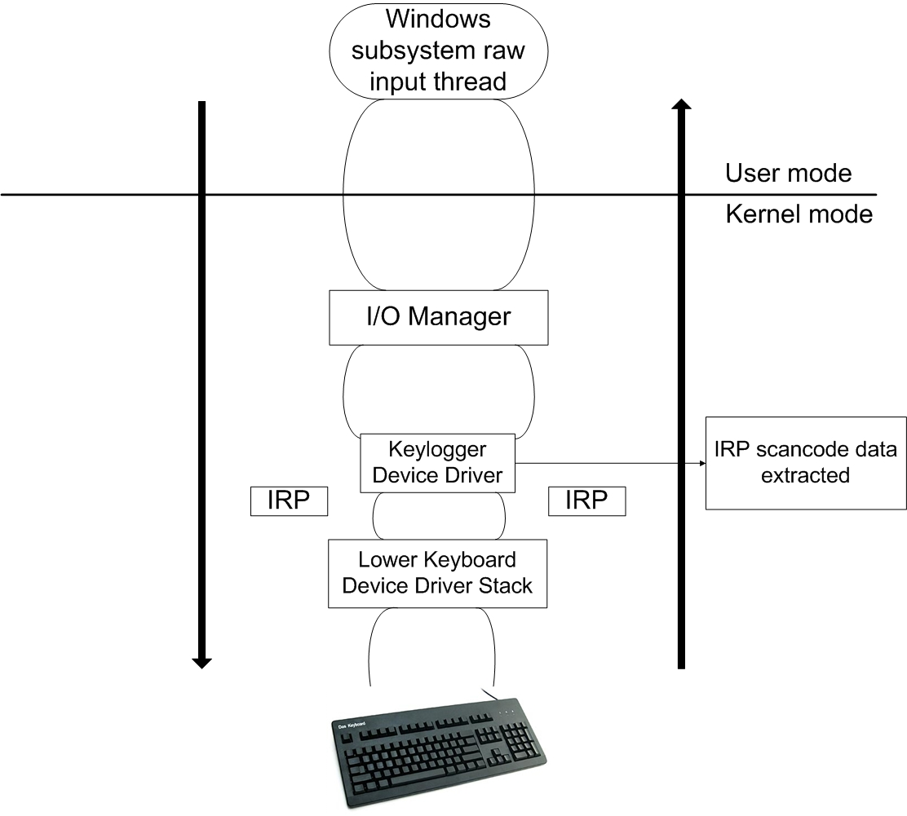
Implementation
User-mode
  Trojan horse malware
  OS user-mode hooks
Kernel-mode
  Rootware
  Layered drivers and kernel hooks
Networking
  Client – Server model
  Use of covert channels

Slide 7
Static Detection
Pattern- and signature-based
Relies on previously implemented malware to identify recognizable malicious signatures (checksums)
Ineffective for keylogger detection (constantly evolving malware)

Slide 8
Dynamic Detection
Behavioral-based and system monitoring
System is monitored for behavior similar to that of a keylogger (data extraction, transportation, etc.)
Oversee memory usage to identify unauthorized access to privileged memory and OS resources
R&D Techniques: Enhanced malware categorizing and tainted data analysis

Slide 9
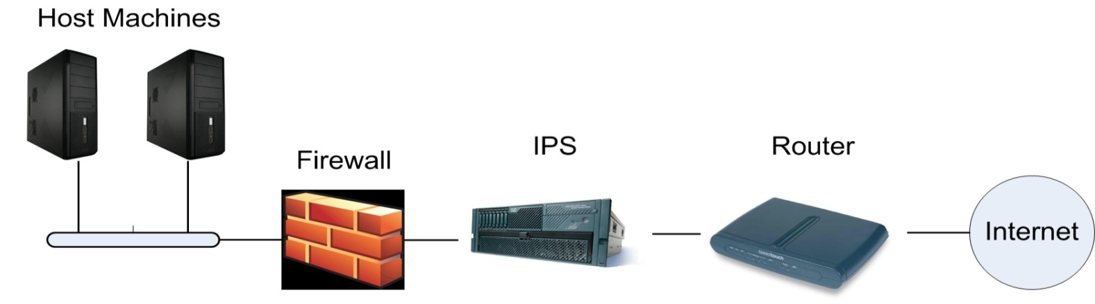
Prevention
5 layers:
  Application settings
  Antivirus software
  Firewalls
  Intrusion Prevention Systems (IPS)
  Routers

Slide 10
Project Overview
Teach students from both black- and white-hat perspective
Introduce students to kernel development
Broaden students’ programming experience
Foster new thoughts and ideas about malware development and detection techniques

Slide 11
Implementation Exercises
Take the role of the black-hat
Practice keylogger implementation to help formulate new ideas about keylogger implementation
Teach students to approach malware detection by thinking like the attacker

Slide 12
Literature Survey
Many detection techniques are still prototypes that are not in production level
Dive into malware detection research to stay on the bleeding edge of modern security issues
Foster interest in future research opportunities

Slide 13
Questions?

