Slide 1
Keyloggers in Cybersecurity Education
Rochester Institute of Technology
July 13th, 2010
Christopher A. Wood
Department of Software Engineering
Rajendra K. Raj
Department of Computer Science

Slide 2


Outline
Motivation
Design and implementation
Detection and prevention
Keylogging in cybersecurity education
Status and future work

Slide 3
Why Study Keyloggers?

Slide 4
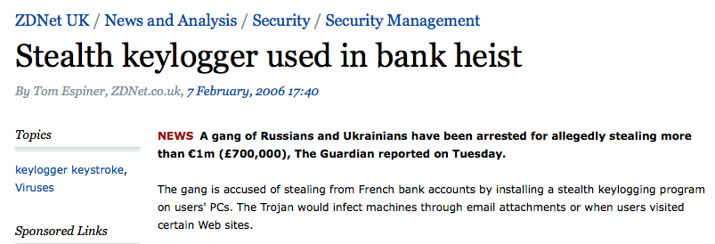

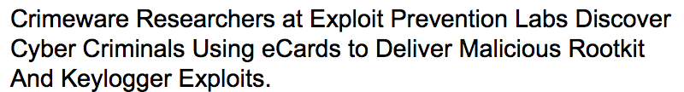

Slide 5
Motivation
Realistic problem in security world
Cover wide variety of programming paradigms
Educate cybersecurity practitioners at an earlier age
Foster student research interests
Teach fundamental security concepts

Slide 6
Preliminaries
Keyloggers
  Typically implemented as rootware, a combination of both rootkits and spyware
Rootkit
  Small set of programs or tools that covertly run on an infected machine to provide long-term undetected access to the root of a system for the attacker
Spyware
  Software that collects user data usually without victim consent

Slide 7
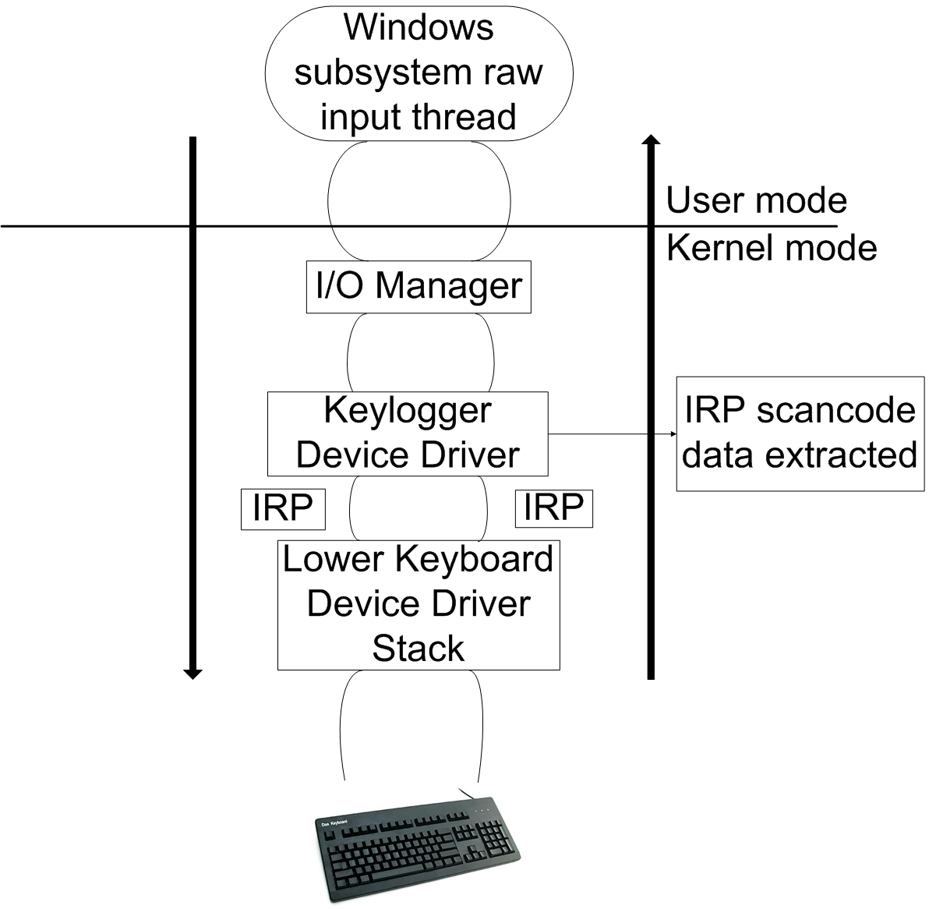
Design and Implementation
User-mode
  OS user-mode hooks
Kernel-mode
  Rootware
  Layered drivers & kernel hooks
Networking
  Client–server model
  Use of covert channels

Slide 8
Static Detection of Malware
Pattern- and signature-based
Relies on previously identified malware with known malicious signatures (checksums)
Static detection generally ineffective for keylogger detection
  Keyloggers often are constantly evolving malware

Slide 9
Dynamic Detection
Behavioral-based and system monitoring
System monitored for behavior similar to that of a keylogger
  Data extraction, transportation, and so on
Track memory usage to identify unauthorized access to privileged memory and OS resources
Relevant techniques
  Enhanced malware categorizing and tainted data analysis

Slide 10
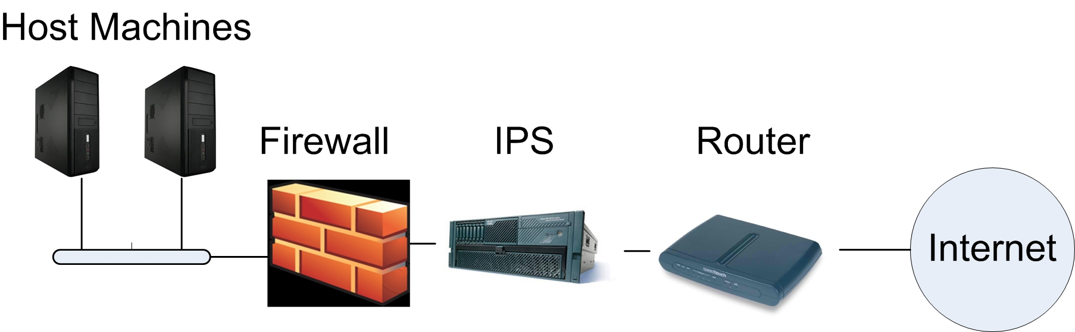
Prevention
5 layers
  Application settings
  Antivirus software
  Firewalls
  Intrusion Prevention Systems (IPS)
  Routers

Slide 11
Keyloggers in Cybersecurity Education
Teach students from both black- and white-hat perspective
Introduce students to kernel development
Broaden students’ programming experience
Foster new thoughts and ideas about malware development and detection techniques

Slide 12
Role of Keylogger Projects
Take the role of the black-hat hacker
  Play around with keylogger design and implementation
  Help catalyze new ideas about keyloggers
Take the role of the white-hat hacker
  Approach malware detection by thinking like the attacker

Slide 13
Sample Keylogger Projects
Legal and ethical issues
  Crucial to make students understand this upfront
Programming projects
  Virtual machines and device drivers
  Introduction to rootkits
  Linux keylogger implementation
  Networked keyloggers
  Kernel-level covert channel
  Keylogger detection techniques

Slide 14
Literature Survey Projects
Many detection techniques are still prototypes that are not in production level
Dive into malware detection research to stay on the bleeding edge of modern security issues
Foster interest in future research opportunities

Slide 15
Questions?

