Slide 1
Keyloggers in Cybersecurity Education
Rochester Institute of Technology
July 13th, 2010
Christopher A. Wood
Department of Software Engineering
Rajendra K. Raj
Department of Computer Science

Slide 2


Outline
Motivation
Design and implementation
Detection and prevention
Keylogging in cybersecurity education
Status and future work

Slide 3
The Big Questions
What are keyloggers?
Why study keyloggers?
What makes them unique?

Slide 4
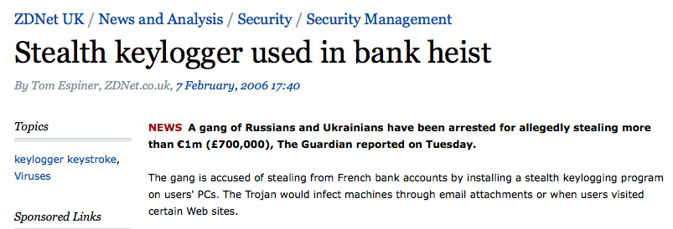

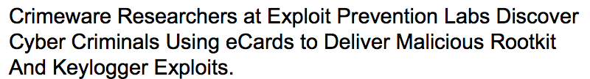

Slide 5
Motivation
Realistic problem in security world
Cover wide variety of programming paradigms
Teach fundamental security concepts

Slide 6
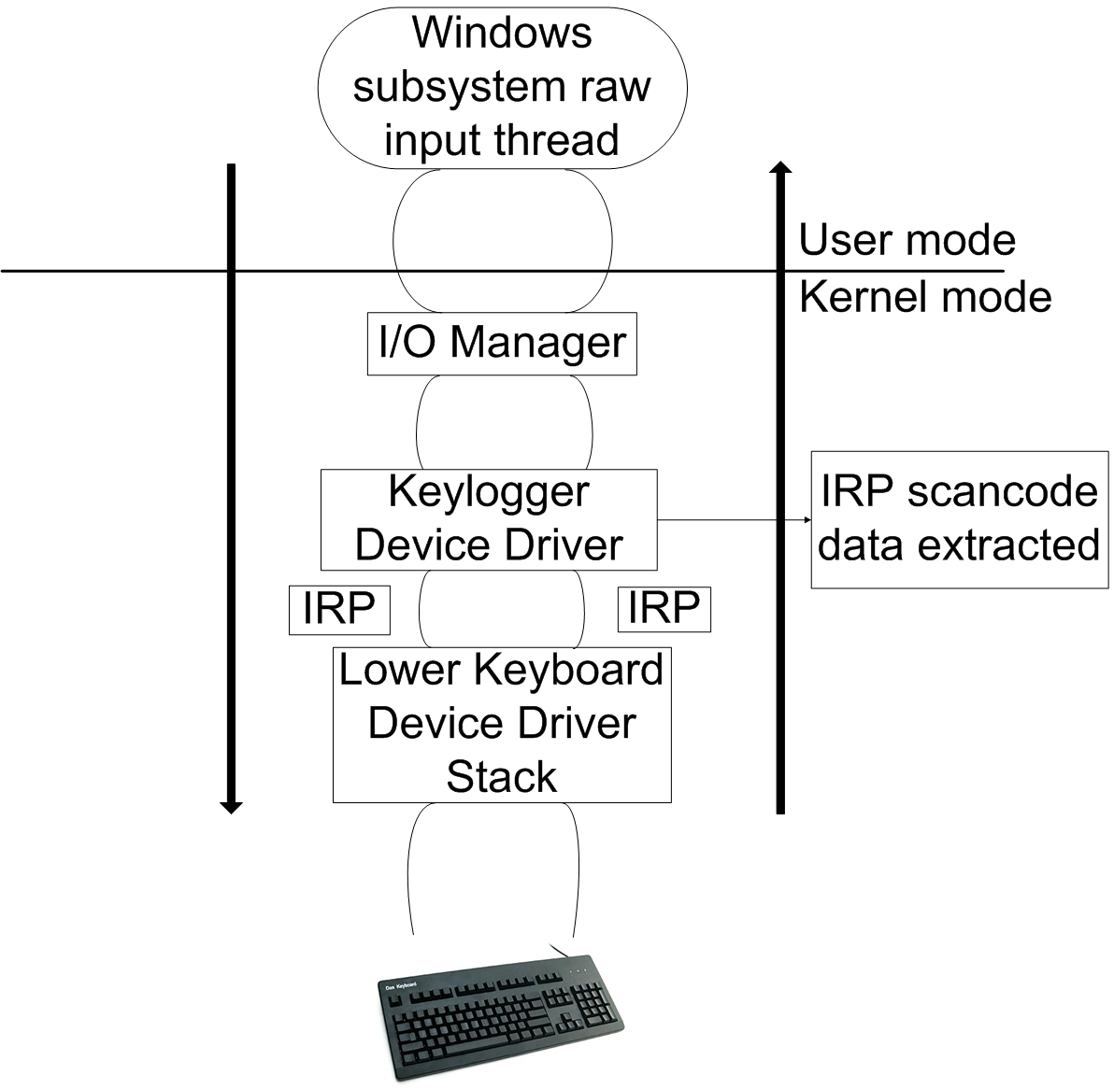
Design and Implementation
User-mode
  OS hooks
Kernel-mode
  Rootware
  Layered drivers
Networking
  Client–server model
  Covert channels

Slide 7
Detection
Static detection
  Pattern- and signature based
  Relies on previously implemented malware with known malicious signatures (checksums)
Dynamic detection
  Behavioral-based using system monitoring
  System monitored for behavior similar to that of a keylogger
  Relevant techniques: enhanced malware categorizing and tainted data analysis

Slide 8
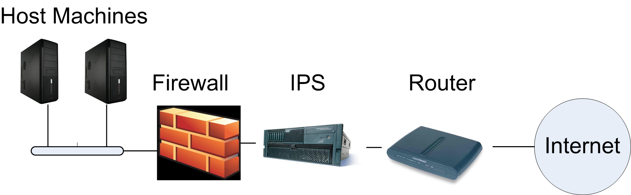
Prevention
5 layers
  Application settings
  Antivirus software
  Firewalls
  Intrusion prevention systems (IPS)
  Routers

Slide 9
Keyloggers in Cybersecurity Education
Teach students from both black- and white-hat perspective
Introduce students to kernel development
Broaden students’ programming experience
Encourage more student participation in research environments

Slide 10
Role of Keylogger Projects
Cover legal and ethical issues
  Crucial to make students understand them upfront
Take the role of the black-hat hacker
  Play around with keylogger design and implementation
  Help create new ideas about keyloggers
Take the role of the white-hat hacker
  Approach malware detection by thinking like the attacker

Slide 11
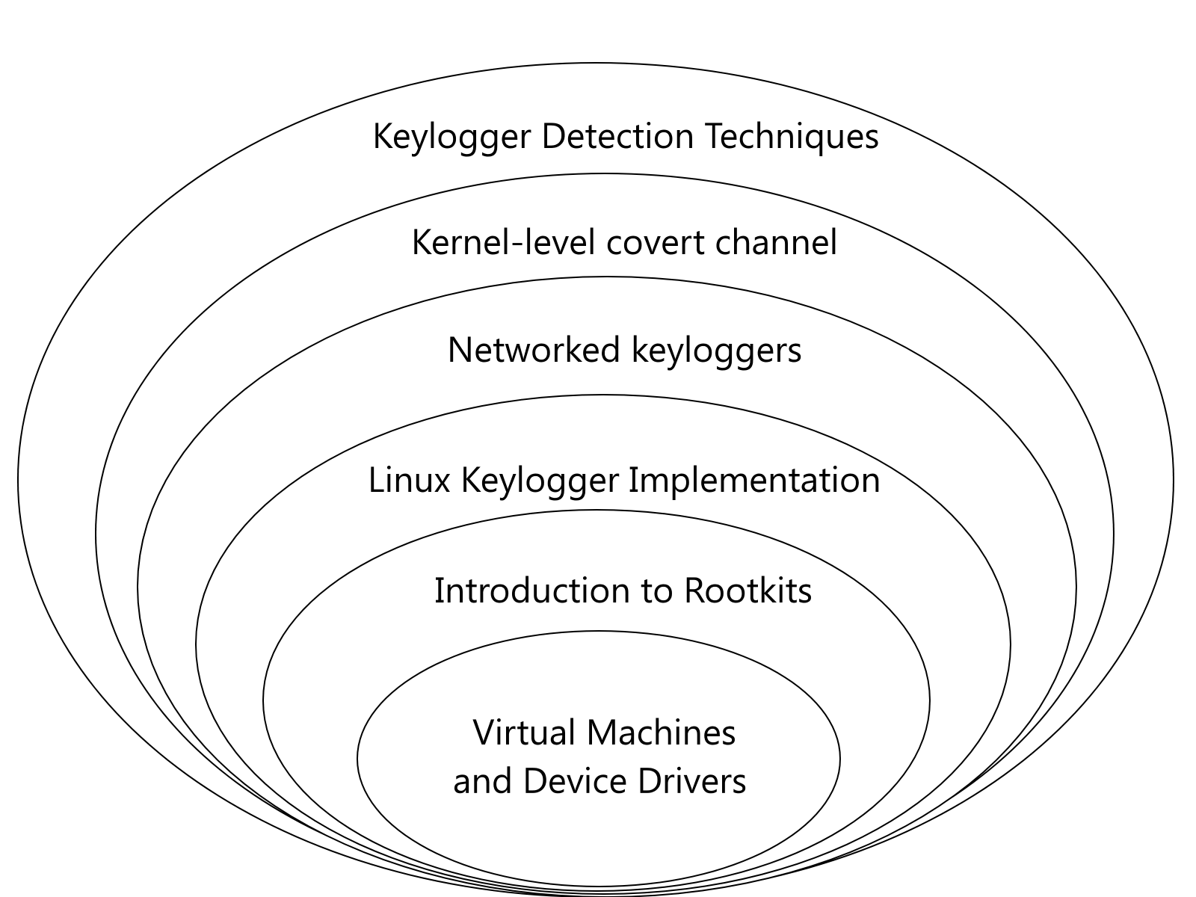
Sample Keylogging Projects

Slide 12
Literature Survey Projects
Many detection techniques are still prototypes that are not in production level
Dive into malware detection research to stay on the bleeding edge of modern security issues
Foster interest in future research opportunities

Slide 13
Status and Future Work
Material to be adapted into a course on Secure Coding in Fall 2010
Project exercises almost complete
Work maintained on website hosted by the authors
  http://www.cs.rit.edu/~rkr/keylogger2010
Future results to be collected and presented based on student experiences and feedback

Slide 14
Thank You

