Slide 1
IDA Splode
Dynamically Enhancing Static Analysis
Notes:
Hello, this is Zach from Endgame. For today’s Hack week, I’ll be talking about a tool that I’ve spent entirely too much time on, but that I think is really cool and useful.
The working name is “IDA Splode”, named mostly for how I felt trying to work on the problem that drove me to write it.

Slide 2
IDA Splode - Overview
Background
Motivation
Walkthrough
Examples
Future
Demo?
Notes:
The slide deck is cut into four parts:
Some technical background on the technologies involved
Some bits on the motivation for the tool and why it’s useful at a high level
A quick walk-through of how to make the tool work
The bulk of the time will be in the examples and screenshots that I’ve included
At the end, I’d like to do a live demo if time and VTC technology permits

Slide 3
Background

Slide 4
IDA Splode - Background
IDA-Splode
Horrible name for the tool I wrote, which combines…
Hex-Rays IDA Pro
Application to disassemble software
Static analysis
while(1){} → 0xebfe: jmp $-2
IDA Python
Python bindings for IDA’s API
while ea != BADADDR: ea = NextHead(ea)
Intel’s Pin
Dynamic binary instrumentation framework
Effectively hook executing code at the instruction level
INS_AddInstrumentFunction(CalledOnEachInstruction)
Notes:
Awesome, with all of that out of the way, let’s cover some of the tools and ideas involved. For the XXXXXXXXXXXXXXXX, most of this will feel pretty familiar.
First off, the tool’s name is IDA Splode. The name sucks, so if you’ve got something better I’ll buy you a beer.
IDA Pro is a tool by hex-rays which disassembles software into assembly, and provides a nice interface for trawling through tons of it.
IDA Python is a Python language binding and scripting interface for IDA Pro
Pin is a tool by Intel (of Pentium fame) that makes dynamic binary instrumentation easy

Slide 5
IDA Splode - Background
Pin and Dynamic Binary Instrumentation
Dynamic Binary Instrumentation (DBI) is a method of analyzing the behavior of a binary application at runtime through the injection of instrumentation code. This instrumentation code executes as part of the normal instruction stream after being injected.
– Skape (Uninformed v7a1)
Notes:
Here’s a nice definition of Dynamic Binary Instrumentation. Think of it as being able to hook every single instruction as it executes, completely transparent to the target application.
In a quick pinch, you can use a debugger to set breakpoints and execute a few commands for a small task.
Pin is a heavy-lifting version of this, designed to instrument any and all instructions, and to do so very quickly.

Slide 6
Motivation
Notes:
So let’s talk a bit about why I created this tool

Slide 7
IDA Splode - Motivation
Origins of IDA Splode
Single-byte mutation
Heap overflow with corrupted data
Decompression failure
Root Cause Analysis of Heap Overflow
Parser for undocumented format
Closed source, but have debugging symbols
All file data is compressed (flat entropy)
Extensive use of COM interfaces
Lots of C++ isms (OO, virtual inheritance, etc)
Lots of shiny things to get distracted by
Too much churning, need better tools
Notes:
Had a cool crash, and I was reversing the target application, and not really getting anywhere with it.
The fuzzed crash was the result of a single-byte mutation, and caused a heap overflow.
The data in the overflow, and the overflow size, seemed to be trashed heap data (did not mirror file contents)
Simple execution trace diffing showed that somewhere down in the decompression routines there was a checksum failure or something along those lines.
So here I am, trying to get to the root cause of the crash so that I know what we have available to us for exploitation.
Unfortunately, the file format is completely undocumented (not even other hackers had looked at it, as best I can tell)
Closed source
Almost all of the file contents were compressed (very high, flat entropy across the file)
It used COM like crazy
Everything was written in C++ with polymorphism, virtual inheritance, template routines, the works
Lots of things to get distracted by

Slide 8
Motivation for Developing IDA Splode
IDAPython
Limited exposure
Small-scale applications
Pin
Powerful tool with lots of potential
No previous personal experience
Some previous organizational experience
Exists to answer
Given mov [esi+0x18], eax
What is in the memory esi points to?
Where did the allocation come from?
Which routines touch that data?
Notes:
In addition to the “I’m getting nowhere fast” aspect of the crash that I was investigating, I was also looking for an opportunity to get my hands dirty with IDAPython.
I’d also heard about Pin, and the idea was intriguing, and we already had some internal Pin tools developed, so I decided to take a look at those.
My **original** direction when I first started writing Pin tools was pretty straightforward, and simple, and had already been done before ad finitum.
However, what I ended up with is a tool that does a pretty awesome job of answering the question of “What the fuck is that?” when you have little context.
What is in that memory?
Where did that block of memory come from?
What other routines touch that data?

Slide 9
IDA Splode - Motivation
Static Reversing & Runtime Analysis
Load binary in Windbg
Breakpoint on instruction
!heap, kv, ln, dd, wt
All require useful symbols, standard allocators
Load binary in IDA
Annotate nearby instances of esi
Maybe create a struct
Tedious, manual, error-prone
Single-step sample size n=1, no automation
Notes:
Normally when reversing, I spend most of my time bobbing between IDA and Windbg.
In general, the workflow is to start in Windbg, find something interesting, then swap over to IDA to move around easier.
When you find the next thing you want, set a breakpoint there and re-run the executable.
A few commands help the most when trying to get your initial feel for things;
Getting stack traces
Checking heap allocations
Looking for nearby symbols
Dumping memory
Trace function calls
Unfortunately, these really only get you so far.
These methods give you very direct, raw access, but there’s not really a good way to aggregate information, and there’s not an autopilot button.
If you don’t have source or private debugging symbols, and you’re working on a new or unfamiliar target, you’re in for a rough time.

Slide 10
IDA Splode - Motivation
Dynamically Enhanced Analysis
PIN Tool + IDAPython
Log all memory accesses
Instrument all mov/movzx/lea/cmp
Record metadata at runtime
Stack?
Instrument all call and ret and instructions
Given stack pointer, know parent frame & BP offset
Heap?
Page Heap gives allocation size and stack trace
Given heap pointer, know size, offset and origin
Symbol?
Windbg/DbgHelp.dll to resolve symbols
Notes:
The general idea with IDA-Splode is to make life a bit easier, and require less switches between IDA and Windbg.
Instead of single-stepping, and needing to set/unset/reset breakpoints dozens of times, just run the target binary to completion once and have everything you need.
IDA-Splode has a few goals when instrumenting, but they can all be thought of as “metadata”.
For each instruction that touches any memory, try to find out as much about that memory as possible, and record that information.
Also record the value being read from / written to that address.
With all of this information, you can do some nifty stuff.

Slide 11
IDA Splode - Motivation
Scope and Features
Scope Limited by Pin’s OS Support
Intel CPUs only (Windows, Linux, OSX, Android-on-Intel)
Currently Windows-only
For other OSes, would need to change
Debug symbol resolution (macho, elf)
Heap allocation tagging
Does
Augment reversing (no source)
Make getting started easier
Get more useful with debug symbols
Does Not
Detect OOB access or exploitable conditions (a la Valgrind)
Track taints, symbolic, concolic, etc. analysis
If you see “symbol” or “symbolic” in this presentation, think Windbg
Notes:
All of that said, there are some limitations to the tool. PIN supports most operating system, though it has poor support for BSD.
IDA-Splode only supports Windows, since that’s all I needed. However, that’s a limitation that could be overcome if needed – it’s not a hard limit.
It’s also important to understand when IDA-Splode would be most useful: When you’re getting going, working with an unfamiliar target, and don’t have source access.
It’s also important to know what IDA-Splode is not. It does not know anything about vulnerabilities, or attempt to detect anything. It is dumb, and logs what happens.
It also doesn’t do any kind of symbolic analysis or taint tracking. If you hear me say “symbol”, think “windbg”, not “SMT solver”.

Slide 12
Basic Use Walkthrough
Notes:
Great, so now we know a little about the technologies that I’ve used to build the IDA-splode, why I built it, and have a high-level view of what it’s supposed to do.
Let’s do a very quick walkthrough of how to use it.

Slide 13
IDA Splode - Walkthrough
Three Parts to IDA Splode
Running Pin Instrumentation
Import Traces Into Database
IDA Pro Script, Usage, and Hotkeys
Notes:
IDA splode’s use is pretty straightforward. It consists of three parts.

Slide 14
IDA Splode - Walkthrough
Running Pin Instrumentation
Acquire ida-splode.dll pintool (on SVN)
Run target binary under Pin, specify ida-splode.dll tool
pin.exe –t ida-splode.dll -- target.exe args
Outside scope of presentation, knobs available for…
Metadata gathering
Heap vs. Stack vs. Debug Symbols
Limiting scope of instrumentation or logging
By module (-m foo.dll) or routine (-r foo!Function)
Types of instructions instrumented
MOV vs. LEA vs. CMP
Instrument registers vs. const values
Notes:
The first step is to run the instrumented binary.
Just check out the project from SVN, you get a DLL. Run that with the command specified, and magical things happen.
There are various knobs you can twiddle, but those are outside the scope of the presentation.
To give you an idea, you can turn various features off, limit the scope of logging, etc.
This instrumentation step will gather a bunch of data as the target binary runs, and spit out a giant log file.

Slide 15
IDA Splode - Walkthrough
Import Traces into Database
Uses MongoDB for ease-of-use and zero configuration
\path\to\bin\mongod --dbpath "any folder"
Log files created by Pin instrumentation
All logs are plain Python
One dict per instrumented instruction
Greppable
Run target.exe.py to import traces into MongoDB
Traces are in target.exe.py.traces.py
Modules are in target.exe.py.modules.py
Notes:
Awesome, we’ve instrumented the binary. Now to put that data somewhere useful.
I chose MongoDB because it’s trivial to turn on, requires no configuration, and integrates well with Python.
Those log files that the instrumentation pass created comes in a few pieces:
Generated Python script to import the data into MongoDB
Instruction traces
Module information
In the event that you want to do something else with these traces, they’re all valid Python, and pretty easily greppable.

Slide 16
IDA Splode - Walkthrough
IDA Pro Script & Usage
Single script to run via ALT+F7 or “File>Script File”
ida-splode\py\idapython_script.py
Upon execution
Displays usage and hotkeys
Connects to MongoDB on localhost
Shows a list of candidate databases
Must contain a module with matching MD5
First run, asks user which database to load
Subsequent runs, auto-loads previously-used database
Common Hotkeys
^⇧H Help and usage
^⇧C Color instructions in module
^⇧S Summary for selected instruction
^⇧D Details for selected instruction
^⇧X Create X-refs from module trace info
^⇧L Load a different MongoDB database
Notes:
Great, we’ve got some data in MongoDB, and we’re itching to do something with it.
Load up the target binary in IDA, and run the aptly-named “idapython_script.py”.
This will connect to the MongoDB server, look for matching databases, and ask you which one you want.
On subsequent loads, it will just automatically load the same thing as last time.
Everything is hotkey-driven, so you just pick the instruction you want, hit the hotkey, and go.
Here’s a few example hotkeys. They aren’t super important right now, but give you a general feel for some of the features that I’m about to show you.

Slide 17
Examples & Screen Shots
Notes:
Awesome, finally some actual examples to show you why you care about any of this at all.

Slide 18
IDA Splode - Examples
Example Usage Cases
Easiest to demonstrate in bite-sized, contrived examples
Features Demonstrated
Instruction Tracing
Memory Value Recording
Branch Tracing & Statistics
Vtable Resolution
IAT Rebuilding
Extramodular xrefs
Branch Statistics
Stack Variable Propagation
Heap Metadata
Notes:
I’ve put together some bite-sized examples to show you the various features of IDA Splode.
We start out with the very simple and beat-to-death Pin examples, and move on to cooler stuff.

Slide 19
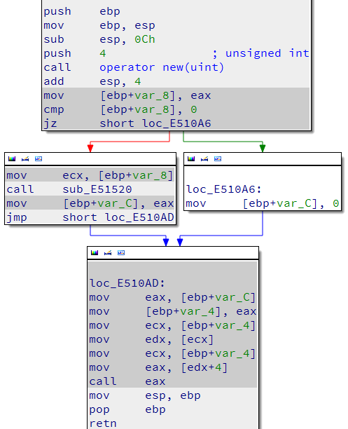
IDA Splode - Examples
Instruction Tracing
Simplest PIN task
On each instruction, log IP
Simplest IDA task
Color those instructions
Example Disassembly
Enhanced
Not Executed
Executed
Notes:
The first thing anybody ever does when they build a Pin tool is count the number of instructions executed.
The second thing they do is just dump out the address of every instruction executed.
For reversing, particularly when looking at a specific crash, this is useful so that we don’t investigate code that was never even executed.
Because IDA Splode does some other extra stuff, there is a third option. So you get “Executed”, “Not Executed”, and “Enhanced”, which means if you select the instruction
And hit a hotkey, cool things happen.

Slide 20
IDA Splode - Examples
Memory Values
For most instructions…
Log memory value read/set
Log memory address
Basic stats on common vals
Values stand out
Example Disassembly
Normal Run
Crashing Run
Notes:
The next most basic, but very useful feature, is basic value tracking. Like I said earlier, we track both the
Address read, what was read from / written to that address, and metadata about both.
Here’s an example of where that could be useful. Normally, this value is a small value. In the crashing run, it’s a giant (negative, actually) value.
To me, this clearly sticks out. Normally this would require a bunch of breakpoints and Windbg commands, which would inevitably get lost
In the giant sea of Windbg output, or in one of three dozen open notepads. Here we get a succinct “ecx is only ever 0x24 or some other crazy value”.
This also makes keeping track of things like counters very simple, since you’ll see sequentially-increasing values.
The other useful bit about this is seeing edge cases. For example, if instead of a 50-50 split between the two values, if one was seen 90% of the time,
That could be useful information in a number of ways.

Slide 21
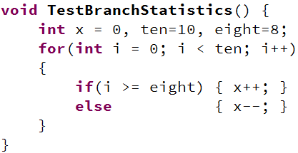
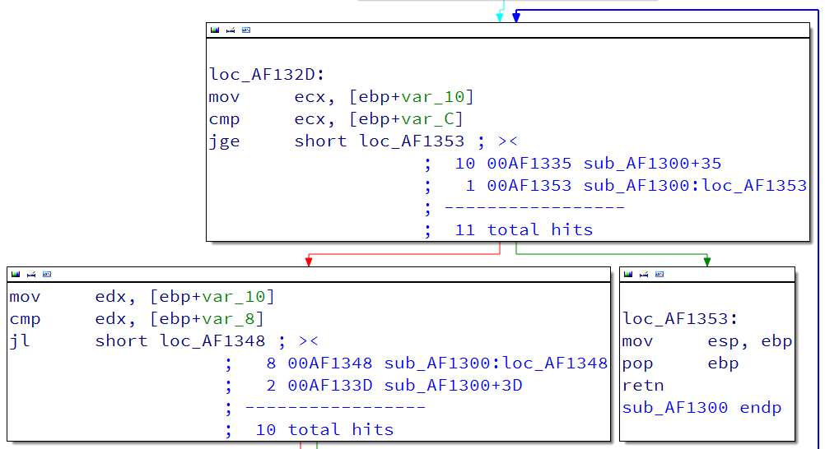
IDA Splode - Examples
Branch Tracing
Logs branches taken
Generates statistics
Useful for
Loops
Error handlers
Example Source
Example Disassembly
Notes:
In addition to simply coloring which instructions are hit, we can also generate statistics about branches.
This is a pretty simple example, so the comparison values are conveniently located, but in a more complex case
It might be very useful not to have to pan around in IDA just to find out when we eventually break out of a given loop,
Or how many times a loop executes.
Here you can see that the outer loop is executed 10 times, and then exits.
The inner conditional is hit 10 times, and takes a given branch eight of them, and the other two times.
Clicking on the addresses before the human-readable name would take you directly to those locations.

Slide 22
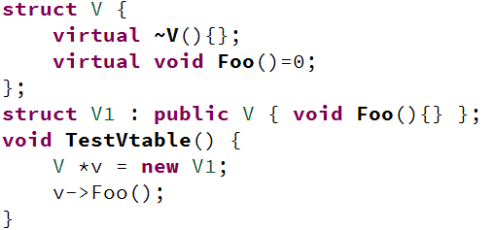

IDA Splode - Examples
Vtable Call
Lots of Pin Tools do this
Might as well do it too
Adds XREFs
Example Source
Example Disassembly
Notes:
Virtual function tables are common targets for both IDA scripts and PIN tools, since they’re both simple to make and very useful.
IDA-Splode includes this functionality for resolving vtable calls, and adds X-refs as appropriate. Not exciting, but useful.
Here you see that the indirect call goes to the V1 implementation of Foo. Clicking on the address would take you directly to the routine.
The ‘1’ at the beginning is the number of times that the call is hit. If there were alternate destinations for the Vtable call, you’d see all
Of them and their hit counts.

Slide 23
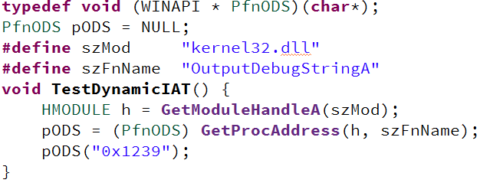
IDA Splode - Examples
Dynamic Imports
Lots of Pin Tools do this
Might as well do it too
Dynamic Import Section
Adds function stub
Adds XREFs
Example Source
Example Disassembly
Notes:
Dynamically-resolved imports are another common target for IDA scripts and Pin tools.
This is almost the exact same thing as the Vtable resolution, except that the Vtable is at least
Sometimes within the current module, while the dynamically-resolved imports are always in
Another module. This doesn’t mean much, but it does mean that we have to resolve symbols
At instrumentation-time.
Here you can see an indirect function call, which is resolved during instrumentation to go
To OutputDebugString.

Slide 24
IDA Splode - Examples
Extramodular Xrefs
Dynamic imports is only half the battle
Where else is <API> called?
Segment created for external refs
Create Fn stub for each enhanced insn
…or batch mode (entire module)
Example Disassembly
Notes:
For dynamic import resolution,
IDA-Splode takes this a little bit further, and creates an extra segment to have stubs for dynamically-resolved
Routines. This allows us not only to see “where did this code go with the ‘call dword’, but also what other code
Makes the same call.”
This resolution of indirect function calls, function stub creation, and x-ref creation can be done both on an
Individual-instruction basis, or for the entire module in one fell swoop.
Here you can see a stub for OutputDebugString from the previous example, as well as the x-ref back to that code.

Slide 25
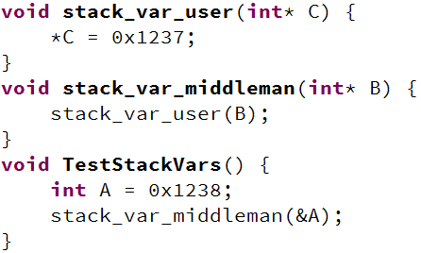
IDA Splode - Examples
Stack Tracking
Tracks all stack frames
Hook each call/ret
Save ESP after call
Check ESP after ret
Ptr-to-stack = obvious
Example Source
Example Disassembly
Notes:
Stack tracking is also a cool feature of IDA-Splode. Since we can instrument anything we want, we can instrument call
CALL and RET instructions, and keep track of the stack. By keeping track of the stack frames, we can determine exactly
Which stack frame a given pointer belongs to, if any. On top of that, we can capture the offset from the base of the frame,
And then use’s IDA’s stack variable detection to pull out that information later.
Here’s an example where we just have a stack-declared integer, and pass it down by reference.
In this example, tracking up a few routines to find out where the arguments came from wouldn’t
Be difficult, but in a larger example with more complex calls, it is much more convenient to just cheat and have the answer.
Here you can see in the enhanced disassembly that the stack-variable “C” is actually a pointer to the stack variable “A” in TestStackVars’ frame.

Slide 26
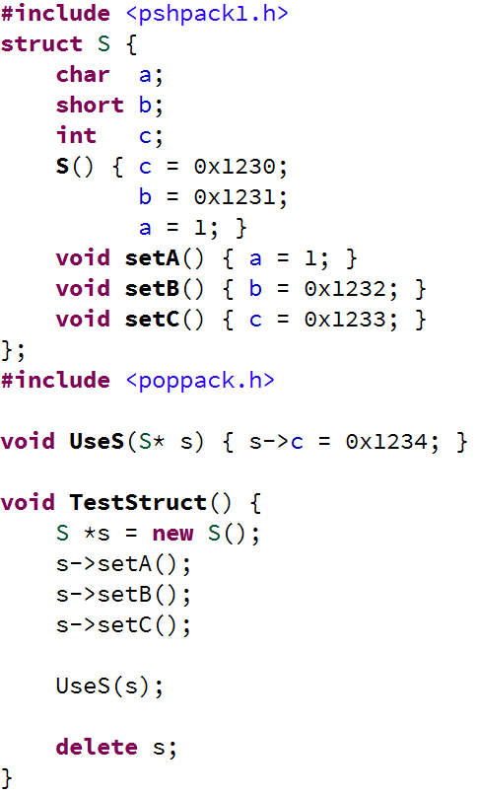
IDA Splode - Examples
Heap Metadata
Contrived Example
Create struct on heap
Set values inside struct
__thiscall and __stdcall
Example Source
Notes:
All of this brings us to the heap metadata and tracking. This is a contrived example, but it works equally well with real-world applications.
To the right is the source for the disassembly you’ll see next. The only important thing is that it’s a structure with three fields, and the
TestStruct routine allocates one on the heap. The constructor is called, and some other routines get called to set values in the struct.
Also note the use of structure packing, and the fields. First is a 1-byte field, then a 2-byte field, then a four-byte field. The struct should be seven bytes.
Easy peasy.

Slide 27
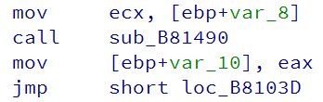
IDA Splode - Examples
Heap Metadata
var_8 looks like a object
Where is it from?
How big is it?
Where else is it used?
How can IDA Splode help?
Example Disassembly
Notes:
In the disassembly, stumbling across a ‘mov ecx’ directly before a ‘call’ is a giveaway of some kind of object-oriented code.
All of the IDA-Splode heap functionality works the same whether it’s C structs passed by pointer, or C++ OO code.
In any case, var_8 looks like some kind of object. Without any context, we have no idea what it is, where it’s from,
How big it is, what the values are in it, or what other routines operate on the data.
This is what IDA splode is really for.

Slide 28

IDA Splode - Examples
Summary View
“Value” only
Single hotkey to enhance
Smaller amount of screen space
Example Disassembly
Allocation size in bytes
Offset Into Allocation (ecx is base of alloc)
First useful frame of alloc stack trace
Notes:
We can enhance the ‘mov ecx’ instruction to get at the Summary View for the heap data. The Summary view is what you’ve seen up
Until this point, because for most things there’s a very limited amount of data to see.
We can see that ‘var_8’ is a pointer to the base of a 7-byte allocation, and we see the origin of the allocation.
This information is available because when PageHeap is enabled, it sticks all of this metadata at the beginning of
The allocation block. The way that IDA-Splode determines the first ‘useful’ frame is simply to filter out things
Like ‘malloc’ and ‘operator new’. I don’t really care what allocator they used to allocate the memory, I want to
Know where the thing came from.

Slide 29
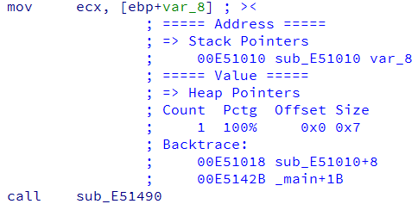
IDA Splode - Examples
Details View
“Address” & “Value”
Does what it says on tin
Heap metadata
More exploded view
Statistics & Stack Trace
Example Disassembly
Where are we reading from or writing to?
What was read from or written to that address?
Notes:
In addition to the summary view, there is also a details view. It’s just a different hotkey.
The two heading, “Address” and “Value” are exactly what they sound like. What address was being manipulated,
And what did we read from it or stick into it.

Slide 30
IDA Splode - Examples
Details View
“Address” & “Value”
Does what it says on tin
Heap metadata
More exploded view
Statistics & Stack Trace
Example Disassembly
Tells us what we already know.
Heap!
One distinct allocation size/offset pair, which is seen 100% of the time.
Allocation stack trace; trims off actual allocator name (e.g. malloc/new). Addresses clickable.
Notes:
In this case, the address being manipulated is var_8. We already know this, because IDA tells us this in the disassembly.
However, the text in the comment isn’t relying on that information, but rather the information gathered at runtime,
Mixed with what IDA knows about the stack for the routine that the stack frame belonged to.
The ‘value’ that we read out of that stack variable is a heap pointer. Here we see the same information as before, but
Enhanced with statistics like the branch stats, and an actual backtrace instead of a single point of allocation.
Allocators name are filtered off the top, and things like “underscore underscore t main” are filtered off the bottom.
Like everything else before, if there were multiple styles of allocations (for example, different offsets into the allocation
From iterating over a bunch of heap memory, or different sizes from polymorphism) each would be printed here.
This can get unwieldy for particularly popular code. For example, it would be a *very* bad idea to try to enhance
Any instructions inside of memset or memcpy. Luckily, those routines are usually imported from msvcrt, so they
Aren’t relevant.

Slide 31

IDA Splode - Examples
Heap Metadata
var_8 looks like a object
Where is it from?
Created at sub_E51010+8
Easy search forward for c’tor
How big is it?
7 bytes
What does it look like?
Where else is it used?
Summary Hotkey
Details Hotkey
Notes:
Awesome, so we thought that var_8 looked like something interesting, and IDA-splode basically gives us two
Autopilot buttons – summary and details. These are the same two hotkeys as used in all the previous examples.
You just pick the instruction you want, hit the hotkey, and IDA-Splode figures out what to display.
We have answered two of our questions before – we know where the data pointed at by var_8 came from,
And we know how big it is. We don’t know what the data looks like, or where else it’s used. From here
Alone, we could probably go back to the allocation site, and see what that routine does with the allocation.

Slide 32

IDA Splode - Examples
Heap Metadata
var_8 looks like a object
Where is it from?
Created at sub_E51010+8
Easy search forward for c’tor
How big is it?
7 bytes
What does it look like?
Three fields (1b, 2b, 4b)
Where else is it used?
sub_E51490
sub_E514C0
Etc.
Compile
Reconstruct Hotkey
Notes:
However, since we have all of this metadata about the allocation, we can do some nifty things.
IDA-Splode doesn’t know anything at all about the address of the allocation being manipulated, because that value isn’t recorded.
What it does know is how big the allocation is, at what offset a given instruction touched it, how many bytes it touched, and the full
Stack trace for that allocation.
It turns out that this is sufficient information to find other instructions which touched the same data. Given the pair
(allocation size, allocation stack trace), we can find all of the other instructions which touched an identical allocation.
From there, we can pull the traces from all of *those* instructions, and automagically re-create a best representation
Of the structure. Here’s an example from the source from before. Again, note the three fields, all accumulating into
Seven bytes. The field sizes are also correct.

Slide 33
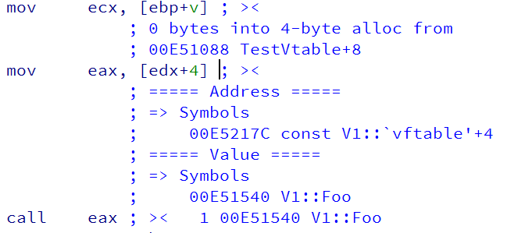
IDA Splode - Examples
Vtable Call (Again)
Same Example
Heap metadata enhanced
Provides a bigger picture
Source
Notes:
Revisiting an earlier example with the vtable, we can combine a few of the previous examples to see how this might be useful.
We know that whatever is in variable “v” is a 4-byte allocation. We know where it came from, we know where its vtable is, and
We know the routine being invoked.
Not once did we need to go to Windbg, or set a breakpoint, for any of this.

Slide 34
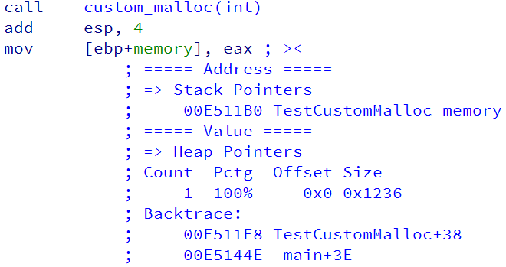
IDA Splode - Examples
Scenario: Custom Allocator
Can’t, or won’t, change to PageHeap-compatible
E.g. Closed-source software implementing its own heap
Redirect execution at runtime
In this example, custom_malloc redirected to malloc
Works because of redirection to malloc
Notes:
One of the issues that will inevitably be run into is the use of custom allocators, which PageHeap doesn’t pick up on.
Pin makes it sufficiently easy to completely redirect execution, so that’s what we do. In this example, there’s a mocked
Custom allocator.
I put a lot of effort into making it very easy to hook allocators, because otherwise you end up with weird nasty hacks.
In this case, custom_malloc is never actually executed, as the pintool redirects execution to the regular malloc.
The same would be set up for the “free” call.
While this example uses the same arguments in custom_malloc as real malloc, that’s not a limitation. The pintool
Has full control over the stack, so you can move around arguments and return addresses to your heart’s content.

Slide 35
IDA Splode - Examples
Scenario: Custom Allocator
Can’t, or won’t, change to PageHeap-compatible
E.g. Closed-source software implementing its own heap
Redirect execution at runtime
In this example, custom_malloc redirected to malloc
Notes:
Here is the single line of code required to intercept the call to custom_malloc and redirect it to malloc.
The arguments (0,1) that are provided are the index of the argument that contains the number of bytes (so that it can be passed along)
And the total number of arguments (so that the stack can be rewritten). Simply providing the symbolic name of the allocator lets
The rest of the infrastructure know where to perform the hooking.

Slide 36
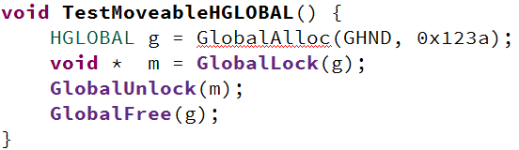
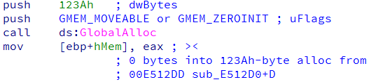
IDA Splode - Examples
Moveable Heap
GlobalAlloc & LocalAlloc
Allow MEM_MOVEABLE flag
Used by IStream COM iface
E.g. lots of MSFT code
Get handle to allocation
OS can move around allocation & data unless “Locked”
No PageHeap Support
Hook RtlAllocateHandle
Keep track at runtime
HGLOBALs are heap pointers, not possible to confuse a la HANDLEs
Notes:
As a more practical example of custom allocator hooking, let’s look at moveable allocations.
At some point in time, it was a good idea to have the OS be able to move allocations around out from
Underneath you, so the standard Windows heap allocators support the notion of MEM_MOVEABLE.
Instead of getting back a pointer to an allocation of the size you requested, you get back a handle to
That allocation. You can later pass that handle to another routine (e.g. GlobalLock) to get a pointer to
The bytes you requested. This is all fine and dandy, unless the application actually passes around handles
rather than pointers.
As a useful side-effect of the implementation of MEM_MOVEABLE allocations, the handles are also
Valid heap pointers, which means that we don’t have to worry about collisions with small constant values
As we would with file handles (which could be the value 1 or 2, etc.)
Essentially, we hook RtlAllocateHandle at a low level, and keep track of all available heap handles.
When IDA-Splode performs its instrumentation and hits any of these values, we automatically
Translate that value into the appropriate address of the actual location.
All of this is important when reversing MSFT code, as COM makes pretty extensive use of HGLOBALs,
As I found out the hard way.
In the example here, you see an allocation request for a MEM_MOVEABLE allocation. While the actual
Return value is some opaque handle value, the instrumentation does some voodoo in the background,
And when we enhance any instructions that pass that handle around, it instead records information
About the actual allocation.

Slide 37
Future
Notes:
So those are the features that currently exist and are worth mentioning.
As far as the future of IDA-Splode…

Slide 38
IDA Splode - Future
Potential Enhancements & Future
Scalability & Analytics
Lots of trace data generated every run
80mb of data for ~0.030 seconds of computation
Defense
CTFGRIND + EMET emulation
Valgrind Rewrite
Useful for ARM binaries
Linux/OS X Support
Not everything is Windows-based
More intuitive/useful UI
Comments are quick-and-easy
IDA runs a full QT UI
Notes:
..Ideally we would be able to integrate it into XXXXXXXX UI. The use-case would be that you’re looking
At some crash, you get the disassembly of the surrounding instructions. Wouldn’t it be nice to just click on the
Instruction, and have it enhanced to say “oh, this is a heap pointer that came from CreateFooBarBaz?”.
Even better, if we have symbols, the enhanced info would be great. If we don’t have enhanced symbols,
The information provided by IDA would be invaluable since you’d get a routine name instead of “module+offset”.
In any case, it’d be nice to have Linux and OS X support at some point in time, but until somebody actually wants
It, I’ll leave it alone. It might be something that I do in my personal time, but only to spin off a small bit of the
Functionality for attack-defend CTF scenarios.
A valgrind port would be nice for the same reason, for ARM-based attack-defend CTFs like DEFCON last year.
Of course, a more intuitive and useful UI would be nice. The comments are quick-and-easy. IDA Pro has
Full support for QT, so any UI is possible, really. Since the idea is to integrate into XXXXXXXX, the need for
A better UI will probably be filled by something web-based through XXXXXXX.

Slide 39
Questions?
Notes:
Does anybody have any questions?

Slide 40
Notes:
Awesome, presentation is over. I’m just going to stumble around blindly in an IDB for a few minutes to show you how some of the
Functionality works when you’re actually reversing. For being introduced to the features, I think screenshots worked well, but you
Kind of have to see how it lets you move around quicker to really “get it”.

