Slide 2
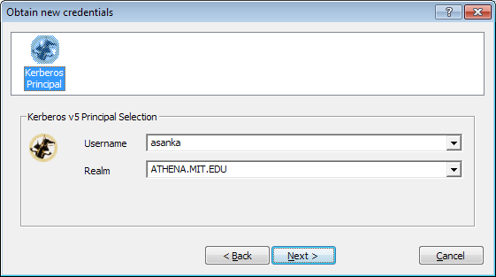
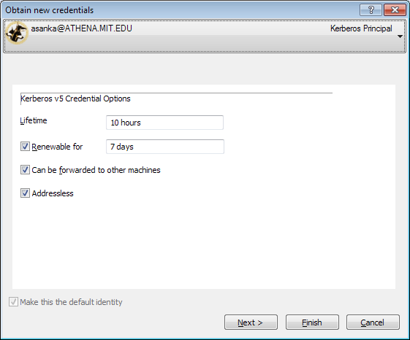
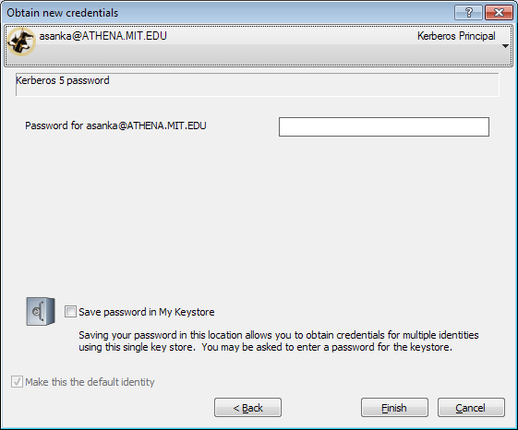
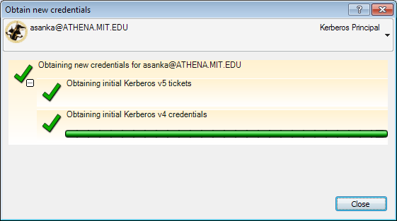
Specify an identity
Configure
Enter password
Done

Slide 3
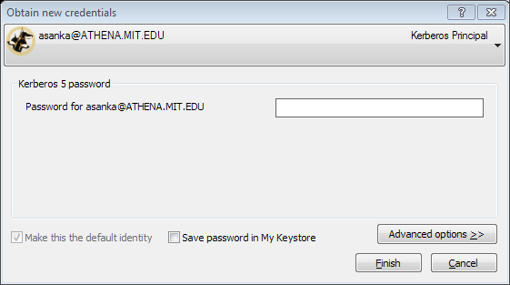
Enter password
Done

Slide 4

Network Identity Manager
Version 2.0

Slide 5
Identity A
Identity B
My KeyStore
Master password
Identity C
Unlocked passwords
Derived identities

