Slide 1
Set<Flow>.add()
flows.containKey()
flows.put()
switchMatrix.get():Set<Flow>
List<DPID>path.add()??
dealWithFlowAddMsg()
Set<Flow>.remove()
Set<DPID>.iterator()
Set<Flow>.iterator()
Set<Flow>.iterator()
flows.get()
switchMatrix.get():
Set<Flow>
flows.remove()
switchMatrix.ketSet():
Set<DPID>
flows.keyset():Set<Flow>
flows.get()
switchMatrix.get():
Set<Flow>
dealWithFlowRemoved
Msg()
updateSwitchSelection()
SwitchSelectionBasic
CentralityModule
IFlowMessageListener
Set<Flow>.iterator()
mapForSwitchSamplingInfo.size ()
mapForSwitchSamplingInfo.put ()
switchMapXid.put()
switchMatrix.get(sw)
:Set<Flow>
FlowAdd_FlowRemoved
Comsumer Thread
getFlowMatrix(): switchMatrix
flowInfos.get()
workingSwitches.
contains()
SwitchSelectionBasicCentralityModule
FlowStatsCompute
ISwitchSelectionService
IFlowStatsService
currentSamplingSws.remove()
workingSwitches.
remove()
switchSelectionUpdate()
currentSamplingSws.contains()
flowInfos.remove()
HashBasedUniformSampling
ISwitchSelectionUpdateListener
mapForSwitchSamplingInfo.remove()
mapForSwitchSamplingInfo.get()
messageRecive()
notifySwitchSelectionUpdate()
workingSwitches.
add()
FlowStatsCompute
currentSamplingSws.add()
Set<Flow>.iterator()
switchMatrix.get(sw)
:Set<Flow>
workingSwitches.add()
getFlowMatrix(): switchMatrix
SwitchSelectionBasicCentralityModule
flowInfos.get()
workingSwitches.contains()
ISwitchSelectionService
FlowStatsCompute
多线程模式下的共享变量，以及作用在其上面的操作
IFlowStatsService
mapForSwitchSamplingInfo.keyset().iterator()
flowInfos.put()
flowStatsUpdate()
mapForSwitchSamplingInfo.get ()
switchMapXid.get()
mapForSwitchSamplingInfo.get()
currentSamplingSws.add()
FlowStatsCompute
HashBasedUniformSampling
实体类上调用的方法
mapForSwitchSamplingInfo.size()
Flow Stats Comsumer Thread
IFlowStatsService
IFlowMessageListener
FlowStatsUpdateListener
mapForSwitchSamplingInfo
.remove()
对应的实体类
HashBasedUniformSampling
接口
workingSwitches.add()
Set<Flow>.iterator()
execute()
workingSwitches.remove()
flows.keyset():Set<Flow>
StopSamplingJob
currentSamplingSws.remove()
getFlowInformation(): flows
SamplingJob
SwitchSelectionBasicCentralityModule
Sampling Job& Stop Sampling Threads
ISwitchSelectionService
流速率信息采集线程

Slide 2
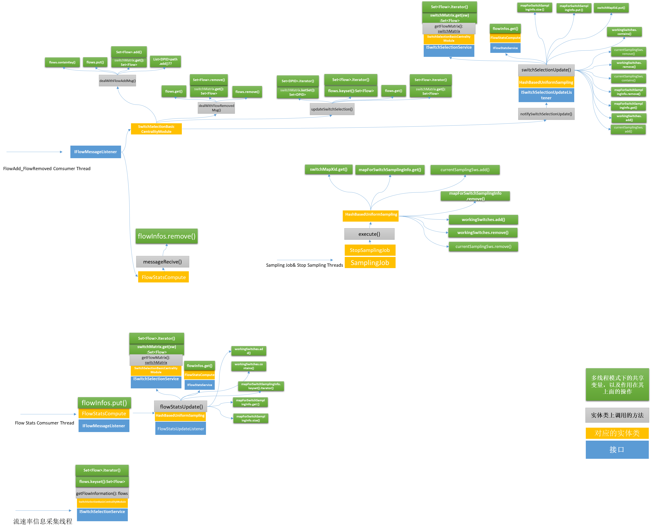

Slide 3
多线程模式下的共享变量，以及作用在其上面的操作
实体类上调用的方法
对应的实体类
接口

Slide 4
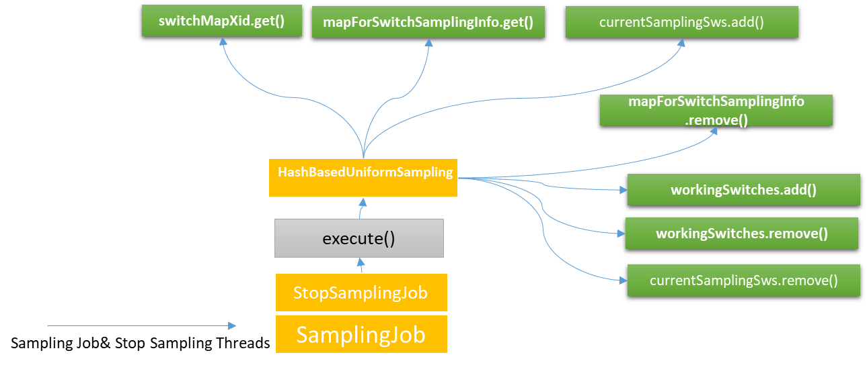

Slide 5
