Slide 1
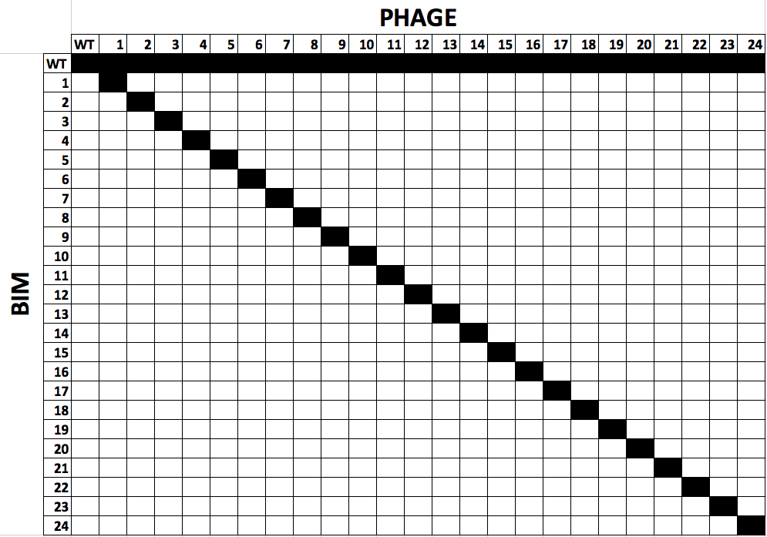
2 BIMs
+
1 lacZ-BIM
+
1 escape phage
+
SM
5 BIMs
+
1 lacZ-BIM
+
1 escape phage
+
SM
11 BIMs
+
1 lacZ-BIM
+
1 escape phage
+
SM
23 BIMs
+
1 lacZ-BIM
+
1 escape phage
+
SM
23 BIMs
+
1 lacZ-BIM
+
ancestral phage
+
SM
1 BIM
+
1 escape phage +
SM
1 BIM
+
ancestral phage
+
SM
1-clone
N = 24
1-clone (ancestral)
N = 24
3-clone
N = 8
6-clone
N = 8
12-clone
N = 8
24-clone
N = 8
24-clone (ancestral)
N = 8

