Slide 1
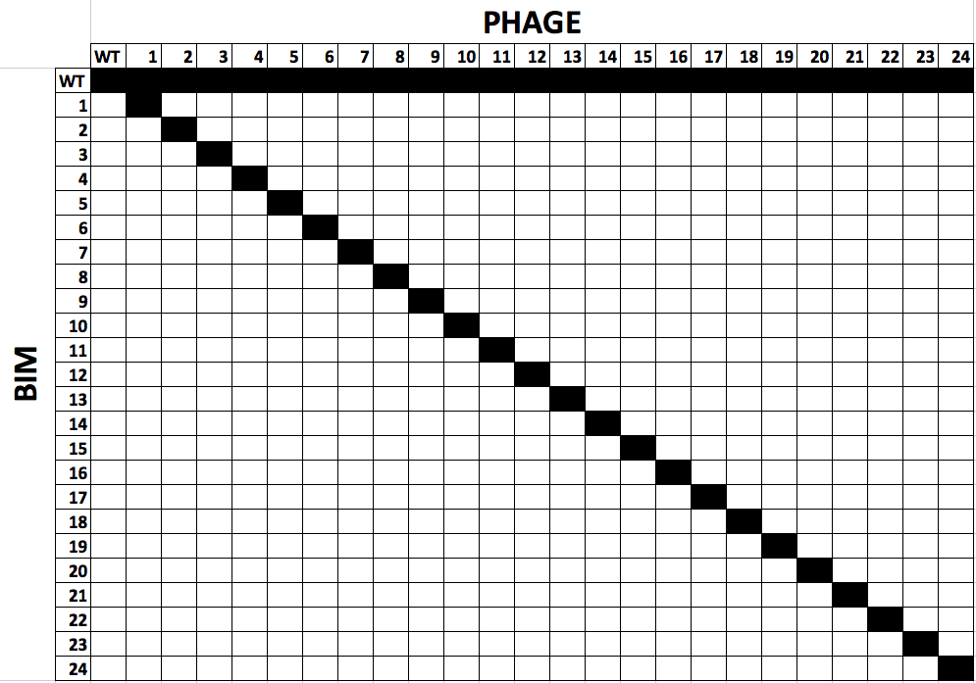
1 BIM
+
1 escape phage
1 BIM
+
ancestral phage
2 BIMs
+
1 lacZ-BIM
+
1 escape phage
5 BIMs
+
1 lacZ-BIM
+
1 escape phage
11 BIMs
+
1 lacZ-BIM
+
1 escape phage
23 BIMs
+
1 lacZ-BIM
+
1 escape phage
23 BIMs
+
1 lacZ-BIM
+
ancestral phage
1-clone
N = 24
1-clone (ancestral)
N = 24
3-clone
N = 8
6-clone
N = 8
12-clone
N = 8
24-clone
N = 8
24-clone (ancestral)
N = 8

