Slide 1
Moneypad
By: Jackson Davis
Capstone Project
Spring 2023
Supervisor: Prof. Brockenbrough

Slide 2
Table of Contents
Student Objectives
Problem Specification
Benchmark Specification
Tools used
Features Implemented
Postmortem
What I delivered
Amendments
Deliverables

Slide 3
Student Objectives
Experience with JavaScript
Learn more about Finance and Money Management
Learn more front-end to make websites
Learn more about SQL
Try to run the web app online

Slide 4
Problem Specification
A Web App for all information related to personal finance and investing
Expected Income
Transactions and Expenses
Stock Information (price, portfolio etc.)
Able to get notifications and recommendations

Slide 5
Tools Used
Backend
Node.js, Express
Frontend
React-Bootstrap, CSS
Database
MySQL
Programming Language
JavaScript
Project Management Tools
Trello
https://trello.com/b/cE22K4xL/jacksons-capstone-project
Source Control Tool
Github
https://github.com/JackD27

Slide 6
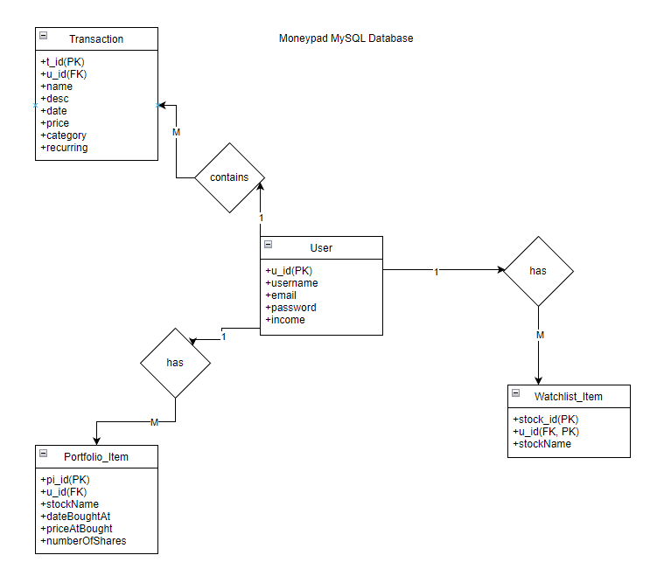
Preliminary Database Design

Slide 7
Demo
Frontend
Backend
Github / Version Control

Slide 8
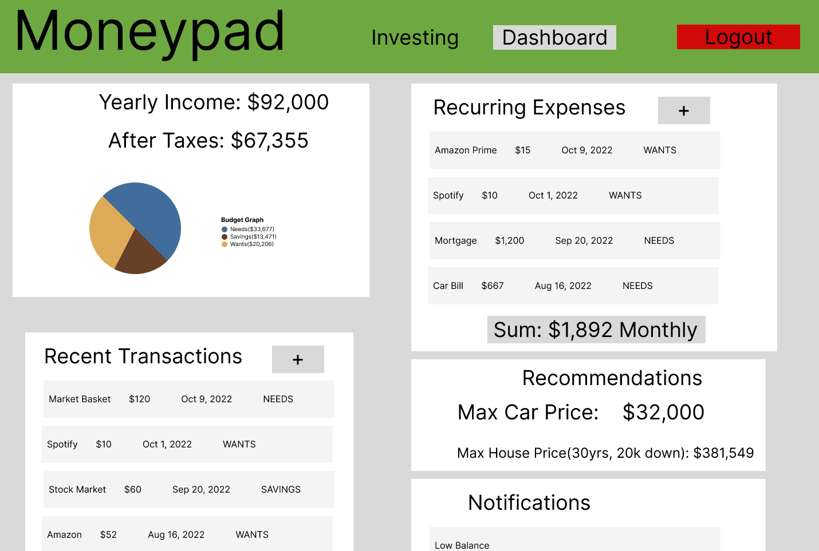
UI Mockup (Dashboard)

Slide 9
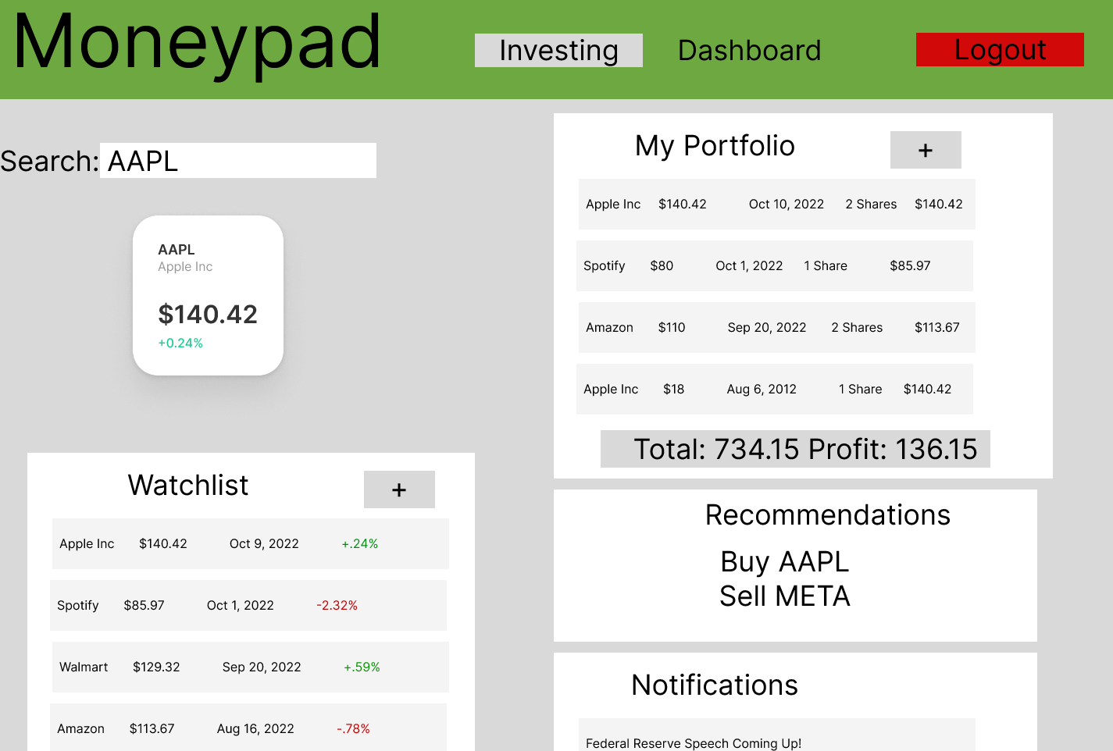
UI Mockup (Investing)

Slide 10
Benchmark Specification
Benchmark 1:Database Setup and Testing
Benchmark 2: User Signup/Login and Testing
Benchmark 3:Transaction Service and Testing
Benchmark 4:Stock Service and Testing
Benchmark 5: GUI Design
Benchmark 6: Notification/Recommendation System and Testing
Benchmark 7: Integration Testing

Slide 11
Features Implemented
Everything from the UI Mockup
Added an Admin page
You can make others admin
Also delete users
Instead of searching for a stock, you can just click on it for more info

Slide 12
Postmortem
Brought a full web app to life from start to finish, frontend and backend.
I learned how to fetch from public APIs other than ones I created myself
Learned much more about parent and child components with React
Gotten much more familiar with JavaScript
Learned much more about a SQL database
Learned how to host a website and how to host a server online as well.

Slide 13
Amendments
Removed search bar from stock page
Removed notifications from stock page
Added a feature to be able to click the stock name, that brings the user to yahoo finance.
Added an admin page
Combined Transactions and Expenses into one component

Slide 14
What I delivered
Original Proposal of CSC 520 and 521 Project
System architecture diagrams
GitHub Source Code
Database Design
Demo of the Project
Presentation
Postmortem
Amendments

Slide 15
Thank you
Questions?

