Slide 1
Moneypad
By: Jackson Davis
Capstone Project
Spring 2023
Supervisor: Prof. Brockenbrough

Slide 2
Table of Contents
Student Objectives
Problem Specification
Benchmark Specification
Tools used
Features Implemented
Postmortem
What I delivered
Deliverables

Slide 3
Student Objectives
Experience with Javascript
Learn more about Finance and Money Management
Learn more front-end to make websites look aesthetically pleasing
Learn more about SQL
Possibly try to connect this to AWS to run it 24/7

Slide 4
Problem Specification
A Web App for all information related to personal finance and investing
Expected Income
Transactions
Expenses
Stock Information (price, portfolio etc.)
Able to get notifications and recommendations

Slide 5
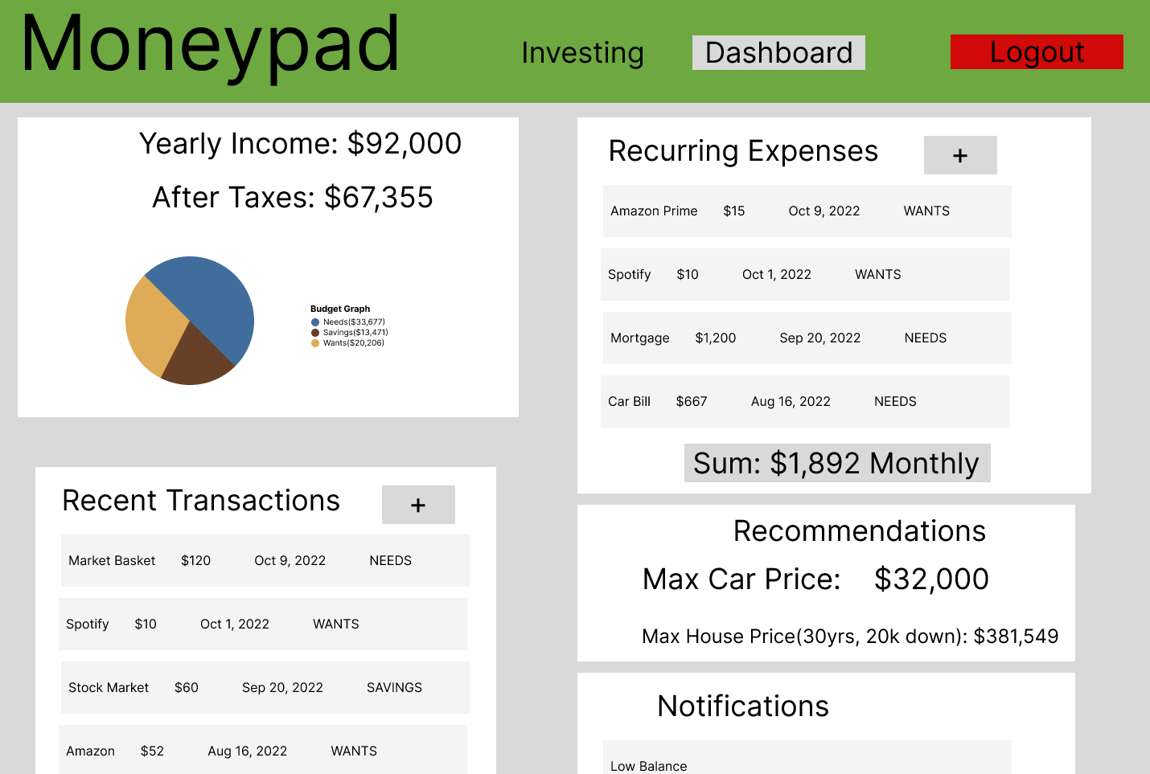
UI Mockup (Dashboard)

Slide 6
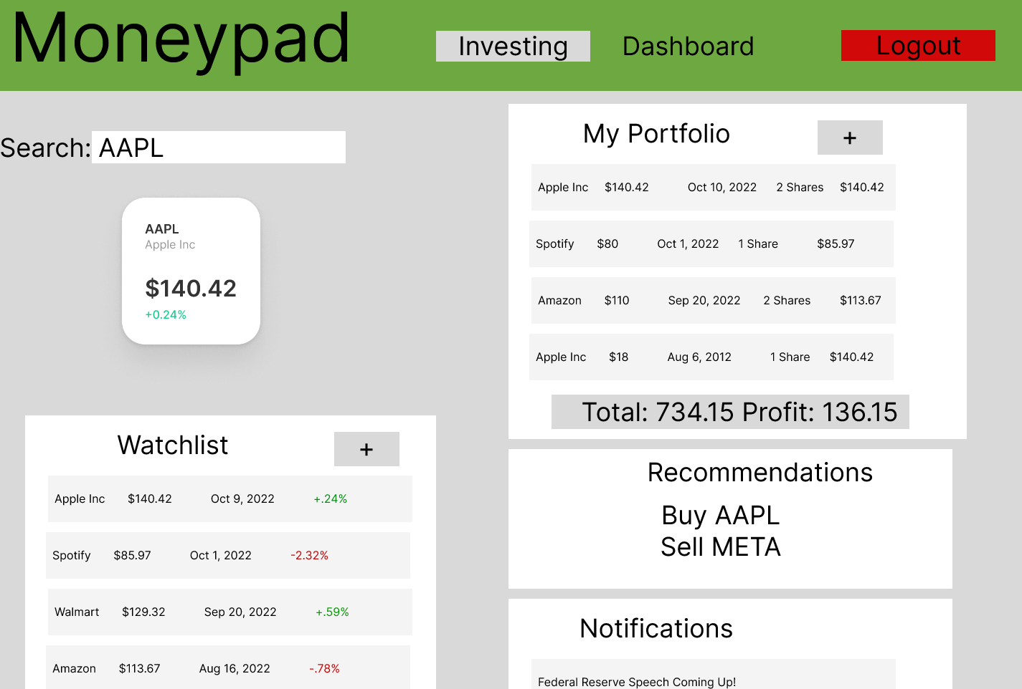
UI Mockup (Investing)

Slide 7
Demo
Frontend
Backend
Github / Version Control

Slide 8
Benchmark Specifcation
Benchmark 1:Database Setup and Testing
Benchmark 2: User Signup/Login and Testing
Benchmark 3:Transaction Service and Testing
Benchmark 4:Stock Service and Testing
Benchmark 5: GUI Design
Benchmark 6: Notification/Recommendation System and Testing
Benchmark 7: Integration Testing
ALL FINISHED

Slide 9
Tools Used
Programming Language
Javascript
IDEs
Visual Studio Code
Backend
Node.js, Express
Frontend
React-Bootstrap, CSS
Database
MySQL
OS
Windows
Project Management Tools
Trello
https://trello.com/b/cE22K4xL/jacksons-capstone-project
Source Control Tool
Github
https://github.com/JackD27

Slide 10
Features Implemented

Slide 11
Post Mortem

Slide 12
What I delivered

Slide 13
Deliverables
Amendments to the proposal.
All design diagrams (e.g., UCD, DFD, ERD, etc.) updated/enhanced with details determined during the implementation of the project
Documentation of completed project functionality
Sample output (e.g., screen shots)
Executables or URL (if the application is hosted in the cloud)
Description of the source control tool used for the project implementation
Project journal
Project postmortem
Presentation Document for CSC521

