Slide 1
Moneypad
By: Jackson Davis
CSC 520
Fall 2022

Slide 2
Table of Contents
Student Objectives
Problem Specification
Solution Process and Design
Preliminary Database Design
CSC 521 Supervisor Selection
Benchmark Specification
Proposed Tools for Implementation
Time Schedule / Grading Scheme
Deliverables

Slide 3
Student Objectives
Experience with Javascript
Learn more about Finance and Money Management
Learn more front-end to make websites look aesthetically pleasing
Learn more about SQL
Possibly try to connect this to AWS to run it 24/7

Slide 4
Problem Specification
A Web App for all information related to personal finance and investing
Expected Income
Transactions
Expenses
Stock Information (price, portfolio etc.)
Able to get notifications and recommendations

Slide 5
Solution Process and Design: Req. Collection and Analysis
Many people don’t know how to manage money or invest properly. This web app will help you on that.
The web app will help with your budgeting
Also be able to see stock information to keep up to date on your favorite stocks
Get recommendations and notifications
Assumptions:
Database with Stock prices over the years from an API

Slide 6
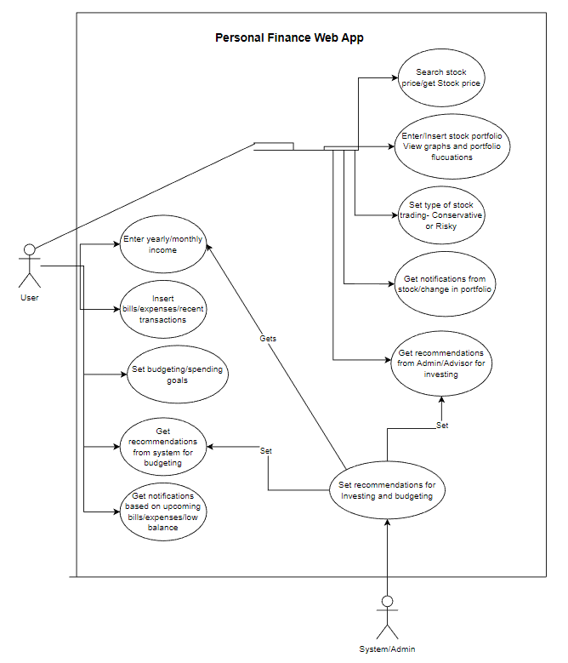
Solution Process and Design: Use Case Diagram

Slide 7
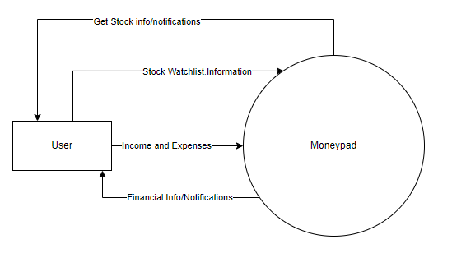
Solution Process and Design: System Context Diagram

Slide 8
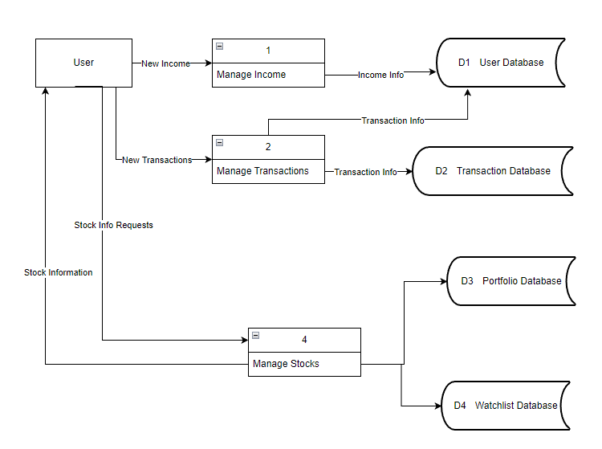
Solution Process and Design: Data Flow Diagram (Level 0)

Slide 9
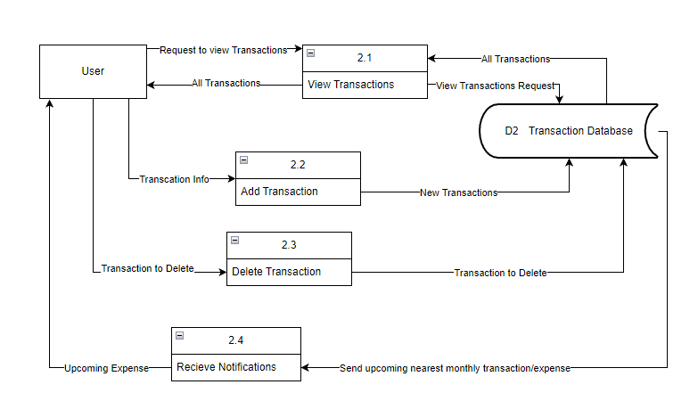
Solution Process and Design: Data Flow Diagram (Level 1)

Slide 10
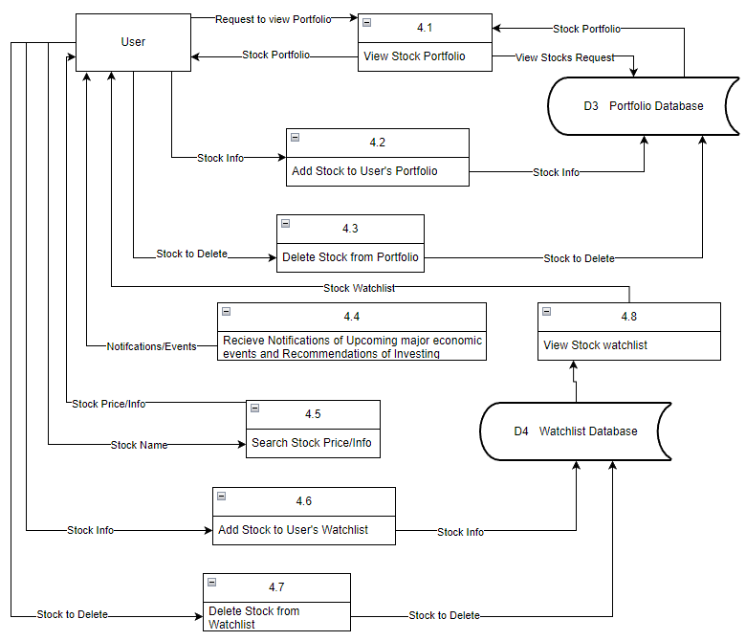
Solution Process and Design: Data Flow Diagram (Level 1)

Slide 11
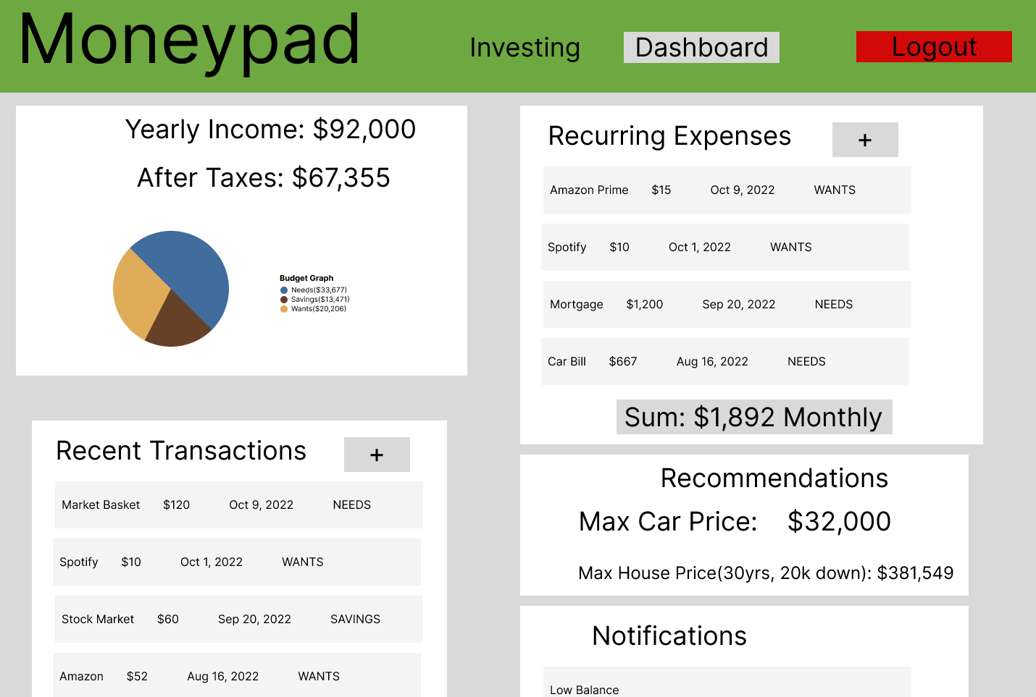
UI Mockup (Dashboard)

Slide 12
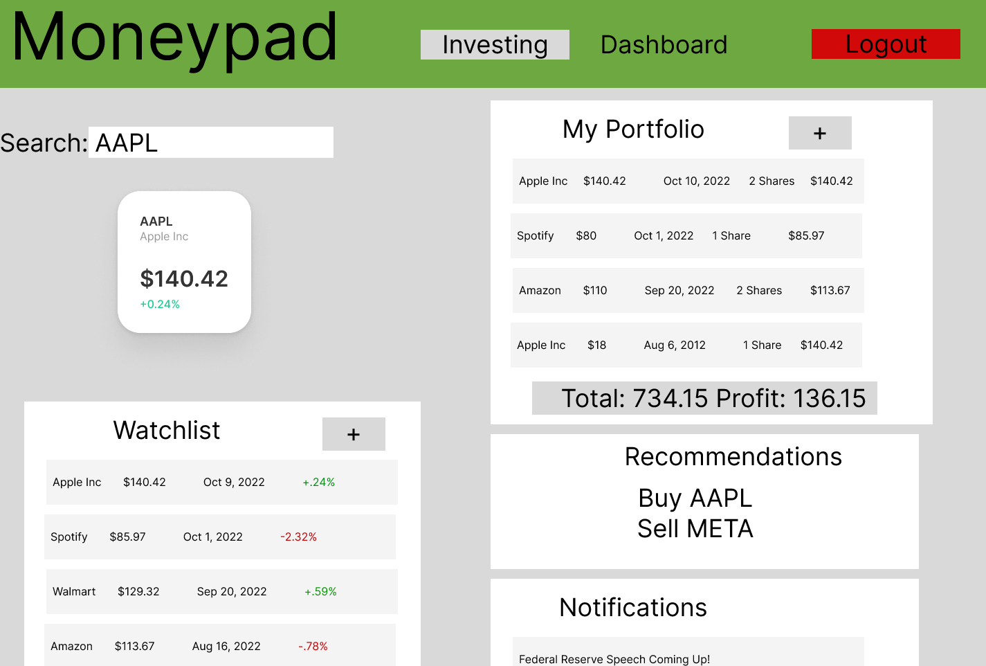
UI Mockup (Investing)

Slide 13
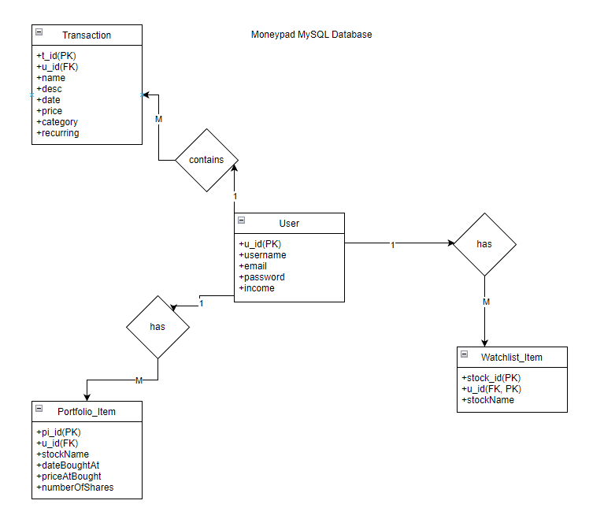
Preliminary Database Design

Slide 14
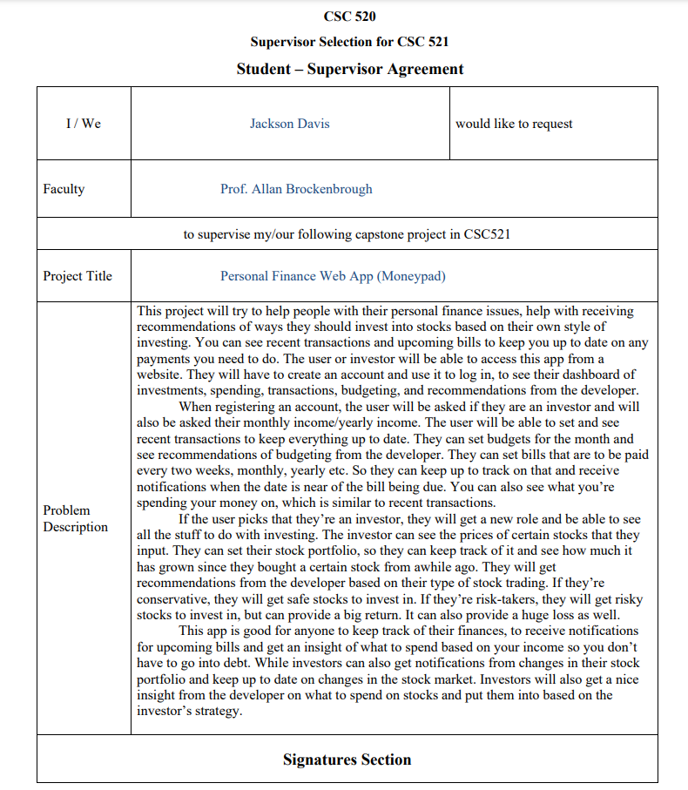
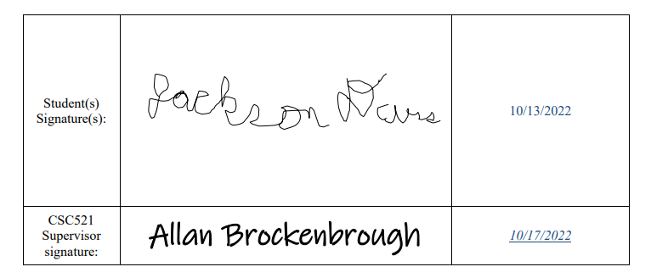
CSC 521 Supervisor Selection

Slide 15
Benchmark Specifcation
Benchmark 1:Database Setup and Testing
Benchmark 2: User Signup/Login and Testing
Benchmark 3:Transaction Service and Testing
Benchmark 4:Stock Service and Testing
Benchmark 5: GUI Design
Benchmark 6: Notification/Recommendation System and Testing
Benchmark 7: Integration Testing

Slide 16
Proposed Tools for Implementation
Programming Language
Javascript
IDEs
Visual Studio Code
Backend
Node.js, Express
Frontend
React-Bootstrap, CSS
Database
MySQL
OS
Windows
Project Management Tools
Trello
https://trello.com/b/cE22K4xL/jacksons-capstone-project
Source Control Tool
Github
https://github.com/JackD27

Slide 17
Time Schedule / Grading Scheme
Database Setup:(1 weeks) (10 pts)
User Signup:(2 weeks) (10 pts)
Transaction Service:(2 weeks) (15 pts)
Stock Service:(3 weeks) (20 pts)
GUI Design(3 weeks) (20 pts)
Notification System(2 week) (10 pts)
Integration Testing:(1 week) (5 pts)
521 Presentation: (10 pts)

Slide 18
Deliverables
Amendments to the proposal.
All design diagrams (e.g., UCD, DFD, ERD, etc.) updated/enhanced with details determined during the implementation of the project
Documentation of completed project functionality
Sample output (e.g., screen shots)
Executables or URL (if the application is hosted in the cloud)
Description of the source control tool used for the project implementation
Project journal
Project postmortem
Presentation Document for CSC521

