Slide 1
Moneypad
By: Jackson Davis
Capstone Project
Spring 2023
Supervisor: Prof. Brockenbrough

Slide 2
Table of Contents
Student Objectives
Problem Specification
Benchmark Specification
Tools used
Features Implemented
Postmortem
What I delivered
Deliverables

Slide 3
Student Objectives
Experience with Javascript
Learn more about Finance and Money Management
Learn more front-end to make websites look aesthetically pleasing
Learn more about SQL
Try to run the web app online

Slide 4
Problem Specification
A Web App for all information related to personal finance and investing
Expected Income
Transactions and Expenses
Stock Information (price, portfolio etc.)
Able to get notifications and recommendations

Slide 5
Tools Used
Programming Language
Javascript
IDEs
Visual Studio Code
Backend
Node.js, Express
Frontend
React-Bootstrap, CSS
Database
MySQL
OS
Windows
Project Management Tools
Trello
https://trello.com/b/cE22K4xL/jacksons-capstone-project
Source Control Tool
Github
https://github.com/JackD27

Slide 6
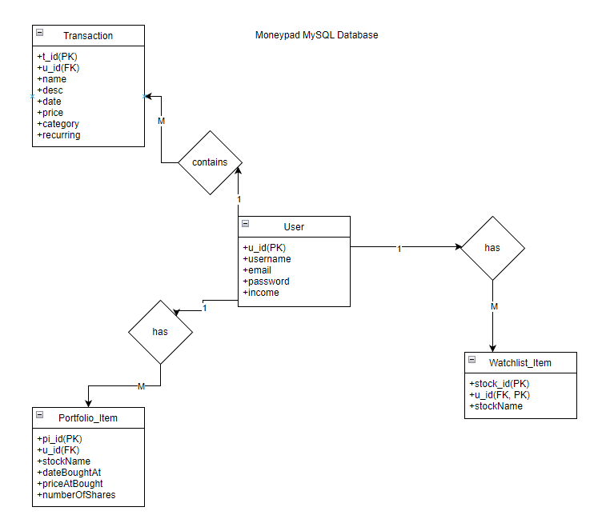
Preliminary Database Design

Slide 7
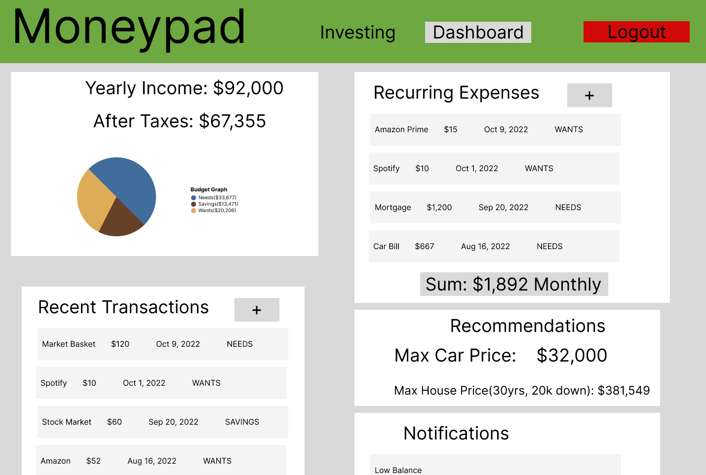
UI Mockup (Dashboard)

Slide 8
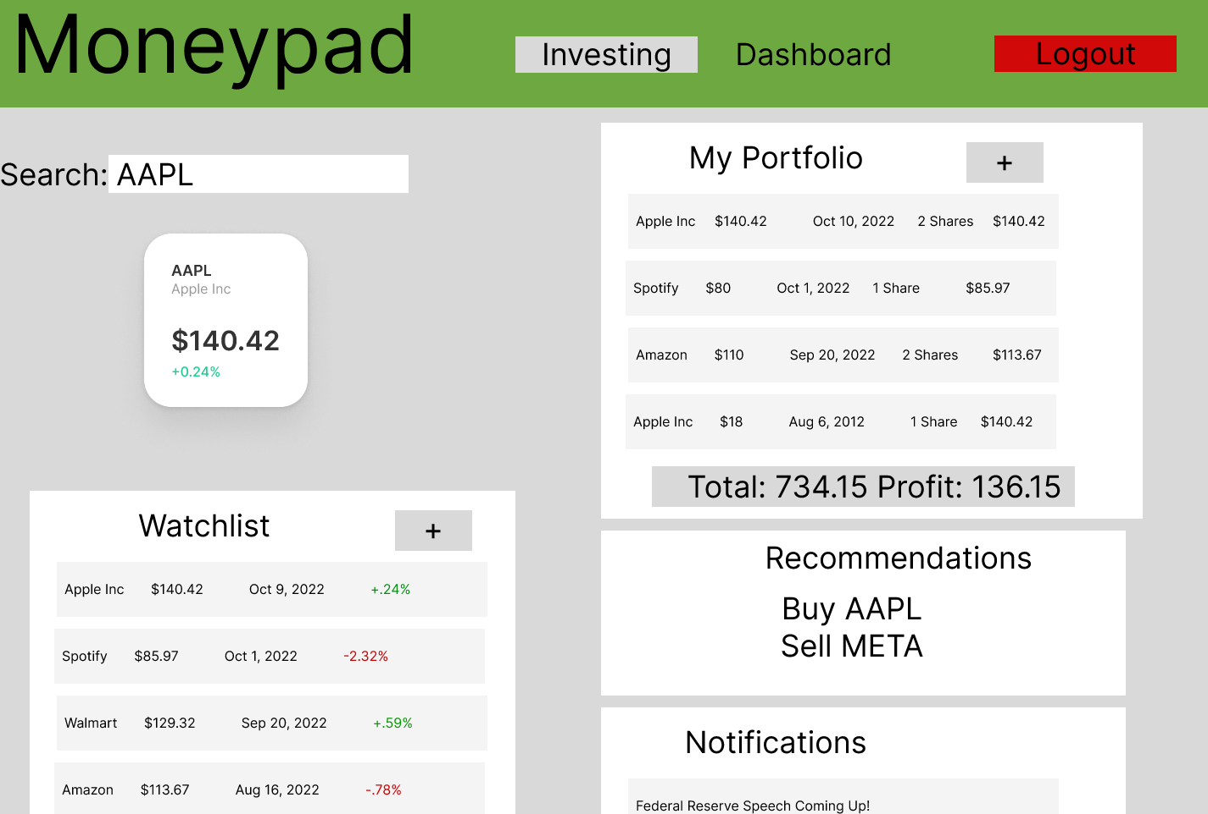
UI Mockup (Investing)

Slide 9
Benchmark Specifcation
Benchmark 1:Database Setup and Testing
Benchmark 2: User Signup/Login and Testing
Benchmark 3:Transaction Service and Testing
Benchmark 4:Stock Service and Testing
Benchmark 5: GUI Design
Benchmark 6: Notification/Recommendation System and Testing
Benchmark 7: Integration Testing
ALL FINISHED

Slide 10
Features Implemented
Everything from the UI Mockup
Added an Admin page
You can make others admin
Also delete users
Instead of searching for a stock, you can just click on it for more info

Slide 11
Post Mortem
I learned how to fetch from public APIs other than ones I created myself
Learned much more about parent and child components with React
Learned how to host a website and how to host a server online as well.
Brought a full web app to life from start to finish.
Gotten much more familiar with Javascript
Learned much more about a SQL database

Slide 12
Demo
Frontend
Backend
Github / Version Control

Slide 13
What I delivered
Original proposal of CSC 520
System architecture diagrams
Objectives
Benchmarks
Database Design
UI Mockup
Demo of the Project
Tools used

Slide 14
Deliverables
Amendments to the proposal.
All design diagrams (e.g., UCD, DFD, ERD, etc.) updated/enhanced with details determined during the implementation of the project
Documentation of completed project functionality
Sample output (e.g., screen shots)
Executables or URL (if the application is hosted in the cloud)
Description of the source control tool used for the project implementation
Project journal
Project postmortem
Presentation Document for CSC521

