Slide 1
Opening a Gym in Massachusetts
By: Jack Daoud
IBM Applied Data Science Capstone

Slide 2
The Problem
chronic conditions contribute to 56% of all mortality in Massachusetts and over 53% of all health care expenditures ($30.9 billion a year).²
Some of these conditions are manageable when an individual commits to a healthy regime, which of course involves physical activity. This is based off the fact that physical inactivity is a risk factor for cardiovascular disease, type 2 diabetes, cancer of the colon and breast, obesity, hypertension, bone and joint diseases, and depression.³

Slide 3
The Solution
A reasonable solution would be for social entrepreneurs to open health clubs in potential markets (growing neighborhoods within Massachusetts). Growing neighborhoods are preferred so that the entrepreneurs could achieve a successful business outcome, i.e. make a profit.
To predict market growth, housing price data will be used as a proxy. This assumes that as the demand for housing increases in a certain neighborhood, then the population of that neighborhood is increasing. Therefore, average home price growth will be used as a primary indicator of potential markets.
Another important factor to consider when opening a business is competition. There are many big franchise gyms that currently exist within Massachusetts, and so when considering a location for a new health club, it would be wise to not set up shop beside a big player. Venue data from Foursquare will be used to help identify competition heavy locations that should be avoided.

Slide 4
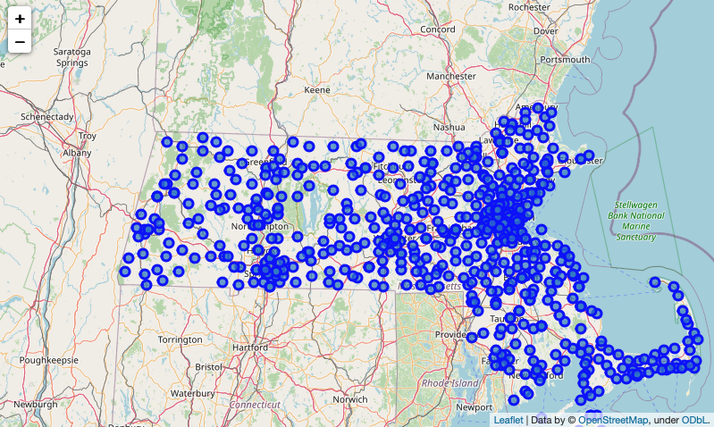
Locations within MA

Slide 5
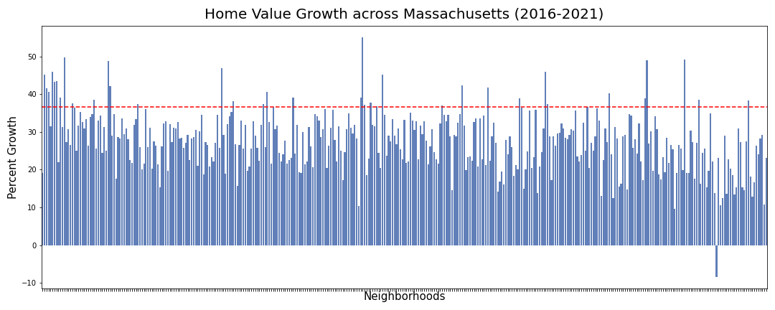
High Growth Locations in MA
High growth is defined as having experienced growth rates in the 90th percentile the past 5 years (2016-2021). This is demarcated by the red line.

Slide 6
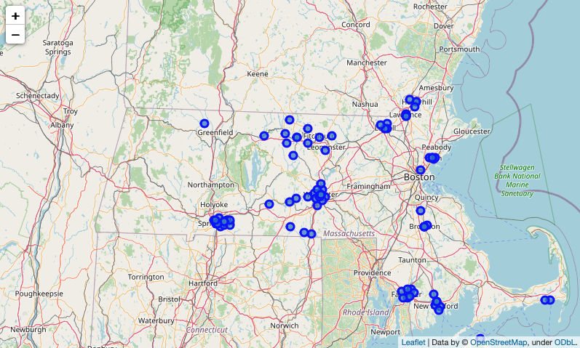
High Growth Locations in MA

Slide 7
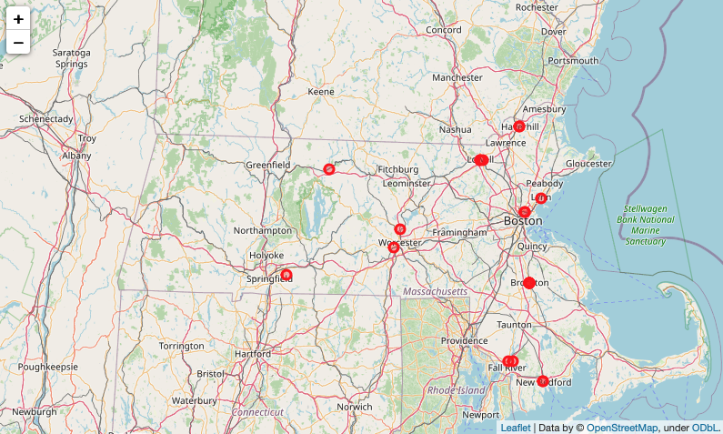
Competition Heavy Locations

Slide 8
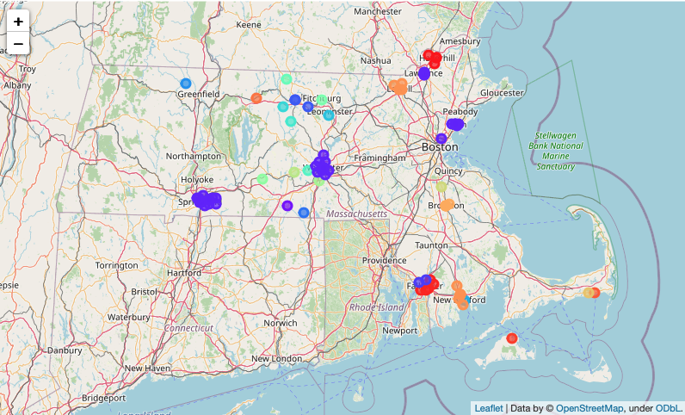
Clustered Neighborhoods

Slide 9
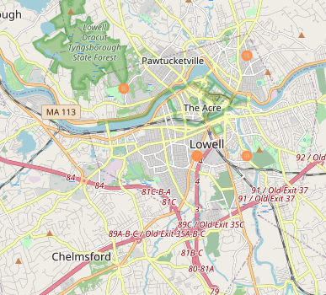
Optimal Neighborhood for a Gym
Lowell is a neighborhood that is experiencing high growth the past 5 years in comparison to the rest of Massachusetts. It also has potentially limited competition at this point.

