Slide 1
Team Project
profit optimization
Authors: Carolina Novello Moreira, Jack Daoud, Max Lembke

Slide 2
OVERVIEW PROJECT
Our Project Step by Step
01
03
Objective
Data Optimization
02
04
Overview
Results

Slide 3



OUR OBJECTIVE
Optimize Profits
Our Client
We are serving the Dominik’s Grocery Store in Chicago and their senior representatives.
Our Challenge
Dominik’s Grocery Store aims to maximize their profits for their Orange Juice products.
Our Objective
The aim of this project is to develop a model to help determine the best pricing and marketing strategy to maximize profits. This should be achieved under the consideration of previous historic data provided by the client.

Slide 4
PRODUCTS OVERVIEW
Dominik’s Grocery Store (Chicago)
1
2
3
4
5
Tropicana Premium
64 oz
Tropicana Premium
96 oz
Tropicana
64 oz
Minute Maid
64 oz
Dominick’s
64 oz
AVG PRICES:
$ 2.90
$ 4.80
$ 3.45
$ 2.27
$ 1.71
~ $ 44,000
Profits
Notes:
$ 44,000 is the average total profit per week obtained with the sales of the 5 products

Slide 5





DATA OVERVIEW
OJ Dataset Description
HISTORICAL DATA
(116 weeks)
Product Sales
Price
Bonus Tags Displayed
Featured in Brochure
Gross margins
How many product units
were sold
How much each product
costs per ounce
Whether or not the product had bonus tags displayed in the store
Whether or not the product was featured in the weekly brochure
Percentage of revenues that are profits
Notes:
Only one product can use each marketing tool at a time.

Slide 6


KEY CHALLENGES
What do we need to tackle?
1) Changing Demand
The change in price of one SKU and change in marketing tools will impact the quantity demanded for other products. We need to consider the impact on all SKUs not only optimize price for one in an isolated context.
2) Changing Gross Margins
A change in price will affect the gross margin. Assuming a historical average or other fixed amount will most certainly lead to an optimized price around the minimum that can be charged.
3) Randomization
There is an infinite amount of possible prices that could be charged. An increase across all prices does not aid the maximization, as various price levels and marketing settings should be considered. The tested settings need to cover “all bases” and be random, whilst only allowing for one SKU to be featured or displayed.

Slide 7
DATA OPTIMIZATION
Stages
01
02
01
Predict DEMAND & Gross Margin
03
Based on historical data, determine how many units of a SKU are sold at a particular price point. Additionally, we predicted gross margin as a function of price per SKU.
02
Calculate revenue
Determine how much revenue is generated per SKU based on the following equation:
units sold * price per oz * nº of oz in the product
03
Calculate Profits
Determine how much profit is generated per SKU based on the following equation:
revenue * gross margins

Slide 8
DATA OPTIMIZATION
Stages
01
04
02
Simulate profits at different prices
We ran 100,000 simulations to define how much profit would be generated by SKUs in a week, considering different price points per SKU, and the use of marketing tools.
03
05
CALCULATE total profits
04
A change in the price of one SKU impacts the sales of other SKUs. Our simulations verified total profits for different combinations of prices per SKU and considered the use of marketing tools.
06
05
Optimize total Profits
We ran 5000 different combinations of prices and marketing settings, to find the best combination of prices per product and use of marketing tools to achieve the highest total profit.
06

Slide 9
OPTMIZED TOTAL PROFITS
Maximum average total profit that can be generated per week with the sales of the 5 products
$ 44,035
$ 135,018
Notes:
$ 44,035 is the original average total profit per week obtained with the sales of the 5 products.
$ 135,018 is the optimized average total profit per week obtained with the sales of the 5 products considering the price changes and use of marketing tools.

Slide 10


OPTMIZED SETTINGS
Combination of prices per product and use of marketing tools that generates the maximum average profit
01
$ 3.20
1
Display Feature
02
03
$ 3.84
$ 2.56
2
3
Display Feature
Display Feature
04
05
$ 3.20
4
5
$ 1.28
Display Feature
Display Feature
Notes:
The prices shown here represent the ideal prices per unit (not prices per ounce). The arrows indicate whether the prices increased or decreased in comparison to the original historical averages.
We are aware that the grocery store can´t use the marketing tools with the same product every week, but the combination presented here is the one that generates the highest amount of profits.

Slide 11
Thank you!
Questions?

Slide 12
APPENDIX

Slide 13
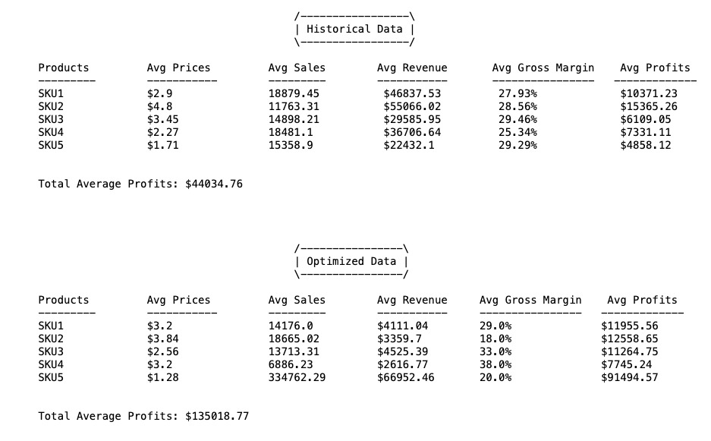
COMPARISON: BEFORE & AFTER OPTIMIZATION

Slide 14
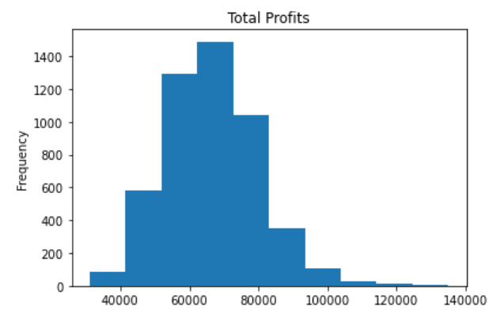
TOTAL PROFITS DISTRIBUTION
Average total profits distribution of all simulations

