Slide 1
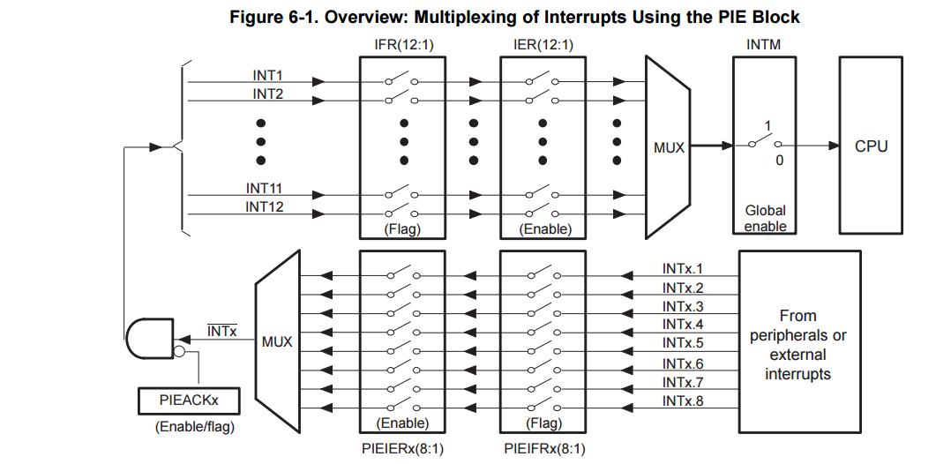
Interrupt Acknowledgement Path

Slide 2
Step 1: Setup
Interrupts must be disabled during the configuration process.
Example Code:
void main(void) {
bootstrap();
DINT; // Turn off ALL interrupts
// Default all PIE interrupts disabled
// and flags are cleared.
InitPieCtrl();
IER = 0x0000; // Disable CPU interrupts
IFR = 0x0000; //clear interrupt flags
// Initialize the PIE vector table
InitPieVectTable();
}
PIE Vector Table
Event Name | Pointer
PieVectTable.* | &nullptr
Event Name | Pointer
PieVectTable.* | &nullptr

Slide 3
Step 2: Map ISR’s
Load the pointers to ISR’s into the vector table
Example Code:
void main(void) {
bootstrap();
DINT; // Turn off ALL interrupts
// Default all PIE interrupts disabled
// and flags are cleared.
InitPieCtrl();
IER = 0x0000; // Disable CPU interrupts
IFR = 0x0000; //clear interrupt flags
// Initialize the PIE vector table
InitPieVectTable();
EALLOW;
PieVectTable.ECAP1_INT = &ecap1_isr;
PieVectTable.ECAP2_INT = &ecap2_isr;
PieVectTable.ECAP3_INT = &ecap3_isr;
PieVectTable.ADCINT1 = &adc_isr;
EDIS;
}
PIE Vector Table
Event Name | Pointer
PieVectTable.ECAP1_INT | &ecap1_isr
PieVectTable.ECAP2_INT | &ecap2_isr
PieVectTable.ECAP3_INT | &ecap3_isr
PieVectTable.ADCINT1 | &adc_isr

Slide 4
Step 3: Enable Groups
Each interrupt event is grouped into one of 12 IER groups
Example Code:
void main(void) {
bootstrap();
DINT; // Turn off ALL interrupts
// Default all PIE interrupts disabled
// and flags are cleared.
InitPieCtrl();
IER = 0x0000; // Disable CPU interrupts
IFR = 0x0000; //clear interrupt flags
// Initialize the PIE vector table
InitPieVectTable();
EALLOW;
PieVectTable.ECAP1_INT = &ecap1_isr;
PieVectTable.ECAP2_INT = &ecap2_isr;
PieVectTable.ECAP3_INT = &ecap3_isr;
PieVectTable.ADCINT1 = &adc_isr;
EDIS;
// Enable interrupts:
IER |= (M_INT1 | M_INT3 | M_INT4);
}
PIE Vector Table
Event Name | Pointer
PieVectTable.ECAP1_INT | &ecap1_isr
PieVectTable.ECAP2_INT | &ecap2_isr
PieVectTable.ECAP3_INT | &ecap3_isr
PieVectTable.ADCINT1 | &adc_isr

Slide 5
Step 4: Enable Individual Events
Then, each individual event is enabled.
void main(void) {
bootstrap();
DINT; // Turn off ALL interrupts
// Default all PIE interrupts disabled
// and flags are cleared.
InitPieCtrl();
IER = 0x0000; // Disable CPU interrupts
IFR = 0x0000; //clear interrupt flags
// Initialize the PIE vector table
InitPieVectTable();
EALLOW;
PieVectTable.ECAP1_INT = &ecap1_isr;
PieVectTable.ECAP2_INT = &ecap2_isr;
PieVectTable.ECAP3_INT = &ecap3_isr;
PieVectTable.ADCINT1 = &adc_isr;
EDIS;
// Enable interrupts:
IER |= (M_INT1 | M_INT3 | M_INT4);
PieCtrlRegs.PIEIER1.bit.INTx1 = 1;
PieCtrlRegs.PIEIER4.bit.INTx1 = 1;
PieCtrlRegs.PIEIER4.bit.INTx2 = 1;
PieCtrlRegs.PIEIER4.bit.INTx3 = 1;
}
PIE Vector Table
Event Name | Pointer
PieVectTable.ECAP1_INT | &ecap1_isr
PieVectTable.ECAP2_INT | &ecap2_isr
PieVectTable.ECAP3_INT | &ecap3_isr
PieVectTable.ADCINT1 | &adc_isr

Slide 6
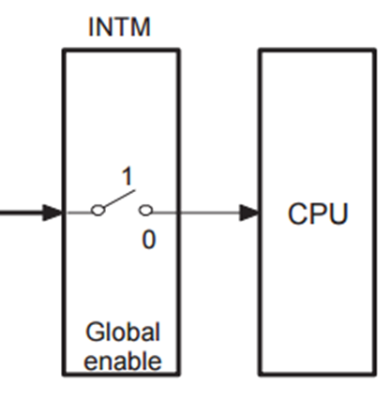
Step 5: Enable Global Interrupts
Turn them on!
void main(void) {
bootstrap();
DINT; // Turn off ALL interrupts
// Default all PIE interrupts disabled
// and flags are cleared.
InitPieCtrl();
IER = 0x0000; // Disable CPU interrupts
IFR = 0x0000; //clear interrupt flags
// Initialize the PIE vector table
InitPieVectTable();
EALLOW;
PieVectTable.ECAP1_INT = &ecap1_isr;
PieVectTable.ECAP2_INT = &ecap2_isr;
PieVectTable.ECAP3_INT = &ecap3_isr;
PieVectTable.ADCINT1 = &adc_isr;
EDIS;
// Enable interrupts:
IER |= (M_INT1 | M_INT3 | M_INT4);
PieCtrlRegs.PIEIER1.bit.INTx1 = 1;
PieCtrlRegs.PIEIER4.bit.INTx1 = 1;
PieCtrlRegs.PIEIER4.bit.INTx2 = 1;
PieCtrlRegs.PIEIER4.bit.INTx3 = 1;
EINT; // Enable global interrupts
ERTM; // (for debugging purposes)
}
PIE Vector Table
Event Name | Pointer
PieVectTable.ECAP1_INT | &ecap1_isr
PieVectTable.ECAP2_INT | &ecap2_isr
PieVectTable.ECAP3_INT | &ecap3_isr
PieVectTable.ADCINT1 | &adc_isr

Slide 7
Final Picture
void main(void) {
bootstrap();
DINT; // Turn off ALL interrupts
// Default all PIE interrupts disabled
// and flags are cleared.
InitPieCtrl();
IER = 0x0000; // Disable CPU interrupts
IFR = 0x0000; //clear interrupt flags
// Initialize the PIE vector table
InitPieVectTable();
EALLOW;
PieVectTable.ECAP1_INT = &ecap1_isr;
PieVectTable.ECAP2_INT = &ecap2_isr;
PieVectTable.ECAP3_INT = &ecap3_isr;
PieVectTable.ADCINT1 = &adc_isr;
EDIS;
// Enable interrupts:
IER |= (M_INT1 | M_INT3 | M_INT4);
PieCtrlRegs.PIEIER1.bit.INTx1 = 1;
PieCtrlRegs.PIEIER4.bit.INTx1 = 1;
PieCtrlRegs.PIEIER4.bit.INTx2 = 1;
PieCtrlRegs.PIEIER4.bit.INTx3 = 1;
EINT; // Enable global interrupts
ERTM; // (for debugging purposes)
}
PIE Vector Table
Event Name | Pointer
PieVectTable.ECAP1_INT | &ecap1_isr
PieVectTable.ECAP2_INT | &ecap2_isr
PieVectTable.ECAP3_INT | &ecap3_isr
PieVectTable.ADCINT1 | &adc_isr

Slide 8
Step 1: Enable Interrupts
// Enable global Interrupts and higher priority real-time debug events:
// Enable Global interrupt INTM
ERTM; // Enable Global realtime interrupt DBGM

