Slide 1

Club Forum app
Development

Slide 2
Requirements of the app
Provide a forum for a martial arts club to record:
Members
Techniques
Classes
Details of classes (which techniques were taught and which members attended)

Slide 3
Development
MoSCow
Azure Boards
Git
Pycharm
Google cloud
SQL
Jenkins

Slide 4
MoSCow
Must:
Have CRUD functionality on all tables
Use VCS (Git)
Use Flask
Use Jenkins with GUNICORN
Hosted on VM (GCP)

Slide 5
MoSCoW
Should
Have login page for admins
Be scaled to multiple clubs

Slide 6
MoSCoW
Could
Have login for members
Have CSS styling and formatting

Slide 7
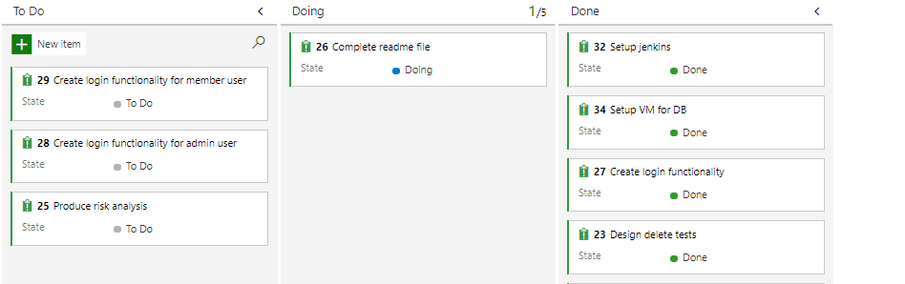
Project planning

Slide 8
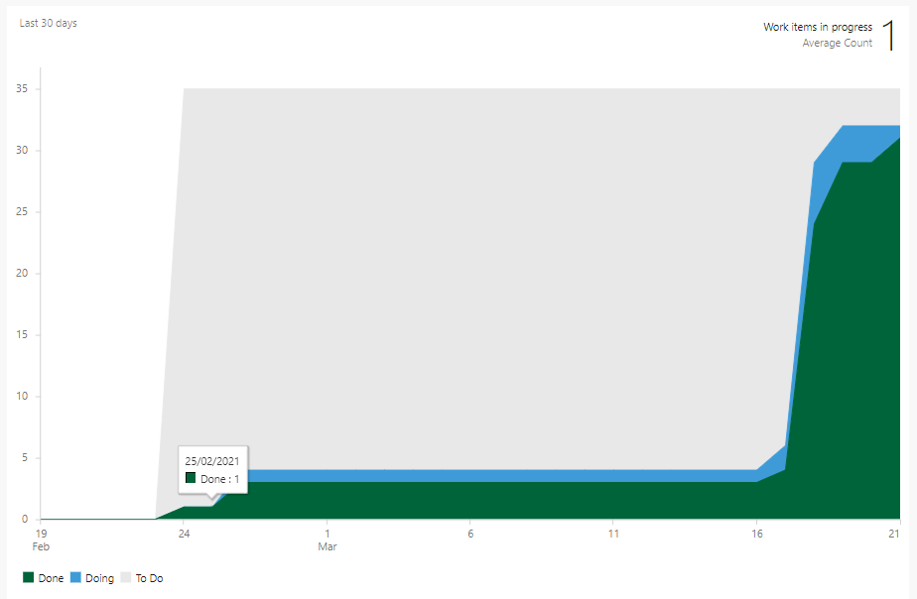
Project planning

Slide 9
Database
The app uses a MySQL database
Three main tables:
Members, Techniques, Classes
Two intersection tables:
Members/Classes, Techniques/Classes

Slide 10
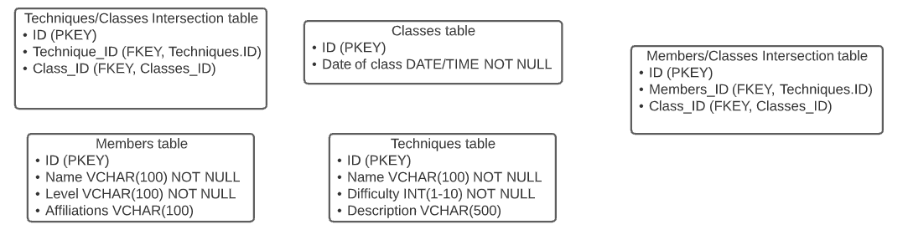
Database defenitions

Slide 11
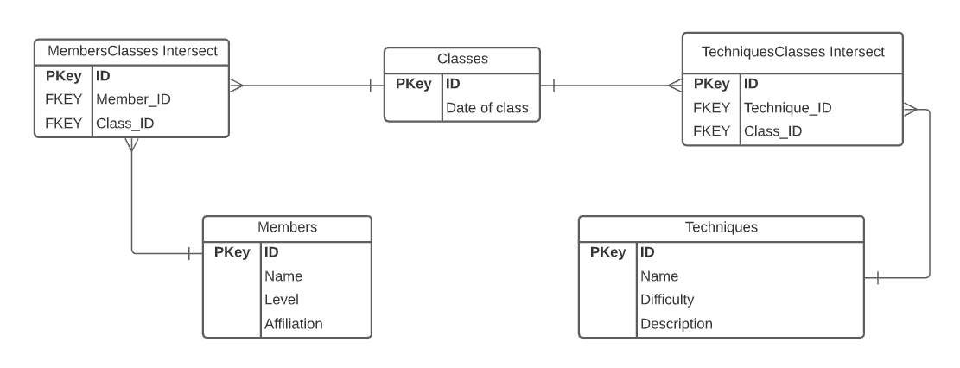
Database ERD

Slide 12
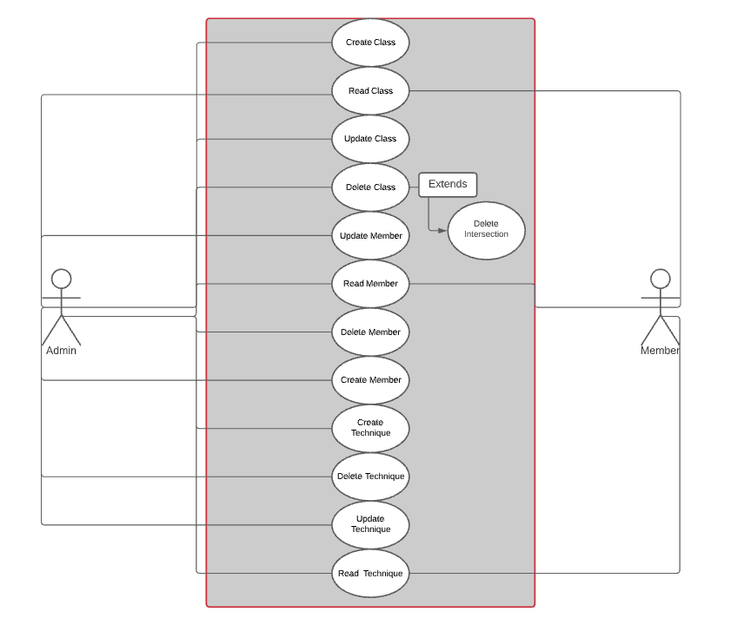
Use Case
*As users were not a base requirement, and they were not fully implemented. All users are currently admins

Slide 13
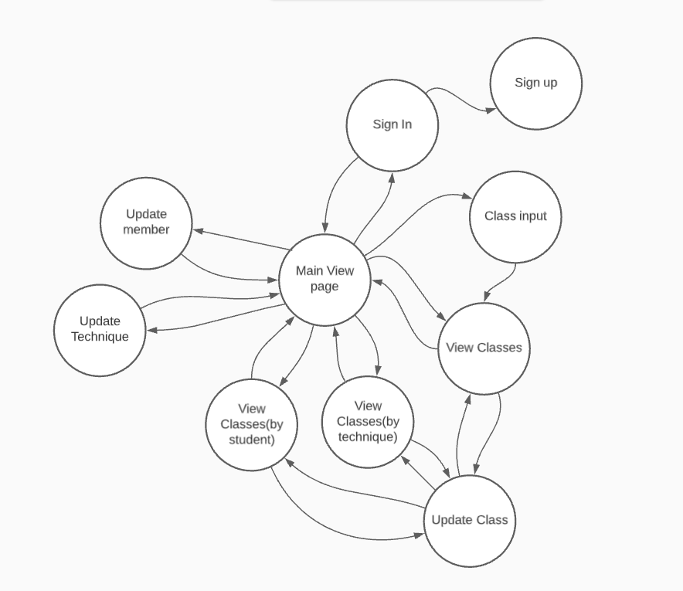
GUI design
A simple GUI with html
Finite state machine:

Slide 14
Testing the application
Once "complete" testing was done to ensure:
All templates rendered
All redirects completed
All CRUD functions worked correctly

Slide 15
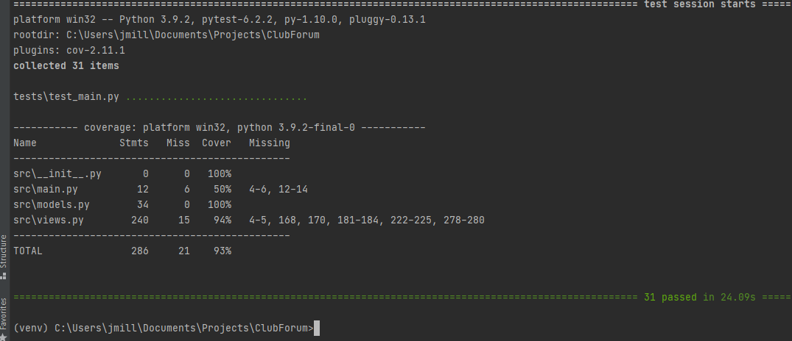
Testing Coverage
A total of 31 tests were created covering 93% of the code.

Slide 16
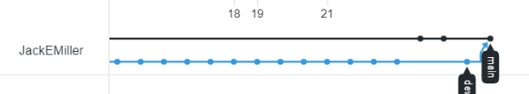
Git
As we have passed testing and ready to deploy we can merge our Development branch into our main branch.

Slide 17
Demonstration and questions:
Lets go!:
http://34.121.73.96:5000/

