Slide 1

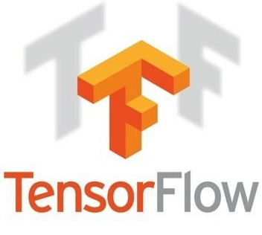

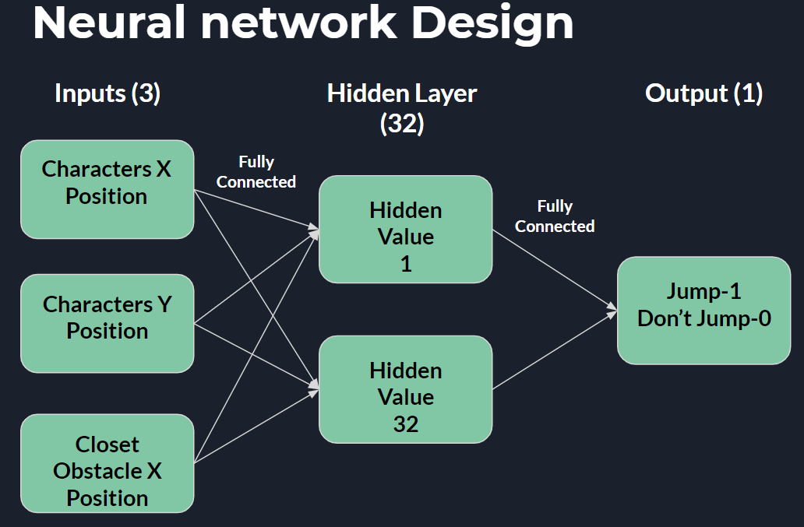
Develop and train an artificial neural network to play Geometry Dash
Jack Fennell
Introduction
Methods
Results
Conclusions
For my Research Project I wanted to create an artificial neural network (ANN) to play a game of Geometry Dash.
Geometry Dash is an endless runner game in which the player must avoid obstacles only using jump.
I wanted to use two different training methods of Backpropagation and Genetic Algorithms to train my ANN to play the game and compare the results.
Develop Game and ANN in Python as most available external libraries like Tensorflow run best in Python.
Develop the Geometry Dash game through the Arcade library.
Collect Data while playing the game for training the network and by extension the Backpropagation training.
Use Genetic Algorithm by letting the game play with several same characters with randomised weights and allow them to adjust based off the top 2 results
Recreated the Geometry Dash Game minus some complexity with the obstacles.
Designed, developed and train a ANN with the help of TFLearn an extension of Tensorflow.
Learned how to code in Python libraries, Arcade and TFLearn.
Learned about the complexity of ANN’s and their uses in a varying field of research.
Learned how different
ANN training methods have varying results and how they work.
Backpropagation adjusting it’s weights
backwards to correct them from the output.
Genetic Algorithm learning from the best surviving data with continues through generations to reach the best result.

