Slide 1

RubixOnRails
Analysing periodic Santander bike usage in London to predict hourly demand

Slide 2
Introduction
Climate change and global warming is a growing issue, especially in densely populated cities such as London.
In 2010 Santander bikes were introduced into London not just to improve transport within the city but, also to reduce pollution.
We aimed to analyse how different variables affect the number of bikes rented on a day; this can vary from weather controls such as it being cloudy to whether it is on the weekend or during a rush hour. From this, we wanted to investigate the possibility of accurately predicting the number of bikes required for the next hour/day.

Slide 3

Objectives
Primary Objective
Create a model that will provide accurate predictions of bike usage count for any given hour provided the required data.
Secondary Objective #1
Find relationships between predictors from the dataset.
Secondary Objective #2
Identify trends within the dataset.

Slide 4
Methodology
Linear Regression
Find relationships between predictors
Time Series
Establish trends within a year period
Neural Networking
Train models to predict future usage given estimated predictors

Slide 5

Data Source
Sourced from a TFL OpenData dataset on kaggle.com
Provides number of bikes in use per hour
Provides contextual data such as:
Temperature
Weather
Wind Speed
If it is a weekend or holiday

Slide 6
Data Quality
Precision
Accuracy
Bias
Conistency
Completeness

Slide 7
Key Development Notes (Regression)
Created multi-linear and non-linear models – disregarded non-linear models as no single predictor displayed linear relationship with bike count
Most likely due to multi-collinearity with predictors
Standardized data to overcome issue of different measuring units
Converted hours to numeric values 1-24
Figured best polynomial for non-linear orders for majority of variables are 4, higher makes little difference excepting risking overfitting
Exception was timestamp, which was
Did not remove outliers

Slide 8
Key Development Notes (Time Series)
Pre-processing
Implementation of Bins
8 Bins of 3-hours to analyse rush hour periods better.
Use of Mode for weather code representation within each Bin.
Use of Mean for the rest of the variables within the dataset such as temperature & wind speed.
Analysis of trends within
Weekdays (Factors such as Rush hour & various weather conditions)
Weekends & Holidays (Factors such as Time of the day, Tourists & weather conditions)
different seasons of the year (Factors such as Weather & Holidays)

Slide 9
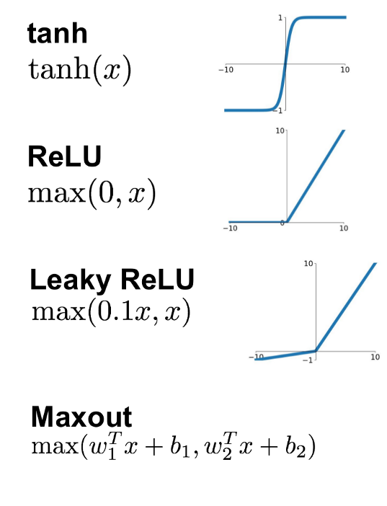
Key Development Notes (NN)
Standarised Data with Z Scoring and 0 to 1
Ran epochs until we hit period of no improvement
2 Hidden Layers with 40 / 40 Neurons
More started to overfit
Experimented with different functions
Tanh didn't handle periodicity of data well
ReLU handled better but overfitted
Leaky ReLU leaked too much
Maxout good compromise of ReLU and Leaky ReLU
Image courtesy of towardsdatascience.com (Pawan Jain, Jun 12)

Slide 10
Results and Findings (Regression)
Relatively average MAE and RMSE, whilst low R^2 values
Multi-linear showed no inherent improvement compared to non-linear regression
Weekend and weekdays do make difference to results
Observed temperature and real feel temperature changed results very little
Temperature was found to have the strongest relationship
However no relationship really stood out, suggesting regression was not the best method to predict bike count

Slide 11
Results and Findings (Time Series)
The purpose of time series was not to necessarily retrieve scores, but more to find trends within data.
Due to multiple factors simultaneously affecting the number of Santander bikes being used, we have come to the conclusion that Time Series isn’t the best method for finding out the precise reason behind trends.
However, we can show consistent pattern coinciding with rush hour period.

Slide 12
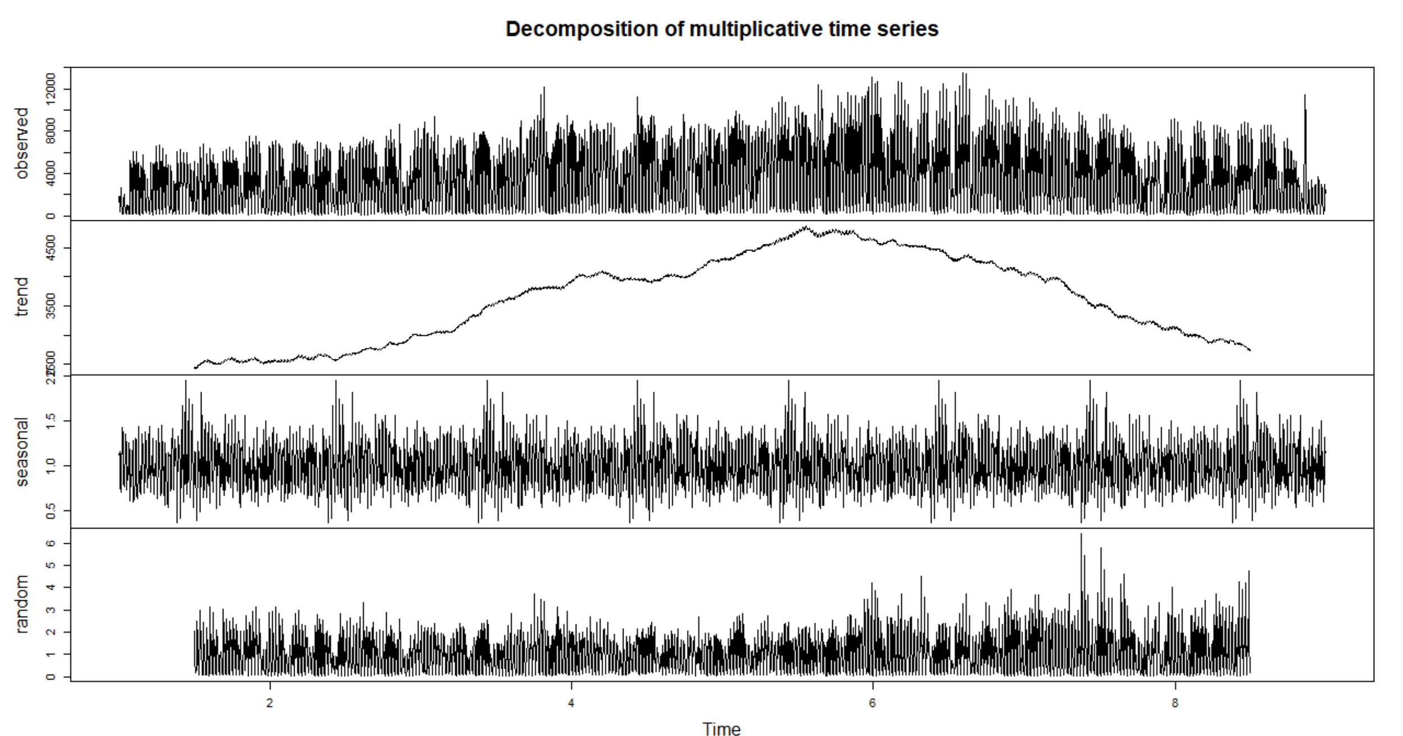
Bike count analysed over 2016 data starting from January.

Slide 13
Results and Findings (Neural Networks)
The model reached high r^2 values with the highest being 0.92 when applying the maxout activation function.
The most influential factors are
Time of the day
Weekend or Weekday
Other predictors still contribute and deliver the nuance to the results
Given a weather forecast for the next day, we can inform with relative confidence the number of bikes to be in use per hour, allowing for more fuel-efficient morning deliveries.

Slide 14
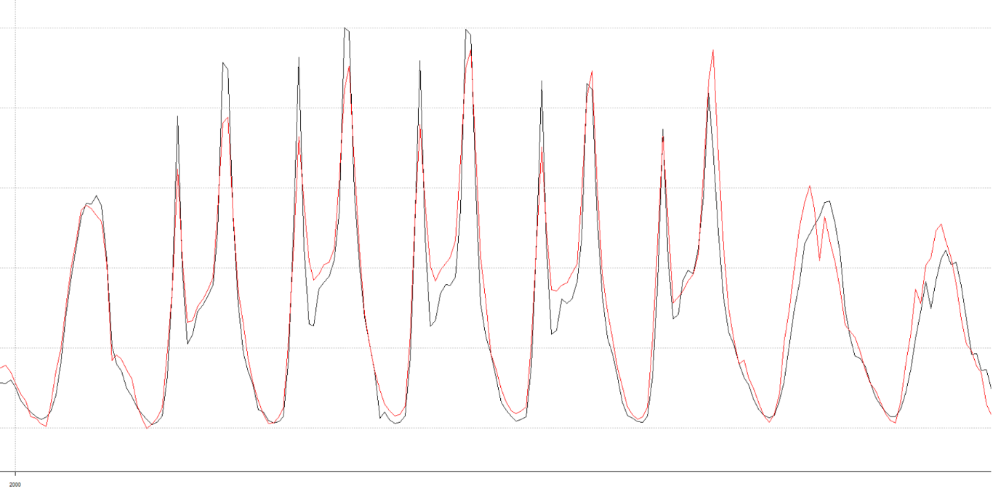
Conclusion
To conclude, out of the three models, we analyzed our deep neural network produced the most consistent results.
The graph represents a snippet from a comparison between our predicted results vs expected output.
From this, we are happy that we have met our primary objective of accurately being able to predict the bike count for any given hour.

Slide 15


