Slide 1
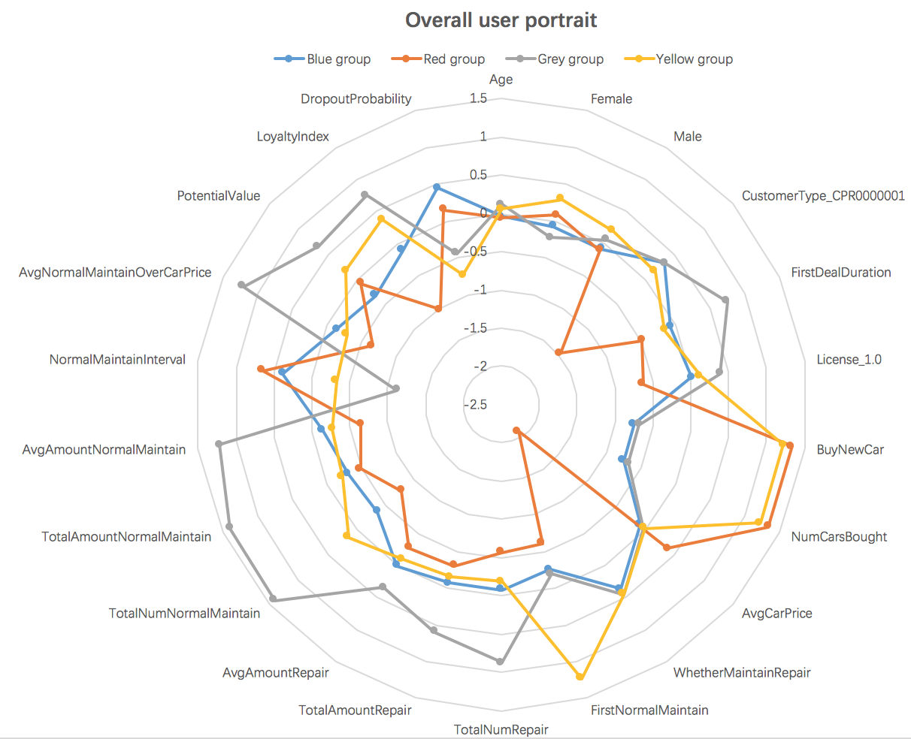
Overall user portrait analysis—group features
Grey group:
Old customer
High value
Living in a city of restricted licenses
Blue group:
Medium value
Not buying new cars in Yongda
Red group:
Low value
Buying new cars in Yongda
Not living in a city of restricted licenses
New Customer
Not doing the first normal maintenance in Yongda
Yellow group:
Medium value
Buying new cars in Yongda
Doing the first normal maintenance in Yongda

Slide 2
Overall user portrait analysis—marketing measures
Measures:
In terms of the grey group with high loyalty, focus on improving service quality and efficiency and provide some privilege service such as no waiting in line, specialized people to fetch your car for maintenance. At the same time, utilize this high loyalty to boost the sales of additional products.
In terms of the blue group and yellow group, develop promotions at key time points of consumers’ decision process to increase consumption frequency and amount in Yongda.
In terms of the red group, expand the service regions and cover these customers in distant regions.

