Slide 1
PYTHON: Natural language Tool Kit & Latent Semantic Analysis
SMU_6306-403 – Doing Data Science
Jack K. Rasmus-Vorrath
8/8/17

Slide 2
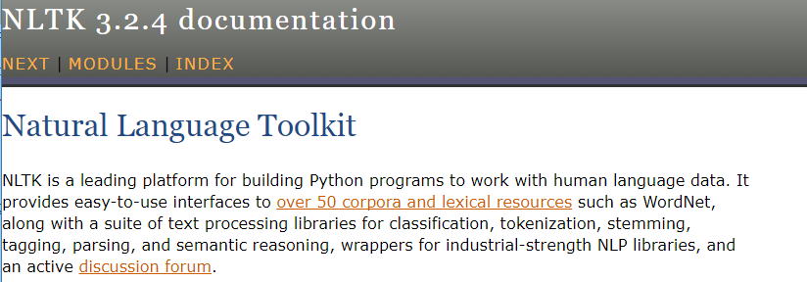
Natural Language Tool Kit (NLTK) USE CASES:
https://groups.google.com/forum/#!forum/nltk-users

Slide 3
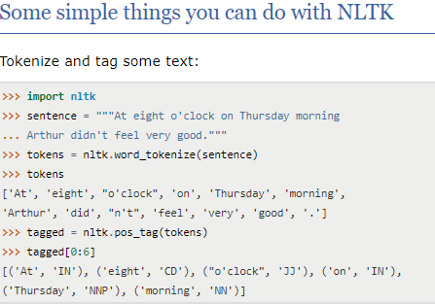
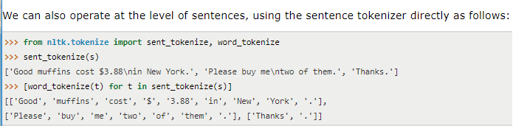
NLTK: Tokenization
In the Data Security setting, tokenization substitutes
sensitive data elements with non-sensitive
equivalents (or tokens) with no extrinsic value.
In the Linguistics setting, tokenization can be used for
parsing and visualizing syntactic trees.
NLTK supports easy regular-expression based
tokenization of punctuated text.

Slide 4
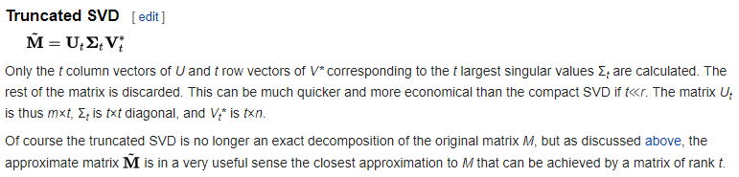
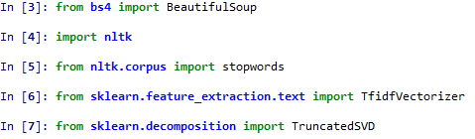
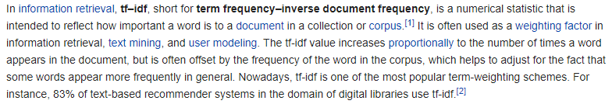
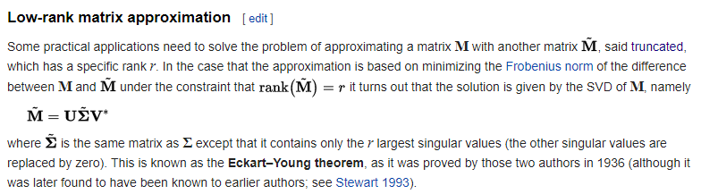
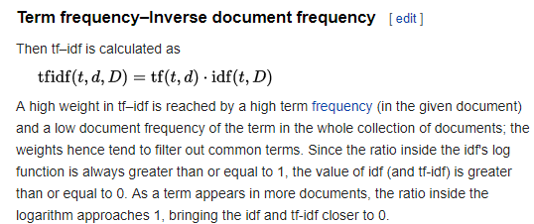
NLTK: textual Latent Sentiment analysis (LSA)
Imports include: BeautifulSoup for parsing XML, TfidfVectorizer for textual feature extraction and weighting, and
TruncatedSVD from sklearn for singular value decomposition of TF-IDF transformed documents.

Slide 5
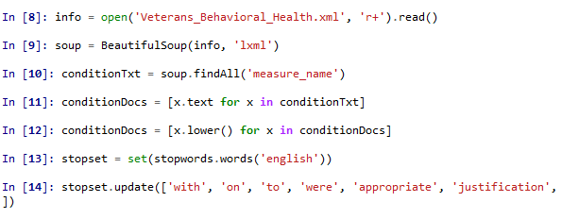
NLTK: File Opening & brewing the TEXTUAL soup
The ‘LXML’ parser is used on the opened file and read into the object ‘soup’, on whose XML tag (‘measure_name’)
list comprehension is performed to return only lowercased textual values.
An imported set of stop words filtering negligible, weakly semantic, or extraneous content can be updated with
additional terms as required.

Slide 6
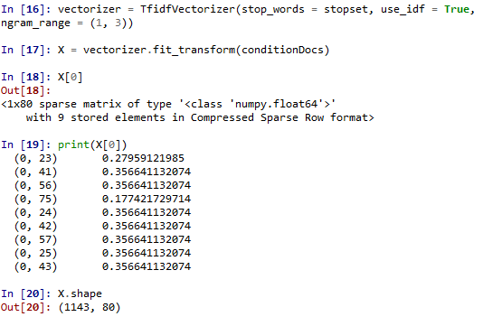
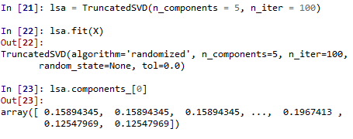
NLTK: TF-IDF Vectorization & Singular Value Decomposition
The TfidfVectorizer function arguments apply
the desired set of stop words, as well as
the number of terms constituting each textual
concept as an ‘ngram’ tuple (from 1 to 3).
The TF-IDF fit on the 1143 records of veteran
behavioral health treatment reports returns
a sparse matrix compressing 80 elements
into nine efficiently stored scores.
The truncated SVD fit to the sparse matrix returns
the desired number of textual concepts (5),
the first of which consists of the array of
printed values.
https://link.springer.com/article/10.1007%2FBF01937276

Slide 7
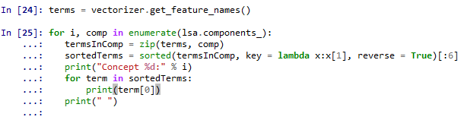
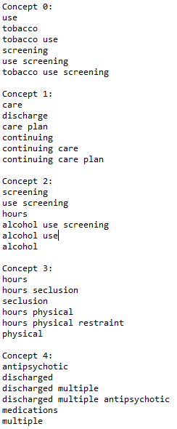
NLTK: Patient Profiling & Veteran Behavioral Health
The component scores of each textual concept are zipped to their most constitutive terms,
whose desired number (6) is returned from their sorted values and printed
in order of decreasing importance.
Distinct patient profiles emerge, characterizing common client needs (care planning) and
patterns of behavioral health (tobacco-, alcohol-, manic-depressive-, and psycho-medicinal),
knowledge of which can be used to facilitate efficient operation and optimize treatment.

