Slide 1
Week 15 | Day 1 Peter Wiemer-Hastings Latent Semantic Analysis
Philosophy 144 – Language, Meaning, Understanding
Dr. Jack K. Rasmus-Vorrath
12/5/17

Slide 2
Course Housekeeping Items
Response Paper #3 was due Sunday [10/22]
Response Paper #4 was due Sunday [11/5]
Response Paper #5 was due Sunday [11/19]
Response Paper #6 was due Sunday [12/3]
Final Paper is due Sunday 11:59PM [12/17] – NO EXTENSIONS
Remember that daily discussion questions are 15% of the total grade
Don’t miss out on easy points!
Comments and questions (via email) on student debates/presentations are required components of participation (together with in-class participation, 10% of the total grade)
Submit debate/presentation material to Blackboard for grading
Office hours are held on Thursdays from 2:45-3:45PM in Vera Long 127
The following shows the remaining schedule for team debates:
Debate 4 – “Does technology primarily enhance or delimit understanding?” (12/7)
(Tabitha Gilbert & Jazmyne Bisquera | Sadina Tarbox & Kelly Pringle)

Slide 3
Natural Language Processing
A field of study at the intersection of Computer Science, Artificial Intelligence, and Computational Linguistics
Concerned with linguistic computer-human interaction and the programmatic processing of natural language corpora
Common use cases:
Morphological Segmentation
Part-of-speech Tagging
Parsing
Sentence Boundary Disambiguation
Stemming
Chatbots
Sentiment Analysis – Extracting info from corpus of documents, often useful in a marketing setting or for data mining purposes—e.g., for identifying trends in, or polarity of public opinion in social media.
Discourse Analysis
Word Segmentation
Terminology Extraction
Machine Translation
Optical Character Recognition
Question Answering
Relational Extraction
Topic Segmentation
Word Sense Disambiguation
Speech Recognition and Segmentation
Text-to-Speech Conversion
Automatic Summarization

Slide 4
Latent Semantic Analysis
A technique in Natural Language Processing and Distributional Semantics
Analyzes relationships between document sets and contained terms
Produces mathematically represented “concepts” whose values reflect the document-term relations, which are “scored” according to relative frequency, weighted by term prevalence among the document corpus (i.e., inverse document frequency)
Analysis assumes a distributional hypothesis:
Words closer in meaning will occur in similar pieces of text
Other key assumptions:
Documents are “bags of words”; the relative frequencies are important, not the word order in the document
Concepts are represented as patterns of words commonly appearing together in documents
Matrices of word frequencies per document are constructed from the corpus
Singular Value Decomposition or SVD (a mathematical technique for factorizing matrices) reduces the number of matrix rows while preserving the structural similarity among columns
SVD is performance and memory efficient, storing information in a sparse, compressed format
The relative importance of terms in a document are stored in document vectors (rows or columns of data) which together constitute the matrix set
Queries of term importance are represented in a common vector space whose geometry is defined by the unique characteristics of the document collection (i.e., the matrix set)
There are many meanings or concepts behind a given word– latent semantic analysis (LSA) maps word-document relationships in a “concept space” and performs its comparisons within this space.
Defining a “vector space model” is an important step in document classification/clustering
Common use cases:
Find similar documents across languages, after analyzing a training set of translated documents
Identify/classify term relations (synonymy and polysemy)
Information retrieval (finding matching documents)
Analyze word association

Slide 5
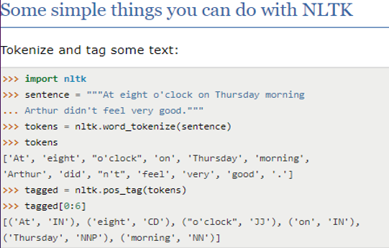
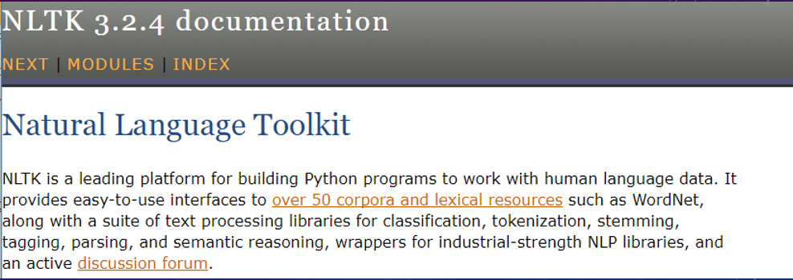
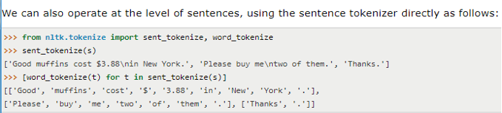
Python Natural Language Processing Toolkit
In a Data Security setting, ‘tokenization’ substitutes sensitive data elements with non-sensitive equivalents (or ‘tokens’) with no extrinsic value.
In the Linguistics setting, tokenization can be used for parsing and visualizing syntactic trees.
The Natural Language Tool Kit (NLTK) supports regular-expression based tokenization of punctuated text.

Slide 6
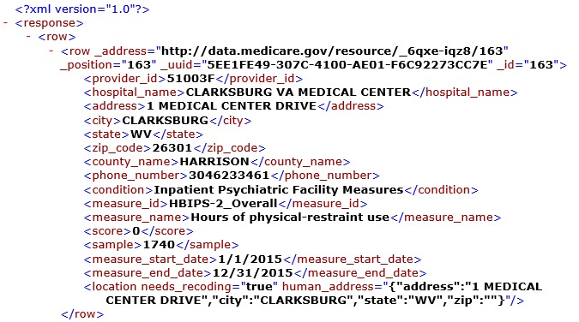



LSA of Veteran Mental Health Data with Python NLTK
Package imports include:
Beautiful Soup – Tool for parsing XML (extensible mark-up language)
Stopwords – words of little semantic value to be excluded from analysis
Tf-idf Vectorizer – Extracts and weights textual features. Turns terms into vectors of values representing word importance in the document of a corpus. Values are determined according to term-frequency, weighted by inverse-document frequency (Tf-idf value increases proportionally to word frequency in a document, but is offset by frequency of the word in the corpus, adjusting for the fact that some words appear more frequently in general). Mathematically represented, where N is the total number of documents in the collection, df_t is the number of documents containing the term t, and idf_t is the term’s inverse document frequency:
As the term appears in more documents, the ratio inside the logarithm approaches 1, bringing the idf and tf-idf values closer to 0.
In sum: Tf-idf assigns to a term t a weight in document d that is:
1) Highest when t occurs many times within a small number of documents (lending high discriminating power to those documents)
2) Lower when the term occurs fewer times in a document, or occurs in many documents (offering a less pronounced relevance signal)
3) Lowest when the term occurs in virtually all documents
TruncatedSVD – for singular value decomposition of Tf-idf transformed documents. Breaks Tf-idf values in the term-document matrix into simpler meaningful pieces (only storing terms present in a given document, compressing the data while mathematically preserving its structure).
Sample Record from XML Data Set

Slide 7
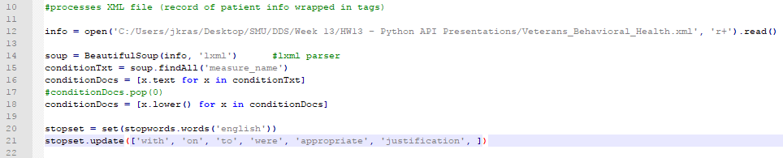
File Opening, XML Parsing, and Stopword Processing
The file is opened and the XML data read into an object called ‘info’
With the LXML parser, the BeautifulSoup function parses that ‘info’ into an object called ‘soup’, which maintains the hierarchical structure of the XML data, allowing for easy retrieval by tag name
In this dataset, the information of interest is stored in a tag called ‘<measure_name>’. The ‘findAll’ method is applied to the ‘soup’ object, storing all ‘measure_name’ data in an object called ‘conditionTxt’
List comprehension (a text processing technique) breaks up the ‘conditionTxt’ object into separate records, i.e., documents, storing the relevant textual information in a list called ‘conditionDocs’
All text stored in the ‘conditionDocs’ object is converted to lower case for simplicity
A dictionary included with the ‘Stopwords’ package is used to filter out semantically insignificant words. The dictionary can be updated with other words according to user preference

Slide 8
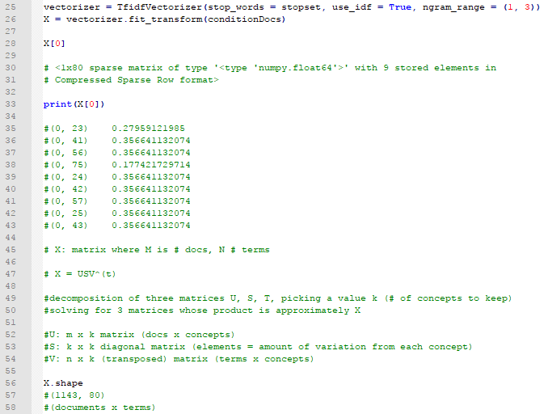
TF-IDF Vectorization
The Tf-idf Vectorizer uses the predefined set of stopwords called ‘stopset’, applying inverse document frequency weights, and limiting the number of terms constitutive of a semantic ‘concept’ to a maximum of three
The vectorized output is stored in the object ‘vectorizer’. The document list ‘conditionDocs’ is passed to the ‘fit_transform’ function applied to the ‘vectorizer’ object, storing the Tf-idf transformed values in compressed format in the sparse matrix called ‘X’.
The first document of the sparse matrix is printed for viewing. The shape of ‘X’ consists of 1143 documents from which 80 significant terms have been gleaned.
‘X’ is the product of three other matrices, whose dimensions are defined by the number of documents, the number of terms, and the number of ‘concepts’ to be identified (set by the user)

Slide 9
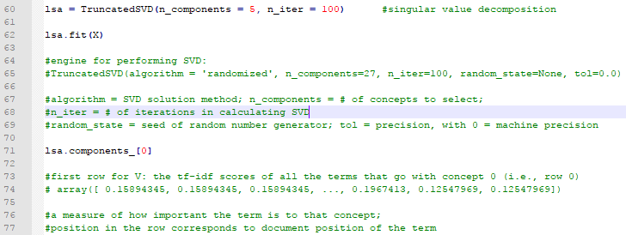
Singular Value Decomposition (SVD)
The number of concepts (5) and the number of iterations to be performed by SVD (100) are passed as arguments to the ‘TruncatedSVD’ function, and stored in the object called ‘lsa’
‘Lsa.fit(X)’ shows all of the arguments used in performing SVD on the matrix ‘X’
The decomposed Tf-idf transformed values for the first of the 5 concepts to be identified are returned by the ‘lsa.components_[0]’ command. This returned object contains the ‘scores’ of all the terms associated with the first concept—a measure of each term’s conceptual importance.

Slide 10
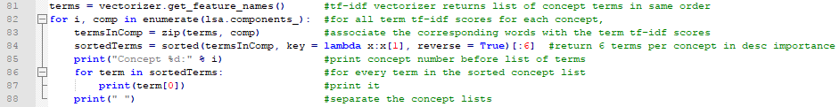
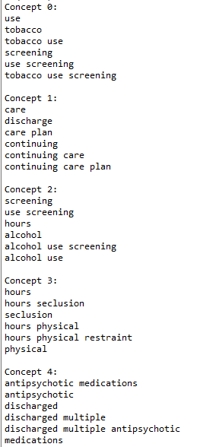
Managing Patient Profiles & Optimization of Care
The ‘get_feature_names’ method is used on the ‘vectorizer’ object output by the Tf-idf Vectorizer, storing all the words from which the Tf-idf transformed values are derived into the object called ‘terms’
For each concept, the Tf-idf values of these words or ‘terms’ are associated with their corresponding ‘feature_names’—i.e., with the actual words themselves. This association of words and Tf-idf values is stored in the object ‘termsInComp’—i.e., the terms which define a given ‘concept’ in the semantic space
The ‘termsInComp’ is passed to the ‘sorted’ function, along with the desired number of terms per concept, listed in descending importance and stored in the object called ‘sortedTerms’
This sorted list of terms is printed for every ‘concept’
Distinct patient profiles emerge, which can be characterized according to common client needs (care planning - Concept #1), administrative and medicinal measures (screening, seclusion, restraints, psychopharmacology – Concepts #0, 2, 3, 4), as well as mental and behavioral health patterns (tobacco abuse - Concept #0; alcoholism - Concept #2; aggression - Concept #3; and psychosis – Concept #4)
Paired with evaluative strategies like historical trend analysis, LSA can be used to drive efficient operation, facilitate delivery of services, and optimize treatment and patient care

Slide 11
Socratic Discussion: Wiemer-Hastings
With respect to the following passages, consider the underlying philosophical presuppositions at work in applications of Latent Semantic Analysis. What operative notions of language, meaning, and understanding are implied?
“By basing the representations on a reduced number of dimensions, words that generally occur in similar contexts have similar vectors and will therefore get a high similarity rating. The discarded dimensions are assumed to be the product of noise, random associations, or some other non-essential factor,” (p. 3)
“ ‘…for a large class of cases – though not for all – in which we employ the word ‘meaning’ it can be defined as thus, the meaning of the word is its use in language.’ (Wittgenstein, 1958),” (p. 5).
“LSA can even interpret metaphors like, ‘My lawyer is a shark’,” (p. 6).
“LSA […] has the advantage of graceful degradation. If it doesn’t know a word, LSA simply ignores it and bases its representation on the other words,” (p. 6).
“One critical objection that is raised against the LSA approach is that not only does it ignore the syntactic structure of sentences, it even ignores word order. In other words, LSA treats a text as a bag of words. In practice, LSA does well with longer passages of words […] where syntactic details may be ‘washed out’, and it also does well with single words […], but it does not do well on single sentences,” (p. 8).
Another notable gap in LSA’s competence is negations. [That is, one] thing that LSA ‘ignores’ is negations, either because they are omitted from the LSA training via a ‘stop words’ list, or simply because their widespread use throughout a corpus renders them representationally depleted,” (p. 9).
“A more fundamental question about LSA is what its dimensions ‘mean.’ Because they represent latent variables, there is no clear definition. […T]here is a high correlation between the first dimension [of the semantic vector space] and the frequency of occurrence of the words in the corpus. Beyond that, there are no clear answers,” (p. 9).

Slide 12

Google Labs’ N-gram Viewer

Slide 13
Coming Up: Terrence Deacon
Remember to complete the Mills College course evaluation online
Remember to complete a review on RateMyProfessors
Required reading for (12/7):
Deacon – “Memes as Signs in the Dynamic Logic of Semiosis”
See you Thursday!

