Slide 1
Topic Modeling Movie Reviews
Dr. Jack K. Rasmus-Vorrath
12/4/18

Slide 2




The WHY: Understanding Discussion Criteria
Hypothesis: the ‘best’ and ‘worst’ horror movies are reviewed with respect to common criteria.
Modeling the topics prevalent in a shared corpus of ‘good’ and ‘bad’ horror movie reviews provides insight into audience experience of the genre as a whole.
Identifying the foci of discussion facilitates understanding of what makes a good ‘B’-movie (and a bad ‘A’-movie).
This is beneficial to filmmakers, studios, producers, marketers, production teams, and industry stakeholders of various kinds.

Slide 3

The WHAT: Data Description
1000 reviews of the ‘100 Best’ and ‘100 Words’ horror movies on IMDB.com
A web crawler gathered the top 5 ‘most helpful’ reviews of each film appearing on the two listings
All reviews were included in a common corpus
The criterion of ‘helpfulness’ is determined according to a private proprietary algorithm belonging to IMDB.
Inputs:
Preprocessed movie review text data
Outputs:
Topic allocations and summary statistics, model evaluation metrics, and 2D & 3D visualizations

Slide 4
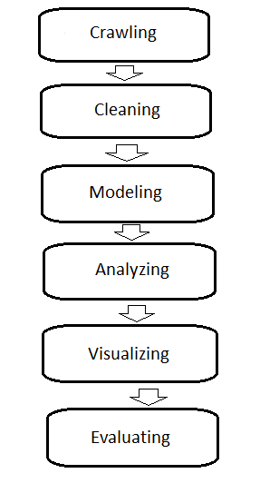
The HOW: Workflow, Algorithms, and Evaluation Metrics
Crawling:
Beautiful Soup, Reg-ex
Cleaning:
Tokens, Spell Correct, Lemmas, Punctuation, Stop Words,
Normalization, TF-IDF
Modeling:
Latent Dirichlet Allocation (LDA), Mallet LDA
Hierarchical Dirichlet Process (HDP)
Latent Semantic Indexing (LSI)
Non-negative Matrix Factorization (NMF)
Analyzing:
Coherence modeling (identifying the best number of topics)
Perplexity, U-mass, CV measures
Topic similarity
Hellinger Distance
Dominant topics, Most representative documents
Probability Contributions
Corpus topic distributions
Allocation Percentages
Visualizing:
Coherence charts
pyLDAvis
Truncated SVD (2D and 3D interactive scatterplots)
PCA-initialized T-SNE Embedding (2D interactive scatterplot)
Evaluating:
Model interpretation, Performance comparison
Workflow

Slide 5
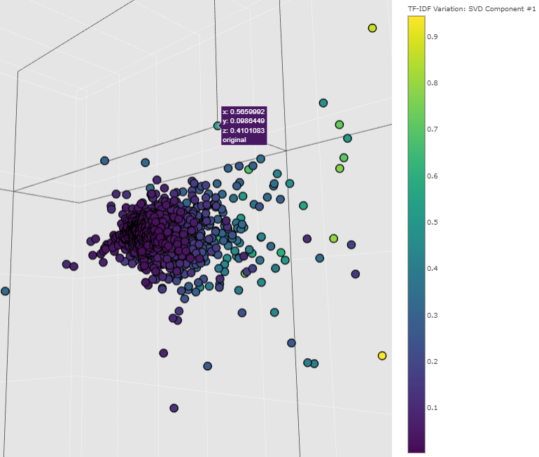
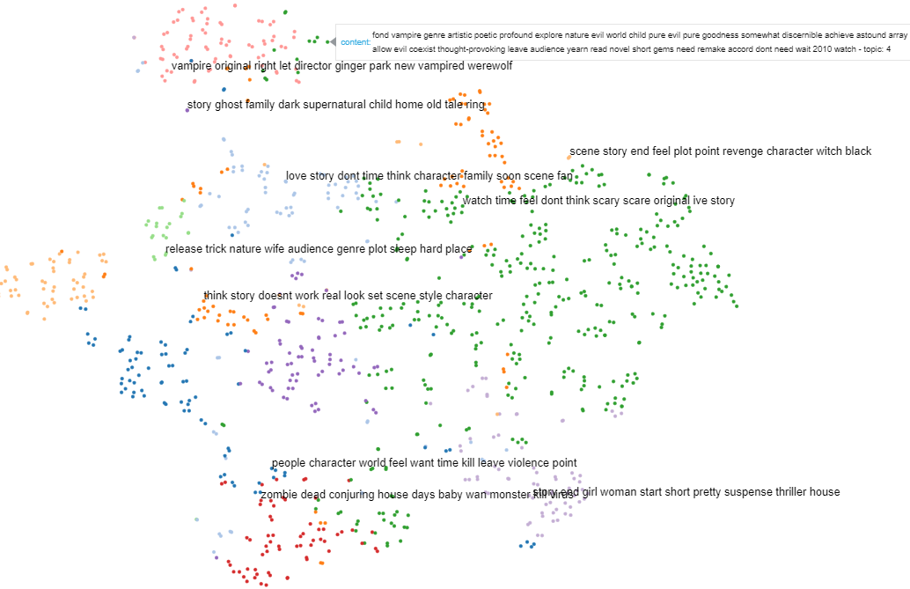
Visualizations
Interactive 3D Truncated SVD revealed primary dimensions of variation across TF-IDF scores of document terms
PCA-initialized T-distributed Stochastic Neighbor 2D Embedding of LDA topics facilitated high-level synopses and interpretation of prevalent foci of discussion

Slide 6
Key Insights
Common sets of discussion criteria presented themselves in allocations of good and bad movie reviews to prevalent topics.
Audiences of the ‘best’ and ‘worst’ horror movies have shared concerns regarding investment in the genre’s defining qualities, on which their experience turns.
Mood, tone, pacing, atmospheric staying power, and characters with which one can identify are qualities that transcend distinctions between low-brow horror entertainment and ‘high art’.
The size of the corpus and lengths of the documents impacted the performance of the algorithms applied.
The MALLET implementation of LDA returned more coherent, interpretable topics than the standard Gensim implementation.
MALLET uses Gibbs sampling, a Markov chain Monte Carlo algorithm for obtaining a sequence of observations approximated from a specified multivariate probability distribution. Identifying the latent variable subset involves using this sequence to compute a numerical approximation to the exact posterior.
Gensim LDA implements the Variational Bayes algorithm, which is faster, but less precise, providing a locally-optimal exact analytical solution to an approximation of the posterior.
The non-parametric Hierarchical Dirichlet Process adds another layer to the generative model, sampling the finite distribution of topics from a common base distribution representing the countably-infinite set of possible corpus topics.
HDP was useful for a first-pass, high-level of view of the great diversity of potential topics, whose meaningful coherence would depend on assembling a much larger data set.
The topic allocation distribution produced by the LSI algorithm indicated similar constraints. Its discriminative power in identifying quantitatively distinct topics depends on a data set rich enough to support meaningful differentiation.
Though it lacks certain interpretive advantages that a generative mixture modeling approach provides, NMF is the most appropriate topic modeling method for a corpus of 1000 documents of relatively short length.

Slide 7
References
Blei, D., Ng, A., and Jordan, M (2003). Latent Dirichlet Allocation. In: Journal of Machine Learning Research 3. 993-1022. https://dl.acm.org/citation.cfm?id=944937.
Deerwester, S., Dumais, S., Furnas G., and Landauer, T. (1990). Indexing by Latent Semantic Analysis. In: Journal of the American Society for Information Science. https://doi.org/10.1002/(SICI)1097-4571(199009)41:6<391::AID-ASI1>3.0.CO;2-9.
Lee, D. and Seung, H. (2000). Algorithms for Non-negative Matrix Factorization. In: Proceedings of the 13th International Conference on Neural Information Processing Systems. Denver, USA. MIT Press, Cambridge, MA. http://www.cs.virginia.edu/~jdl/bib/nmf/lee00.pdf.
van der Maaten, L. and Hinton, G. (2008). Visualizing Data using t-SNE. In: Journal of Machine Learning Research 9. 2579-2605. http://www.cs.toronto.edu/~hinton/absps/tsne.pdf.
McCallum, A (2002). MALLET: A Machine Learning for Language Toolkit. http://mallet.cs.umass.edu.
Röder, M., Both, A., and Hinneburg, A (2015). Exploring the Space of Topic Coherence Measures. In: Proceedings of the Eighth ACM International Conference on Web Search and Data Mining. Shanghai, China. https://dl.acm.org/citation.cfm?doid=2684822.2685324.
Sievert, C. and Shirley, K. (2014). LDAvis: A method for visualizing and interpreting topics. In: Proceedings of the Workshop on Interactive Language Learning, Visualization, and Interfaces. Baltimore, Maryland. 63-70. https://doi.org/10.3115/v1/W14-3110.
Wang, C., Paisley, J., and Blei, D. (2011). Online Variational Inference for the Hierarchical Dirichlet Process. In: Proceedings of the 14th International Conference on Artificial Intelligence and Statistics. Fort Lauderdale, USA. http://proceedings.mlr.press/v15/wang11a/wang11a.pdf.

