Slide 1
QUANTMOD in R (Yahoo Finance API)
https://github.com/JackKRasmus-Vorrath/Quantmod_R_Financial-Analysis
Smu_6306-403 – Doing Data Science
Jack k. Rasmus-Vorrath
7/9/17

Slide 2
Package Loading & Data Download
The following presents a simple walkthrough analysis and visualization of time series financial data on IBM stock performance using the 'quantmod' package in R to interface with the Yahoo Finance API.
The required packages for the workflow include 'quantmod' and 'tidyverse'. Necessary dependencies 'xts’, 'TTR', and 'zoo' will load along with these libraries.
Note that possible conflicts with preloaded packages may result.
The IBM NYSE ticker ('IBM') can be identified with a simple search on the home page for Yahoo Finance.
The ‘quantmod’ function to retrieve the price data is 'getSymbols()'.

Slide 3
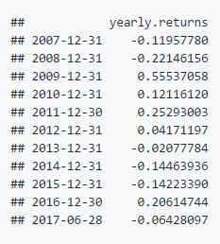
Data GLIMPSE, Head, Series High, & Yearly Returns
A first look at the retrieved data frame consisting of 2641 rows (the number of trading days since IBM's IPO)
and 6 variables (open price, high price, low price, close price, volume, and adjusted) is produced with
the function 'glimpse()’. Tabular data on the first 6 rows is presented with the head() function.
'Volume' corresponds to the number of transactions. The discrepancy between 'Adjusted' and 'Close' reflects
any share splits or rights issues.
Identifying the highest recorded price of a time series is made possible with the function 'seriesHi()'.
The calendar year market rate of return is produced with the function 'yearlyReturn()'.

Slide 4
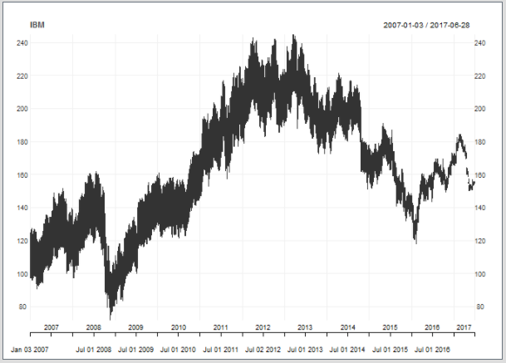
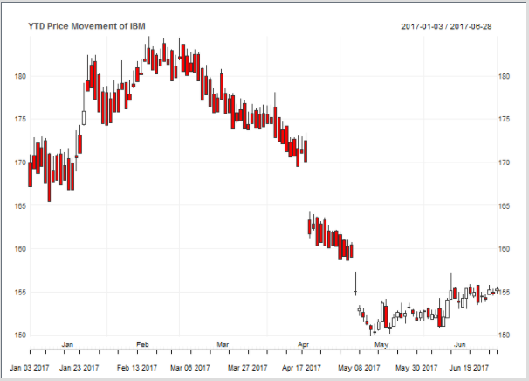
Price Movement Line Chart & Year-to-Date Candlestick Chart
With ‘quantmod’, a line chart visualization is produced with the function 'chart_Series()'.
A candlestick chart can be produced by default when year-to-date data is requested.

Slide 5
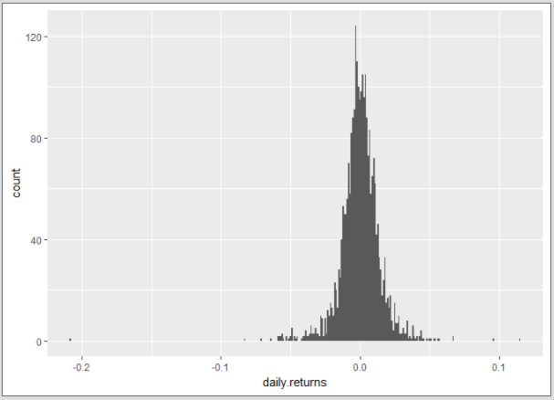
Daily Returns Distribution
Histograms displaying the distribution of daily returns can be produced by passing the object
returned by the 'quantmod' function, 'dailyReturn()’, to functions of the 'ggplot' package.
The 'quantmod’ package thus simplifies interfacing to finance APIs and makes
preliminary analyses and visualizations of time series data easy!

