Slide 1
Time Series Analysis
SMU_6372-403 – Applied Statistics
Jack K. Rasmus-Vorrath
6/1/17

Slide 2
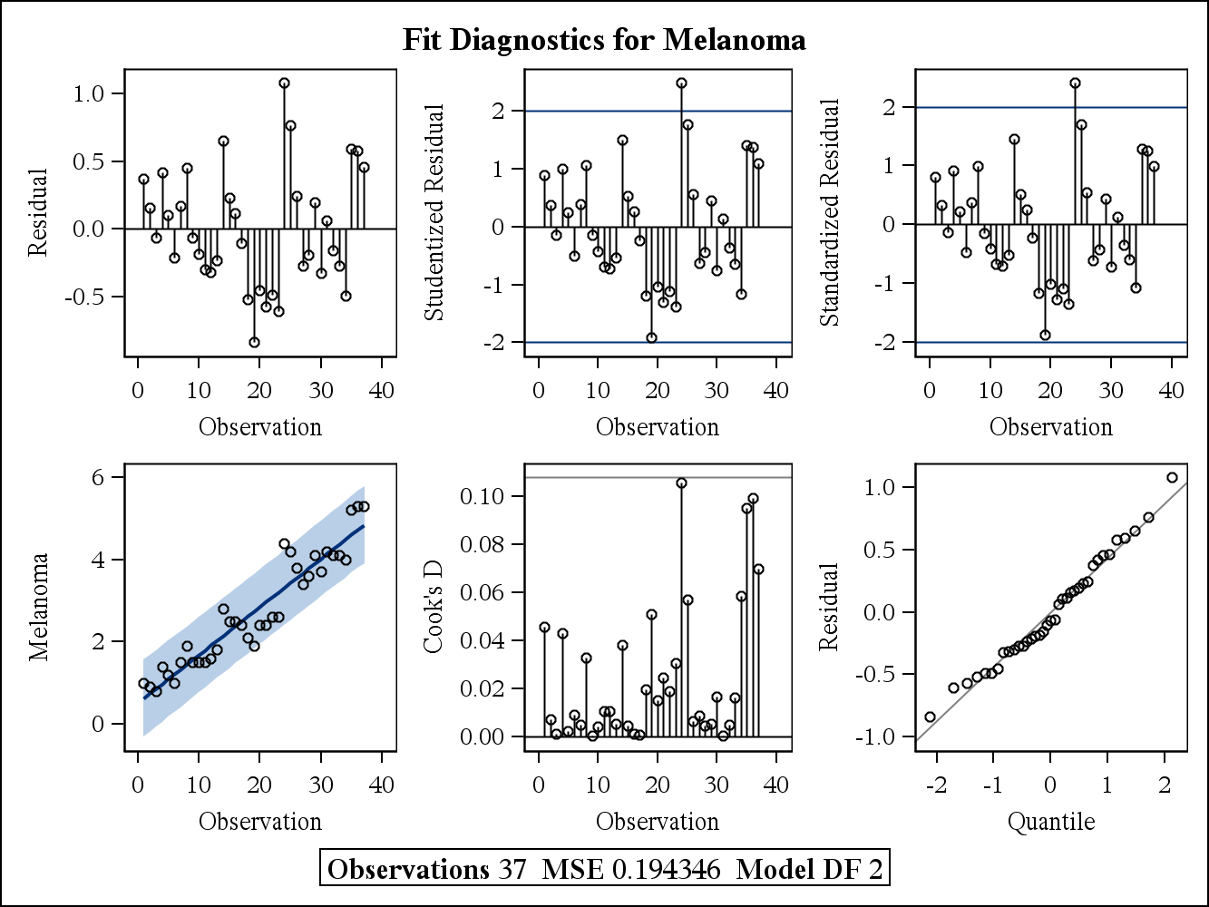
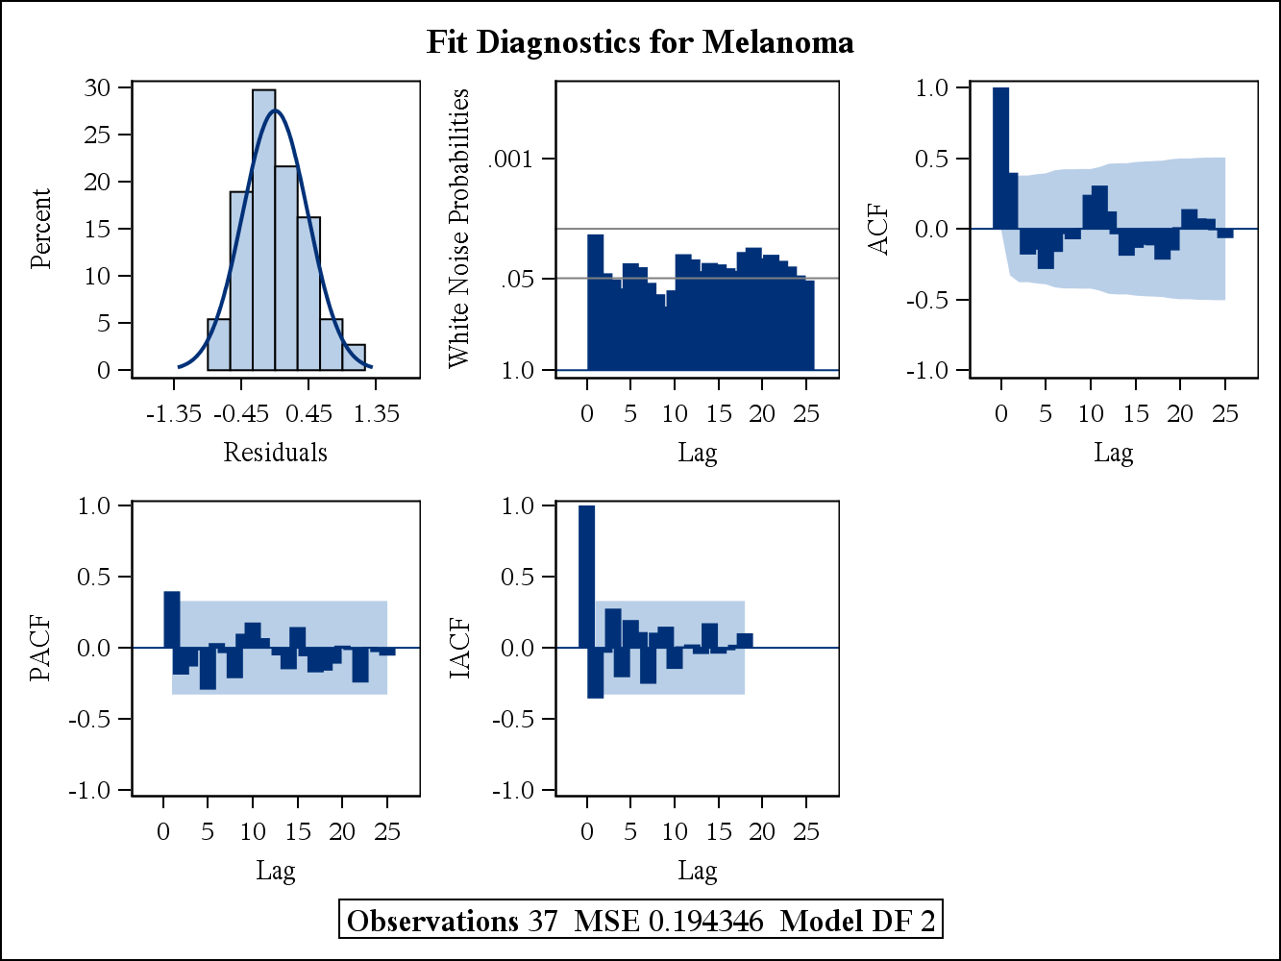
Q1&2: Melanoma | Year – Simple Linear Regression
Residual plots (cyclical pattern),
PACF/ACF (bars exceeding light blue shaded area),
White Noise Probabilities (exceeding .05 threshold), and
DW statistics (1st order P-values)
all indicate evidence of autocorrelation.
Parameter Estimates
Variable | DF | Estimate | Standard Error | t Value | Approx Pr > |t| | Variable Label
Intercept | 1 | -225.9264 | 13.2637 | -17.03 | <.0001
Year | 1 | 0.1170 | 0.006788 | 17.24 | <.0001 | Year
Durbin-Watson Statistics
Order | DW | Pr < DW | Pr > DW
1 | 1.1550 | 0.0018 | 0.9982
2 | 1.8986 | 0.3789 | 0.6211
3 | 2.2085 | 0.7956 | 0.2044
4 | 2.0791 | 0.7291 | 0.2709
Ordinary Least Squares Estimates
SSE | 6.80212423 | DFE | 35
MSE | 0.19435 | Root MSE | 0.44085
SBC | 49.5570177 | AIC | 46.3351818
MAE | 0.35885843 | AICC | 46.688123
MAPE | 14.9095671 | HQC | 47.4710299
 |  | Total R-Square | 0.8946

Slide 3
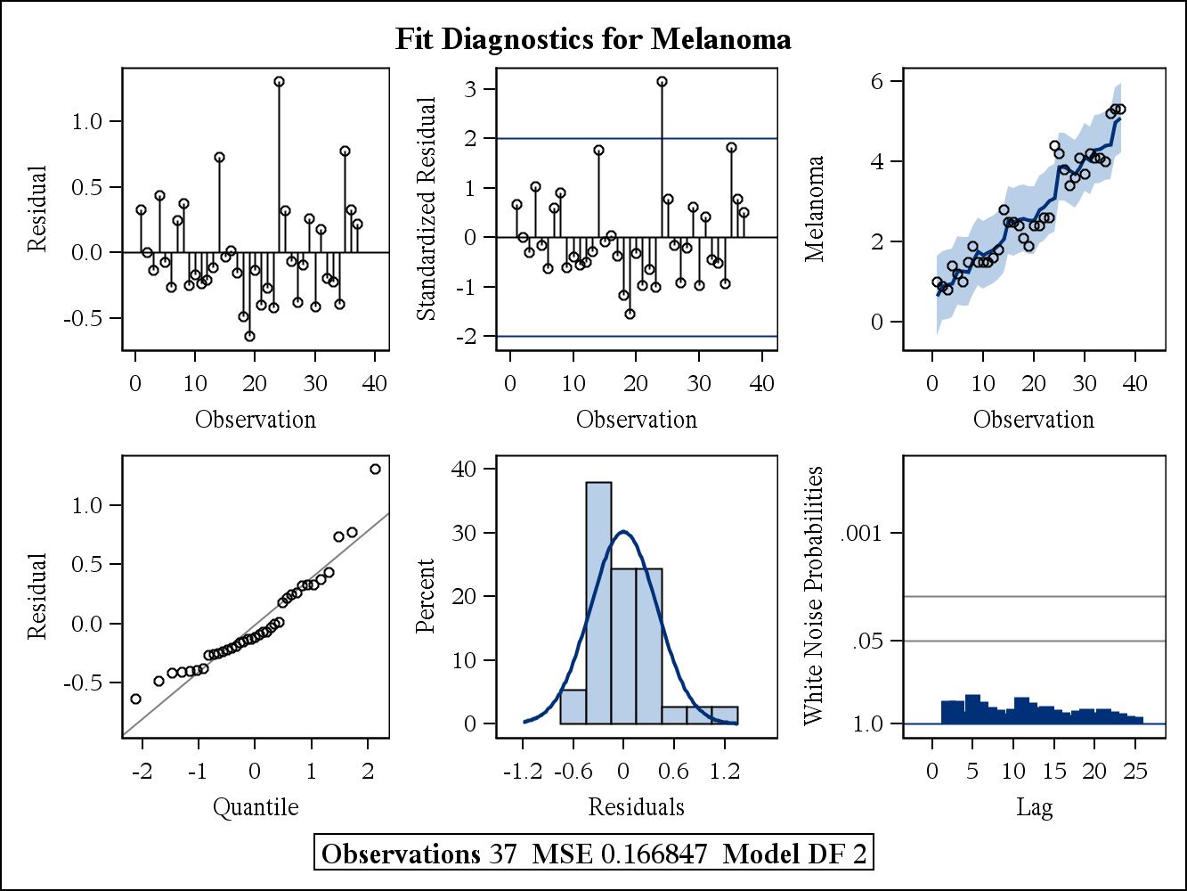
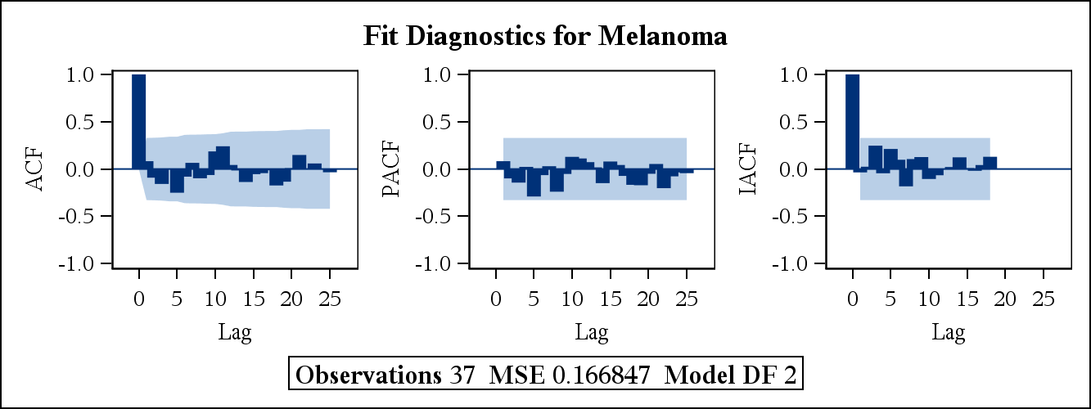
Q3: Melanoma | Year – Autoregressive Model
Compared with the SLR model,
the ACF peaks and valleys are now more moderate, and the PACF bars are all within the light-blue shaded area,
indicating that a 1st order autoregressive correction was sufficient for correction (confirmed by DW statistics).
Furthermore, White Noise probabilities have been lowered well below the .05 threshold.
In the AR model, the parameter estimate for Year has increased slightly (from .1170 to .1173),
and the SE measure has increased more substantially
(from .006788 to .009896).
Parameter Estimates
Variable | DF | Estimate | Standard Error | t Value | Approx Pr > |t| | Variable Label
Intercept | 1 | -226.3828 | 19.3379 | -11.71 | <.0001
Year | 1 | 0.1173 | 0.009896 | 11.85 | <.0001 | Year
Durbin-Watson Statistics
Order | DW | Pr < DW | Pr > DW
1 | 1.8024 | 0.2460 | 0.7540
2 | 2.1317 | 0.6896 | 0.3104
3 | 2.1478 | 0.7647 | 0.2353
4 | 1.7666 | 0.3950 | 0.6050
Yule-Walker Estimates
SSE | 5.67279475 | DFE | 34
MSE | 0.16685 | Root MSE | 0.40847
SBC | 46.621896 | AIC | 41.7891422
MAE | 0.3042134 | AICC | 42.516415
MAPE | 12.7399723 | HQC | 43.4929143
 |  | Transformed Regression R-Square | 0.8050
 |  | Total R-Square | 0.9121
Estimates of Autoregressive Parameters
Lag | Coefficient | Standard Error | t Value
1 | -0.396907 | 0.157411 | -2.52

Slide 4
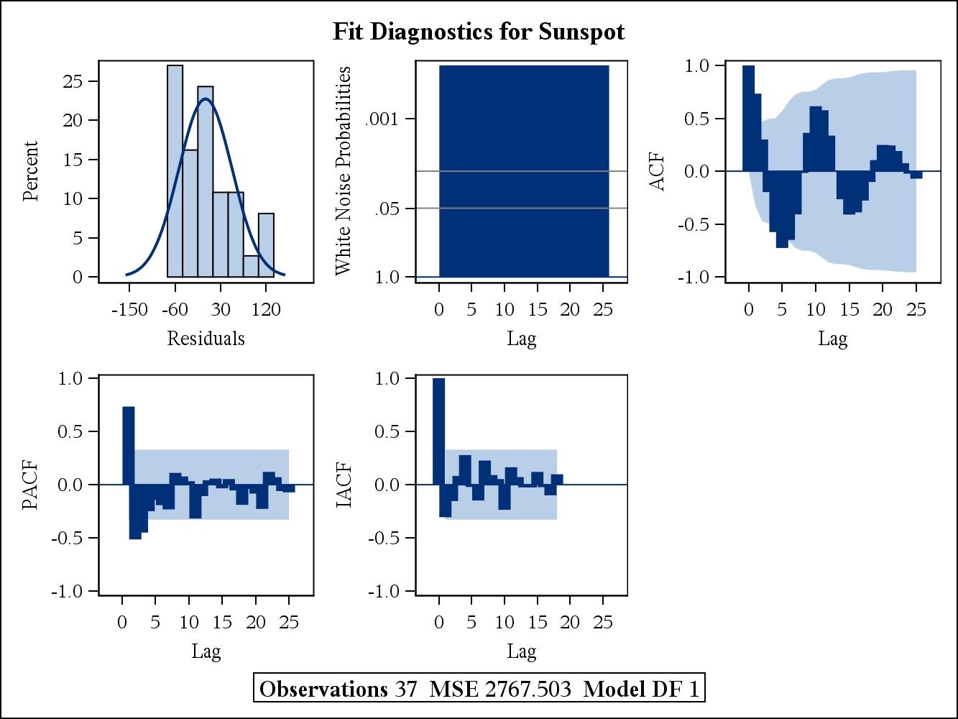
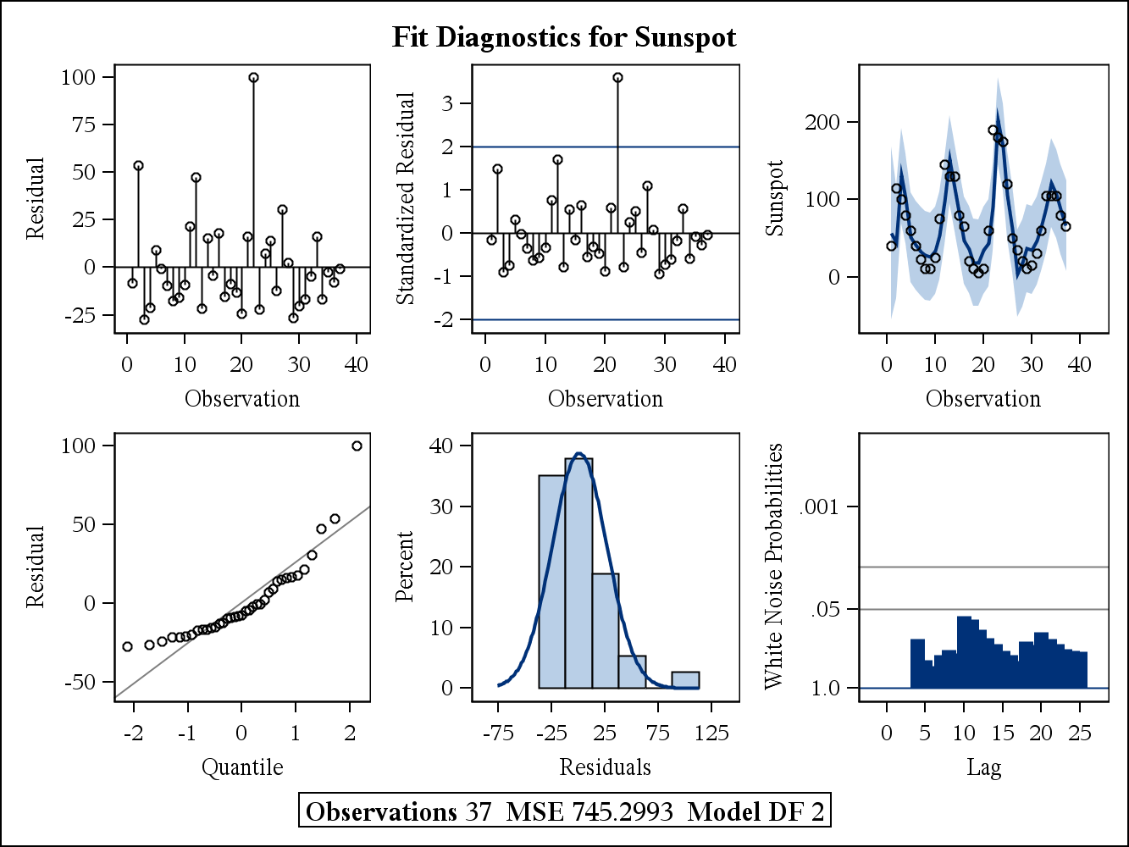
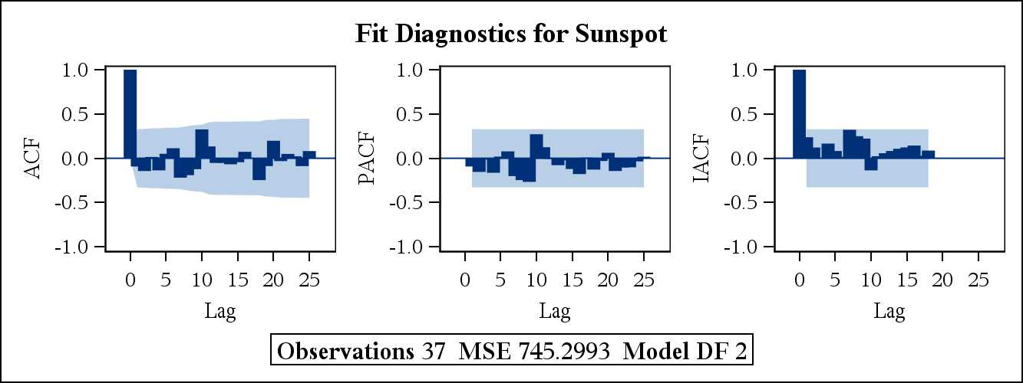
Q4: Sunspots v. Year – Autoregressive model
Diagnostics and ACF/PACF plots of Sunspots| . & Sunspots | Year strongly suggest autocorrelation.
Bars on ACF/PACF plots exceed the light-blue shaded area to at least the 2nd or 3rd order.
Comparisons of AIC statistics and ACF/PACF plots for AR(1)-AR(4) suggest AR(3) as an appropriate model.
Sunspots | Years (SLR)
Sunspots | Years (AR(3))
Yule-Walker Estimates
SSE | 45498.4171 | DFE | 34
MSE | 1338 | Root MSE | 36.58126
SBC | 379.842305 | AIC | 375.009551
MAE | 25.7681669 | AICC | 375.736824
MAPE | 74.7261157 | HQC | 376.713323
Durbin-Watson | 1.2003 | Transformed Regression R-Square | 0.0020
 |  | Total R-Square | 0.5433
AR(1)
Yule-Walker Estimates
SSE | 29947.1244 | DFE | 33
MSE | 907.48862 | Root MSE | 30.12455
SBC | 368.617804 | AIC | 362.174132
MAE | 21.6000882 | AICC | 363.424132
MAPE | 63.794352 | HQC | 364.445828
Durbin-Watson | 2.4132 | Transformed Regression R-Square | 0.0103
 |  | Total R-Square | 0.6994
AR(2)
Sunspots | Years (AR(3)) – ACF/PACF
Yule-Walker Estimates
SSE | 23849.578 | DFE | 32
MSE | 745.29931 | Root MSE | 27.30017
SBC | 364.473082 | AIC | 356.418492
MAE | 18.3328526 | AICC | 358.353976
MAPE | 56.1976134 | HQC | 359.258113
Durbin-Watson | 2.1835 | Transformed Regression R-Square | 0.0168
 |  | Total R-Square | 0.7606
AR(3)
Yule-Walker Estimates
SSE | 22670.2107 | DFE | 31
MSE | 731.29712 | Root MSE | 27.04251
SBC | 366.468015 | AIC | 356.802507
MAE | 17.6227227 | AICC | 359.602507
MAPE | 54.2132242 | HQC | 360.210051
Durbin-Watson | 2.0476 | Transformed Regression R-Square | 0.0199
 |  | Total R-Square | 0.7725
AR(4)

Slide 5
BONUS(Q): Forecasting Melanoma | Year, Sunspots | Year
The Melanoma incidence was forecasted using the AR(1) model suggested by analysis.
The Sunspot incidence was forecasted using an AR(3) model.

