Slide 1
TWO-WAY ANOVA
Jack K. Rasmus-Vorrath
SMU 6372-403: Applied Statistics
5/25/17

Slide 2
Discussion #1 : ANOVA - VISUAL Comparison
Additive Model: Roughly parallel lines indicate that additional BACKGROUND affects SCORE by SEX in the same way
Interaction Model: Increasing difference in SCORE by SEX indicates that BACKGROUND more substantially affects Males
No Interaction – [Additive Effect]
Ordinal Interaction – [SEX * BACKGROUND]

Slide 3
Discussion #1 : ANOVA - NUMERICAL Comparison
Overall F-tests for both (unbalanced) data sets indicate statistical significance (p < .0001)
In keeping with their respective parallel and non-parallel visualizations:
The data set with additive main effects indicates non-significance for the SEX*BACKGROUND Type III SS (p = .4629)
The data set with ordinal interaction indicates significance for the SEX*BACKGROUND Type III SS (p < .0001)
No Interaction: [Additive Effect]
Ordinal Interaction: [SEX * BACKGROUND]
Source | DF | Sum of Squares | Mean Square | F Value | Pr > F
Model | 5 | 16172.84679 | 3234.56936 | 132.47 | <.0001
Error | 855 | 20876.81871 | 24.41733
Corrected Total | 860 | 37049.66551
Source | DF | Sum of Squares | Mean Square | F Value | Pr > F
Model | 5 | 28219.61567 | 5643.92313 | 231.14 | <.0001
Error | 855 | 20876.81871 | 24.41733
Corrected Total | 860 | 49096.43438
R-Square | Coeff Var | Root MSE | Score Mean
0.436518 | 32.22401 | 4.941390 | 15.33449
R-Square | Coeff Var | Root MSE | Score Mean
0.574779 | 29.89206 | 4.941390 | 16.53078
The additive model better fits the 1st data set
The non-additive model better fits the 2nd data set
Source | DF | Type I SS | Mean Square | F Value | Pr > F
Background | 2 | 15618.58726 | 7809.29363 | 319.83 | <.0001
Sex | 1 | 516.61082 | 516.61082 | 21.16 | <.0001
Sex*Background | 2 | 37.64871 | 18.82436 | 0.77 | 0.4629
Source | DF | Type I SS | Mean Square | F Value | Pr > F
Background | 2 | 22178.60151 | 11089.30075 | 454.16 | <.0001
Sex | 1 | 5121.98259 | 5121.98259 | 209.77 | <.0001
Sex*Background | 2 | 919.03157 | 459.51578 | 18.82 | <.0001
Source | DF | Type III SS | Mean Square | F Value | Pr > F
Background | 2 | 14479.52273 | 7239.76136 | 296.50 | <.0001
Sex | 1 | 311.93574 | 311.93574 | 12.78 | 0.0004
Sex*Background | 2 | 37.64871 | 18.82436 | 0.77 | 0.4629
Source | DF | Type III SS | Mean Square | F Value | Pr > F
Background | 2 | 19062.31704 | 9531.15852 | 390.34 | <.0001
Sex | 1 | 3833.11311 | 3833.11311 | 156.98 | <.0001
Sex*Background | 2 | 919.03157 | 459.51578 | 18.82 | <.0001

Slide 4
Discussion #2: CONTRAST ESTIMATES - VISUAL COMPARISON
Where there is ordinal interaction, contrasts between pairwise groups indicate increasingly substantive differences in SCORE
Such differences increase with increasing BACKGROUND:
A vs. C [with Interaction] – A vs. C [without Interaction] > A vs. B [with Interaction] – A vs. B [without Interaction]
No Interaction [Additive Effect]
Ordinal Interaction [SEX * BACKGROUND]

Slide 5
Discussion #2: Contrast Estimates - Numerical Comparison
In keeping with the visuals, LS Means tables indicate increasing pairwise differences where there is ordinal interaction
The second contrast estimate (“What do you think?”) refers to those with BACKGROUND C vs. A
The third contrast estimate (“What do you think2?”) refers to those with SEX Male vs. Female
Both contrasts indicate the increasing pairwise differences associated with non-additivity
No Interaction [Additive Effect]
Ordinal Interaction [SEX * BACKGROUND]
Background | Score LSMEAN | LSMEAN Number
a | 10.2657520 | 1
b | 14.7644234 | 2
c | 25.0312327 | 3
Background | Score LSMEAN | LSMEAN Number
a | 10.2657520 | 1
b | 16.2644234 | 2
c | 27.5312327 | 3
Least Squares Means for Effect Background t for H0: LSMean(i)=LSMean(j) / Pr > |t| Dependent Variable: Score
i/j | 1 | 2 | 3
1 |  | -9.09307 <.0001 | -23.1797 <.0001
2 | 9.093072 <.0001 |  | -20.6454 <.0001
3 | 23.17971 <.0001 | 20.64541 <.0001
Least Squares Means for Effect Background t for H0: LSMean(i)=LSMean(j) / Pr > |t| Dependent Variable: Score
i/j | 1 | 2 | 3
1 |  | -12.125 <.0001 | -27.1044 <.0001
2 | 12.12499 <.0001 |  | -22.6563 <.0001
3 | 27.10435 <.0001 | 22.6563 <.0001
Parameter | Estimate | Standard Error | t Value | Pr > |t|
B vs A | 4.4986713 | 0.49473614 | 9.09 | <.0001
What do you think? | 14.7654807 | 0.63700027 | 23.18 | <.0001
What do you think2? | 1.5965223 | 0.44667487 | 3.57 | 0.0004
Parameter | Estimate | Standard Error | t Value | Pr > |t|
B vs A | 5.9986713 | 0.49473614 | 12.12 | <.0001
What do you think? | 17.2654807 | 0.63700027 | 27.10 | <.0001
What do you think2? | 5.5965223 | 0.44667487 | 12.53 | <.0001

Slide 6
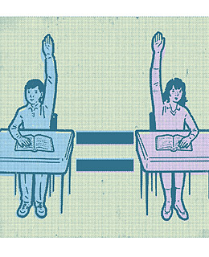
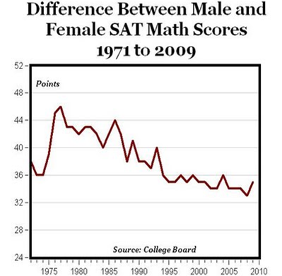
FUN FACTS: Nature or Nurture?

