Slide 1
Repeated Measures
SMU_6372-403 – Applied Statistics
Jack K. Rasmus-Vorrath
6/14/17

Slide 2
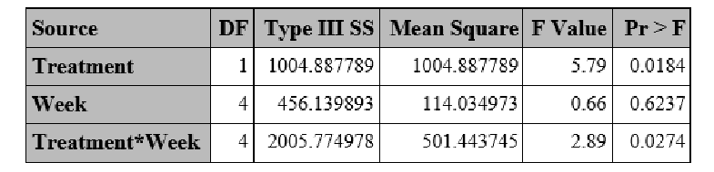
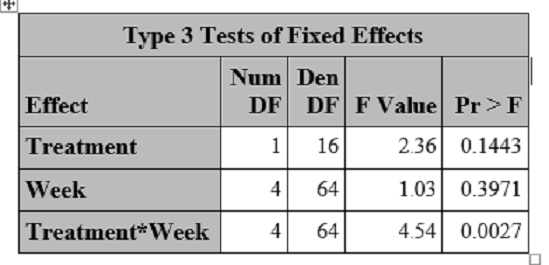
Q2: PROC GLM v. MIXED – Type-3 ANOVA v. Fixed Effects Tables
In accounting for influence of repeated measures in the data,
F-values and P-values have changed for all three predictors of interest:
The Treatment effect has become non-significant
at the alpha = .05 level in the MIXED model.
The Week effect now bears a larger influence,
though it remains statistically non-significant on its own, at p = .3971.
The interaction of the two effects has substantially increased in significance (p =.0027).

Slide 3
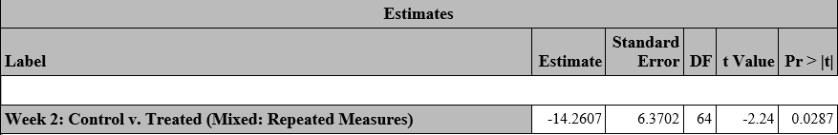

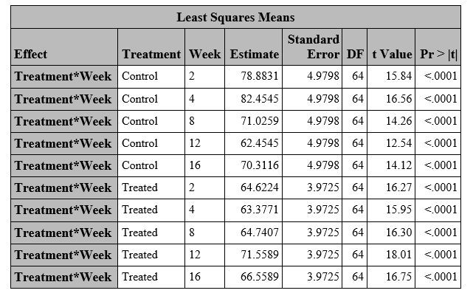
Q3: Interaction & Contrast (Treated v. Control at Week 2)
From slopes of linear plots and tabular figures from the previous slide, evidence of Treatment*Week interaction was already
evident (p = .0274), becoming more pronounced when accounting for the influence of repeated measures (p = .0027).
A contrast of performance by Treated and Control groups at Week 2 indicates a statistically significant
difference in the mean percentage of the response variable, Percentage Correct (p = .0287),
confirming the effect of treatment on short-term memory performance at this time index.

Slide 4

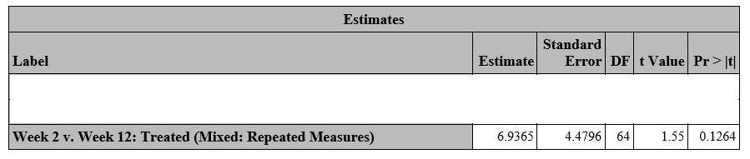
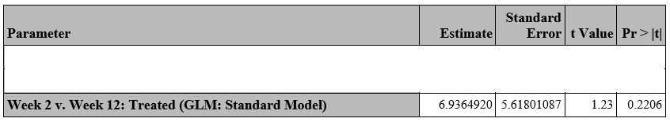
Q4: PROC GLM v. MiXed – Treated group Contrast (Week 2 v. 12)
When comparing the output of PROC GLM and MIXED, contrast estimates of Treated group performance at Weeks 2 v. 12
indicated increased statistical significance in the latter procedure.
Though the estimate values were near identical, the standard error was reduced, and the t-value increased.
Although the corresponding reduction in p-value (from .2206 to .1264) did not attain alpha = .05, the change demonstrated
the influence of repeated measures on interpreting the difference in Treated short- and long-term memory performance.
Intuitively, such a difference should be more substantial if the respective response measures were taken on the same subject.

Slide 5
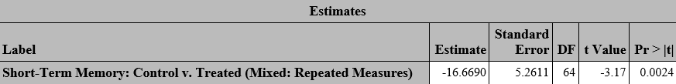
Q5: Contrast – Short-Term Memory (Control v. Treated)
In output from both the generalized linear and repeated measures models, contrast estimates
of short-term memory performance across Control and Treated groups confirmed
the study’s findings that inhibiting access to the Hippocampus region significantly affected
correct identification of previously learned objects at the Week 2 and Week 4 time indices.
As before, the influence of repeated measures affected estimates of the standard error
and the corresponding t- and p-values of the contrasts.

Slide 6


