Slide 1

Yelp’s Review Filtering Algorithm
Yao Yao¹, Ivelin Angelov¹, Jack Rasmus-Vorrath¹, Mooyoung Lee¹, Daniel W Engels¹
¹Southern Methodist University, Dallas, TX, US
{yaoyao, iangelov, jrasmusvorrath,
mooyoungl, dwe}@smu.edu
https://www.yelp.com

Slide 2
Motivation
Algorithms can inherently have unethical procedures when filtering out reviews
Yelp filters reviews to:
Promote quality and reliable information
Help consumers gain insight and make decisions
https://www.yelp-support.com/Recommended_Reviews

Slide 3

Problem
Yelp's filtering algorithm can misclassify:
Credible reviews as not recommended
Deceptive reviews as recommended

Slide 4
Yelp’s Background
Online third-party crowd-sourced platform for:
Users seeking and submitting advice
Businesses seeking feedback
Reviews are ratings with written text
Recommended Reviews:
Calculate Average Rating
Influence consumer decisions
Impact business revenue^{[1]}

Slide 5
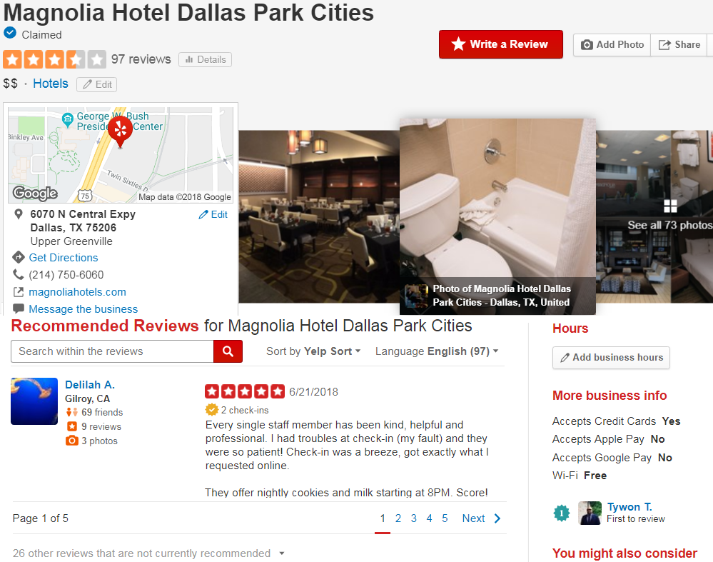
https://www.yelp.com/biz/magnolia-hotel-dallas-park-cities-dallas

Slide 6
Yelp's Metrics (March 2018)
155 million total reviews:
Recommended: 72%
Not recommended: 21%
Removed (ToS Violations): 7%
https://www.yelp.com/factsheet

Slide 7
Yelp's Metrics (March 2018)
Top reviewed businesses category:
Shopping: 21%
Restaurants: 17%
Home and local services: 14%
Top demographics of US reviewers:
35-54 year olds: 37%
Finished college: 59%
$100k+ income: 49.6%
https://www.yelp.com/factsheet

Slide 8
Understanding Yelp
Not recommended reviews:
Still accessible
Does not censor free speech^{[2]}
Can be recommended when algorithm changes
Reviews are removed by:
Violating Terms of Service
Defamation court rulings^{[3]}
https://www.yelp-support.com/Recommended_Reviews

Slide 9
Yelp’s Filtering Algorithm
Not recommends reviews that are:
Purchased^{[4]}
Bribed^{[5]}
Social/Political protest^{[6]}
Not credible
Unrelated
Non-understandable
Filtering algorithm undisclosed:
Prevent manipulating the system
https://www.yelp-support.com/Recommended_Reviews

Slide 10





Yelp Dataset Collection
The official Yelp dataset:
Does not include not recommended reviews
May inherit cleaning biases
External audit through sampling:
Better observational study
Scrape using Python script
https://www.yelp.com/dataset/challenge

Slide 11
Two-Stage Sampling Procedure
Proportional subgroup method:
Preserves consistency of larger dataset^{[7]}
1) Cluster: Sample cities that adopt Yelp
2) Stratify: Sample restaurants from those cities
Consistent participation per demographic per city size
City
Restaurant
https://www.yelp.com/locations

Slide 12
Cleaned Dataset
676 restaurants from 157 cities:
224,604 recommended: 89%
26,824 not recommended: 11%
Equal probability projection:
198 million recommended reviews
24 million not recommended reviews
More than total 155 million reviews
Removed reviews are not accessible
https://www.yelp.com/factsheet

Slide 13
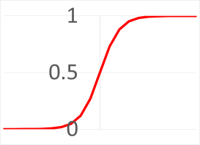
Recommended vs Not Recommended Prediction
Multivariate Logistic Regression:
One unified model
Binary prediction
Features:
Converted numbers from metadata
Adjusted for distribution asymmetry
Scaled from 0 to 1
Direct comparisons without weighting
Coefficients measure feature importance

Slide 14

Binary Prediction Metrics
Accurate predictions:
True positives and true negatives
Misclassifications:
False positives and false negatives
Significance by:
p-value threshold of 0.05
Hypothesis test statistic
Determine probable evidence towards an observation
Accuracy =
Precision =
Recall =
F1-Score* =
True Positives + True Negatives
Total Observations
True Positives
True Positives + False Positives
True Positives
True Positives + False Negatives
2*True Positives
2*True Positives + False Positives + False Negatives
*Harmonic mean between precision and recall

Slide 15

Restaurant Metadata
Category | Data Type | Description | Example
Name | String | Restaurant name | Garaje
Address | String | Full address | 475 3rd St San Francisco, CA 94107
City | String | City hub | San Francisco
Average Rating | Float | Rounded to half-stars | 4.5
Number of Reviews Restaurant* | Integer | Number of reviews | 1354
Number of Restaurants* | Integer | Number of restaurants in city hub | 4829
Restaurant Link | String | Yelp website | https://www.yelp.com/biz/garaje-san-francisco
Restaurant Listing Order | Integer | Yelp listing order | 2
Restaurant ID | Integer | Bind with Reviews.csv | 0
*Adjusted for distribution asymmetry

Slide 16

Review Metadata
Category | Data Type | Description | Example
Date | String | Date formatted MM-DD-YYYY, also shows updated review | 3/9/2016
Number of Friends* | Integer | Number of user's friends, max at 5000 | 22
Has Profile Picture | Boolean | True or false for profile picture | True
Location | String | City, State of user location | San Diego, CA
Number of Photos* | Integer | Number of total photos taken | 122
User Rating | Integer | Rating from 1 to 5 | 5
Number of Reviews by User* | Integer | Number of reviews that the user made | 7
Text | String | Review text | Great place to hang
Username | String | First name, last initial | Alex, B.
Recommended | Integer | 0 for false, 1 for true | 1
Restaurant ID | Integer | Bind with Reviews.csv | 0
*Adjusted for distribution asymmetry

Slide 17
Features Created From Metadata
Category | Data Type | Description | Example
Number of Days Published* | Float | Difference in days between review submission and October 1, 2004 | 525
Has Been Updated | Integer | 0 for false, 1 for true | 0
Has Profile Picture | Integer | 0 for false, 1 for true | 1
User to Restaurant Distance* | Float | Distance between user and restaurant location in miles | 522
Word Length of Text* | Float | Word length of review text | 4
Word Length of Text Without Stopwords* | Float | Word length of review text removal of common semantic words | 3
Number of Sentences of Text* | Float | Number of Sentences of review text | 1
Recommended Ratio | Float | Number of recommended reviews divided by total reviews | 0.9212
Word Length of Restaurant Name | Float | Word length of restaurant name | 1
Word Length of Restaurant Address* | Float | Word length of restaurant address | 7
User to Average Rating | Float | User rating subtracted by average restaurant rating | 0.5
*Adjusted for distribution asymmetry

Slide 18

Processed Text Feature Creation
Score* | Grade Level
1 | Kindergarten
2 | First Grade
3 | Second Grade
4 | Third Grade
5 | Fourth Grade
6 … | Fifth Grade …
Google dictionary API^{[8]}:
% of words spelled correctly
Readability indexes^{[9][10]}:
Statistically solve for text difficulty
Characters
Words
Words
Sentences
Automated Readability Index* = 4.71 + 0.5
Flesch–Kincaid Grade Level Formula = 0.39 + 11.8
Words
Sentences
Syllables
Words

Slide 19
Naïve Bayes Text Classifier
Bag of words model:
Does not check for grammar or word order
Trains words with larger difference in occurrence to classify as label
Trained Text | Positive Label | Word Vectors | This | Place | Is | Good | The | Bad
This place is good. | 1 |  | 1 | 1 | 1 | 1 | 0 | 0
This place is bad. | 0 |  | 1 | 1 | 1 | 0 | 0 | 1
p(label=1) | 0.5 | p(Word|1) | 0.5 | 1 | 1 | 1 | 0 | 0
p(label=0) | 0.5 | p(Word|0) | 0.5 | 1 | 1 | 0 | 0 | 1

Slide 20

Naïve Bayes Equation
p(Positive|Trained Words) =
p(Trained Words|Positive)p(Positive)
P(Trained Words)
P(Trained Words)
(True Positive)
P(Positive)
(FN)
P(Trained Words)
(False Positive)
(True Negative)
P(Negative)

Slide 21

Deceptive Opinion Spam Corpus^{[11]}
Label | Quality | Data Origin
Truthful | 800 | TripAdvisor, Expedia, Hotels.com, Orbitz, Priceline
Deceptive | 800 | Amazon Mechanical Turk
Truthful reviews:
Similar to Yelp:
Opinionated contributions
Community guidelines
Deceptive reviews:
Earn money:
Alters incentives
Submit for monetary gains^{[48]}
Text Classifier | Precision | Recall | F1-Score
Deceptive Score | 0.88 | 0.88 | 0.88

Slide 22

Extreme Text Classifiers
Test if violations of terms and conditions are filtered before removal
Conversation AI Dataset by Google
Filter out online harassment
YouTube, Blogger, Google Maps, Google+
Similar platform interactions and community to Yelp
Classifier | Observations | Precision | Recall | F1-Score
Toxic | 15,294 | 0.96 | 0.96 | 0.96
Severely Toxic | 1,595 | 0.99 | 0.99 | 0.99
Obscene | 8,449 | 0.98 | 0.98 | 0.98
Threat | 478 | 1 | 1 | 1
Insult | 7,877 | 0.97 | 0.97 | 0.97
Identity Hate | 1,405 | 0.99 | 0.99 | 0.99
Total | 159,574
https://conversationai.github.io

Slide 23

Sentiment: Natural Language Processing
Considers word order and grammar^{[12]}
Classify individual words
Split by punctuation
Identify parts of speech, proper nouns
Link pronouns to nouns
Find the tone of a sentence
Total Sentiment = (Very Negative) + 2*(Negative) + 3*(Neutral) + 4*(Positive) + 5*(Very Positive)
Average Sentiment = Total Sentiment / Total Sentences

Slide 24
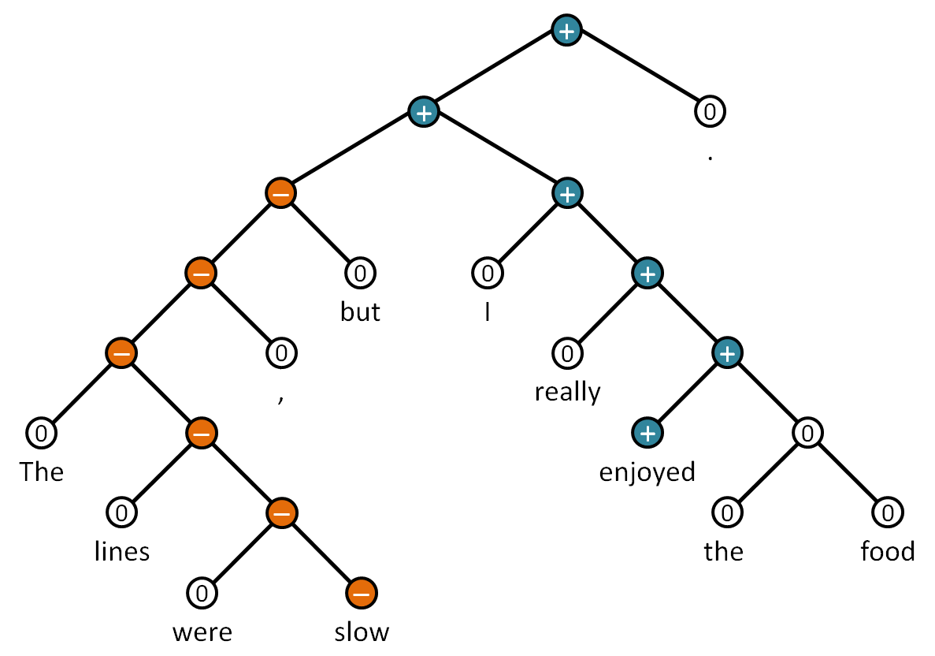
Recurrent Neural Tensor Network^{[12]}
Recursive tree structure
Fragments and uses grammar rules
Find tonality of nested phrases
Stems from individual words

Slide 25
Features Created From Processed Text
Category | Data Type | Description | Example
Text Readability AR Score* | Float | The Automated Readability score is based on age and grade level | 6
Text Spelling Score* | Float | Percentage of review spelled correctly | 1
Text Deceptive Score | Float | Probability that review is deceptive | 0.2
Text Toxic Score* | Float | Probability that review is toxic | 0.11
… |  | …
Text Very Positive* | Float | Percent of sentences that are very positive | 0
… | Float | …
Text Total Sentiment* | Float | Sentiment score weighted by 1 to 5 from their respective categories | 17
Text Average Sentiment | Float | Total sentiment divided by sentences (1-5) | 2.833
Text Sentiment To User Rating | Float | Average user sentiment subtracted by user rating | -2.167
Text Sentiment To Average Rating | Float | Average user sentiment subtracted by average restaurant rating | -1.667
*Adjusted for distribution asymmetry

Slide 26


Multivariate Logistic Regression
Measures collective relationship between features and recommended reviews
Balancing the dataset to 50:50:
Equal emphasis for predicting both review types
Reduced Model:
Remove Insignificant features
That do not contribute to model (p-value)
p

Slide 27
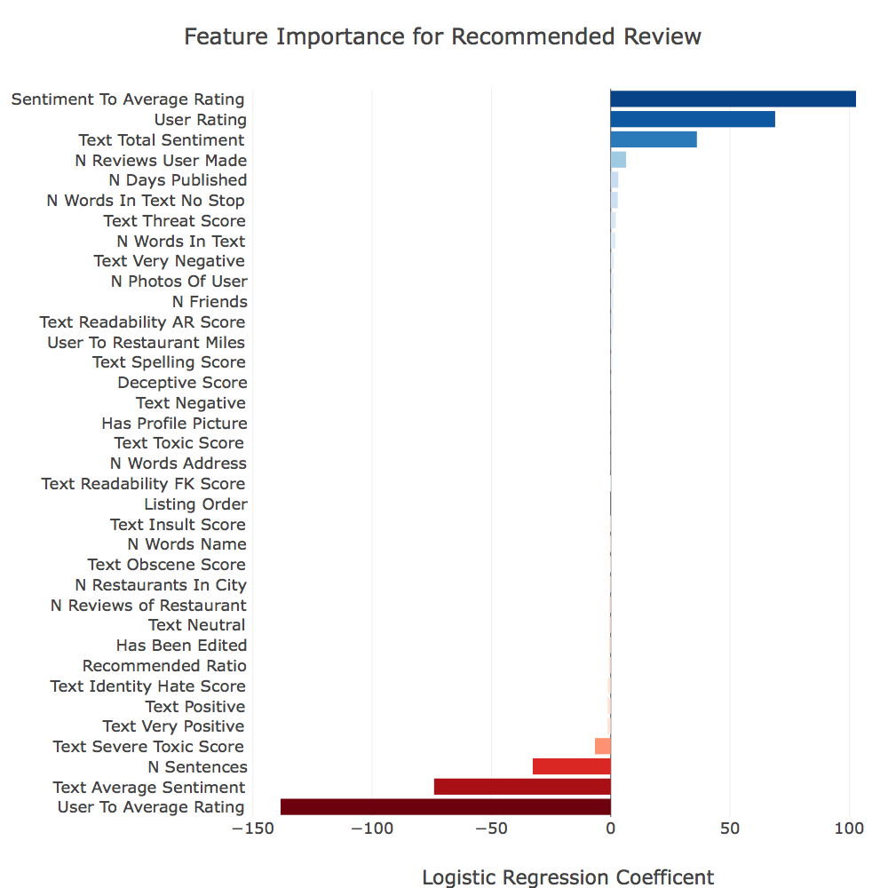
Full model
↑Recommended
↑ Text Sentiment to Average Rating
↑ User Rating
↑ Text Total Sentiment
↑ Not Recommended
↑ # of Sentences
↑ Text Average Sentiment
↑ User Rating to Average Rating

Slide 28
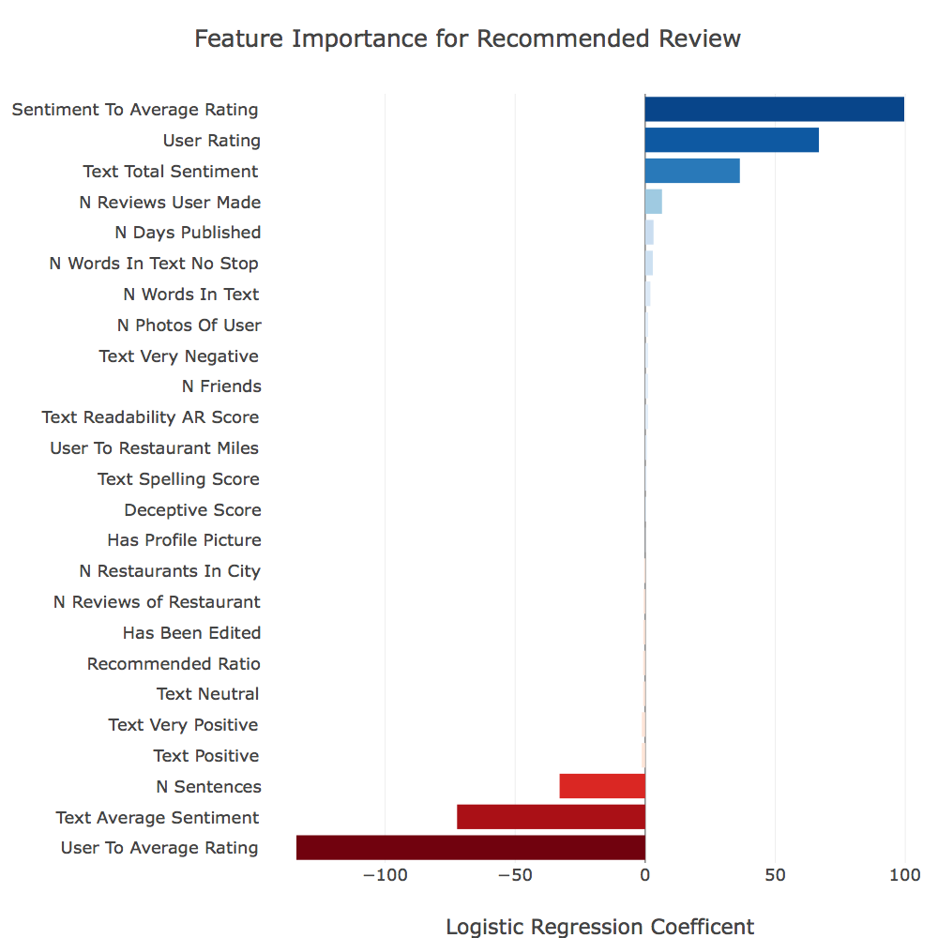
Reduced model
Rate:
Critically
Write:
Concise message
Overall positive message:
Express variations in sentiment
Model | Precision | Recall | F1-Score
Full | 0.80 | 0.74 | 0.77
Reduced | 0.79 | 0.74 | 0.77

Slide 29
Additional Guidelines For Recommended Review
Submit for:
Businesses with less reviews
Write with:
Mild complexity
Less common words
Accumulate data:
Friends
Total reviews
Total photos
Recent reviews
Update reviews:
Less

Slide 30
Insignificant Features
Equal probability in sampling verified by^{[7]}:
# of words in restaurant name
# of words in restaurant address
Yelp listing order
Yelp does not filter for extreme comments:
For removing comments that violate terms of use:
Identity hate score
Insult score
Threat score
Obscene score
Severe toxic score
Toxic score

Slide 31
Ethics
When soliciting, information can be:
Useful, important, misguided, or wrong
Pooling information towards general consensus:
Makes Yelp less likely to be wrong^{[13]}
Justified reflection of the collective experience
Dependent on the end user:
To take advice from Yelp
To make better informed decisions

Slide 32
Conclusions
Yelp’s filtering algorithm promotes:
Critical ratings
Genuine reviews
Quality of text
Reliable content
Insight
Consumers' decisions based on:
Personal discretion
Filtered reviews and average rating
Justified reflection of the collective experience

Slide 33
Citations
1. Luca, M. (2016). Reviews, Reputation, and Revenue: The Case of Yelp.com. [online] Hbs.edu. Available at: https://www.hbs.edu/faculty/Pages/item.aspx?num=41233 [Accessed 19 May 2018].
2. O'Brien, S. (2015). Yelp: You can trust our reviews. [online] CNN Money. Available at: http://money.cnn.com/2015/01/07/technology/ftc-yelp-reviews [Accessed 19 May 2018].
3. Zetter, K. (2010). Yelp Accused of Extortion. [online] Wired. Available at: https://www.wired.com/2010/02/yelp-sued-for-alleged-extortion/ [Accessed 19 May 2018].
4. Streitfeld, D. (2012). Yelp Tries to Halt Deceptive Reviews. [online] NYTimes. Available at: https://www.nytimes.com/2012/10/18/technology/yelp-tries-to-halt-deceptive-reviews.html [Accessed 19 May 2018].
5. Cotter, S. (2017). Quincy Center Jeweler Wins Suit Over Yelp Review. [online] Patriot Ledger. Available at: http://www.patriotledger.com/news/20170405/quincy-center-jeweler-wins-suit-over-yelp-review [Accessed 19 May 2018].
6. McKeever, A. (2015). Why Yelp Emerged as a Site for Social Protest. [online] Eater. Available at: https://www.eater.com/2015/5/19/8588185/yelp-social-protest-trolling-memories-pizza [Accessed 19 May 2018].
7. Blair, E. and Blair, J. (2015). Applied Survey Sampling. Los Angeles: Sage Publications, Inc.
8. Yee, J. (2018). Google's Dictionary API (Unofficial) in Python. [online] Available at: http://www.lleess.com/2013/03/googles-unofficial-dictionary-api-in.html [Accessed 7 Jul. 2018].
9. Readability Formulas. (2018). The Automated Readability Index (ARI). [online] Available at: http://www.readabilityformulas.com/automated-readability-index.php [Accessed 7 Jul. 2018].
10. Readability Formulas. (2018). The Flesch Grade Level Readability Formula. [online] Available at: http://www.readabilityformulas.com/flesch-grade-level-readability-formula.php [Accessed 7 Jul. 2018].
11. Ott, M., Choi, Y., Cardie, C. and Hancock, J. (2011). Finding Deceptive Opinion Spam by Any Stretch of the Imagination. In: Proceedings of the 49th Annual Meeting of the Association for Computational Linguistics. [online] Association for Computational Linguistics. Available at: http://myleott.com/op_spamACL2011.pdf [Accessed 3 Mar. 2018].
12. Socher, R., Perelygin, A., Wu, J., Chuang, J., Manning, C., Ng, A. and Potts, C. (2013). Recursive Deep Models for Semantic Compositionality Over a Sentiment Treebank. [online] Available at: https://nlp.stanford.edu/~socherr/EMNLP2013_RNTN.pdf [Accessed 7 Jul. 2018].
13. CBS This Morning. (2016). Yelp CEO on site’s popularity and pitfalls. [online] Available at: https://www.youtube.com/watch?v=1mlzdXwbtZo [Accessed 7 Jul. 2018].

