Slide 1
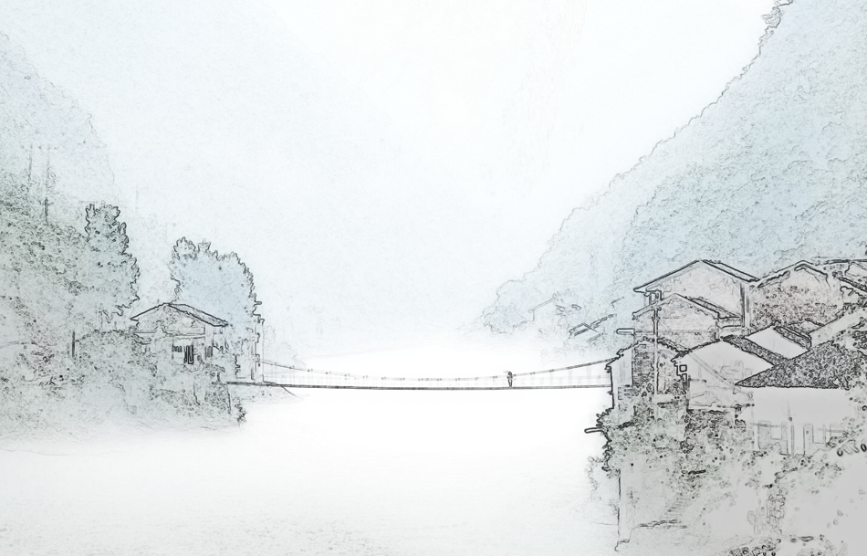
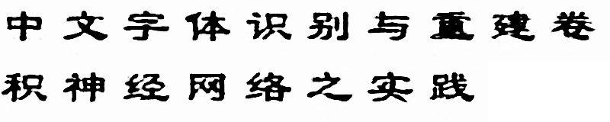
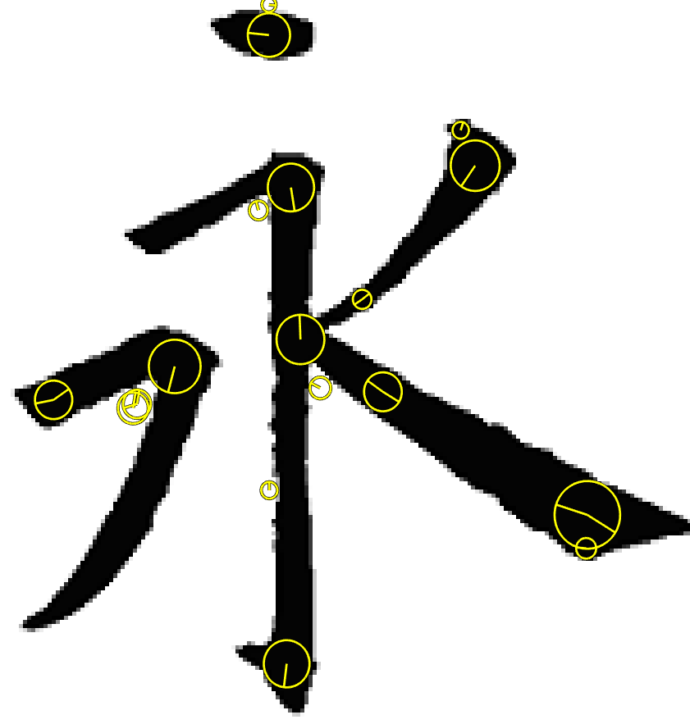





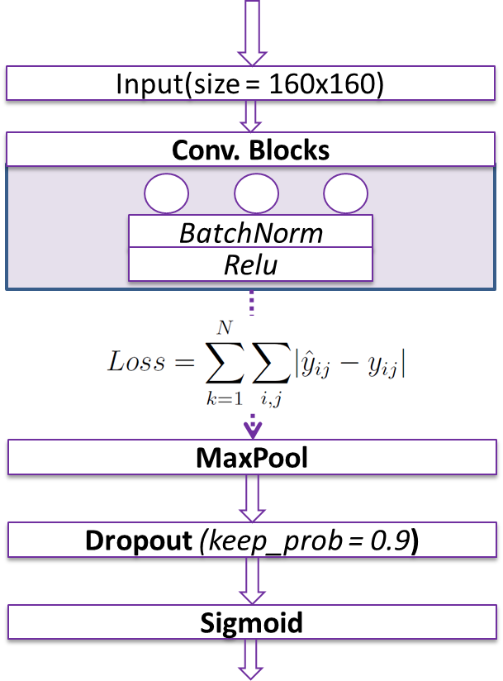
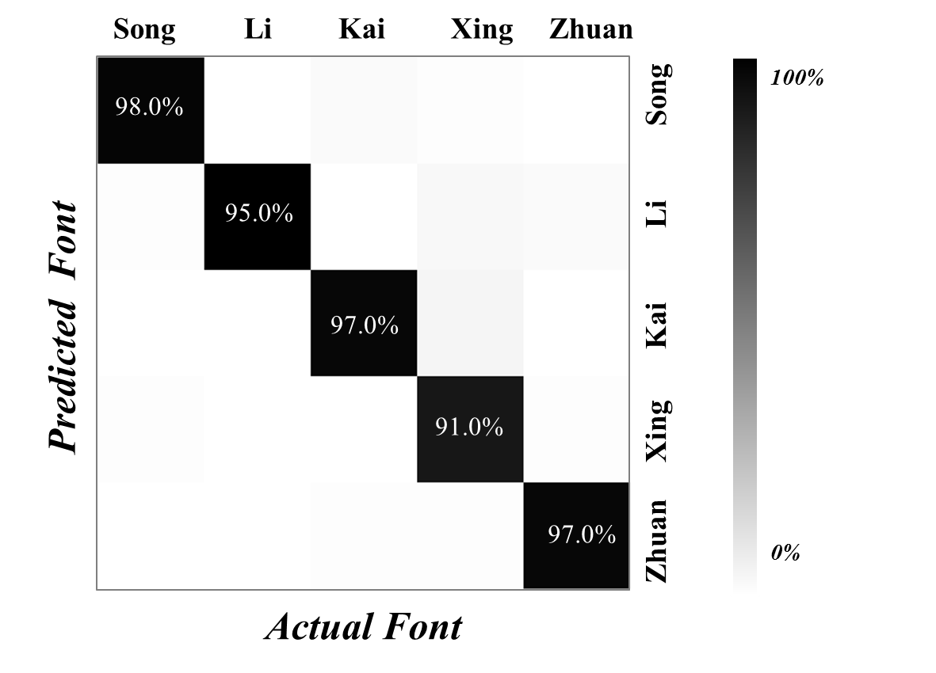
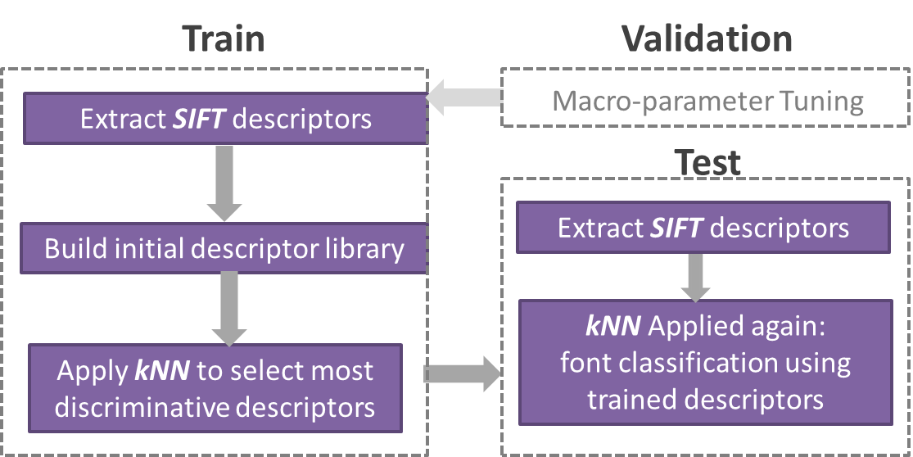
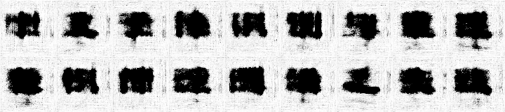
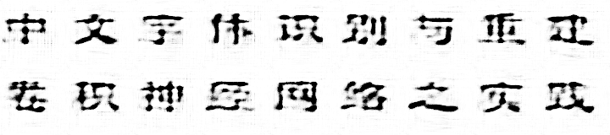
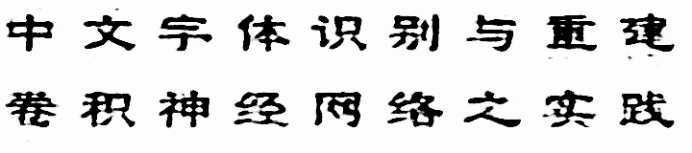

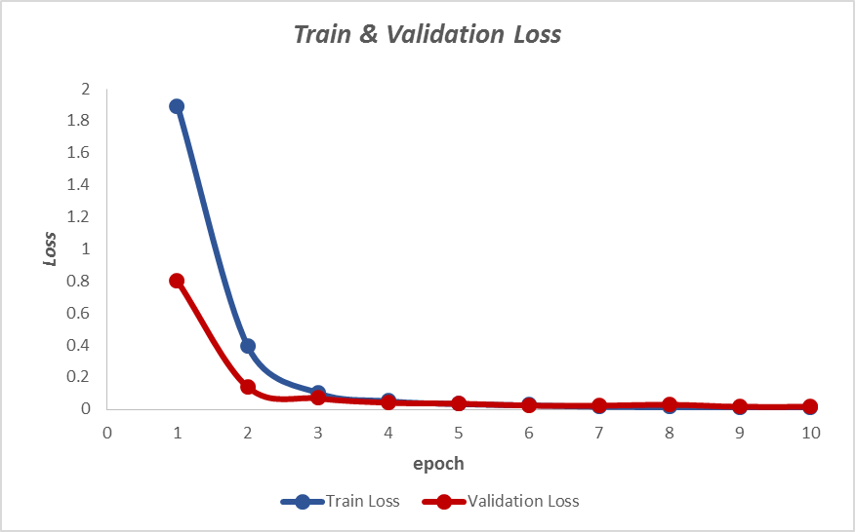
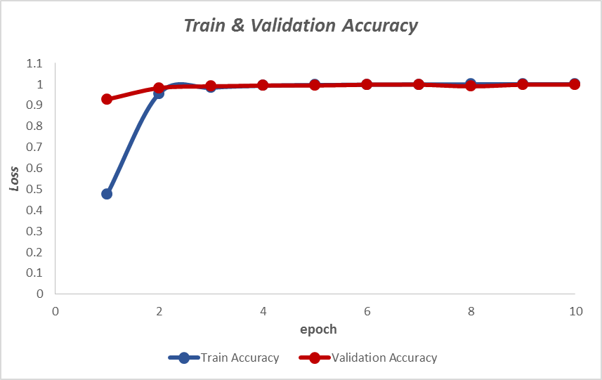
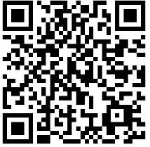
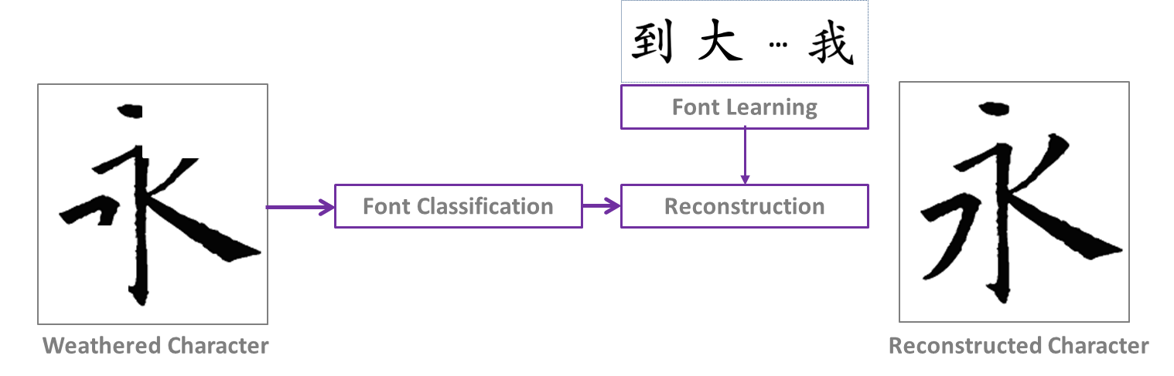
Chinese Calligraphy Font Classification and Transformation
Motivation
Classification
Transformation
Many great works of ancient Chinese calligraphy were carved onto stone tablets. However, after centuries of weathering, many of the characters on these stones have been rendered incomplete.
Inspired by this problem, we sought to answer the following question: is it possible to apply machine learning techniques to recognize the font style of a given calligraphy character, and ultimately, to reconstruct the same character in its original style?
Approach 1: SIFT-kNN
1000 Training Characters
Choose k1 = 3, k2 = 3
中文字体识别与重建
卷积神经网络之实践
Challenges
Pictorial in nature, Chinese characters are significantly more complicated to process than their English counterparts.
Classification of the font style of a Chinese character relies on our ability to extract the relevant discriminative features. However, recognizing these distinctive features is a highly non-trivial problem.
Approach 2: Keras-CNN
500 Training Characters
1 layer neural network, 32 output filters with size 5x5
Methodology
99.9%
Stanford CS229 2016-Autumn
Li Deng Liyi Wang Zhaolin Ren
https://github.com/dengl11/Chinese-Calligraphy-Character-Reconstruction

