Slide 1
Homework3

Slide 2
Homework3
题目1
Consider the following function
typedef unsigned char * byte_pointer;
void show_bytes(byte_pointer start, int len) {
int i;
for (i=0; i<len; i++)
printf(“%.2x”, start[i]);
}
int val = 0x140A0233;
byte_pointer valp = (byte_pointer) & val;

Slide 3
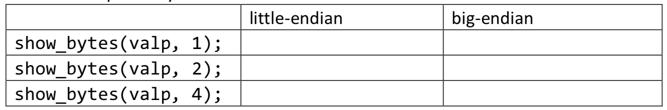
Homework3
题目1
What is the output of the following call to show_bytes on big-endian and little-endian machines respectively?

Slide 4
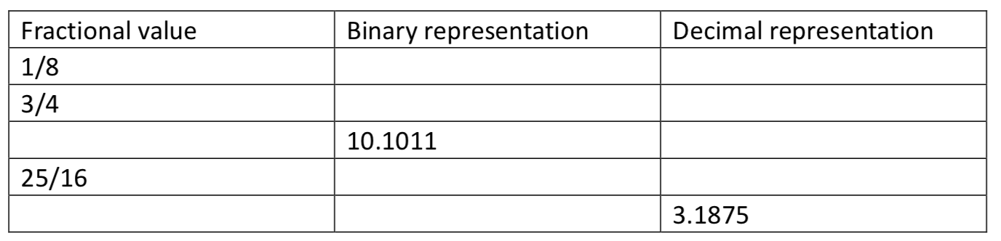
Homework3
题目2
Fill in the missing information in the following table:

Slide 5
Homework3
题目3
Given a floating-point format with a k-bit exponent and an n-bit fraction, write formulas for the exponent E, significand M, the fraction f, and the value V for the quantities that follow. In addition, describe the bit representation.
A. The number 5.0
B. The largest odd integer that can be represented exactly
C. The reciprocal of the smallest positive normalized value

Slide 6
Homework3
题目4
Consider the following two 9-bit floating-point representations based on the IEEE floating-point format.
Format A
There is one sign bit.
There are k = 5 exponent bits. The exponent bias is 15.
There are n = 3 fraction bits.
Format B
There is one sign bit.
There are k = 4 exponent bits. The exponent bias is 7.
There are n = 4 fraction bits.

Slide 7

Homework3
题目4
Below, you are given some bit patterns in Format A, and your task is to convert them to the closest value in Format B. If rounding is necessary, you should round toward
In addition, give the values of numbers given by the Format A and Format B bit patterns. Given these as whole numbers(eg.,17) or as fractions(eg.,17/64 or 17/26).

Slide 8
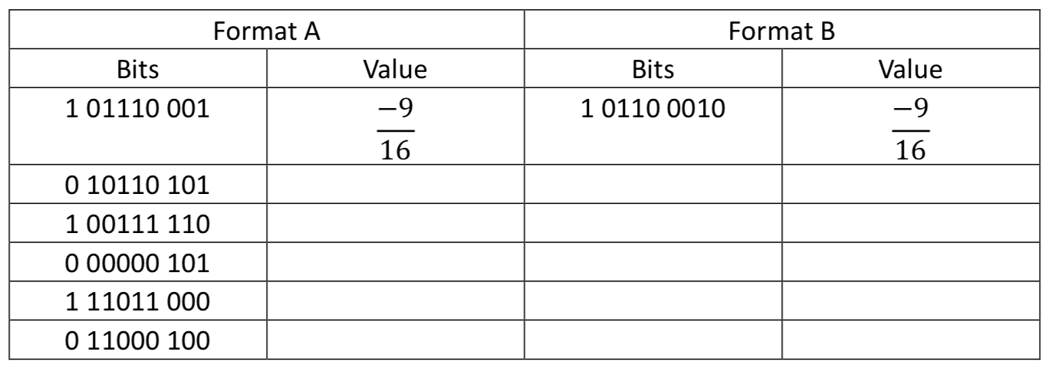
Homework3
题目4

