Slide 1
Homework6

Slide 2
Homework6
题目1
Assume we have following address binding table and value of registers :
Address | Value | Register | Value
0x100 | 0x10 | %eax | 0x10
0x110 | 0x11 | %ebx | 0x100
0x120 | 0x12
...... | ......
0x190 | 0x19
0x200 | 0x20

Slide 3
Homework6
题目1
Please fill in the table below
Operand | Value
%ebx
$0x150
0x170
(%ebx)
(%ebx,%eax)
0x30(%ebx)
80(%ebx,%eax,2)

Slide 4
Homework6
题目1
Suppose registers and bound values will be reset as above after each instruction. Please fill in the table below: (Write all if there are more than one destinations and None if there is no destination)
Instruction | Destination | Value
addl %eax,%ebx
subl %eax,(%ebx)
leal 0x50(%eax), %edx
movzbl %al, %ebx
movsbl %bh, %ecx

Slide 5
Homework6
题目1
Assume the initial value of the flags is 0. Fill the table below
Instruction | OF | SF | ZF | CF
leal(%eax),%ebx
subl %ebx, %eax
xorl %eax, %eax
test %eax, %ebx

Slide 6
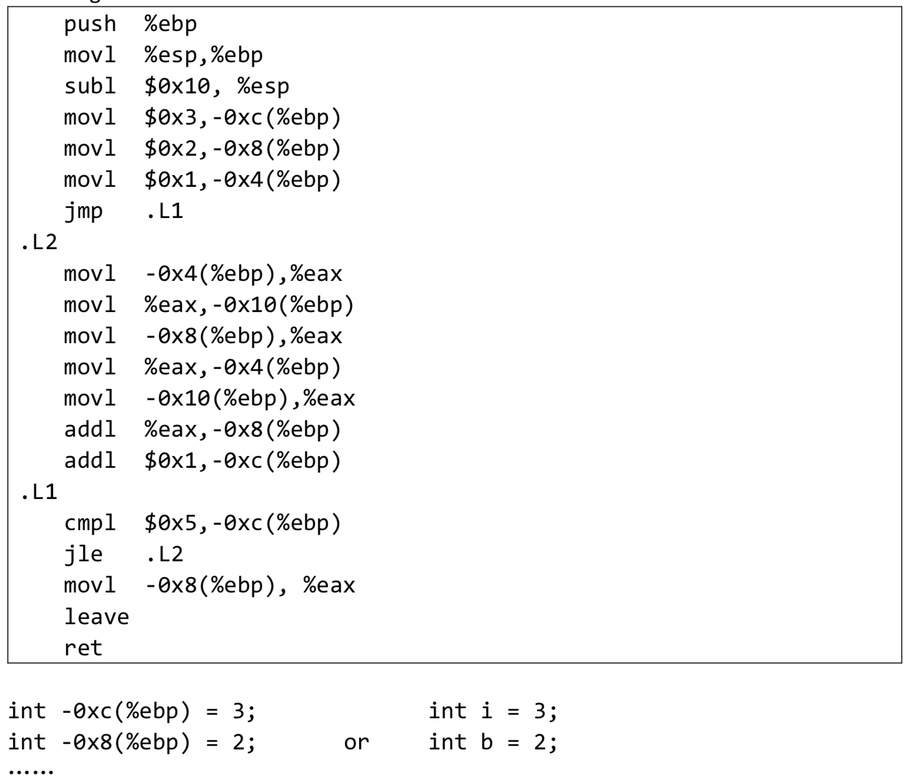
Homework6
题目2
Translate the following assembly into C codes.
You can name local variables represented by -12(%ebp), -8(%ebp)...or a,b,c... freely as you like.
The beginning of C codes is given.

