Slide 1
Decision Tree & Document Clustering
陆林鹏

Slide 2
Decision Tree
DataSet
Age | Income | Region | Credit rating | Buy motorbike?
<20 | High | USA | Low | No
<20 | High | USA | Low | No
21…50 | High | USA | Low | Yes
>50 | Medium | USA | Low | Yes
>50 | Low | CHINA | Low | Yes
>50 | Low | CHINA | High | No
21…50 | Low | CHINA | High | Yes
<20 | Medium | USA | Low | No
<20 | Low | CHINA | Low | Yes
>50 | Medium | CHINA | Low | Yes

Slide 3
Decision Tree
entropy
. . .
data

Slide 4
Decision Tree
Weather
cloudy
sunny
Mood
Mood
good
sad
good
maybe
yes
no
遇到“完全新”的样本[“sunny”,”sad”],如何判定

Slide 5
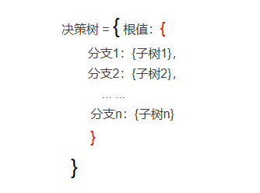
决策树结构(字典结构)

Slide 6
决策树字典结构实例
dataSet = [['cloudy','good','maybe'],
['cloudy','sad','yes'],
['cloudy','sad','maybe'],
['sunny','good','no'],
['sunny','good','no']]
Weather
cloudy
sunny
Mood
Mood
good
sad
good
{'Weather’:
{'cloudy’:
{'Mood’:
{'good': 'maybe', 'sad': 'yes’} },
'sunny’:
{'Mood': {'good': 'no’} }
}
}
maybe
yes
no

Slide 7
测试样本的特征不完备如何处理？
Decision Tree
new = ['21…50','High','USA’]
完整的待测试的样本的特征应该为[Age,Income,Region,Credit rating] 这4个属性，而上述new 样本只提供了3个特征值

Slide 8

Document Clustering
$D_{KL}\left(\vec{a}\left\|\vec{b}\right.\right)=\sum_{t=1}^{m}{w_{t,a}×log\frac{w_{t,a}}{w_{t,b}}.}$
$w_{t,b}$ 为零怎么办？

