Slide 1
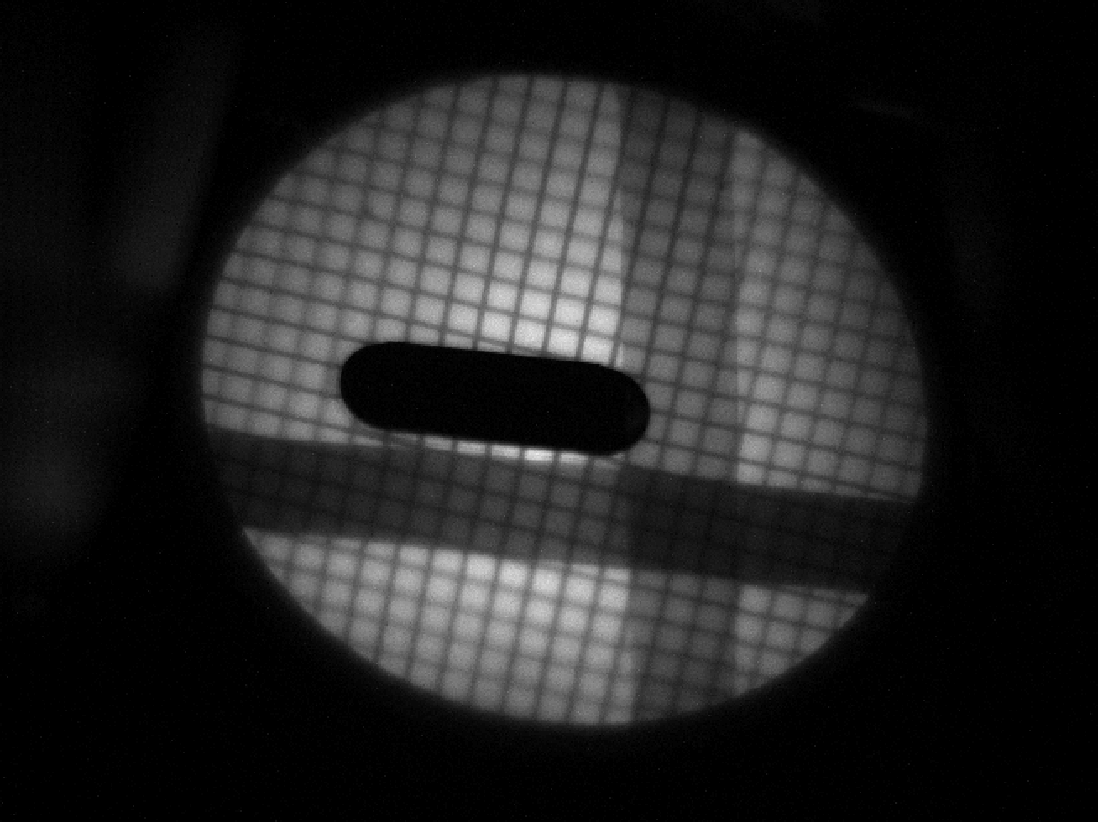
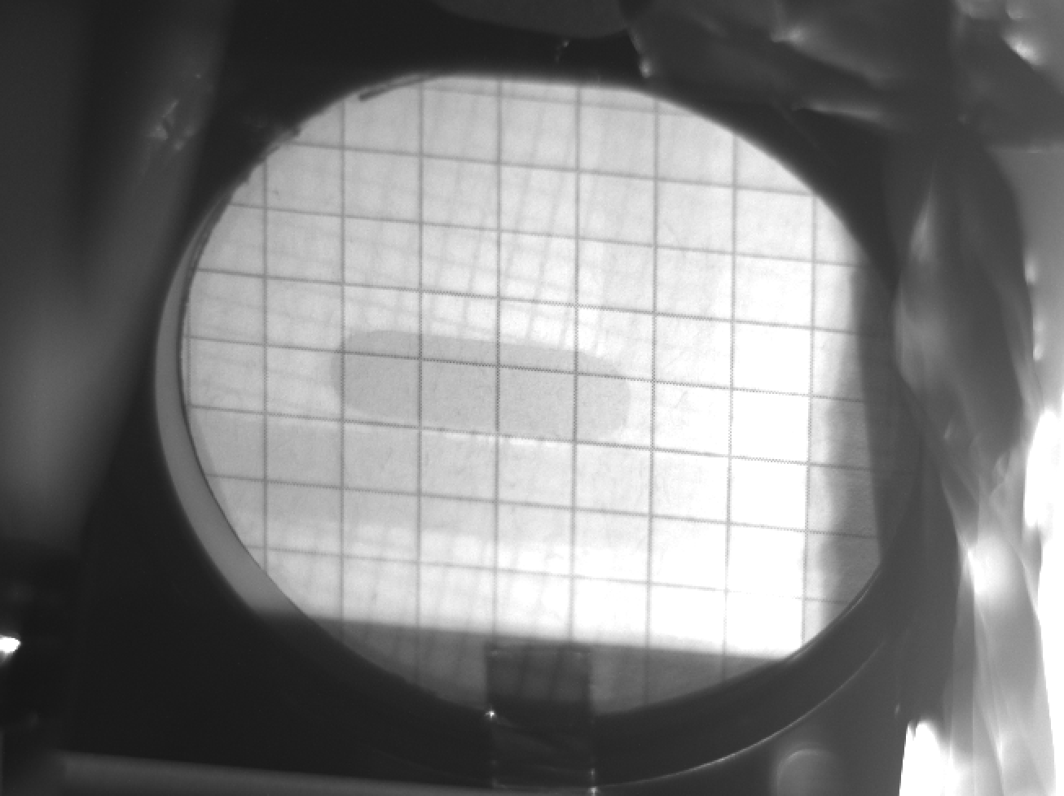
Overlap of the grid and shot to confirm calibration is still good for 20th June.
20210612: 5 mm Grid
20210620: run09 shot4.tiff

